Slide 1
Korea’s Proposal on EVS-GTR
JIN SEOP PARK
Korea Automobile Testing & Research Institute

Slide 2
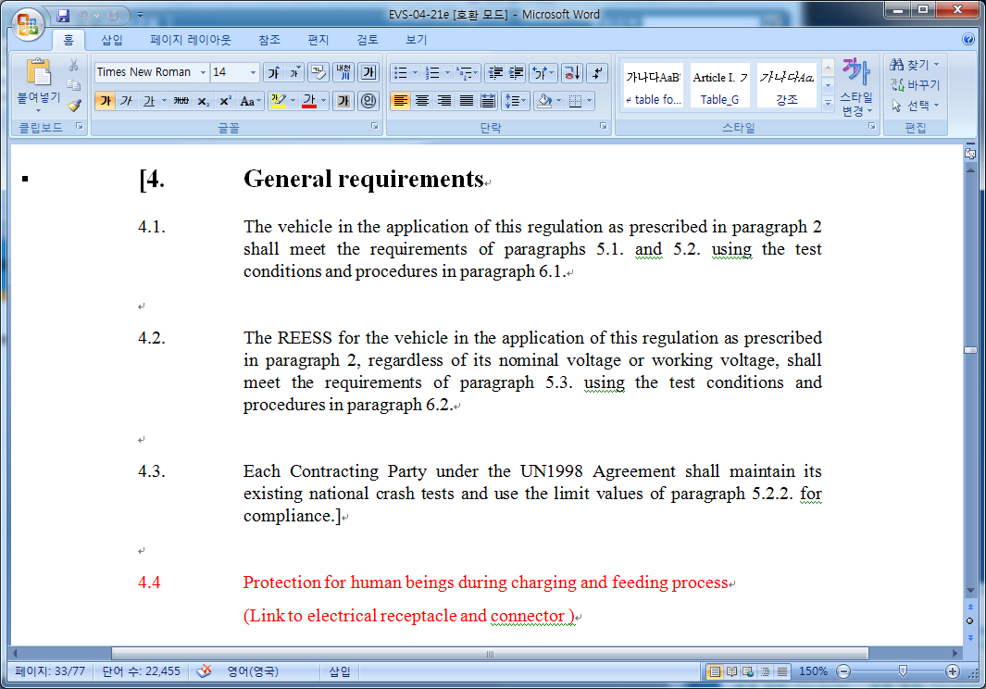
Proposal for Clarification of Existing National Crash tests
Background
Some countries have a static roll-over test for electrolyte leakage assessment
EVS GTR admits existing national crash test procedures, but there is no
specific description of what national existing crash tests are
Current EVS GTR Draft

Slide 3
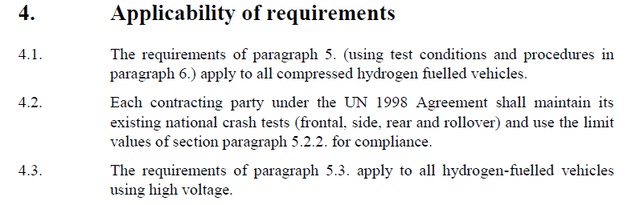
Proposal for Clarification of Existing National Crash tests
HFCV GTR
Proposal
Clarify what are existing national crash tests by noting possible examples of
existing test items in order to prevent misunderstanding
“Each contracting party under the UN 1998 Agreement may maintain its existing national crash tests (e.g. Frontal, side, rear, or rollover) and the shall use the limit values of section paragraph 5.2.2. for compliance”

