Slide 1
Climatic, Mechanical resistance and EMC requirements
Russian justification
Accident Emergency Call System (AECS)
4th meeting
Paris
April 28th - 30th 2014

Slide 2
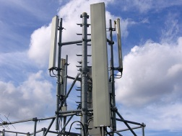

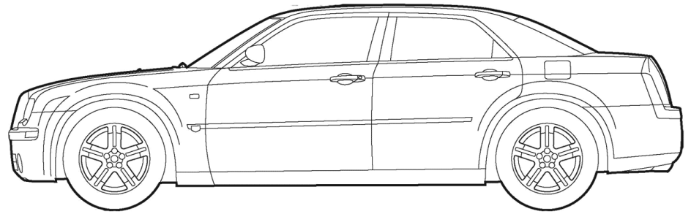

Can not be considered as Regulations for
similar electronic devices
Regulation No. 13
Regulation No. XX AECS
Hydraulic
Control Unit
Cable connection
$$≠$$
Mobile networks
GLONASS/
GPS/
Galileo
Controller/
Electronic Control Unit
Radio
connection
Communication module
Navigation module
Controller
Anti-lock braking system SENSORS

Slide 3
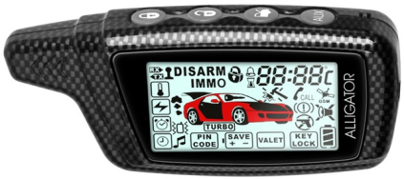

Can be considered as Regulations for
similar electronic devices
Regulation No. 97/116
Regulation No. XX AECS
Mobile networks
$$=$$
Mobile networks
GLONASS/
GPS/
Galileo
Radio
connection
Communication module
Navigation module
Radio
connection
Controller
External radio connection
is present in both cases

Slide 4
Summary table
UN Regulation | Climatic requirements | Mechanical resistance requirements | EMC requirements
Regulation No. 13 | - | - | -
Regulation No. 97 | + 7.1.1. Climatic conditions 7.1.2. Degree of protection for installation | + 7.2.8. Safe operation after vibration test | + 7.2.12. Electromagnetic compatibility
Regulation No. 116 | + 6.4.1.1. Climatic conditions 6.4.1.2. Degree of protection for installation | + 6.4.2.8. Safe operation after vibration test | + 6.4.2.12. Electromagnetic compatibility
Regulation No. XX AECS | Suggestion to include requirements and test methods | Suggestion to include requirements and test methods | Suggestion to include requirements and test methods

Slide 5
Thank you!

