Slide 1
Rationale for ETRTO Abrasion Rate test layout
Document TA-06-05

Slide 2
Rationale for ETRTO Abrasion Rate test layout
Goals:
  representative of real driving environment in European market
    Monitoring of 3555 vehicles in Europe
    Most suitable descriptor for driving conditions concerning tire wear are the experienced accelerations. Specified as standard deviation for lateral and longitudinal acceleration.
  repeatable, reproducible and practicable
  - test should be as less as possible be influenced by outside factors. Especially the overall traffic flow on the chosen track on public roads has to be considered.
  - Parameters for track layout should be universal so that multiple tracks at different locations could be set up.

Slide 3
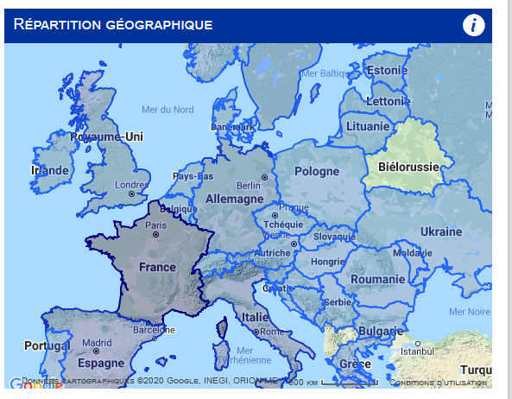
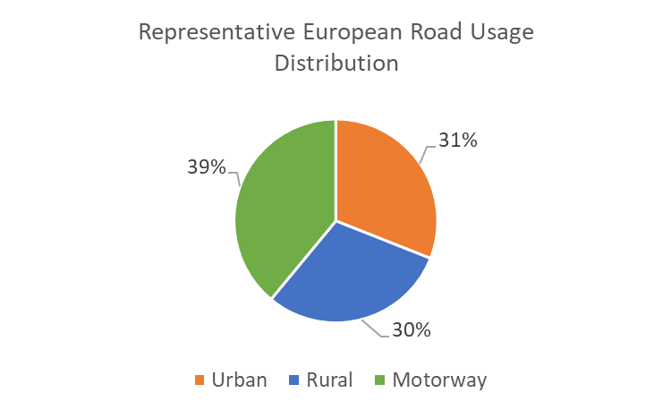
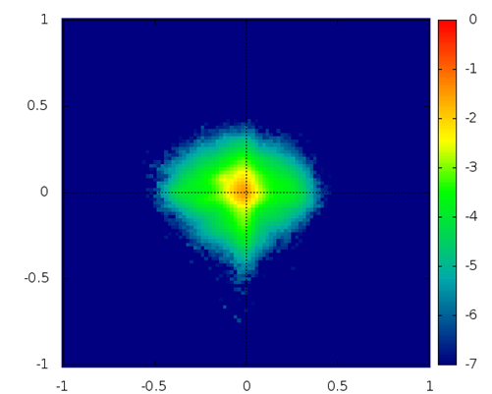
Representative data of real driving in European market
Collecting Europe usage tracking Data Base from Tire Manufacturers
  Most covered countries are F+E+I+D+GB+S
  3555 vehicles
    All PC Market segments
    Since 2015
  15 Millions of trips, 150 Millions of kilometers
Urban, Rural, Motorway Roads classification
  using OpenStreetMap data
Driving Style Statistics
  Speed & Acceleration distributions
Dominique Cettour-Janet, ETRTO, Tire Technology Expo Virtual, 10.06.2021

Slide 4
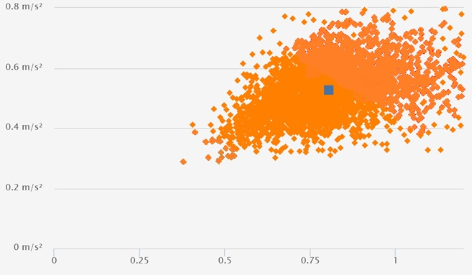
Representative data of real driving in European market
Average accelerations (standard deviation acceleration)
EU usage Data Base reveals the range and variety of severities
Severe
  Each point of the graph represents the range (std dev) of longitudinal and lateral accelerations for one single vehicle over its tracked service life
standard deviation longitudinal acceleration [m/s²]
Soft
standard deviation lateral acceleration [m/s²]

Slide 5
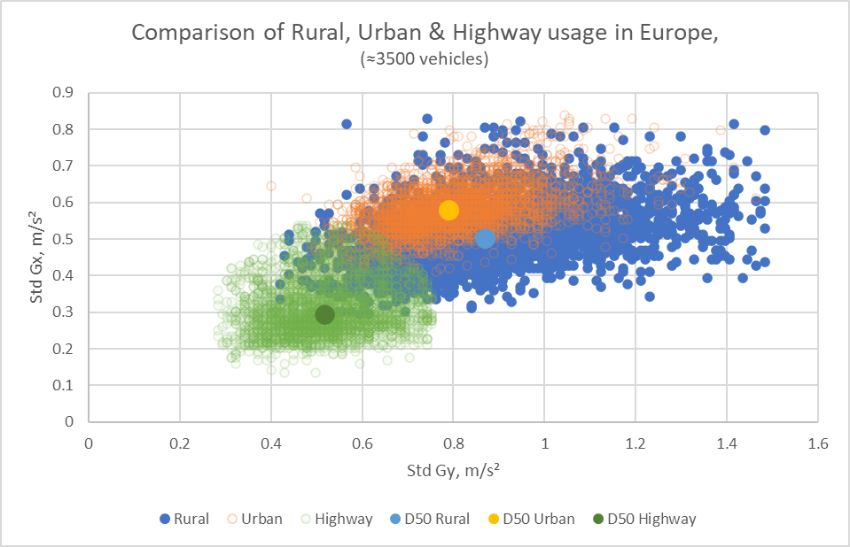
Representative data of real driving in European market
Road type and acceleration levels
Instead of 1 point per vehicle (global severity), it is possible to plot 3 points per vehicle by road classification (Urban, Rural, Motorway)
standard deviation longitudinal acceleration [m/s²]
Outliers have been removed
(unrealistic accelerations, high or low)
Median values unchanged
standard deviation lateral acceleration [m/s²]

Slide 6
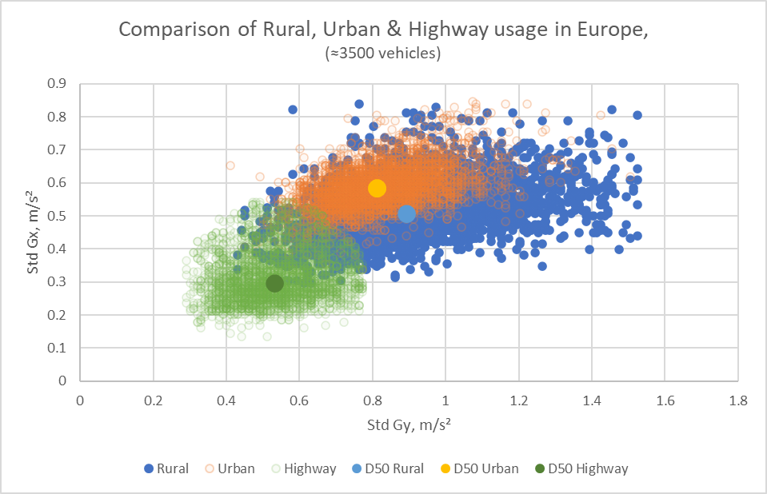
Representative data of real driving in European market
Road type and accelerations level
Determination of typical acceleration levels for each road type (Urban, Rural, Motorway)
Limits = 0.5% & 99.5% of the population in longitudinal and in lateral
 | std dev acc longitudinal |  | std dev acc lateral
 | σ_{x long} low | σ_{x long} high | σ_{y lat} low | σ_{y lat} high
Urban | 0,42 | 0,8 | 0,54 | 1,27
Rural | 0,34 | 0,78 | 0,52 | 1,46
Motorway | 0,18 | 0,53 | 0,32 | 0,78
standard deviation longitudinal acceleration [m/s²]
Areas of typical acceleration levels are overlapping.
Urban acceleration conditions are nearly completely covered by Rural acceleration levels
➔ Accelerations (as “std dev acc”) are a much better descriptor for tire abrasion than simple road type classifications!
standard deviation lateral acceleration [m/s²]

Slide 7
Repeatable, Reproducible and Practicable track layout
The abrasion test must include driving conditions representative of urban area (ca 31%)
Nevertheless, it should be avoided to drive for tire wear testing in actual city areas:
  Disturbed Traffic condition prevents drivers from keeping repeatable acceleration value
  A car convoy is impossible, making it impossible to neutralize all the external factors which affect the tyre abrasion rate
As a natural consequence of the previous point, not to drive for tire wear/ abrasion rate testing in city areas is the best practice for test providers, OEM’s and tire manufacturers (see backup)
The solution for this is to consider the real forces exchanged in the road-tyre contact, which in turn depend on vehicle accelerations. This is described by the standard deviation values of longitudinal and lateral accelerations.
Therefore:
  The target value of standard deviation of longitudinal and lateral accelerations are derived from a data base of vehicles driven in every condition, including the urban part in right and real percentage
  During the test we reach exactly those target values without using urban layout which will cause un-repeatability of the test
Test matches urban conditions without including urban locations through correct accelerations

Slide 8
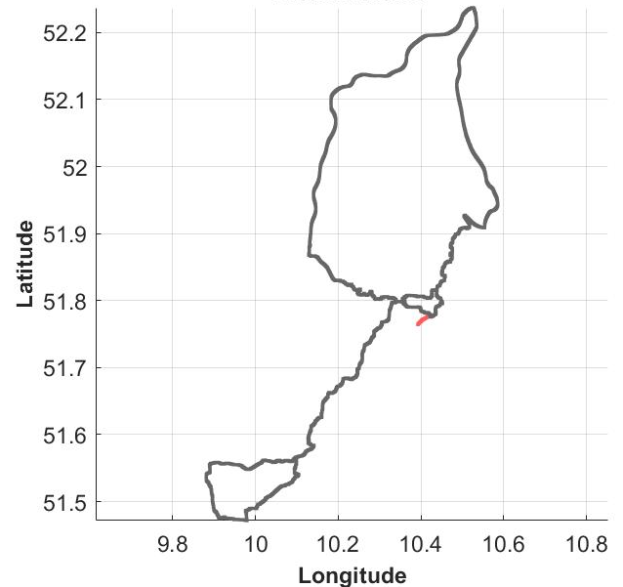
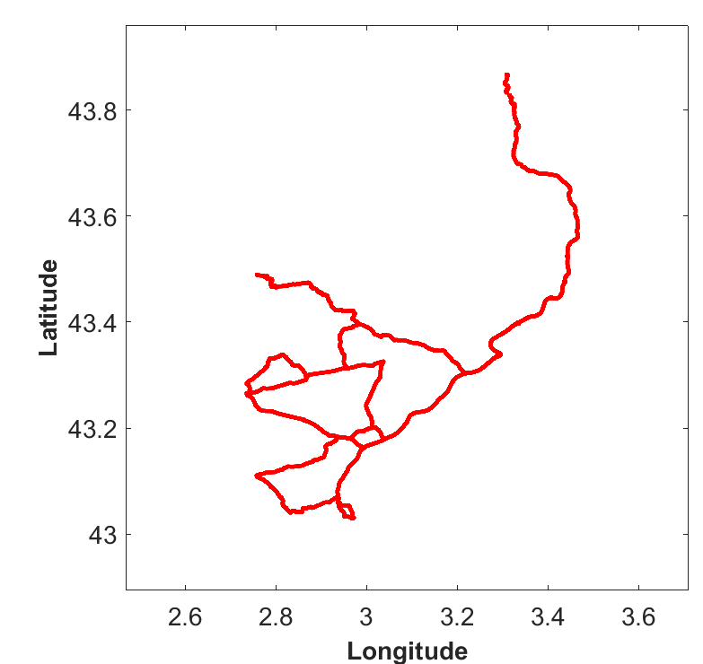
repeatable, reproducible and practicable track layout
ETRTO laid-out two tracks (North Germany and South France)
  Reaching the defined typical acceleration levels for Urban (31%), Rural (30%) and Motorway (39%).
  But driving actually on around 60% country roads and 40% Motorways.
Germany
France
 | std dev acc longitudinal |  | std dev acc lateral
 | σ_{x long} low | σ_{x long} high | σ_{y lat} low | σ_{y lat} high
Urban | 0,42 | 0,8 | 0,54 | 1,27
Rural | 0,34 | 0,78 | 0,52 | 1,46
Motorway | 0,18 | 0,53 | 0,32 | 0,78

Slide 9
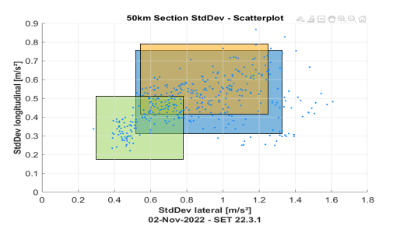
Validity of ETRTO track layout
19.000 km driven on ETRTO tracks were evaluated:
  Dividing into 50 km sections
  Determination of average standard deviation of longitudinal and lateral accelerations
➔ ETRTO track layout contains all representative usage conditions including Urban driving style
 | std dev acc longitudinal |  | std dev acc lateral
 | σ_{x long} low | σ_{x long} high | σ_{y lat} low | σ_{y lat} high
Urban | 0,42 | 0,8 | 0,54 | 1,27
Rural | 0,34 | 0,78 | 0,52 | 1,46
Motorway | 0,18 | 0,53 | 0,32 | 0,78

Slide 10
Summary/ Conclusion
ETRTO Track layout is based on representative European usage data
Accelerations (as “standard deviation longitudinal & lateral acceleration) are the most suitable descriptor for usage conditions in terms of tire wear/ abrasion rate
ETRTO track layout includes representative urban driving style conditons
Driving in city areas should be avoided due to reproducibility reasons (best practice in tire wear/ abrasion rate testing)

Slide 11
Thank you

Slide 12
Vehicle accelerations is the most suited to link “Driving Behavior” and tire wear
Rubber wear is proportional to Friction Energy
$$Wear ≅Friction Energy=Friction Force×Sliding distance$$
Depends on Tire Design
& Friction Force
$$Friction Force={Mass}_{Vehicle}×{Acceleration of vehicle}_{longitudinal \& lateral}$$
Wear depends on Vehicle accelerations
This is the best descriptor of tire wear
Driving speed has not a direct impact on tire wear
  Urban driving has low speed but frequent accelerations (longitudinal and lateral) ➔ high wear
  Rural driving has intermediate speed and occasional accelerations (longitudinal & lateral) ➔ medium wear
  Highway driving has high speed and rare accelerations (longitudinal & lateral) + air drag ➔ low wear
Thus speed is correlated to accelerations, but not the true cause of tire wear.

Slide 13
Acceleration is a better descriptor for tire wear/ Abrasion Rate than e.g. speed
Accordingly with Y. Nakajima Advanced Tire Mechanics, Springer 2019, wear is proportional with wheel slip, both lateral and longitudinal.
We tried to understand in which situation there is the max longitudinal slip. To do this we run a simulation with general vehicle, rear wheel drive, and we found following results:
Speed: 130km/h constant speed: Fr = -0.17, Re (wheel slip) = 0.5
Acceleration: (0-50km/h @~3m/s^2): Fr = -0.2, Re (wheel slip) = 2.8
Deceleration/ Braking: (100-0km/h @~4m/s^2): Fr = -2, Re (wheel slip) = -2
Acceleration has an impact 5 times bigger than speed on wheel slip and therefore tire wear/ abrasion rate.

Slide 14
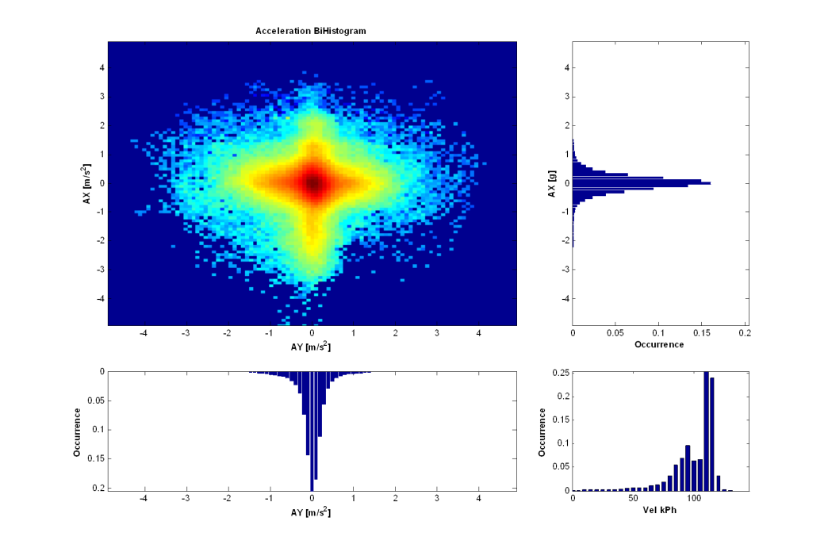
Stand. Dev. of accelerations is a good criteria to evaluate driving severity
The accelerations measurements of any trip can be represented by a “bi-histogram”
  Nb : colors are in log-scale
Driving
σ_{long}
The 1D histogram of long & lat accel can be computed
Average of the distribution is 0
Then Standard Deviation of these 1D histograms gives good criteria for driving severity
  Std Dev for longitudinal
  Std Dev for lateral
Longitudinal acceleration (m/s²)
Braking
Left turn
Lateral acceleration (m/s²)
Right turn
σ_{lat}

Slide 15
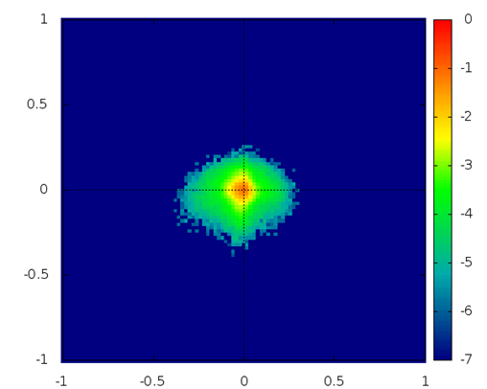
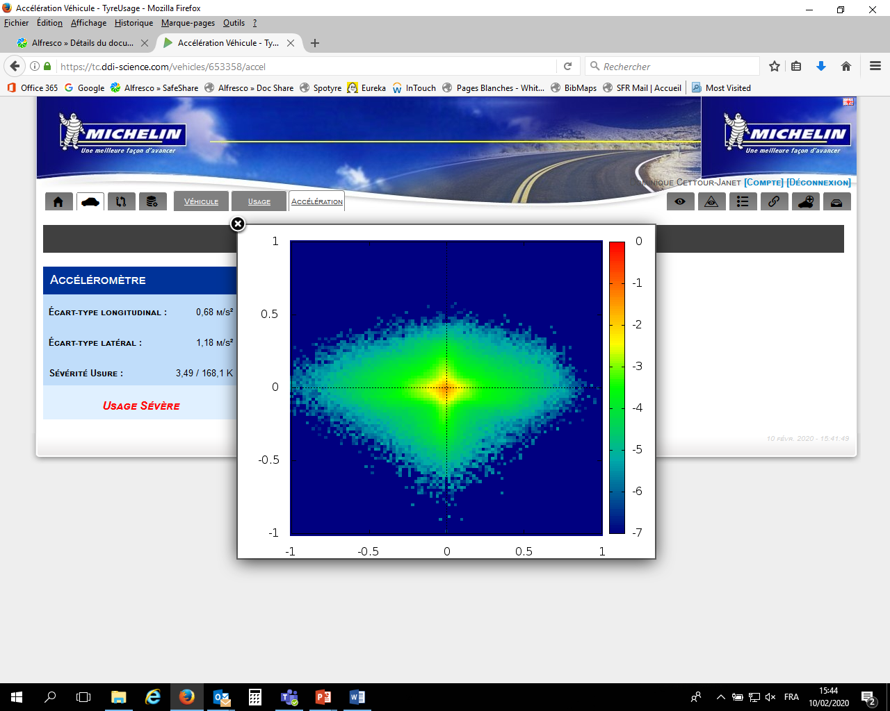
Stand. Dev. of accelerations is a good criteria to evaluate driving severity
Soft usage
Severe braking/ accelerating
Severe cornering
Medium usage
Low σ_{lat}
Low σ_{long}
Medium σ_{lat}
Medium σ_{long}
Medium σ_{lat}
Very high σ_{long}
High σ_{lat}
High σ_{long}
σ_{long}
Severe braking/ accelerating
Severe cornering
Soft
Medium
σ_{lat}

Slide 16


FIA/ ADAC statement of city driving (by Dino Silvestro)
In urban traffic, on the other hand, it is difficult to implement reproducible driving conditions, because the driver's influence on the result can be higher than out of town or on the motorway.
From the ADAC's point of view, a combination of motorway and extra-urban driving offers the best possible compromise of reproducibility, efficiency and risk reduction when carrying out tyre wear measurements.
The ADAC driving profile was created accordingly and contains about 40% motorway and 60% country road and inner-city portions. However, the inner-city portions were limited to only necessary town crossings and only driving on main roads (no side roads, etc.).
I hope that the experiences passed on by the ADAC, fully supported by FIA and mobility clubs affiliated, will be helpful for the further development of the test methodology

