Slide 1
Safety Market Surveillance
Comparison of radiated electromagnetic emission in different normal conditions of use
Akos Kriston, Marco Zanni and Fabrizio Minarini
European Commission, DG Joint Research Centre

Slide 2
Topics
Scope of testing
Laboratory and test articles
Test result of regulated modalities
Test results of other normal driving conditions
Conclusions

Slide 3
Scope of testing
2 vehicles of category M₁ have been tested regarding electromagnetic emission (UNECE Regulation 10) as part of the Vehicle Safety Market Surveillance activities (Regulation (EC) 2018/858.)
Broadband radiated emission other than charging modes
  Regulated modalities (40 km/h)
  Other normal driving conditions upto 120 km/h
Narrowband radiated emission – engine off

Slide 4
Test articles
Vehicle 1
Vehicle 2
Parameter | Value
Model year | 2020
Engine | Asynchronous rear and front electric engine: 300 kW
Battery size | 80 kWh
Charging power | 16A single-phase, 16A two-phases; Direct Current: 200A, Type 2; Combo 2 (CCS), 110kW
Parameter | Value
Model year | 2020
Engine | Dual motor: rear (88kW) and front (65kW)
Battery size | 75 kWh
Charging power | On-board 3-phase 48 A (AC), 250 kW (DC) with Supercharger V3

Slide 5
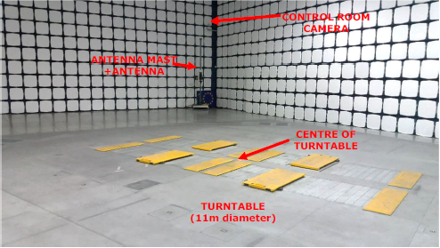
Laboratory: JRC Vela 9
Semi anechoic chamber with dimension 21m x 15.6m x 8m
Chassis dynamo by AVL
Antenna: Schwarzbeck MESS VULB 9162 (placement at 10 m)
Signal receiver: Rohde&Schwarz ESR 7
Pliakostathis K., Zanni M., Scholz H., Trentadue G., Assessment and analysis of the
electromagnetic profile of prototype high-power-charging units for electric vehicles: EUR 29704 EN,
Publications Office of the European Union, Luxembourg, 2019, ISBN 978-92-76-01440-9, doi:10.2760/08750, JRC114312.

Slide 6
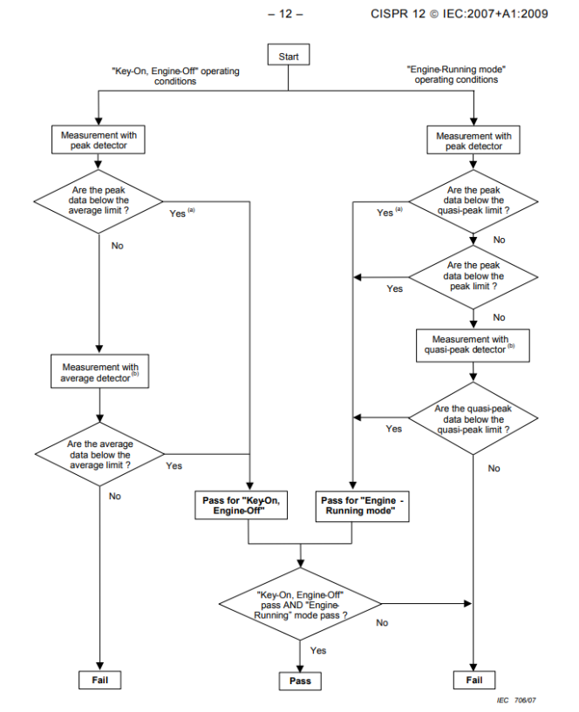
Test conditions
Narrowband radiated emission: ANNEX 5 + CISPR 12: Key-on engine off
Regulated broadband radiated emission: ANNEX 4 + CISPR 12
  Driving at 40 km/h constant speed
Other normal condition of use:
  constant driving: 40, 60 60, 100 and 120 km/h
  0-40-0 km/h acceleration in 10 s and highest regenerative braking power
  0-120-0 km/h acceleration in 30 s highest regenerative braking power
  Stepped driving 40, 60 60, 100 and 120 km/h and highest braking
  Random driving profile upto 120 km/h

Slide 7
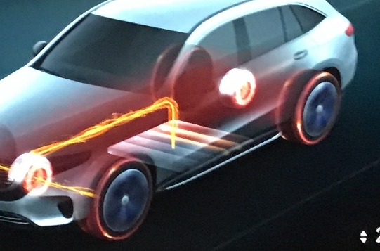
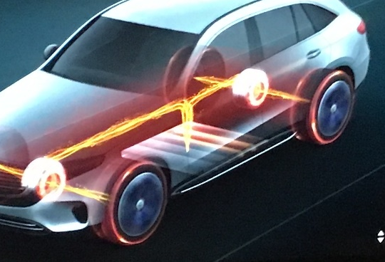
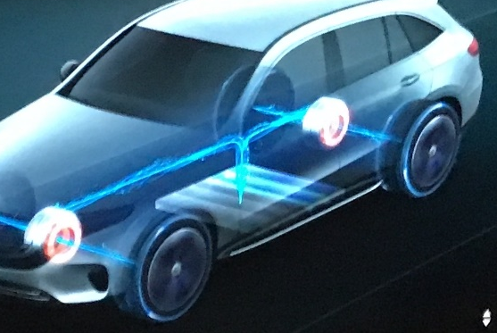
Other normal conditions of use: Rational
Front engines works
at 40 km/h
Both engines works at 120 km/h or during acceleration
Both engines works during recuperation
UN ECE Regulation R10 (v5)
6.1.1. “A vehicle and its electrical/electronic system(s) or ESA(s) shall be so designed, constructed and fitted as to enable the vehicle, in normal conditions of use, to comply with the requirements of this Regulation.”
2.1.1. (ANNEX 4) All equipment capable of generating broadband emissions which can be switched on permanently by the driver or passenger should be in operation in maximum load, e.g. wiper motors or fans.
IEC CISPR 12
5.3.2.2. Vehicles/boats equipped with an electronic propulsion motor shall be test with the vehicle driven on a dynamometer without a load, or on non-conductive axle stands, with constant speed of 40 km/h…

Slide 8
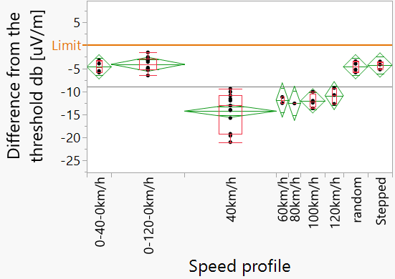
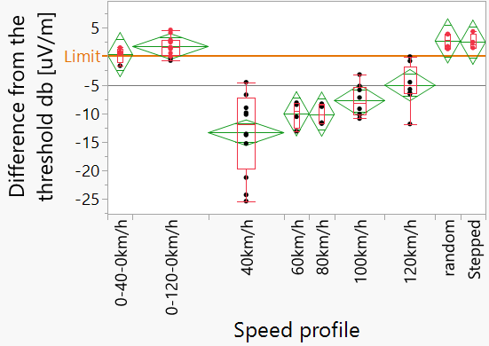
Results - summary
Vehicle 1
Vehicle 2
Both left, right and horizontal and vertical antenna orientation are included
Continuous scan was applied for non-constant speeds
More accurate measuring time is applied than required by regulation for data acquisition
The broadband emission threshold (R10v5) is used for comparison

Slide 9
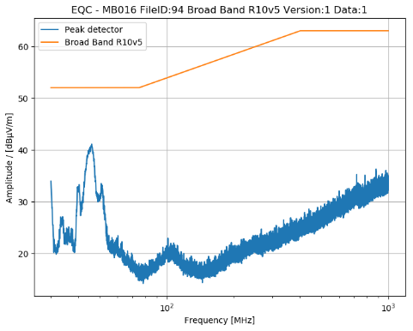
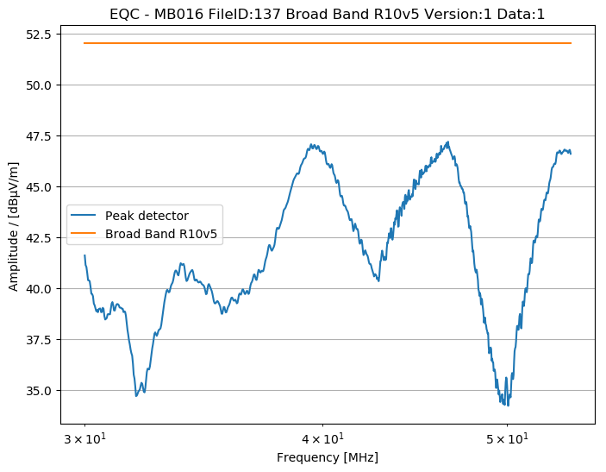
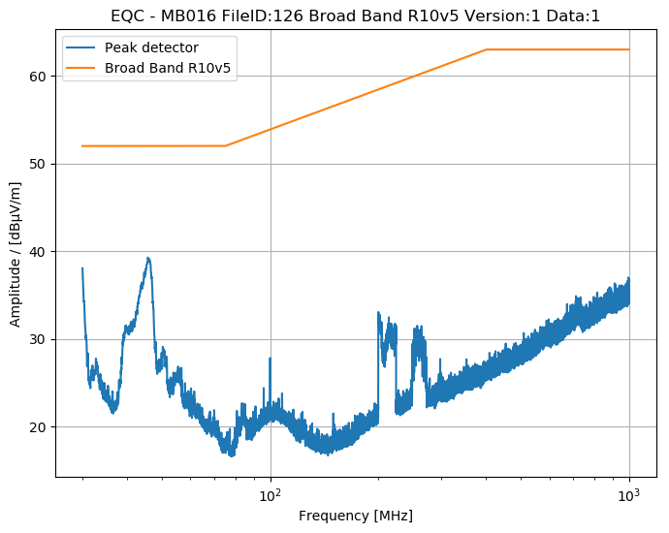
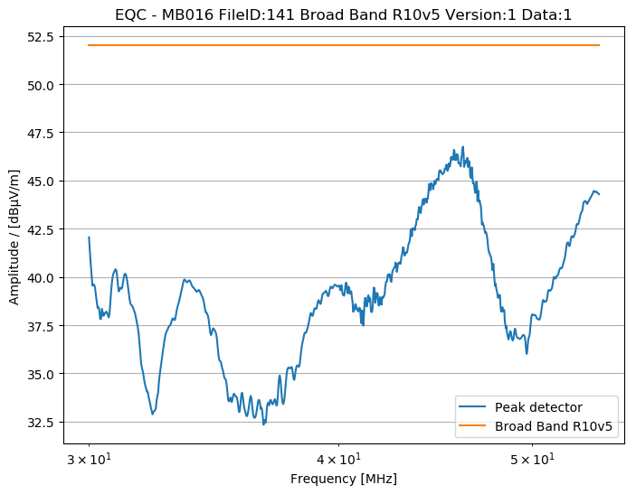
Vehicle 1
0-40-0 km/h
40 km/h
0-120-0 km/h
120 km/h

Slide 10
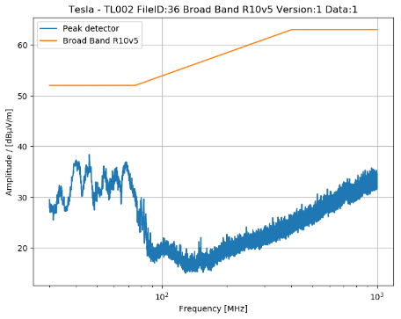
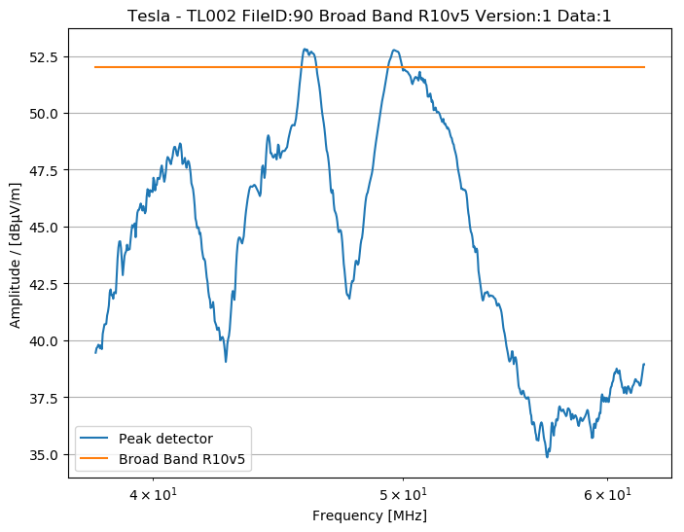
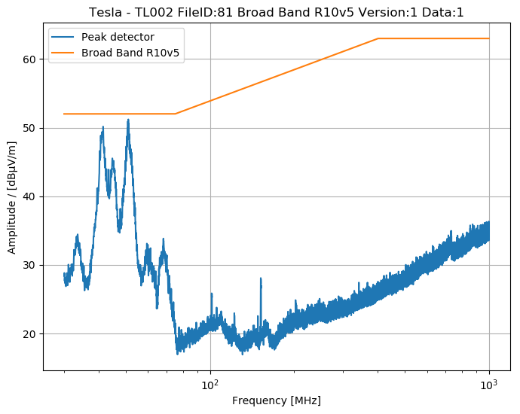
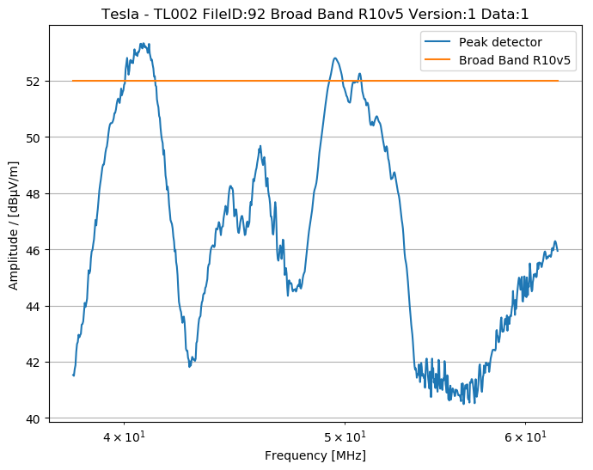
Vehicle 2
Constant 40 km/h
0-40-0 km/h
Constant 120 km/h
0-120-0 km/h

Slide 11
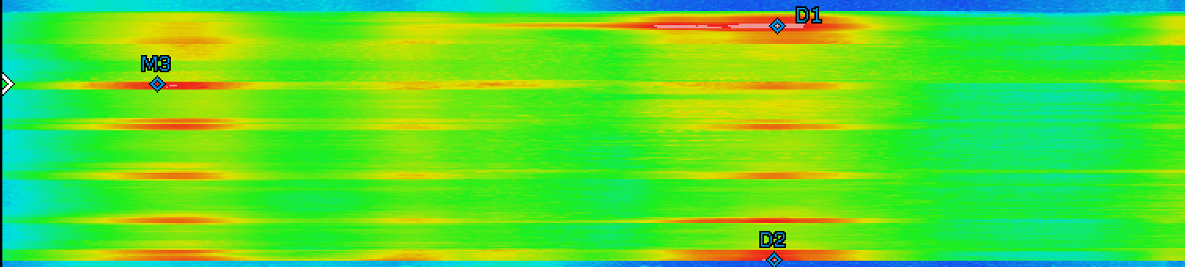
Time-frequency analysis
Vehicle 1: 0-40-0 km/h
0 40 0
Vehicle 2: Random profile
Speed [km/h]
Acceleration [m/s²]

Slide 12
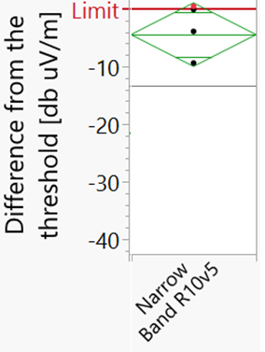
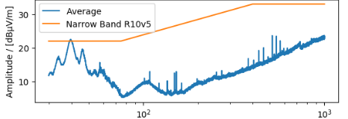
Vehicle 2 – Narrow band - Engine OFF
Ambiguous assessment of compliance
Maybe cooling system turns on
Any auxiliary equipment irrespective who turns them on (i.e. driver or other systems)

Slide 13
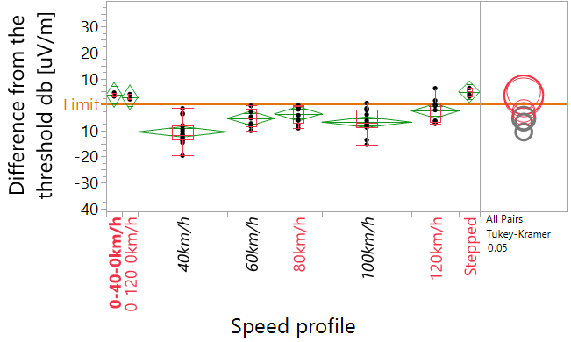
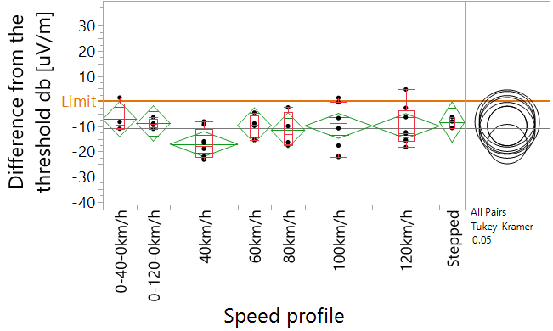
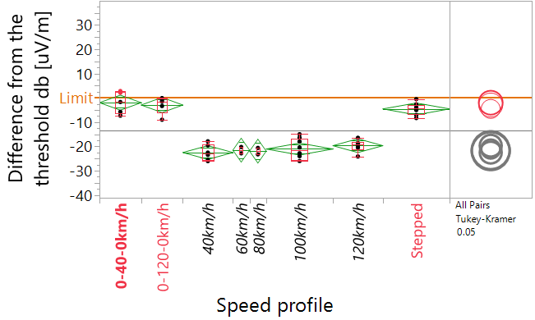
Further vehicles – not under market surveillance
Vehicle 3 (SUV)
Vehicle 4 (VAN)
Vehicle 5 (sedan)
Electric power: Vehicle 3 > 4 > 5
1 out of 3 is above the limit under non-constant speeds
Road load as declared by the manufacturer
2 out of 5 are above the limit during non-constant speed

Slide 14
Key findings
The propulsion electric engine(s) operation strategy highly depends on the speed and acceleration/deceleration modes.
Other than constant 40 km/h normal driving conditions can lead to non-compliant radiated broadband emission (for some vehicles) for 2 out of 5 vehicles
Narrowband emission can be also influenced by some systems (cooling, heating of the battery) that are frequently on and can lead to ambiguous results
Different result can be obtained measuring EMC radiated emission not only positioning vehicle in left side and right side but also in front and rear sides

Slide 15
Concluding remarks
Testing at only constant 40 km/h is an issue since it covers a part of the normal conditions of use therefore the § 6.1.1. of R10 cannot be verified comprehensively.
Proposal for the revision of current testing methods to better reflect reality
  New propulsion technologies
  All propulsion engines
  Other modes of normal use: both during acceleration and in recuperation modes
  Include of on-board devices which are switched on by other systems
  Realistic load conditions

Slide 16
Suggestion to verify compliance
Amend R10 according to the finding and not other static references (e.g. CISPR 12)
Assess all (worst case) normal conditions of use for all propulsion engines both in charge consuming and in recuperation modes.
  EM emission should be below threshold at any driving profile or testing condition
  Apply EMC directive 2014/30/EU to determine the worst case (by manufacturer) and demonstrate it during type approval
  The assessment should include other antenna positions than left-right (i.e. front until it fulfills other requirements)
TA can chose other conditions also
Market Surveillance can assess any normal conditions of use not only reported as worst case

Slide 17

Thank you
© European Union 2022
Unless otherwise noted the reuse of this presentation is authorised under the CC BY 4.0 license. For any use or reproduction of elements that are not owned by the EU, permission may need to be sought directly from the respective right holders.2
Notes:
Update/add/delete parts of the copy right notice where appropriate.
More information: https://myintracomm.ec.europa.eu/corp/intellectual-property/Documents/2019_Reuse-guidelines%28CC-BY%29.pdf

Slide 18





Keep in touch
EU Science Hub: ec.europa.eu/jrc
@EU_ScienceHub
EU Science Hub – Joint Research Centre
EU Science, Research and Innovation
Eu Science Hub
Notes:
Delete/update as appropriate

Slide 19
Acknowledgement
We thank Harald Scholz for his advices and hands-on assistance during testing.

Slide 20
Technical slides

