Slide 1
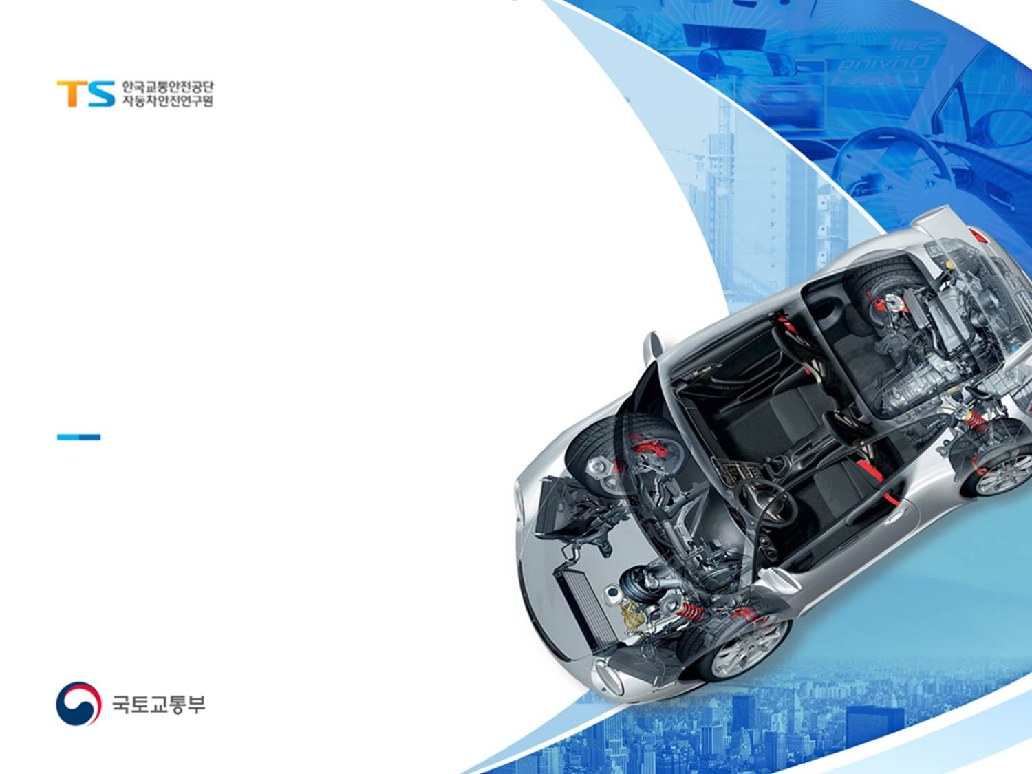

EDR/DSSAD
Reinforcement necessity of Data Survivability for EDR/DSSAD
Korea Automobile Testing & Research Institute(KATRI)
Special Accident Investigation Office
Giok Park

Slide 2
EDR/DSSAD Informal Working Group
01
Background
Continuous increase in EV Registrations
Registrations of EV in S. Korea
Increasing the number of EV registrations in S. Korea
(Unit : thousand)

Slide 3
EDR/DSSAD Informal Working Group
01
Background
EV fires can’t be easily extinguished
Characteristics of EV Battery
Fire occurs after charging is completed or while driving
High voltage battery damage caused a fire after a collision
Fire extinguishing takes a lot of time(thermal runaway)
Fire causes damage to various parts, and fire extinguishing water causes corrosion of ECU
(A large amount of water should be used to extinguish the fire)
Concerned Situation
The surrounding ACM parts are melted by fire and the ACM cannot be separated by normal methods. (Sometimes need hammering and cutting surrounding parts)
Data cannot be extracted due to ACM damage caused by fire and corrosion of internal parts
caused by fire extinguishing water.

Slide 4
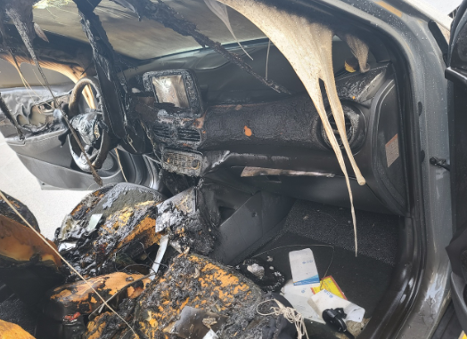
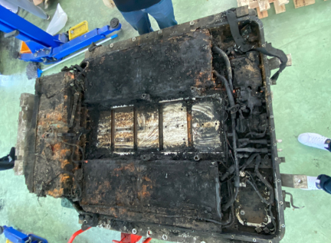
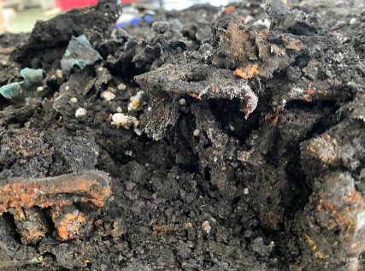
EDR/DSSAD Informal Working Group
02
Electric vehicle fire cases
Cases of fire after charging (Korea, Hyundai Kona EV)
(Summary) The fire occurred while parking after charging was completed
- After about 30 minutes of completion of charging, smoke was observed, and then it turned into a fire
(damage) Vehicles and facilities were damaged due to a vehicle fire surrounding the parking lot
(Cause) Internal short circuit due to defective manufacturing of high voltage battery cells
- Worldwide recall of Kona EV, IONIQ EV, and Electricity Bus EV using the same battery
(Issue) Unable to recognize signs of fire, delay in identifying the fire caused due to thermal runaway
- High voltage abnormality detection and risk notification through BMS diagnostic logic reinforcement, etc.

Slide 5

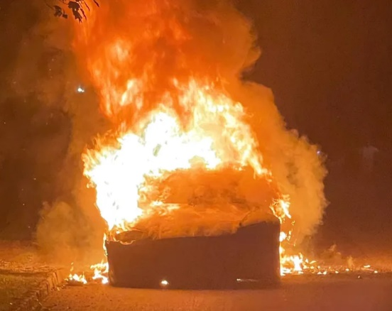
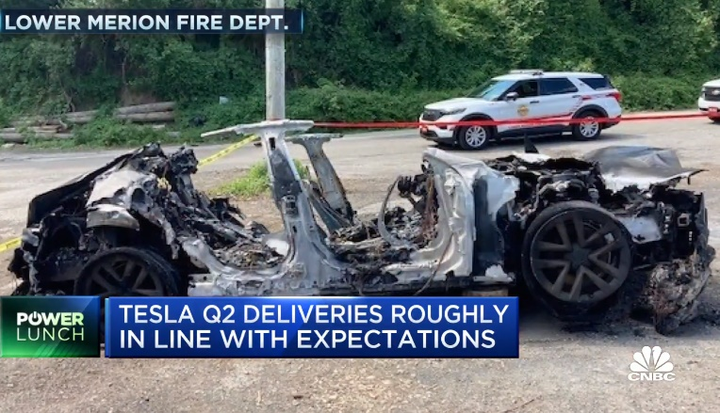
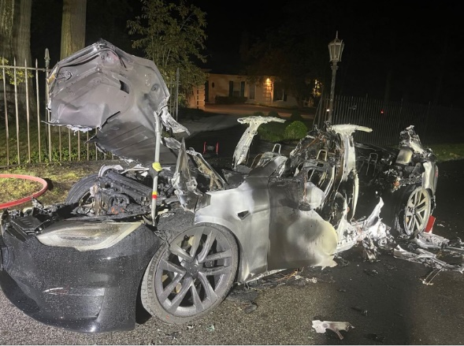
EDR/DSSAD Informal Working Group
02
Electric vehicle fire cases
Cases of fire while driving (USA, Tesla Model S Plaid)
(Summary) Smoke occurred from the rear of the vehicle while driving, and a fire occurred after
the vehicle was stopped
(Damage) It takes 3 hours to extinguish the fire, burns down the vehicle
- Unable to get out from vehicle cabin due to malfunction of door lock
(Cause of fire) Collecting additional NHTSA information

Slide 6
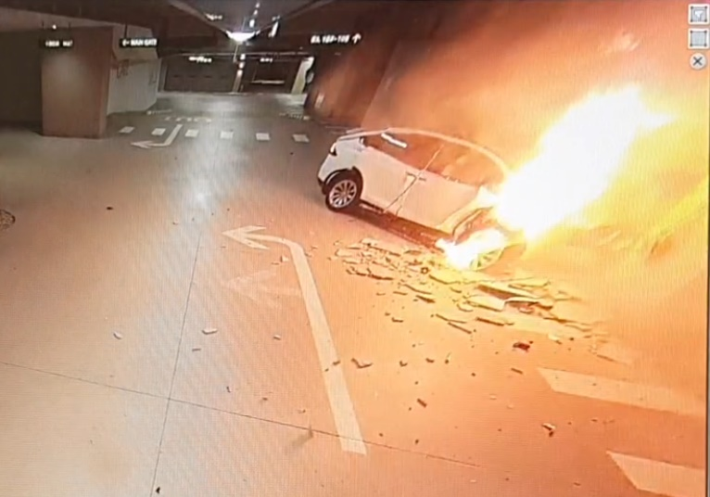
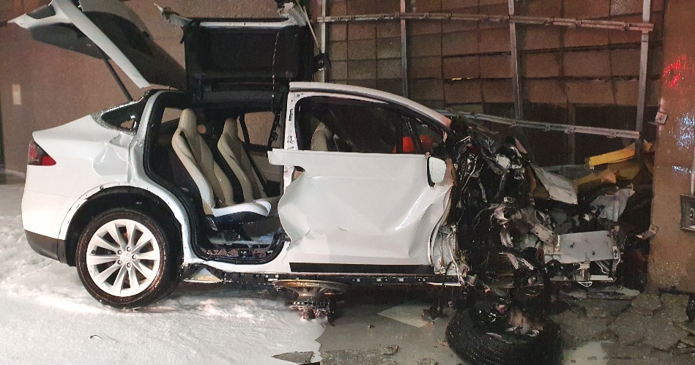
EDR/DSSAD Informal Working Group
02
Electric vehicle fire cases
Cases of fire after crash (Korea, Tesla Model X)
(Summary) The fire occurred after a collision with the wall due to a driver’s misoperation in the
underground parking lot at the apartment
(Damage) The vehicle burned, and the driver escaped, but one passenger died inside the cabin
(Cause of fire) Presumed short circuit in the battery system due to the deformation of the high
voltage battery pack case caused by the frontal impact
(Issue) Unable to extract data from EDR(Both direct connection and EEPROM swapping failed)

Slide 7
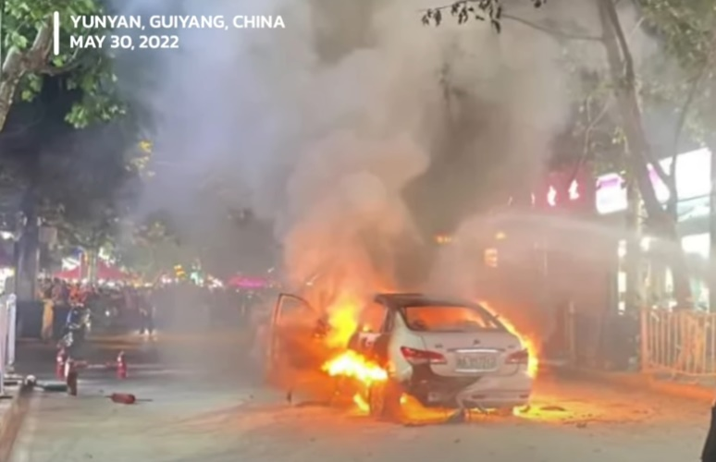
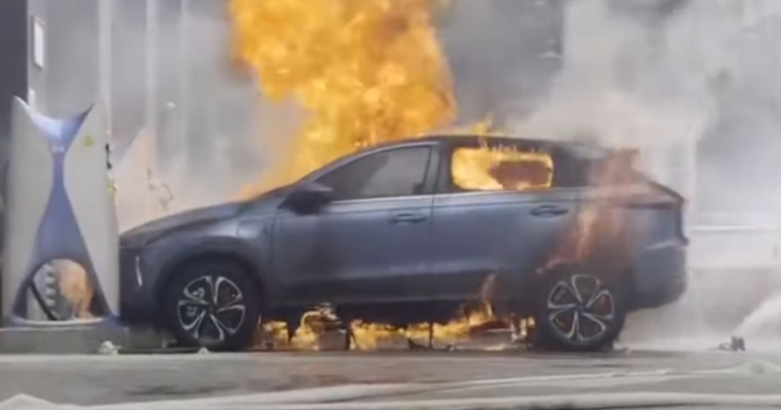
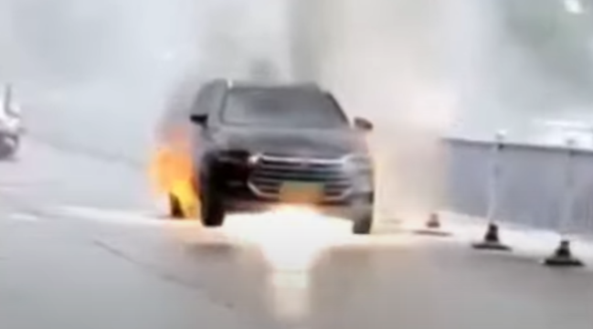
EDR/DSSAD Informal Working Group
02
Electric vehicle fire cases
7 Battery Electric Cars a Day Catch Fire in China (barreriesnews.com)
In the first quarter of 2022, 680 electric car fires were recorded in China
Why electric cars are on fire in China
(The 86 fires of electric cars disclosed by the media)
- when charging the battery 27.5%;
- while parking 38.5%;
- while driving
- after a collision
- unidentified causes, in 7 episodes.
Source : https://batteriesnews.com/7-battery-electric-cars-day-catch-fire-china-most-involved-brands/

Slide 8
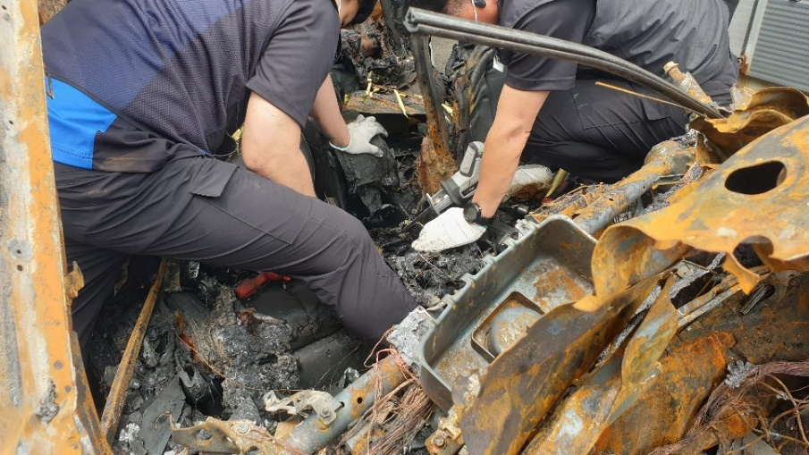
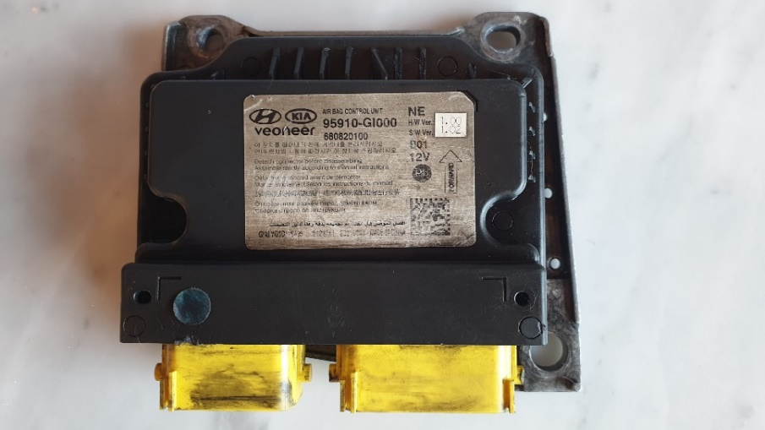
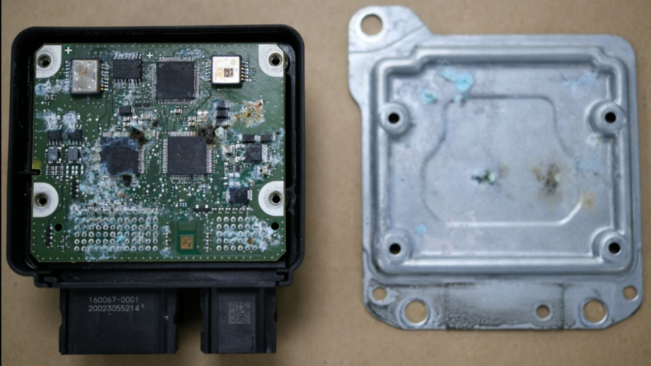
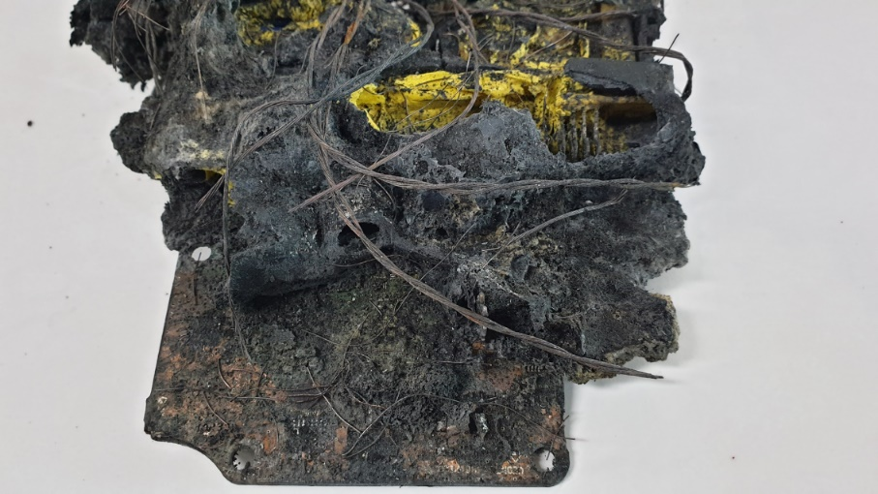
EDR/DSSAD Informal Working Group
03
EDR Data Survivability
ACU detached from electric vehicle after fire
A
B
C

Slide 9



EDR/DSSAD Informal Working Group
04
Proposal
Data Survivability reinforcement for EDR/DSSAD
Proposal for initiate the discussion for data survivability from fire risk
Korea would like to propose the start of the discussion of this issue possibly within EDR/DSSAD group.
A single-product evaluation method(device fitted with EDR/DSSAD)
Data should be preserved even when exposed to high temperatures due to fire
Data should be preserved even in conditions such as fire extinguishing fluid injection and flooding vehicles in a water tank
Data shall be preserved even in direct shocks outside the ACM and vehicle crashes.
Fireproof
Waterproof
Strength

Slide 10

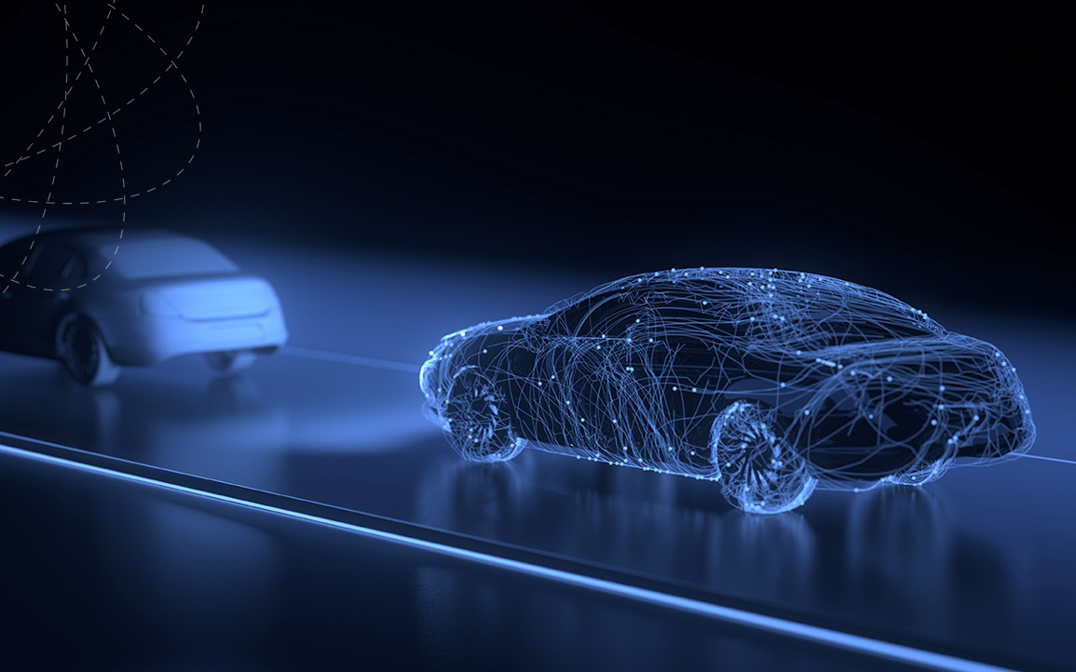

THANK YOU
e-mail parkgiok@kotsa.or.kr
giok.park@gmail.com
Korea Automobile Testing & Research Institute

