Slide 1

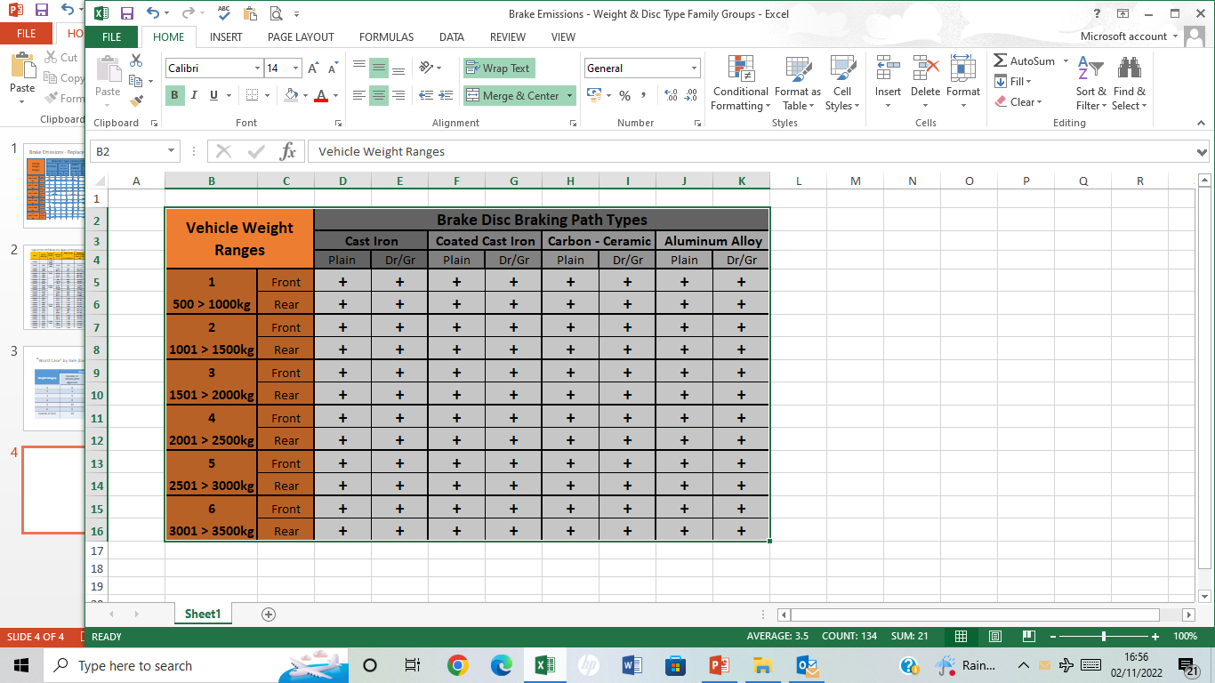
Replacement Brake Family (PM emissions)
Replacement Pad Materials & Brake Discs
Brake Emissions Test Groups formed by a combination of 5 parameters -
Vehicle GVW weight range : 500 to 3500 kg in 500 kg increments
Brake Disc Braking Path Material Type – CI/Coated CI/Carbon-Ceramic/Alum Alloy
Brake Disc Surface Form – Plain or Not Plain (i.e. Drilled or Grooved)
Axle location – Front or Rear
For pads, the friction material (e.g. NAO, Low-Met, Ceramic)
Worst case selection = highest energy / PAD friction area
Mass – as defined in R90 for M1, N1
Speed – Vmax in WLTP Brake Cycle (Trip No.106:133 > 34kph)
or (Vmax > 34kph) where actual Vmax < 133kph
Conduct tests for component required
Replacement Pad Material with OE Disc
Replacement Disc with OE Pad
Replacement Couple (Pad + Disc)
Test Method = GTR Brake PM Cycle

Slide 2
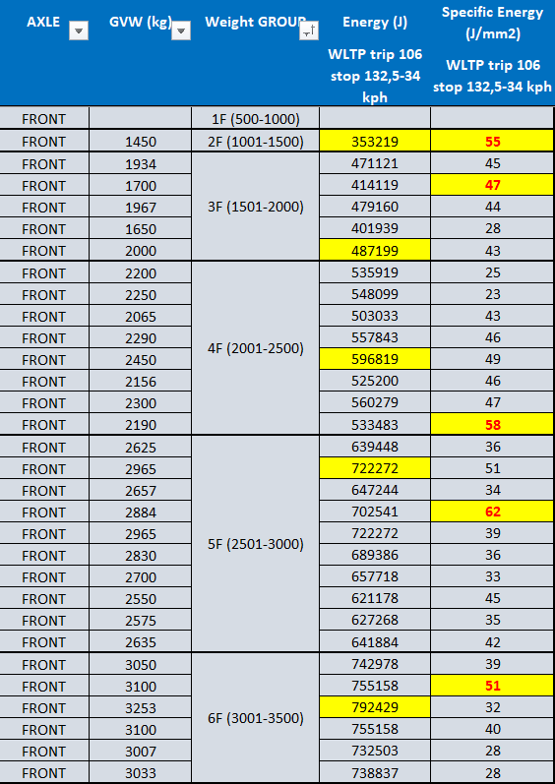
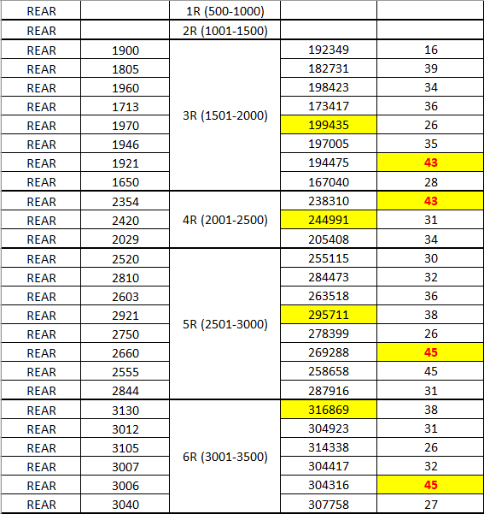
R90 family |  |  | PM family
FA tests | 30 |  | FA tests | 5
RA rests | 25 |  | RA rests | 4
total | 55 |  | total | 9

