Slide 1
UNIQUE IDENTIFIER
Unique Identifier
GRE
IWG
SLR
Result of GRE 87 (ECE/TRANS/WP.29/GRE/87)
9. GRE noted that the use of UI for a particular UN Regulation should only be possible when the following two conditions are met:
• the corresponding summary document has been defined in the Regulation; and
• DETA is providing access to the Summary Document.
10. To stress these requirements, the expert from EC proposed an amendment (GRE-87-24-Rev.1). GRE adopted the proposal and requested the secretariat to submit it for consideration and vote at the March 2023 sessions of WP.29 and AC.1 as a draft Supplement to the 00 and 01 series of amendments to UN Regulations Nos. 148, 149 and 150.
11. In the context of possible replacement of traditional approval markings by UI, the expert from CITA presented a proposal with the aim to ensure the availability of sufficient information on the device for periodic and roadside inspections (ECE/TRANS/WP.29/GRE/2022/13 and GRE-87-07). GRE agreed to revert to this proposal at the next session.
GRE-87-24-Rev.1
Add a sentence (in bold) in the last paragraph of the Introduction section of UN Regulations Nos. 148, 149 and 150:
“… the use of conventional type approval markings is required until the use of the "Unique Identifier" is enabled.
In addition, the use of the “Unique Identifier” shall only be possible if the corresponding Summary Document (ECE/TRANS/WP.29/1159, paragraph 89) has been defined in this Regulation and the database is providing access to the Summary Document.”
SLR-59-09

Slide 2
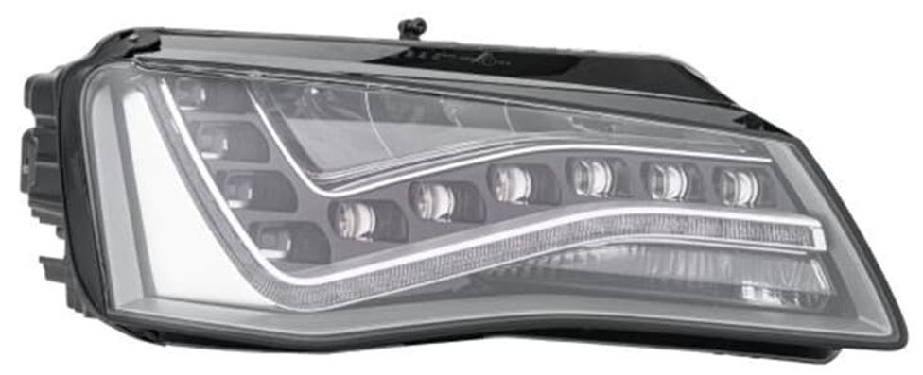
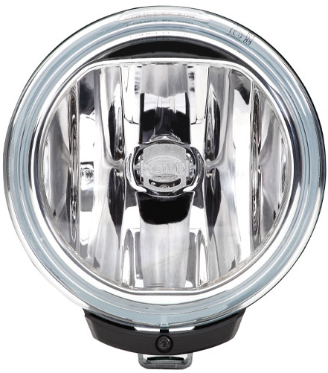






UNIQUE IDENTIFIER
Unique Identifier if used as described now
GRE
IWG
SLR
+
F3 K PL
A 1a PL
F3 K PL
01 XEWR 11111
01 XCV 55555
01 XCWT 88888
01 XCVR 121210
01 XCWR 14441
01 XCWR 552200
E6
E6
E6
R149 01 1122
XEWR 11111
R14901 1122
R14901
SLR-59-09

Slide 3
UNIQUE IDENTIFIER
Unique Identifier if used as described now
GRE
IWG
SLR
Q1: is it possible that those functions are from different manufacturers (and so applicants for type approval)? For example:
a. combined product (so one single physical object) including a single daytime running lamp from one manufacturer and a single front fog lamp from another manufacturer,
b. combined product from one manufacturer also functioning as R123-AFS from another manufacturer.
Are these realistic scenario’s?
For one device it is very unlikely, at least I have never seen something like this. Yes, there are devices where parts are coming from different manufacturers, but these are not type approved before delivered to the manufacturer of the device.
For several devices, combined in one function this scenario is quite usual and nothing special anymore. You already mentioned AFS but also scenarios for front or rear position lamps are realistic
As regards Q1b, where several devices are combined in one function and the devices and function are different approval holders, we need to consider then how this should work in the context of the UI marking. In particular if the UI’s of the devices and the function are combined in one UI marking. For the approval authority that needs to create such a combined UI it is difficult to understand whether an applicant for that combined UI is entitled to include the UI’s of the other involved manufacturer(s). It seems burdensome if the authorities needs to check statements or contracts.
If there would be any solution from lighting industry about this situation that would be most helpful.
In any case we need to discuss this further within the IWG or TF and the below answers contribute a lot to the understanding of the situation.
SLR-59-09

Slide 4
UNIQUE IDENTIFIER
Unique Identifier – Answer to DETA
GRE
IWG
SLR
Approval marking / Unique Identifier
As in R148/149/150 already included
Unique Identifier – Container
Public summary document
1234567
Public
TAA
2
Summary Document
UI
+
Type approval document
Approval marking
or
Unique Identifier
11111
Summary Document
11111
UI
11111
Type approval document
3
+
Summary Document
UI
55555
Type approval document
UI
Summary Document
55555
55555
Type approval document
F3 K PL
01 XEWR 11111
01 XCV 55555
01 XCWT 88888
01 XCVR 121210
01 XCWR 14441
E6
4
+
Summary Document
Summary Document
88888
UI
88888
Type approval document
New UI
UI
88888
Type approval document
R14901
UI
1234567
1122
5
Summary Document
Summary Document
121210
UI
+
Type approval document
UI
121210
Type approval document
121210
1
Summary Document
6
Summary Document
UI
14441
Summary Document
14441
Type approval document
UI
+
Type approval document
UI
+
Type approval document
1122
14441
UI
1122
Summary Document
1122
Type approval document
SLR-59-09

