Slide 1
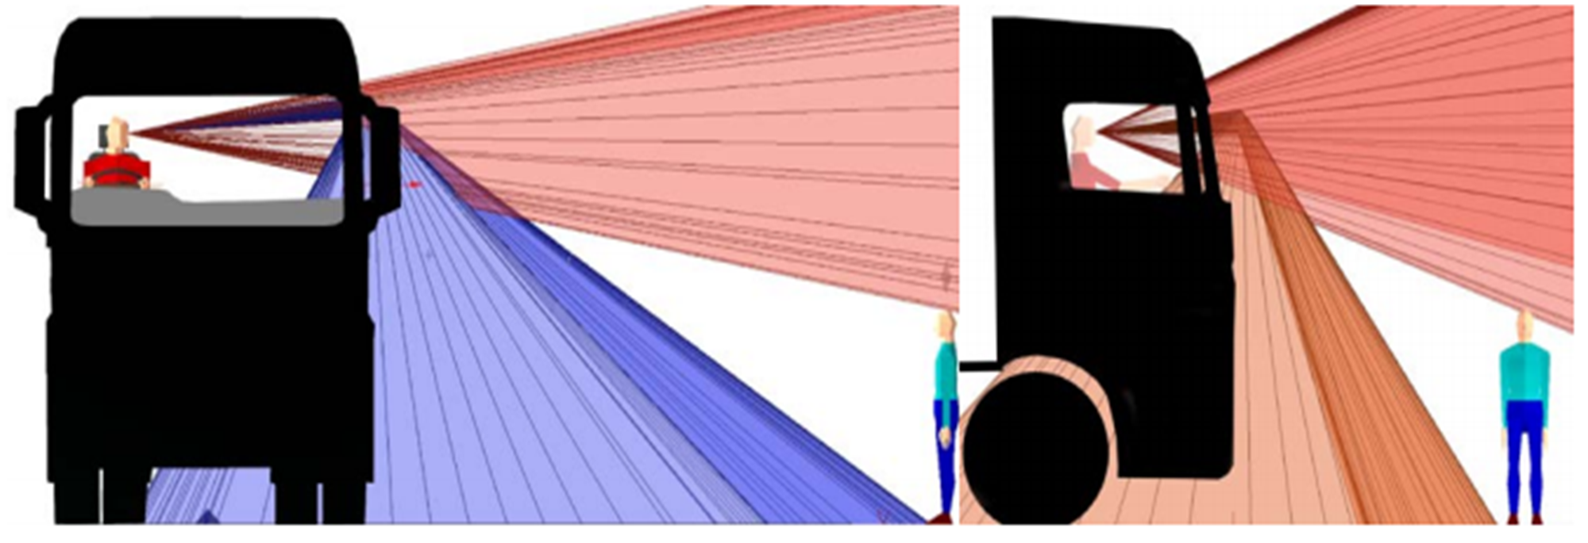

Tech neutrality: Option 3 or Option 4
VRU-Proxi-26-06

Slide 2
What are the criteria by which we should judge?
Degree of incentive to produce design changes that benefit the intended collision types
Insensitivity of method to design changes that do not substantially affect safety in close proximity manoeuvres (e.g. moving A-pillars)
Accuracy with which we can set new limit values at the same level of stringency as the regulated method

Slide 3
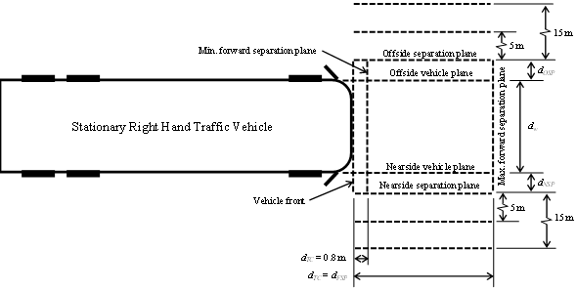
Incentive to change design in a beneficial way
Improvements in all areas of the assessment volume are to be welcomed. They will all improve safety in at least one of the moving off from rest crash type or the low speed turn across VRU path crash type
Reason for the limit to each side is to ensure both crash types benefit from improvements not only the low speed turns where design changes might not be as difficult
Focus on tech neutrality has been the frontal limit value only, with a view to ensuring benefit in moving off from rest collisions (As R159).
Most collisions involve slow moving elderly VRU who will not be far outside the vehicle path at the moment the driver needs to see them
A smaller number of cases will involve faster moving VRUs, in unusual situations etc. Visibility at wider lateral separation is relevant, but less important to moving off collisions
That same area (front and wide to nearside) remains important for nearside turn collisions but volume in this area does count towards both side view and total view in all 3 methods (regulated, option 3, option 4)

Slide 4
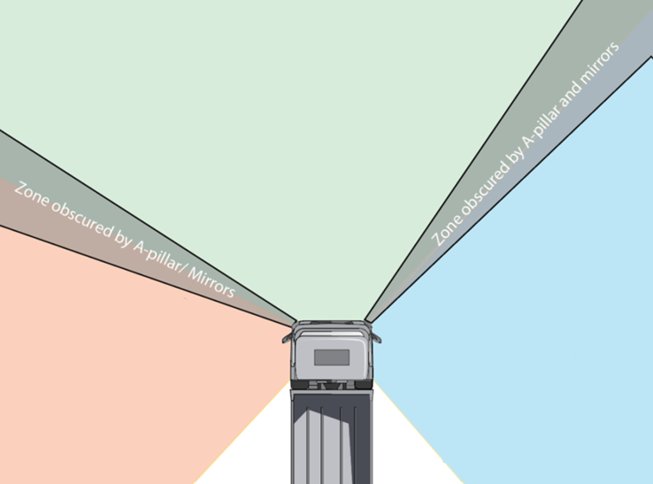
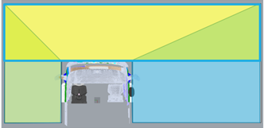
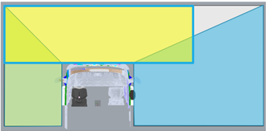
Changes to side window view to improve score in assessment against frontal limit
Volume gained from side window counts only for side limit value and total by definition
Side view limit for urban vehicles already gives incentive to manufacturers to improve side window design, mirrors etc
Total view limit gives incentive to improve side window for all vehicles
In option 3 a further incentive is added to improve side view via the front view limit
The area of vision improved, in relation to moving off collisions, is less important than areas nearer the vehicle path, but not irrelevant
Is this fair?
Does this reduce the incentive to take measures on the front window (e.g. reduced height, less fascia intrusion) given such improvement may be more technically & economically challenging?
Does it make it easier for industry to pass the regulated level of stringency?
Regulated
Volume gained from side window counted against front limit
Option 3
Volume gained from side window counted against front limit will be much smaller, maybe none depending on position of A-pillar etc
Option 4

Slide 5
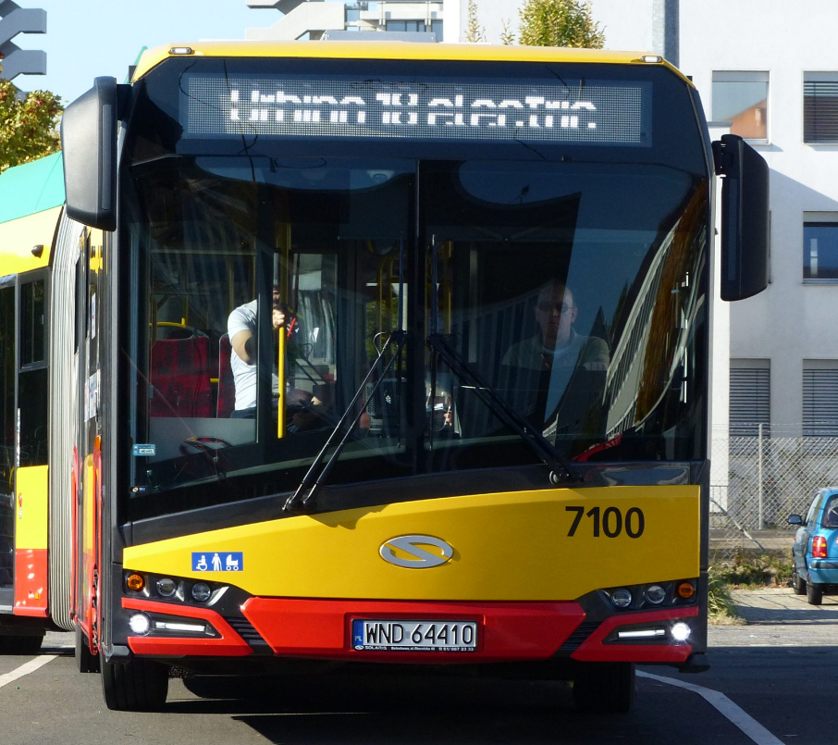
Effect of changes to front window design on frontal limit
Bus example of feasible design change to improve moving off collisions
Option 4 may reduce the effect of this change on front limit compared with existing regulation/option 3.
This lost volume could be in an area as close as 2m to vehicle path, so more relevant to moving off from rest
Is this fair?
Does this make it harder for industry to meet the regulated level of stringency?
All improvements between the A-pillars count linearly to front limit
Regulated
All volume gained counts toward frontal limit, same as regulated method
Option 3
Some of the volume gained by this design improvement may not count toward frontal limit
Option 4

Slide 6
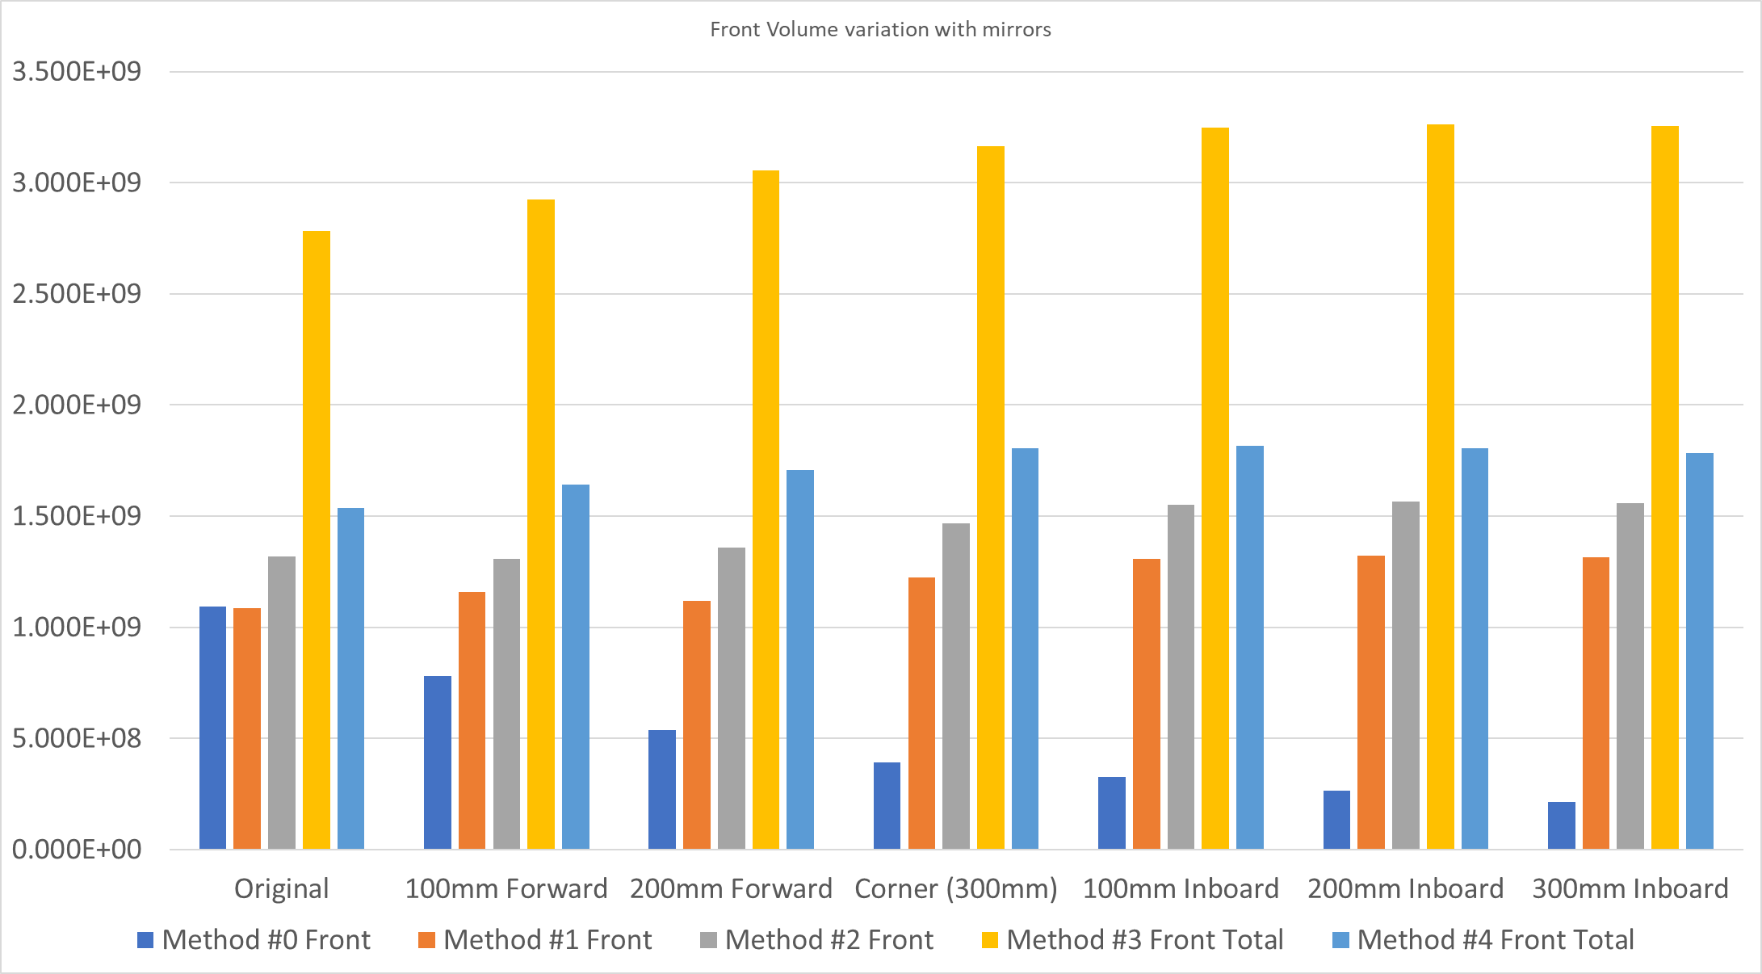
Insensitivity to A-pillar position
Regulated Method is clearly poor in this respect
Both Option 3 and Option 4 are clearly much better
Option 4 is best based on a sensitivity analysis using a generic traditional cab design
Unforeseen and unanswered question
  Does this finding hold true with innovative new cab designs?

Slide 7
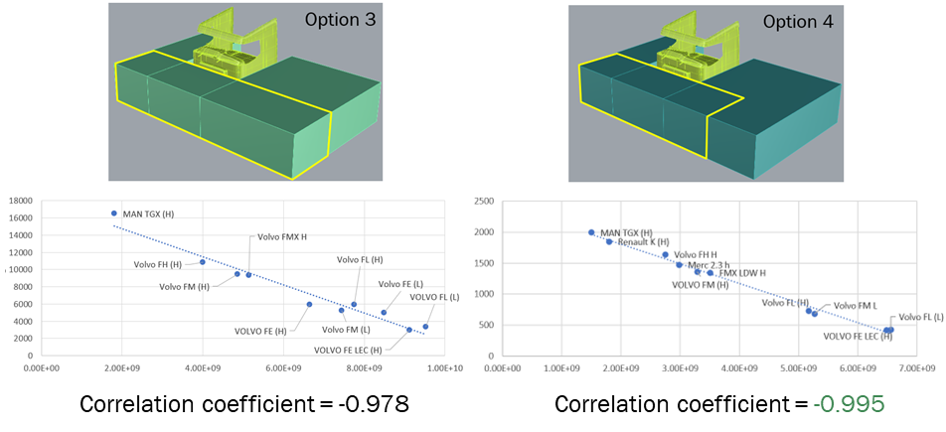
Calculating equivalent limit values for new volumes
Option 4 suggests the best correlation
Option 3 still very good and comparable to what was considered acceptable for original regulation

