Slide 1
TF-ADAS # 17
Presentation of the results from a
Study on L2-Hands-Off
19-Jan-2023

Slide 2
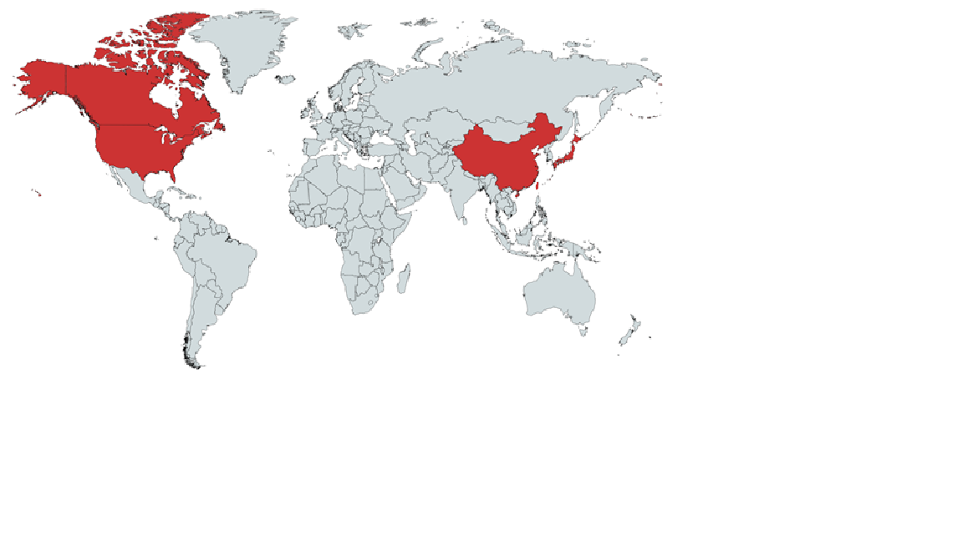
L2-Hands-Off Driving - Introduction and Market Demand
Introduction in different markets:
US: 2018
Canada: 2018
China: 2018
Japan: 2019
Customers are widely using L2 Hands-Off driving systems in major markets since 2018
Growing number of manufacturers are offering these systems
ISO PAS 11585 (Conditional Hands Free Driving Systems) describes State of the Art, expected to be ready mid 2023
Example Cadillac: “Over 34 million hands-free miles driven with Super Cruise” since market introduction*
Example Ford: “More than 10 million miles hand-free in just one year”
* https://www.cadillac.com/world-of-cadillac/innovation/super-cruise (status Nov 2022)
** BlueCruise Ford Power-Up Software Update Transforms F-150, Mustang Mach-E Models for Hands-Free Driving | Ford Media Center (status Jul 2022)

Slide 3
Level 2 Hands-Off - Background
2018: The informal group ACSF (16th session) …
  started to develop provisions for Automated Lane Keeping Systems, ALKS (ECE-R157)
  invited industry to start directly with GRVA the discussion on what needs to be changed /added to ECE-R79 to allow for Hands-Off/ Eyes On Lane Keeping Systems under a SAE Level 1-2 assumption.
2020: GRVA-07-23: OICA/CLEPA submitted a proposal to amend R79 ACSF B1 to allow Hands-Off in specific conditions.
2021: GRVA established a TF-ADAS to develop a new UN-R with the focus on systems of Level 2 (DCAS)
2021-Sept: TF-ADAS-07: OICA/CLEPA announced an independent research project on level 2 Hands-Off in order to ...
  answer the concerns and questions raised at GRVA and at TF-ADAS
  enable a fact-based discussion in the TF-ADAS
2023-Jan-19: GRVA-TF-ADAS -17: Presentation of the study results & recommendations
TF-ADAS to decide on the way forward for L2 Hands-Off Driving

Slide 4
TF-ADAS
Agenda
19-Jan-2023
L2 Hands-Off
Study Results
Introduction
Methodology incl. Q+A
Prolonged Transition Time (CQ2)
Detailed presentation + incl. Q+A
Break
Remaining 4 challenges / questions
(CQ1, CQ3, CQ4, CQ5)
Summary & Outlook
Q+A

