Slide 1
VMAD SG3
Confidentiality of information & aggregate data
19/12/2022
Riccardo Donà

Slide 2
Agenda
Confidentiality & Data Availability
Aggregate Data

Slide 3
Confidentiality & Availability

Slide 4
Short-term reporting template
Stakeholder concerns on a set of entries in the short-term reporting template due to privacy & data availability

Slide 5
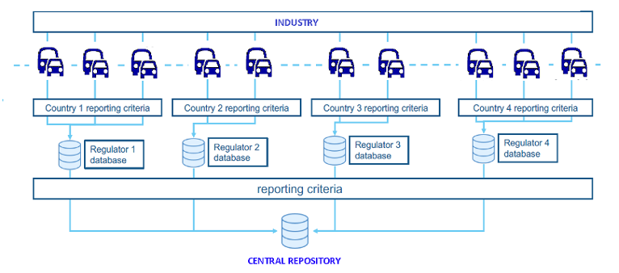
Data reporting schemes
Short-term reporting:
  Reported information shall remain confidential
  Issue safety recommendations
  Only authorities can have access to the information
Long-term reporting:
  Aggregated and anonymized data will be made public
  Authorities will process data on the basis of the short-term reports
Notes:
In our meetings with companies involved in the process we found that the validation of the ADS is often viewed as performing simulation in very same environment used for development which shouldn’t be the case as validation is a completely different use case from development and has stricter requirements.

Slide 6
ISMR vs EDR
Missing key elements in EDR wrt short-term reporting:
  VIN & vehicle details fundamental to identify which ADS
  Global positioning fundamental for ODD analysis
  Date & time of event fundamental for ODD analysis
Those elements are critical for driving automation and to fuel occurrence investigation
The confidentiality of the information flow as of the short-term reporting ensures no privacy concern may arise

Slide 7
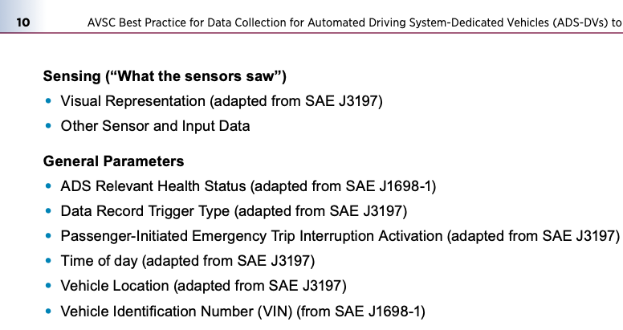
AVSC Best Practice for Data Collection for ADS-DVs to Support Event Analysis
Need to account for technology-related factors for ADS recognized by SAE
Split data-elements into 4 classes:
  What the ADS did (req. speed, steer, …);
  What the ADS thought was important (detection/classification);
  What the sensors saw (low-level info);
  General parameters (time, location, VIN)
Source: https://www.sae.org/standards/content/avsc00004202009/
Notes:
We can think of the virtual testing as being made up of 4 main ingredients which include sensor, ADS, vehicle, world

Slide 8
Data Availability
Reporting to be carried out according to laws applicable to each contracting party
Reporting to be carried out based on the information available to the reporter actors¹ (manufacturers or operators)
¹https://www.nhtsa.gov/sites/nhtsa.gov/files/2021-08/First_Amended_SGO_2021_01_Final.pdf

Slide 9
Aggregate data

Slide 10
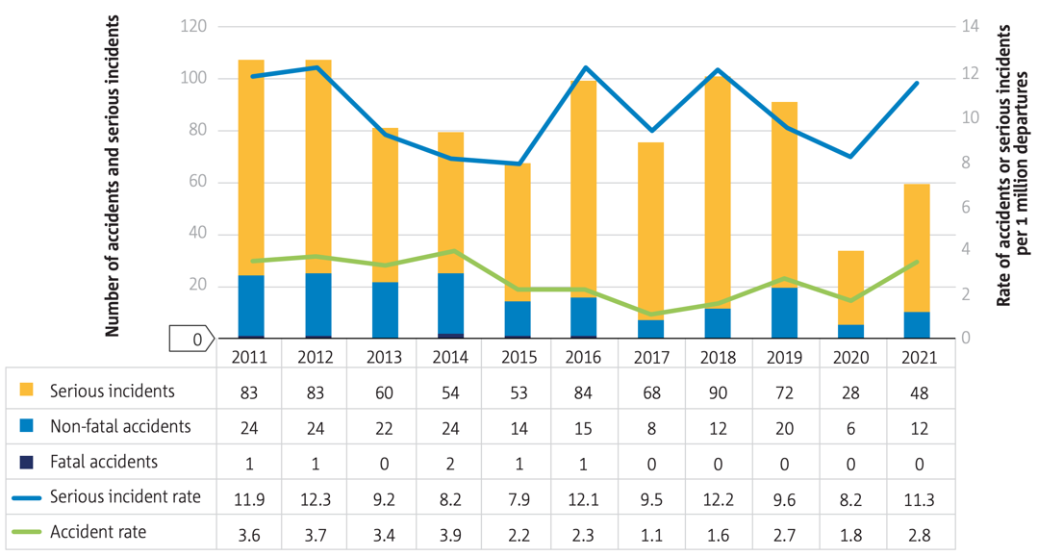
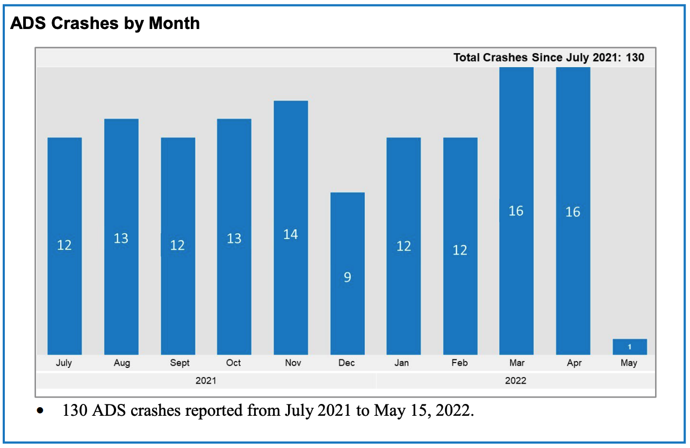
Aggregate data example
Global safety assessment
Identify long-term trends
Source: EASA Annual Safety Review; EASA, 2022;
Source: https://www.nhtsa.gov/sites/nhtsa.gov/files/2022-06/ADS-SGO-Report-June-2022.pdf
Notes:
In our meetings with companies involved in the process we found that the validation of the ADS is often viewed as performing simulation in very same environment used for development which shouldn’t be the case as validation is a completely different use case from development and has stricter requirements.

Slide 11
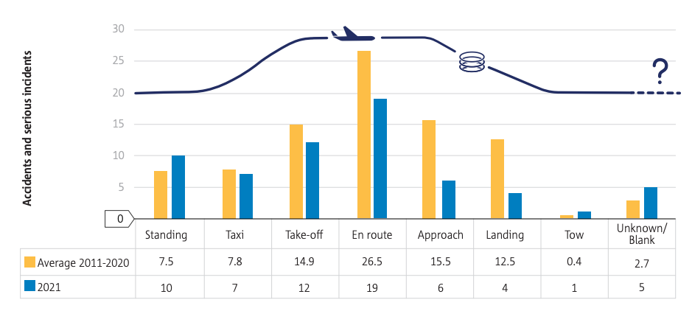
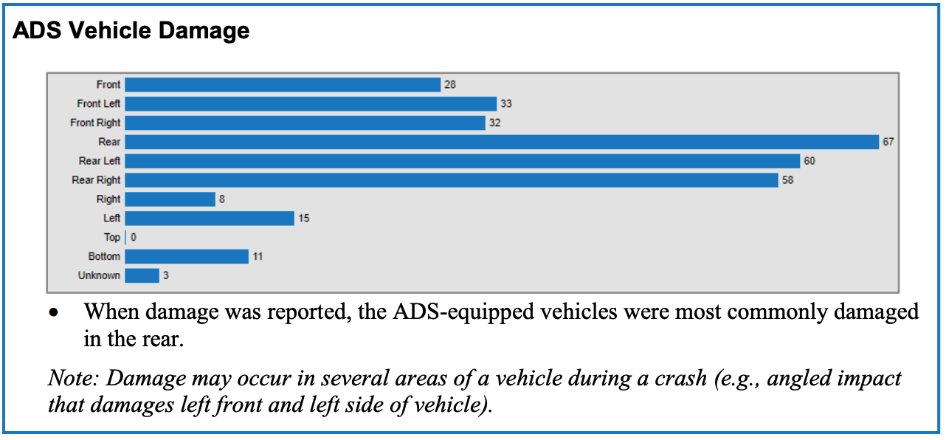
Aggregate data example
Identify in which phase the occurrence took place (statistically)
Source: EASA Annual Safety Review; EASA, 2022;
Source: https://www.nhtsa.gov/sites/nhtsa.gov/files/2022-06/ADS-SGO-Report-June-2022.pdf
Notes:
In our meetings with companies involved in the process we found that the validation of the ADS is often viewed as performing simulation in very same environment used for development which shouldn’t be the case as validation is a completely different use case from development and has stricter requirements.

Slide 12
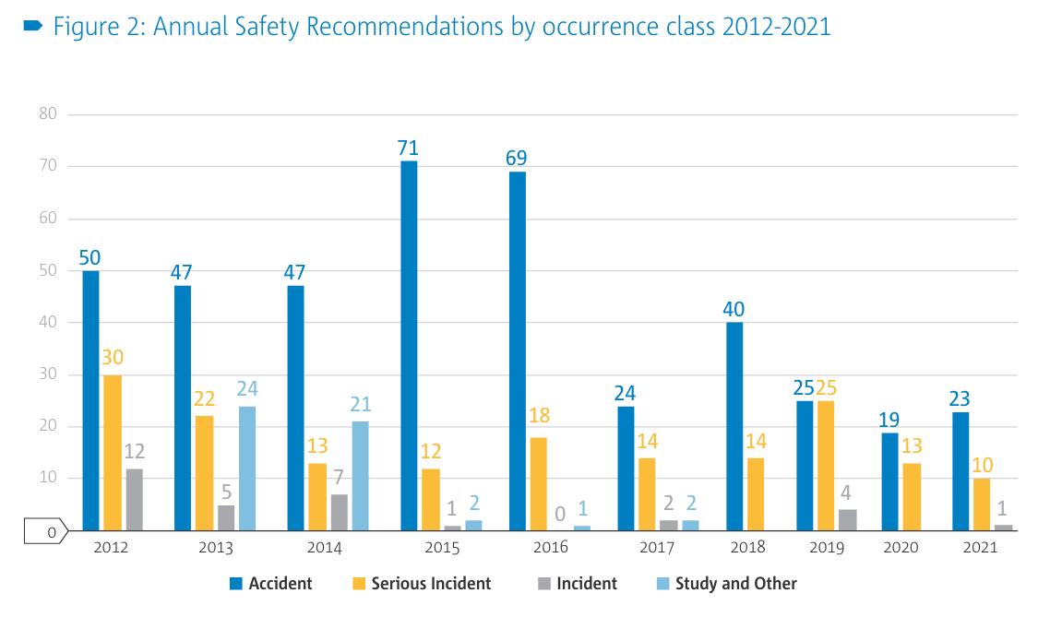
Aggregate data example
Communicate the amount of safety recommendations and how they are linked to the occurrences
Source: EASA Annual Safety Review; EASA, 2022;
Notes:
In our meetings with companies involved in the process we found that the validation of the ADS is often viewed as performing simulation in very same environment used for development which shouldn’t be the case as validation is a completely different use case from development and has stricter requirements.

Slide 13
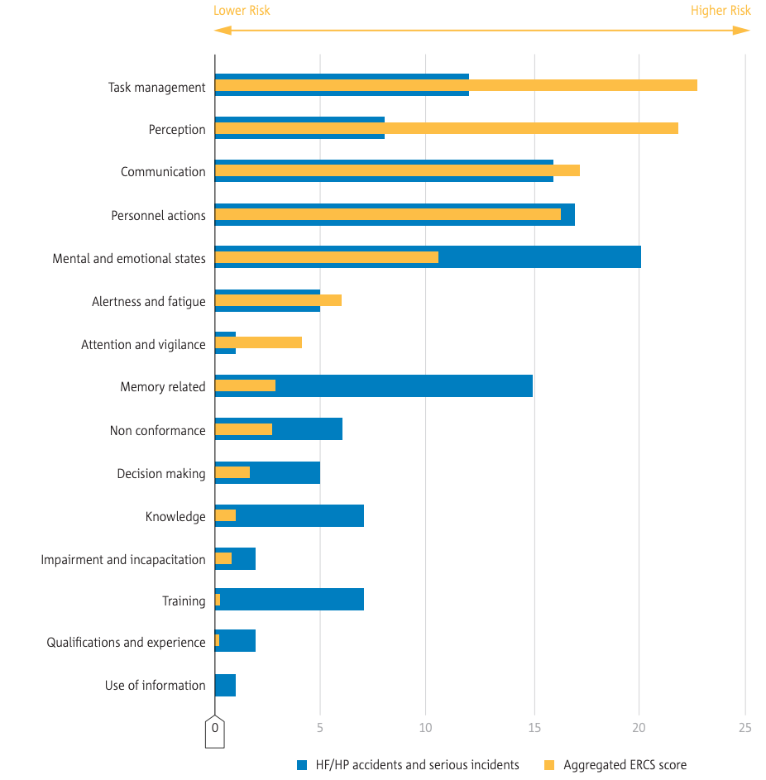
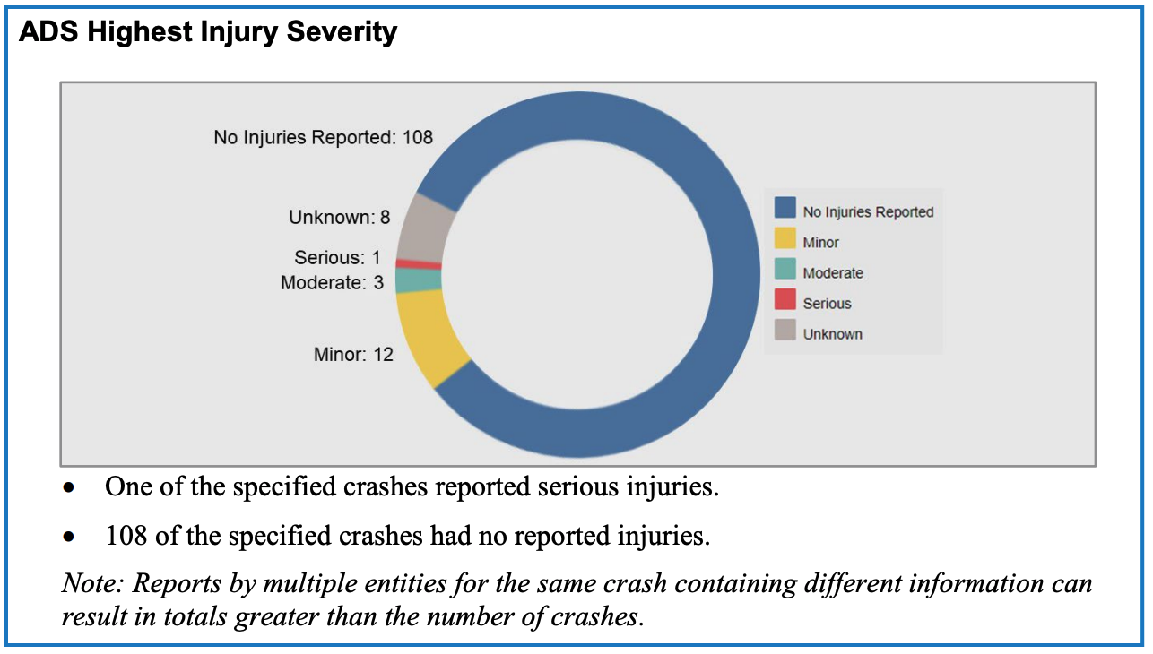
Aggregate data example
Factors, risk, and severity behind occurrences
Source: EASA Annual Safety Review; EASA, 2022;
Source: https://www.nhtsa.gov/sites/nhtsa.gov/files/2022-06/ADS-SGO-Report-June-2022.pdf
Notes:
In our meetings with companies involved in the process we found that the validation of the ADS is often viewed as performing simulation in very same environment used for development which shouldn’t be the case as validation is a completely different use case from development and has stricter requirements.

Slide 14

Thank you
riccardo.DONA@ext.ec.europa.eu
© European Union 2022
Unless otherwise noted the reuse of this presentation is authorised under the CC BY 4.0 license. For any use or reproduction of elements that are not owned by the EU, permission may need to be sought directly from the respective right holders.

