Slide 1
VMAD-SG3
Updates and next steps
VMAD-29-08
29th VMAD Meeting
27th February, 2023

Slide 2
SG3 updates
3 SG3 meetings since last VMAD#28 (19th Dec, 30th Jan, 24th Feb)
Guidelines on Audit, Assessment and ISMR
    Submitted with updates according to UK comments and proposals
    No other comments received by SG3 Members
Template on short term reporting (VMAD-SG3-24-06)
Template on periodic reporting (VMAD-SG3-26-02)
Guidance on SMS
Exchanges with EDR/DSSAD

Slide 3
Roadmap SG3
March 2023
Dec 2022
June 2023
Dec 2023
June 2024
SMS
Safety Assessment + comments China
Audit
Comments EC L4
ISMR (Reporting)
ISMR

Slide 4
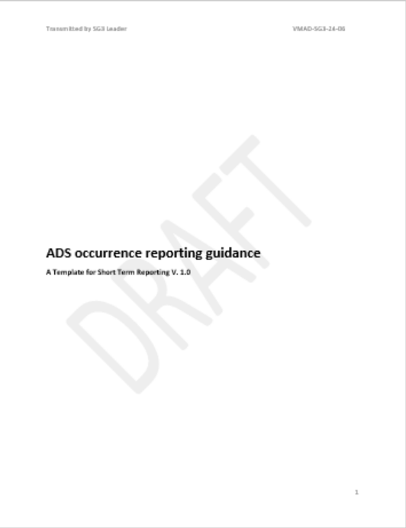
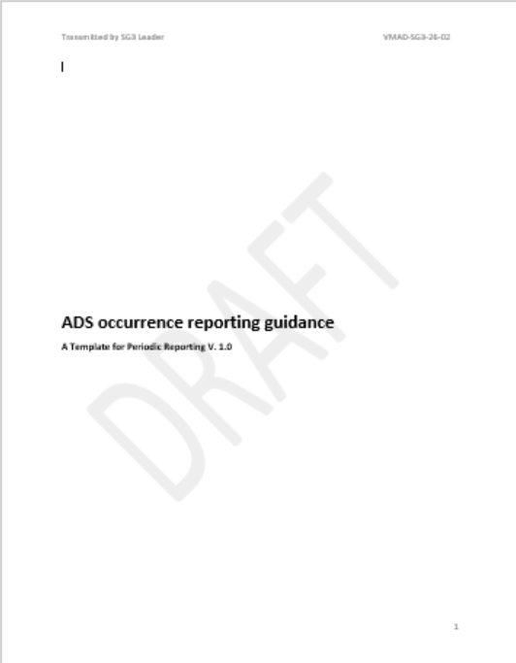
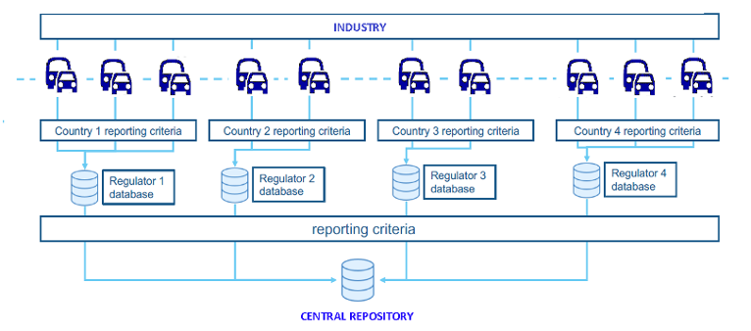
Data reporting
Short-term reporting:
  Reported information shall remain confidential (accessible to authorities only)
  Issue safety recommendations
Long-term reporting:
  Aggregated and anonymized data can be made public (e.g. annual report on AVs safety performance)
  Authorities will process data
Notes:
In our meetings with companies involved in the process we found that the validation of the ADS is often viewed as performing simulation in very same environment used for development which shouldn’t be the case as validation is a completely different use case from development and has stricter requirements.

Slide 5
Exchanges with EDR/DSSAD
Occurrence | Short-term reporting [1 Month] | Periodic Reporting [1 Year]
1.a. Safety critical occurrences known to the ADS manufacturer or OEM | X | X
1.b. Occurrences related to ADS operation outside its ODD | X | X
1.c. ADS failure to achieve a minimal risk condition when necessary | X | X
1.d. Communication-related occurrences |  | X
1.e. Cybersecurity-related occurrences |  | X
1.f. Interaction with remote operator if applicable |  | X
2.a. Driver unavailability (where applicable) and other user-related occurrences |  | X
2.b. Occurrences related to Transfer of Control failure |  | X
2.c. Prevention of takeover under unsafe conditions |  | X
3.a. Occurrences related ADS failure |  | X
3.b. Maintenance and repair problems |  | X
3.c. Occurrences related to unauthorized modifications |  | X
3.d. Modifications made by the ADS manufacturer or OEM to address an identified and significant ADS safety issue | X (if the issue presented an unreasonable risk to safety) | X
4. Occurrences related to the identification of new safety-relevant scenarios | X | X

Slide 6
Thank you
Notes:
Update/add/delete parts of the copy right notice where appropriate.
More information: https://myintracomm.ec.europa.eu/corp/intellectual-property/Documents/2019_Reuse-guidelines%28CC-BY%29.pdf

