Slide 1
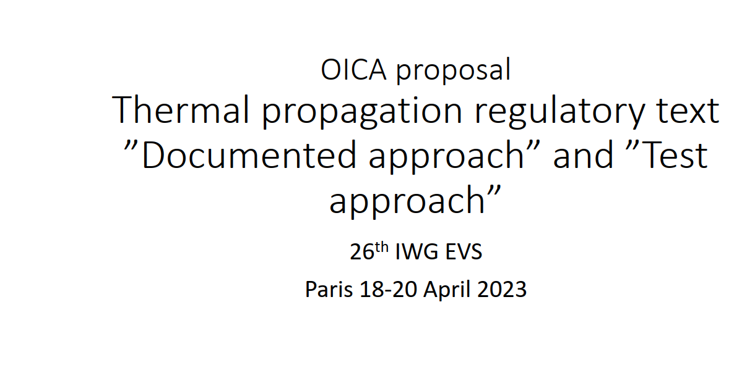
CA questions/comments

Slide 2
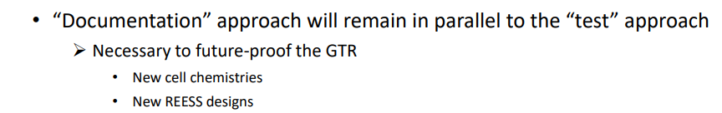
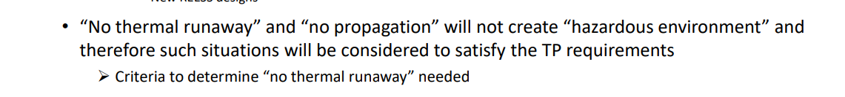
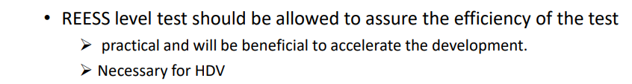
CA Comment – Agree with dual approach however need to ensure that both approaches have the same risk mitigation goals
CA Comment – Could you provide a proposal for “No Thermal Runaway”. In our view, a completely different test method and evaluation criteria are needed to validate No TR.
CA Comment – Equivalency between component and system level must be proven. Do you have suggestions (specifically the “hazardous environment” aspect)?

Slide 3
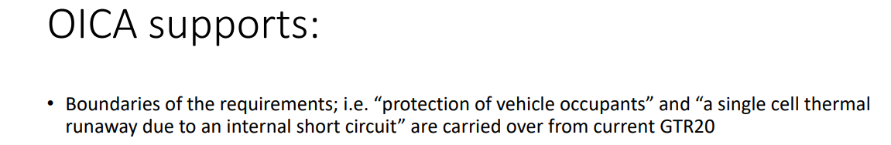
CA Comment – Task Force has identified Parking scenario as a risk that should be evaluated. Does this IWG have a mandate/time to evaluate Park condition within Phase II?
CA Comment – Please explain why the cause of thermal runaway is important.
CA Comment – Current round robin test campaign using the proposed GTR test method (rapid heating) will define the level for “sufficient”. This can then be expanded to other test methods (if approved).

Slide 4
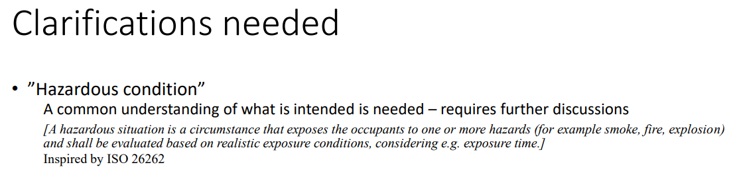
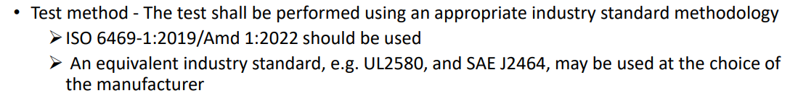
CA Comment – Agreed, clarifications are needed. A better definition is required for progress. What are the variables to be measured and their quantities. Can we look to environmental exposure limits defined for workplace health and safety? (WHO, OSHA, NFPA, ACGIH, NIOSH etc.)
CA Comment – How do you propose to measure/evaluate the equivalency of these?

