Slide 1
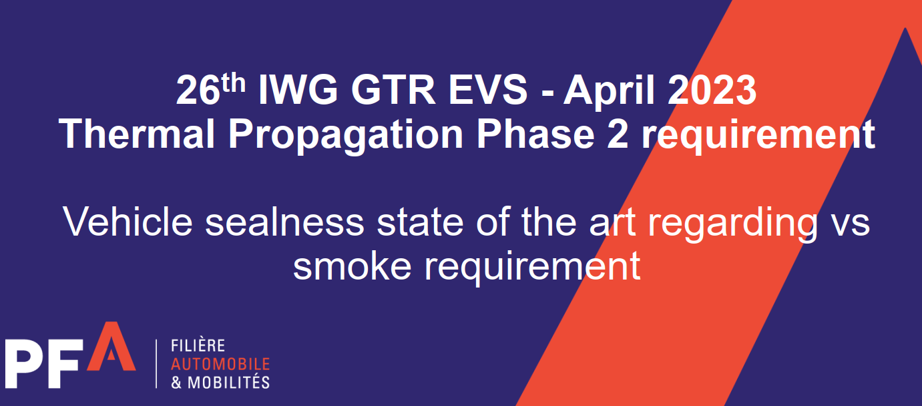
CA questions/comments

Slide 2
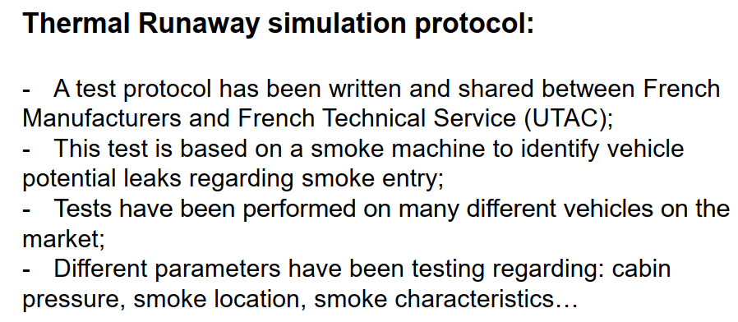
CA comments – Can you share/define this test protocol? You have indicated tests have been conducted on many different vehicles, Can you asses how smoke ingress into the cabin of a vehicle can be evaluated from a component level test.

Slide 3
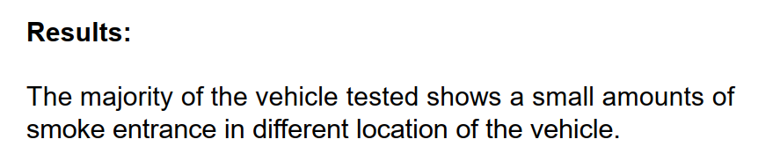
CA comments – Can you propose what an acceptable amount of smoke ingress is permissible.

