Slide 1
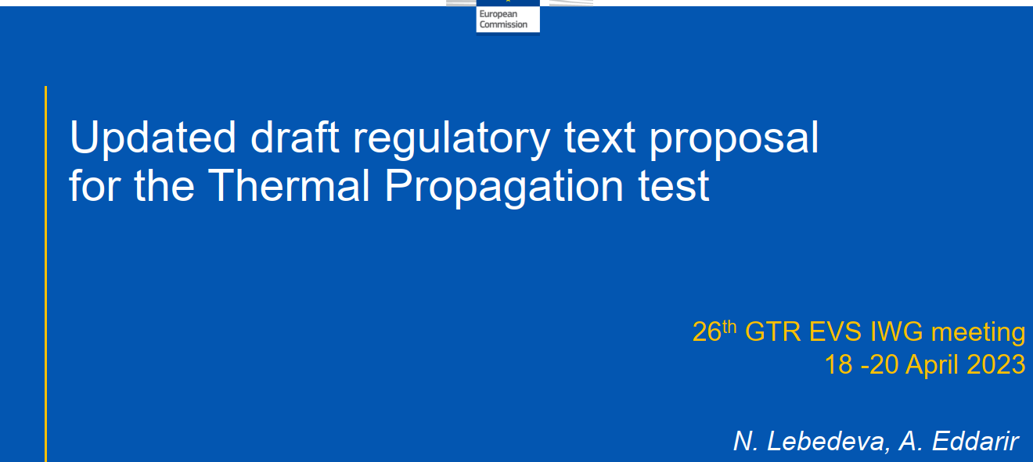
CA questions/comments

Slide 2
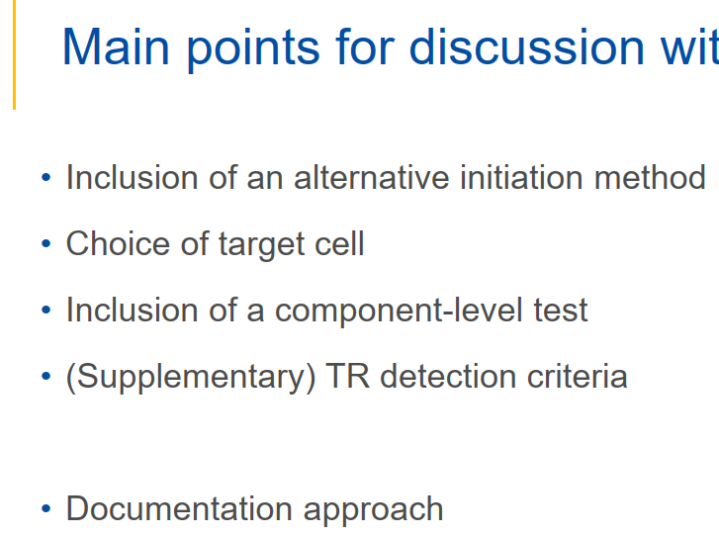
CA comments:
Inclusion – CA is not supportive of this at this stage. Contracting parties are currently planning to conduct round robin testing for the rapid heating method. The repeatability, reproducibility, and equivalency of any other alternative methods needs to be proven at the vehicle level. Given the timeframe of Phase 2, any additional initiation method could be moved to Phase 3.
Target – the choice of max number of nearest cells simplifies selection, but may require significant and unacceptable pack modifications in some designs. We propose a guidance document and discussions between test lab and OEM. This can not be simplified to stating one position as you must consider practical selection limitations (avoid disabling TMS, BMS etc..)
Component – At this point no one has demonstrated equivalency between component and vehicle level (specifically, assessment of hazardous condition for vehicle occupant).
TR detection should be improved.
Temperature overshoot of the heater and REESS pressure are strong indicators. Internal pack video could be beneficial
Documentation approach – see comments within OICA presentation

Slide 3
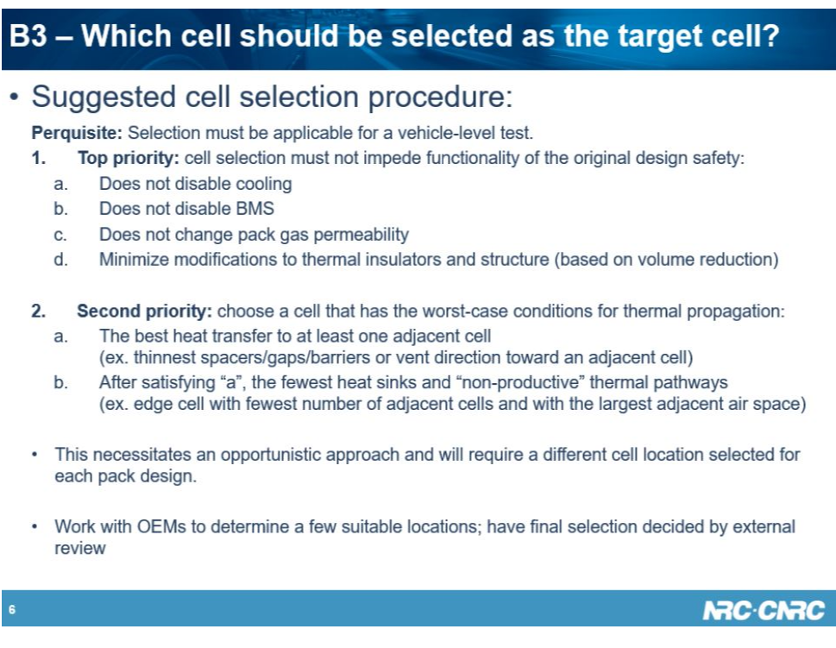
CA comments:
FROM EVS17-E1TP-0500
Target cell selection starts with eliminating cells that can not be used due to design/functionality
Then choose a cell based on neighbor cells and fewest heat sinks
This will not be the same for every battery pack

Slide 4
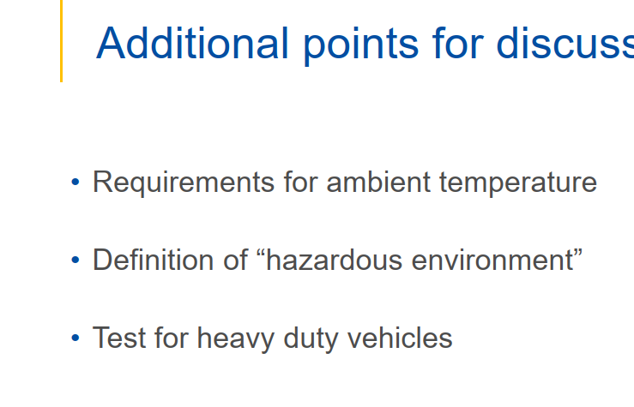
CA comments:
Ambient T – The key to TR/TP test is battery pack temperature, ambient (cabin) temperature is minor, and thus their acceptable ranges should be different.
We suggest:
- Ambient between 5 °C to 35°C could be acceptable.
- REESS between 18°C to max operating temp
(or narrower?)
Hazardous – the values between defining hazardous will vary jurisdictions to jurisdictions. CA wants to leave Paris with a game plan to define this within GTR. Is it simply to remove and rely on warning; if not what cabin gases and what concentration levels.
HD – Is cabin tenability the primary safety concern for TR/TP within HD vehicle? How can equivalency be validated for a component and vehicle level test?

