Slide 1
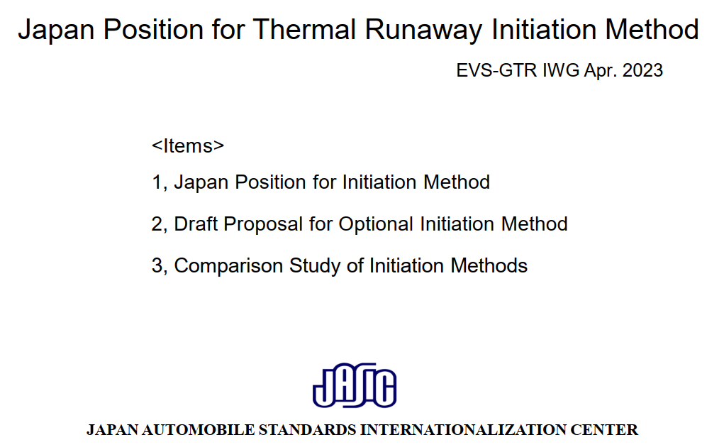
CA questions/comments

Slide 2
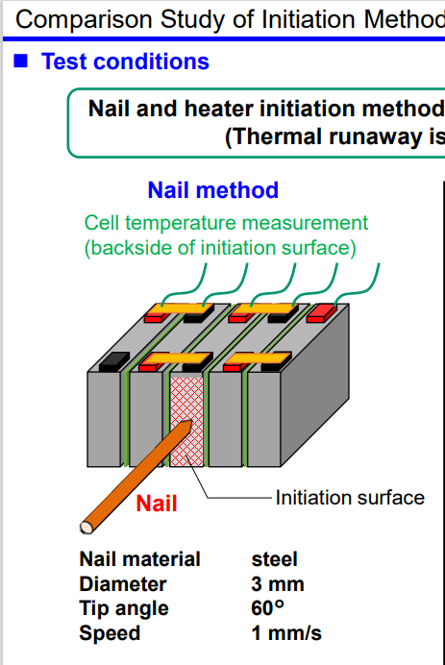
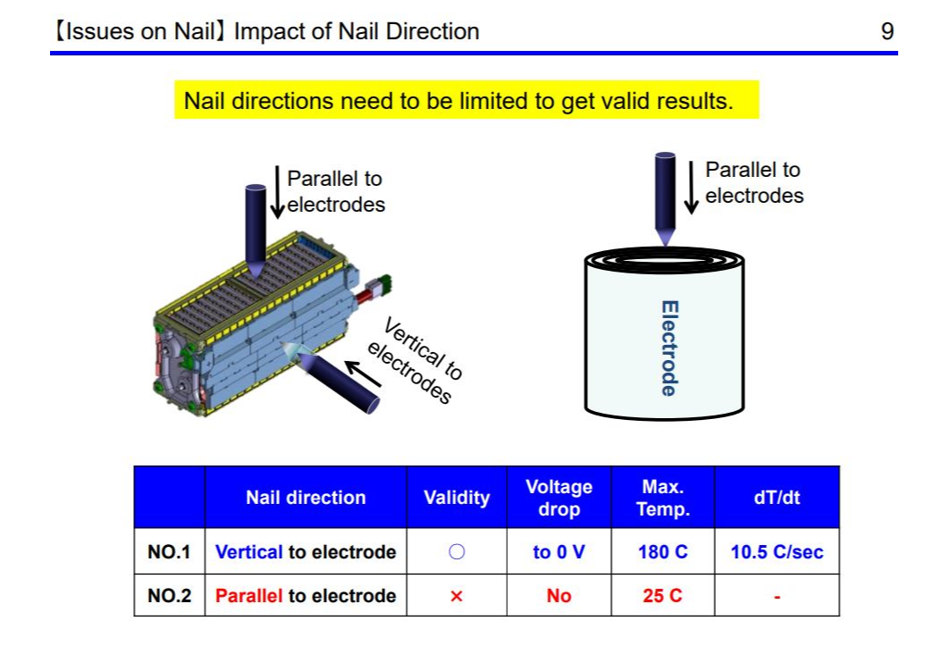
CA questions/comments – Can you confirm in what direction the nail hits the electrodes, especially since your previous work (EVS19-E1TP-0600) describes an important difference. In our experience the direction you show would be parallel to the electrode and you state that this is not valid.
From EVS19-E1TP-0600

Slide 3
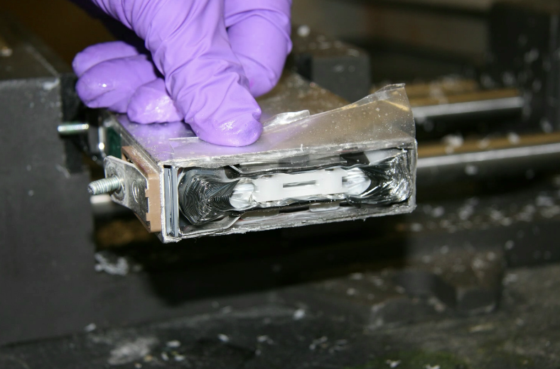
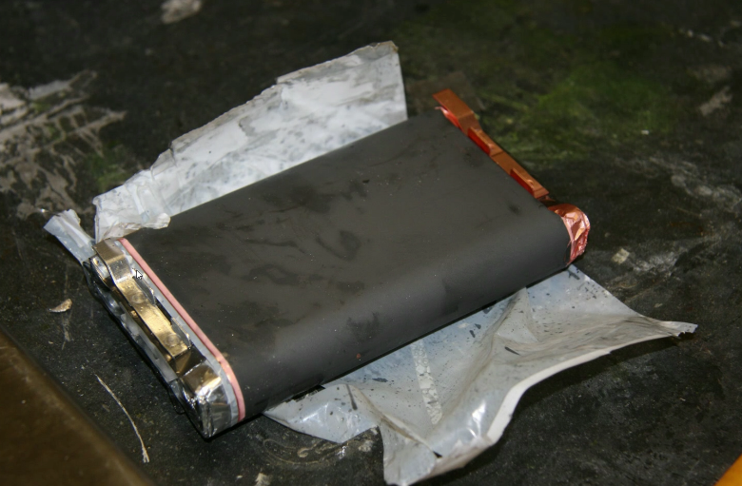
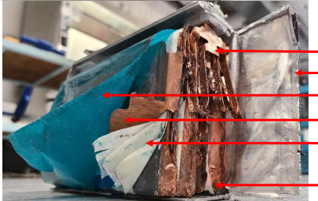
From EVS19-E1TP-0600
CA questions/comments – Sample of a variety of Prismatic cells. If a nail were to enter the cell as shown in previous slide it would do so parallel to the electrode which is not valid as per EVS19-E1TP-0600.

Slide 4
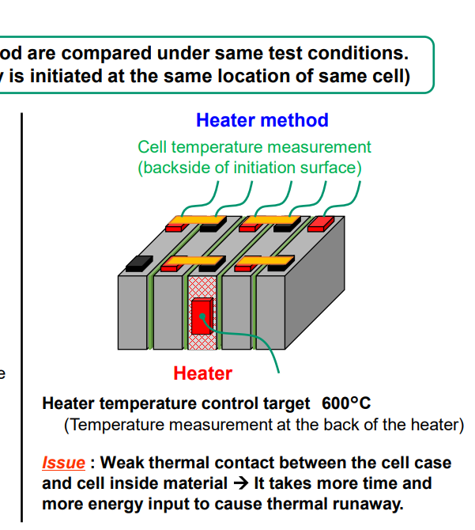
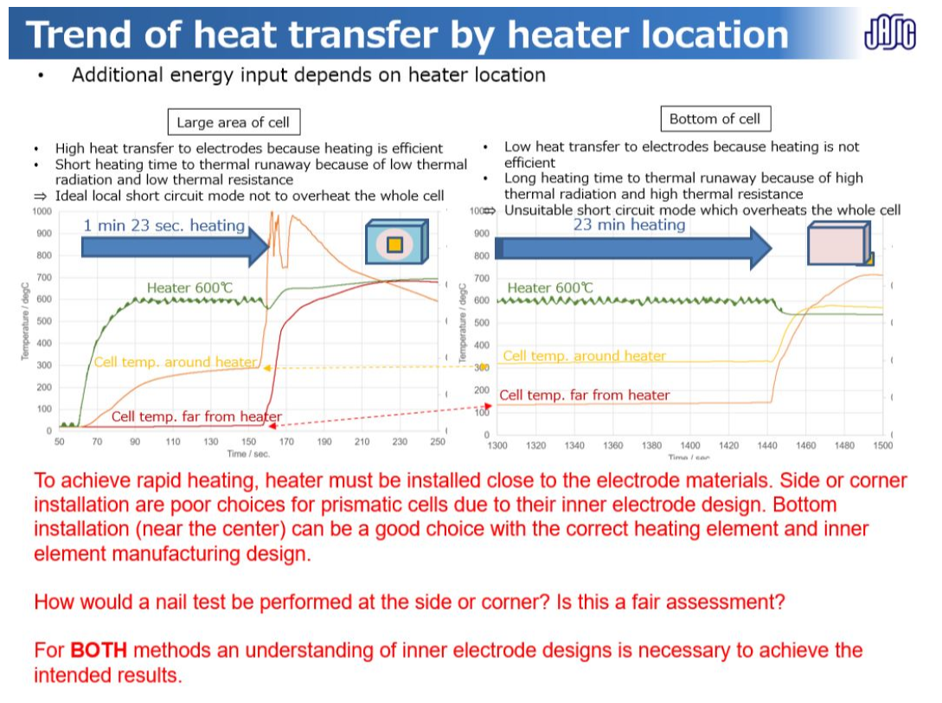
CA questions/comments – Your previous work (EVS21-E1TP-0101) shows that targeting the wrong face of the cell will not achieve the proposed test method of the GTR and is inappropriate. Please explain why you choose to use this location (and not the largest face) for your justification for a new method to be permitted.
JP Presentation
CA response during EVS21 in red

Slide 5
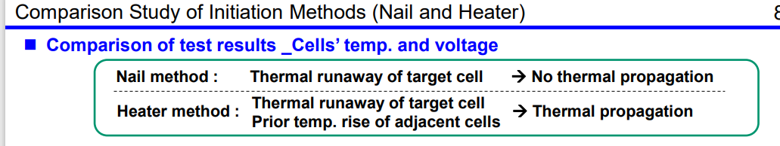
CA questions/comments – This test does not follow the guidelines of the rapid heating procedure of the GTR. Adjacent cells from the slow heating method applied rise to 90°C, which is much more than the max operating temperature for this pack. The guidelines of the GTR test are to heat the cell rapidly, input <20% energy and minimize neighbor cell temperature increase. None of these guidelines were met in this test.

Slide 6
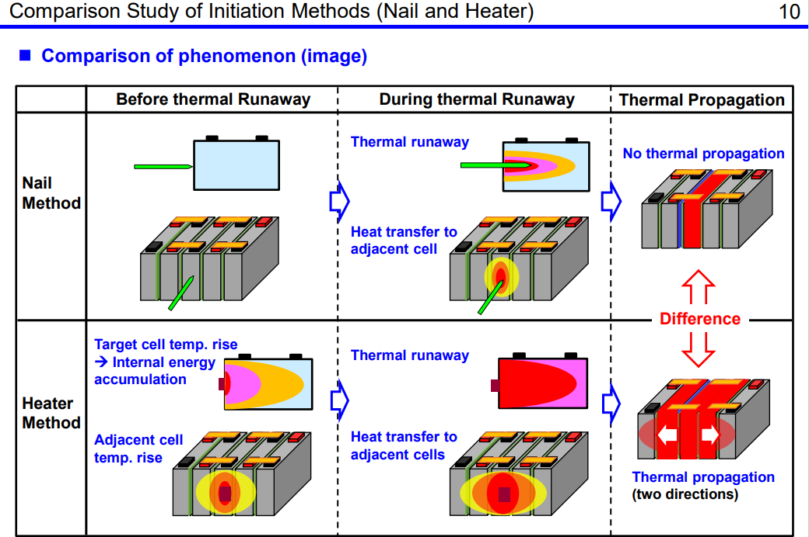
CA questions/comments – Please replace label in column 1, row 3 with SLOW Heater Method
In our opinions, this data can not be used to justify the use of another test method with GTR since the proposed test methodology was not followed. This is an excellent example as to why a slow heating approach can not be used with system level testing of EV when a single cell thermal runaway activation is the goal.

