Slide 1
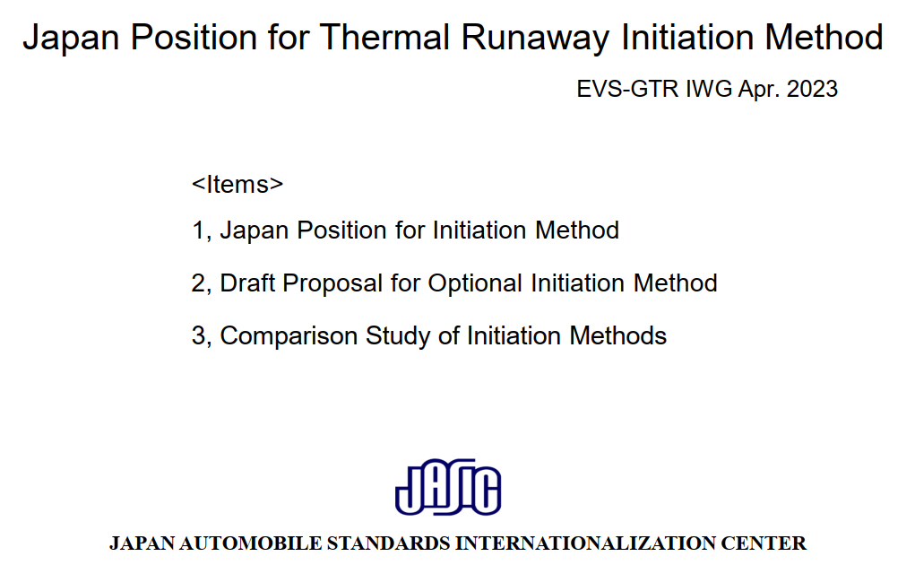
Japan’s reply to CA questions/comments

Slide 2
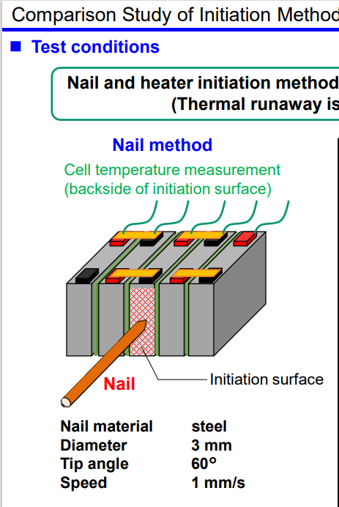
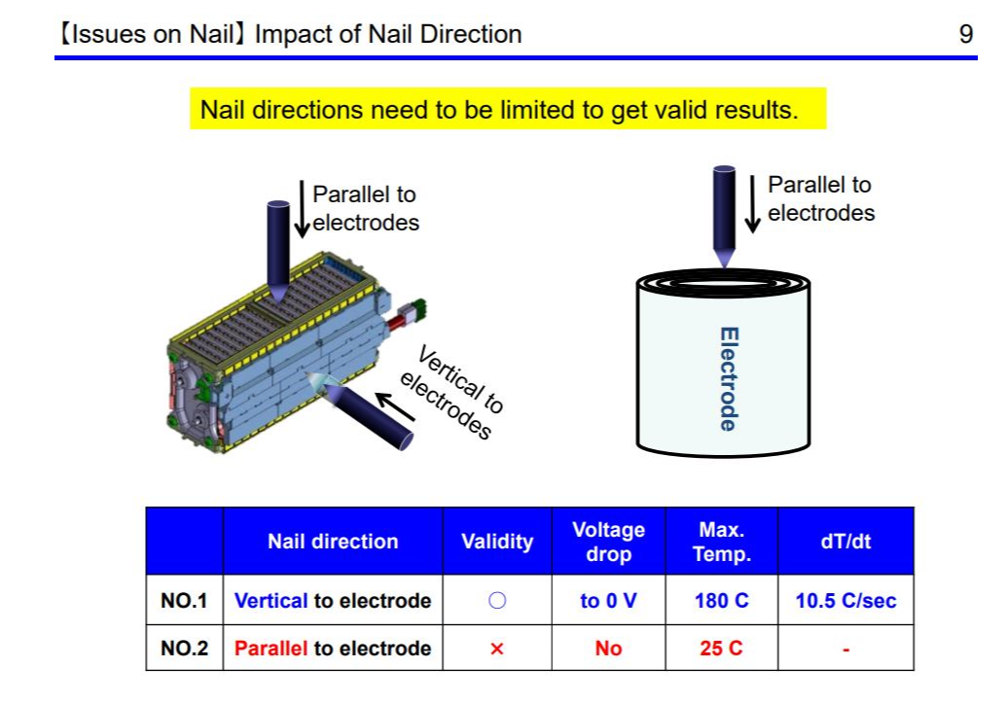
CA questions/comments – Can you confirm in what direction the nail hits the electrodes, especially since your previous work (EVS19-E1TP-0600) describes an important difference. In our experience the direction you show would be parallel to the electrode and you state that this is not valid.
From EVS19-E1TP-0600

Slide 3
CA questions/comments – Can you confirm in what direction the nail hits the electrodes, especially since your previous work (EVS19-E1TP-0600) describes an important difference. In our experience the direction you show would be parallel to the electrode and you state that this is not valid.
Japan’s reply to CA questions/comments –
In this test, the nail is inserted with a parallel direction to the electrode.
Based on our research and accumulated test data, we conclude that it is possible to cause thermal runaway on a target cell with nail penetration parallel to electrodes. The know-how is that the nail needs to aim at tightly stacked part of the electrode, not to aim at the center of the cell.
The nail can forcefully push into stacked electrodes and bridge between plus and minus electrodes. It creates cell internal short circuit and thermal runaway.
Parallel to electrodes
Center of cell
Tightly stacked part of electrode
From EVS19-E1TP-0600
Electrode

Slide 4
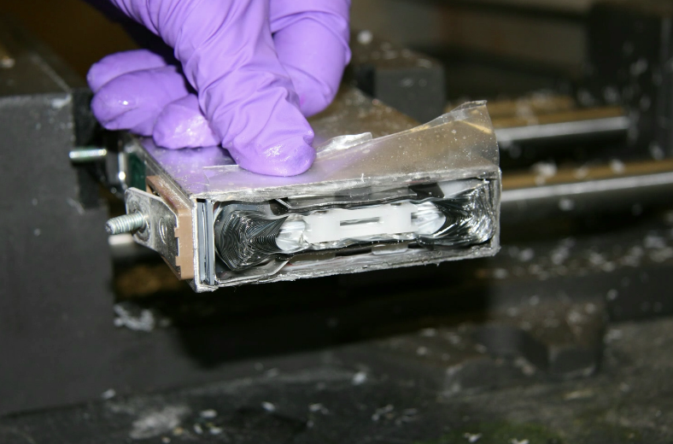
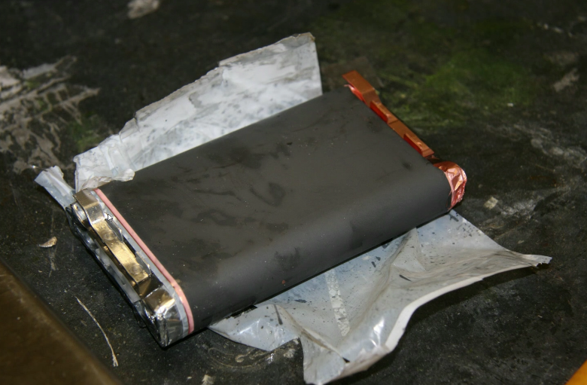
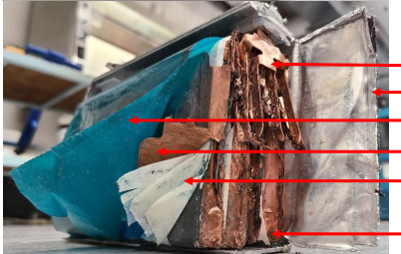
From EVS19-E1TP-0600
CA questions/comments – Sample of a variety of Prismatic cells. If a nail were to enter the cell as shown in previous slide it would do so parallel to the electrode which is not valid as per EVS19-E1TP-0600.

Slide 5
CA questions/comments – Sample of a variety of Prismatic cells. If a nail were to enter the cell as shown in previous slide it would do so parallel to the electrode which is not valid as per EVS19-E1TP-0600.
From EVS19-E1TP-0600
Japan’s reply to CA questions/comments –
If a method can cause target cell thermal runaway, regardless of a nail direction, it can be considered valid and available as an initiation method.

Slide 6
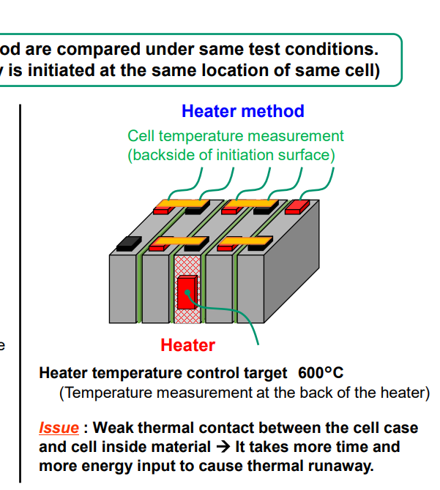
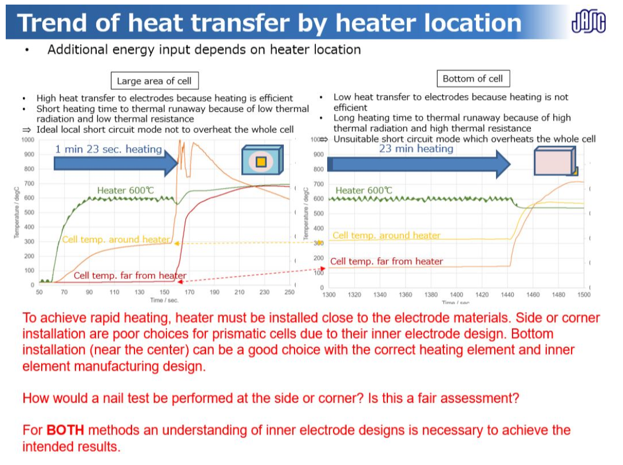
CA questions/comments – Your previous work (EVS21-E1TP-0101) shows that targeting the wrong face of the cell will not achieve the proposed test method of the GTR and is inappropriate. Please explain why you choose to use this location (and not the largest face) for your justification for a new method to be permitted.
JP Presentation
CA response during EVS21 in red

Slide 7
CA questions/comments – Your previous work (EVS21-E1TP-0101) shows that targeting the wrong face of the cell will not achieve the proposed test method of the GTR and is inappropriate. Please explain why you choose to use this location (and not the largest face) for your justification for a new method to be permitted.
JP Presentation
Japan’s reply to CA questions/comments –
The reasons why we choose a center cell and its side face for thermal runaway initiation are below;
1, The target cell selection goes along with GTR20;
23B.3.5. Selection of initiation cell
Select an initiation cell, which is accessible by the selected trigger method described in paragraph 23B.3.2. and also whose heat generated by thermal runaway is most easily conducted to adjacent cells. For example, select the cell that is the nearest to the center of battery casing or the cell that is surrounded by other cells which makes it difficult for the triggered cell to dissipate heat.
2, In a sense, the cell selection strategy in GTR20 seems to be a kind of worst-case scenario. In the case that thermal propagation happens, thermal runaway of cells can spread into two directions at the same time. And then, maximum number of cells that can reach thermal runaway in five minutes after warning is expected.
3, The test cell and module is a part of battery that is already applied in a vehicle model. There is no enough clearance between cells to install a heater. Then, installing a heater on the largest face of a cell is not a possible option to go along with GTR20 cell selection strategy.
CA response during EVS21 in red

Slide 8
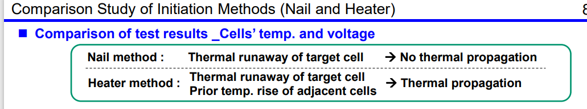
CA questions/comments – This test does not follow the guidelines of the rapid heating procedure of the GTR. Adjacent cells from the slow heating method applied rise to 90°C, which is much more than the max operating temperature for this pack. The guidelines of the GTR test are to heat the cell rapidly, input <20% energy and minimize neighbor cell temperature increase. None of these guidelines were met in this test.

Slide 9
CA questions/comments – This test does not follow the guidelines of the rapid heating procedure of the GTR. Adjacent cells from the slow heating method applied rise to 90°C, which is much more than the max operating temperature for this pack. The guidelines of the GTR test are to heat the cell rapidly, input <20% energy and minimize neighbor cell temperature increase. None of these guidelines were met in this test.
Japan’s reply to CA questions/comments –
I agree with you. Test conditions do not meet the guidelines in ISO6469-1.
By the way, do you have any rational for “<max operating temperature” and “<20% energy”?
According to our test results, “<20% energy” is difficult to achieve in the case of small energy prismatic cells with metal casing.
Do you have any specific idea about what should be done if “<max operating temperature” or “<20% energy” cannot be met? Does the battery need to be retested? What conditions or procedures need to be adjusted for the retest? Are you also going to make guidelines for the retest?
In terms of “low adjacent cell temperature increase” and “low additional energy input”, the nail method can meet these requirements inherently. We think that the nail method should be accepted if it can cause thermal runaway. What do you think about this?

Slide 10
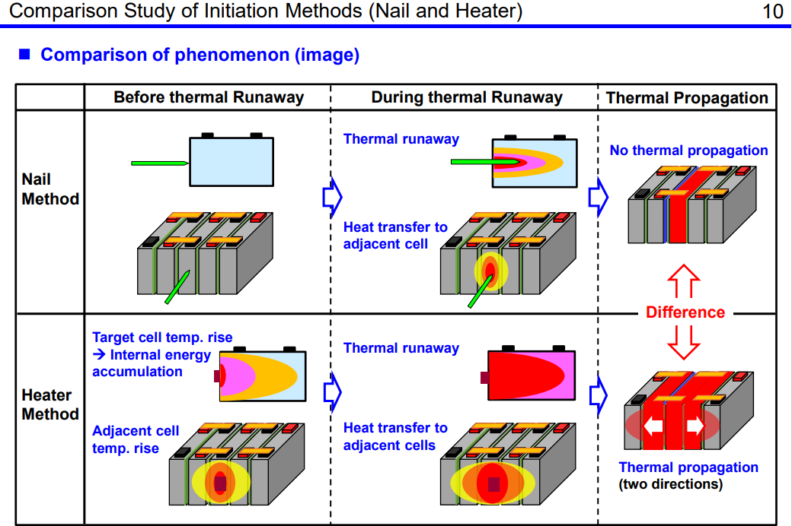
CA questions/comments – Please replace label in column 1, row 3 with SLOW Heater Method
In our opinions, this data can not be used to justify the use of another test method with GTR since the proposed test methodology was not followed. This is an excellent example as to why a slow heating approach can not be used with system level testing of EV when a single cell thermal runaway activation is the goal.

Slide 11
CA questions/comments – Please replace label in column 1, row 3 with SLOW Heater Method
In our opinions, this data can not be used to justify the use of another test method with GTR since the proposed test methodology was not followed. This is an excellent example as to why a slow heating approach can not be used with system level testing of EV when a single cell thermal runaway activation is the goal.
Japan’s reply to CA questions/comments –
In the first place, this figure is just an image of the comparison between the nail and heater method.
We do not mean to oppose to the heater method. Japan position is that both methods are effective for thermal runaway initiation. We just insist that other methods should also be accepted as long as they can cause thermal runaway at a trigger cell.
Though thermal runaway characteristics with the nail method are moderate, they may be closer to thermal runaway situation caused by a cell internal short circuit in the real world. Therefore, it can be considered sufficient and valid for safety evaluation of thermal propagation.
If the heater is one and only choice, there is possibility that excessive measures or design are required to pass the thermal propagation test.
Realistically speaking, other methods including the nail should be used depending on manufacturers’ requests. And, if thermal runaway does not occur with those other methods, the battery has to be retested with the heater method.

