Slide 1
Suggestions on Thermal Propagation Test
China
Apr. 2023

Slide 2
Contents
1、Thermal Propagation Initiation Method Discussion in EVS-GTR
2、The Suggestions Based on The Implementation Experience in China

Slide 3
1、Thermal Propagation Initiation Method Discussion in EVS-GTR

Slide 4
1.1 Background
Initiation method
The [main] initiation method for triggering thermal runaway during the thermal runaway propagation test is localised rapid external heating.
The trigger method applies a high-powered heat pulse, locally, to the external surface of one - initiation - battery cell within the REESS via an external heater with minimal increase in temperature of the adjacent battery cell(s) prior to thermal runaway within the target cell. The increase of temperature of adjacent cell(s), prior to thermal runaway in the target cell, shall remain below the maximum operating or storage temperature (whichever is higher) for the REESS.
In the current regulation draft, localized rapid external heating from ISO 6469-1 AMD1:2022 is the only mentioned initiation method
Question in EVS-GTR:
Do you think alternative method are necessary ?
If alternative method is necessary, what’s the relationship of this method?
  Equivalent options
  Main method and alternative method

Slide 5
1.2 Content
Every initiation method has its advantages and disadvantages, suitable for different types of cells and structures. So ISO 6469-1 AMD:2022 proposed several initiation methods.
Rapid External heating can effectively trigger thermal runaway of the battery, but in some cases, other methods may have more advantages
We suggest that alternative initiation methods such as nail penetration and internal heating in ISO 6469-1 AMD:2022 are necessary

Slide 6
2、The Suggestions Based on The Implementation Experience in China

Slide 7
2.1 Overall situation
China’s mandatory traction battery standard（GB 38031-2020） includes thermal propagation test requirements in coordination with GTR 20 Phase 1, which has been enforced for more than 2 years. According to the feedback after implementation, there have been over 1000 products were tested at the testing agency, the current test method is basically enforceable and repeatable for various types of RESS.
The standard allows manufacturers to choose the vehicle level or component level test. However, all mandatory tests are carried out at the component level so far.
Among the 150 projects in the statistics, 129 (86%) used external heating method and 21 (14%) used penetration method.

Slide 8
2.2 Suggestions
It’s suggested to allow the manufacturers to choose vehicle level test or component level test, because:
1. Component level testing can meet the purpose of safety verification of products.
2. The cost of vehicle level testing is much higher than that of component level testing.
More complex experimental preparation and longer testing time
More expensive sample costs
Higher laboratory requirements (larger space, higher environmental requirements, higher safety protection requirements, etc.)
3. It is difficult to fulfill more than 600 products mandatory test needs, lack of enough test capability will be a significant problem in actual implementation.

Slide 9
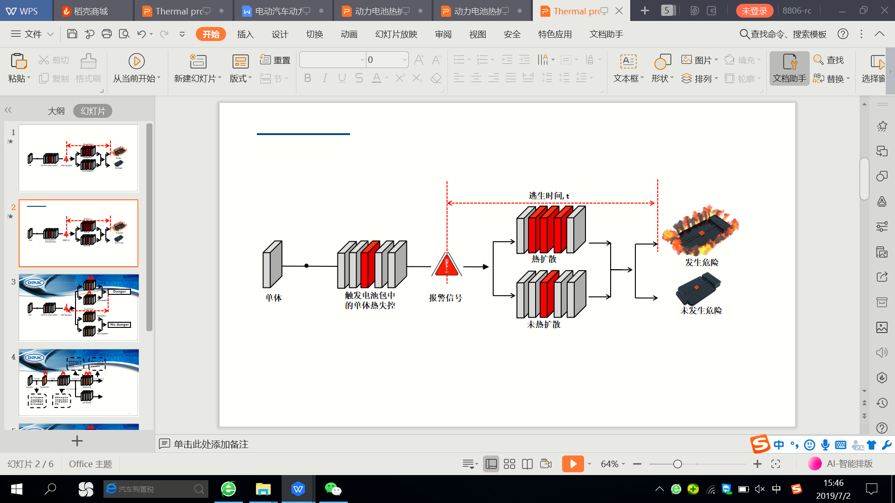
2.2 Suggestions
About the egress time
Egress time，t
t ＜ X
：Fail
t ≥ X
：Pass
TP
Danger
Target cell
Trigger TR in the pack
Warning signal / TR detected
：Pass
No danger
No TP
Note：
Choose the shorter one of the two situation (Warning signal →Danger, TR detected→Danger) as the egress time. This is to avoid the possible cheating caused by the failure of TR triggering or the continuous heating after the REESS sends out the warning signal.
X is the necessary egress time.

Slide 10
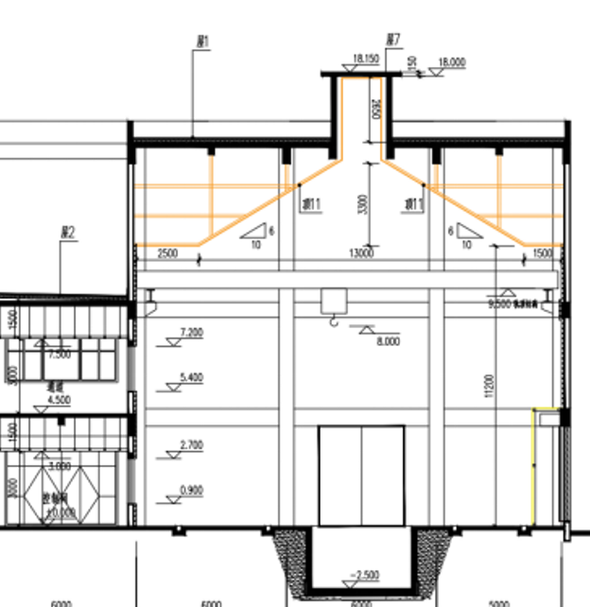
2.3 Experience
Test lab
Connect to the smoke exhaust and post-treatment system
Test lab: for vehicle and RESS
20m*20m*15m
L*W*H
Among them, sufficient laboratory height can ensure that smoke does not affect the observation
If the laboratory space is too small and the smoke exhaust is not sufficient, there is a high risk of explosion
Control and observation room

Slide 11

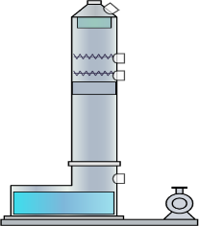
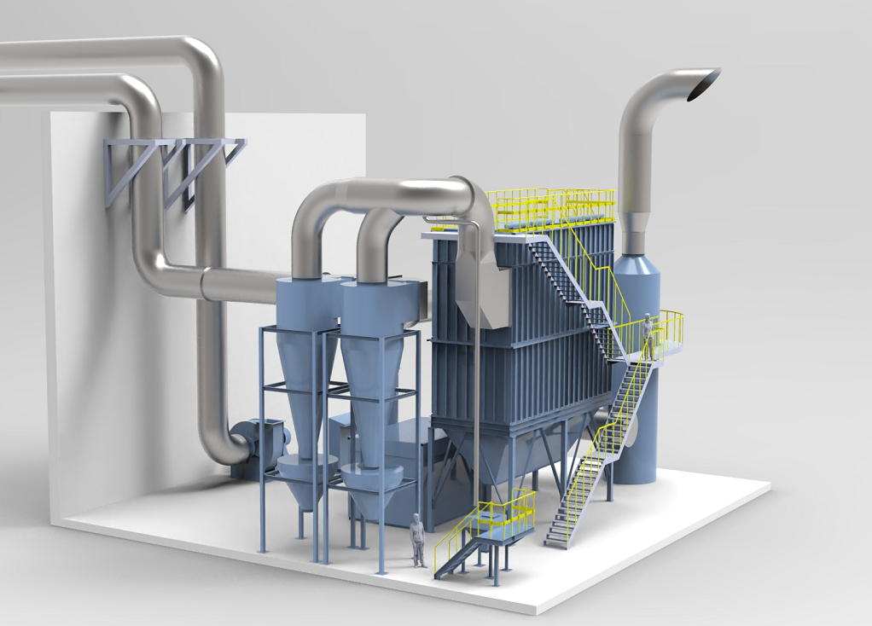

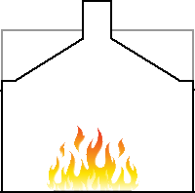

2.3 Experience
Smoke exhaust and post-treatment system
Accident fan
Dust collector
switching air valve
60000m³/h
switching air valve
switching air valve
cyclone separator
No.1
Deodorization tower
Induced draft fan
muffler
cyclone separator
No.2
CO₂Fire extinguishing equipment
Lab 1
Lab 2
Powder supply device
Machine | cyclone separator | Powder supply device | Dust collector | CO₂ Fire extinguishing equipment | Induced draft fan | Deodorization tower
function | Equipment that generates centrifugal force in the exhaust gas to separate dust from the exhaust gas and prevent dust from flowing into subsequent devices. | A device that uses a blower to press the filtering auxiliary material (zeolite powder) into a bag filter, providing protection by adding inert powder to the surface of the filter screen. Purpose of inert powder protection: ① Improve filtration efficiency. ② Protect the filter screen. | A device that attaches dust from exhaust gas to the surface of the filter screen through 360 filter screens (cylindrical filter bags) suspended in the dust collection equipment. The dust adhering to the surface of the filter screen is blown into the bottom ash hopper by high-pressure gas backwashing method, and finally discharged into the designated storage tank by a screw propeller and a rotary discharge valve. | A device that suppresses the occurrence of a fire on the filter screen when there is an abnormal increase in exhaust gas temperature. When the temperature rises abnormally, the dust collector will immediately stop running and close the pneumatic fire dampers at the inlet and outlet of the dust collector, injecting CO2 gas into the interior of the dust collector. | Provide the main fan with the required air volume for various operating modes. The motor adopts a frequency conversion starting method and adjusts the air volume through the opening of the electric air valve. | Inhalation and deodorization of odor molecules contained in exhaust gas.

Slide 12
Summary
Alternative initiation methods such as nail penetration and internal heating in ISO 6469-1 AMD:2022 are necessary.
China's mandatory testing has been conducted for over 2 years, with over 1000 products.
Providing both vehicle and component level testing options is necessary for actual implementation.
Method for calculating safe escape time is necessary for the implementation of the test.
The thermal propagation testing lab needs to be designed in terms of safety and environmental protection.

Slide 13
Thank You

