Slide 1
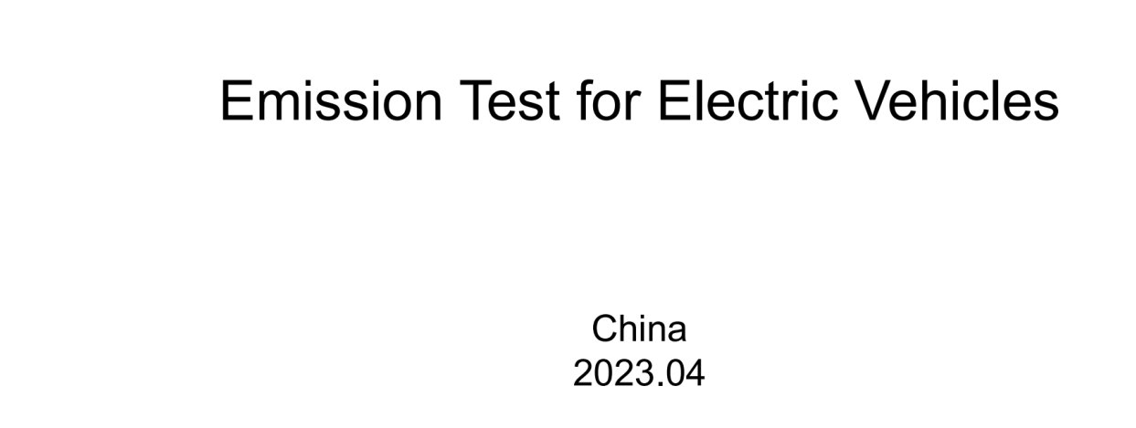
CA questions/comments

Slide 2
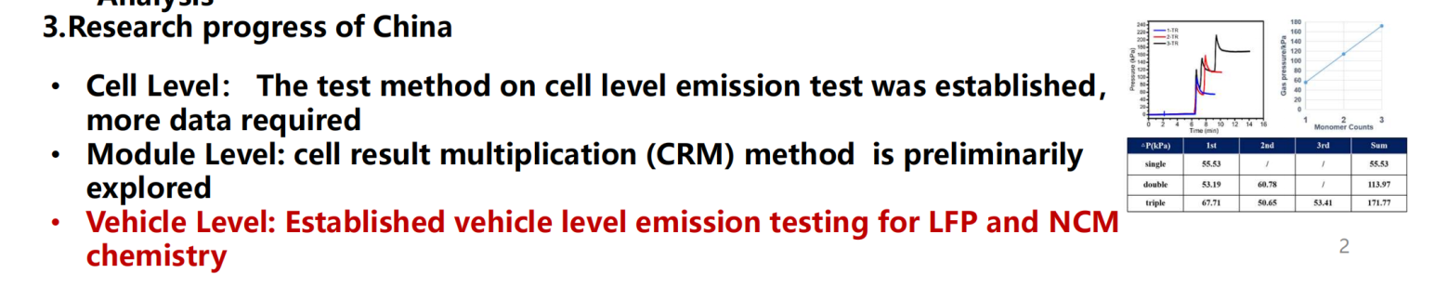
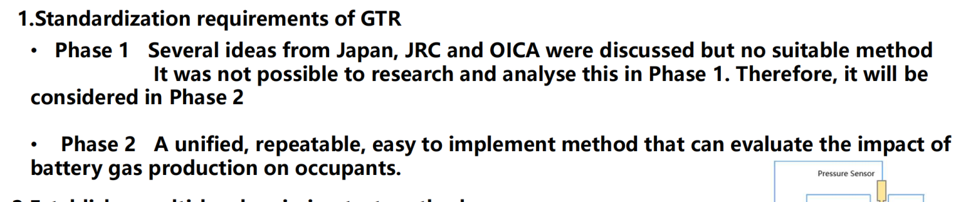
CA - Please Explain what CRM method is and how it is applied
CA- For Phase 2 – Please use the proposed test methodology (including thermostatic closed-loop heating) from current discussion as these “emissions” are from Thermal runaway of cells.
CA - General Note – The authors should not be stating these are vehicle emissions, these are emissions from the TR of battery cells. If no TR there is no emission.

