Slide 1
GRE
IWG
SLR
Transmitted by GRE-IWG SLR
Informal document GRE-88-xx
(88th GRE, 25-28 April 2023,
agenda item 4)
SLR-61-07
Simplification of the UN Lighting and Light-signalling Regulations
Progress report
to GRE-88

Slide 2

- Workload and meeting pace -
  11 September 2014 in Brussels (BE)
  23 October 2014 in Geneva (CH)
  14 January 2015 in Brussels (BE)
  13 April 2015 in Geneva (CH)
  13 October 2015 in Brussels (BE)
  5-6 November 2015 in Brussels (BE)
  15-16 December 2015 in Brussels (BE)
  13-14 January 2016 in Brussels (BE)
  29 February & 1 March 2016 in Brussels (BE)
  14-15 April 2016 in Brussels (BE)
  9-10 June 2016 in Brussels (BE)
  5-7 September 2016 in Brussels (BE)
  5-7 October 2016 in Brussels (BE)
  5-7 December 2016 in Brussels (BE)
  21-23 February 2017 in Brussels (BE)
  22-24 March 2017 in Brussels (BE)
  16-18 May 2017 in Tokyo (JP)
  13-15 June 2017 in Brussels (BE)
  12-14 July 2017 in Brussels (BE)
  4-6 October 2017 in Brussels (BE)
  18-21 December 2017 in Brussels (BE)
  29 Jan / 1 Feb 2018 in Shenzhen (CN)
  4-6 April 2018 in Brussels (BE)
  30 May / 1 June 2018 in Brussels (BE)
  3-5 July 2018 in Brussels (BE)
  24-26 September 2018 in Brussels (BE)
  10-12 December 2018 in Brussels (BE)
  25-27 February 2019 in Brussels (BE)
  27-29 March 2019 in Brussels (BE)
  22-24 May 2019 in Brussels (BE)
  3-5 July 2019 in Brussels (BE)
  3-5 September 2019 in Tokyo (JP)
  9-11 October 2019 in Brussels (BE)
  4-6 November 2019 in Brussels (BE)
61 meetings
  11-13 December 2019 in Brussels (BE)
  8-10 January 2020 in Brussels (BE)
  2-4 March 2020 in Brussels (BE)
  27-29 May 2020 – WebEx
  7-10 July 2020 – WebEx
  26-28 August 2020 – WebEx
  21-23 September 2020 – WebEx
  3-5 November 2020 – WebEx *
  9-11 December 2020 – WebEx *
  12-14 January 2021 – WebEx *
  17-19 February 2021 – WebEx
  24-26 March 2021 – WebEx
  10-12 May 2021 – WebEx
  16-18 June 2021 – WebEx *
  20-22 July 2021 – WebEx *
  9-10 September 2021 – WebEx *
  6-8 October 2021 – WebEx
  15-17 December 2021 – WebEx
  19-21 January 2022 – WebEx
  23-25 March 2022 – WebEx
  18-20 May 2022 – Brussels (BE) *
  27-29 June 2022 – Brussels (BE) *
  15-16 September 2022 – Karlsruhe (DE) *
  12-14 October 2022 – Brussels (BE)
  14-16 December 2022 – Brussels (BE)
  18-20 January 2023 – Brussels (BE)
  22-24 March 2023 – Brussels (BE)
Next meetings (Hybrid sessions from Brussels):
SLR-62 from 26 to 28 June 2023
SLR-63 from 30 August to 1 September 2023
* = In conjunction with a special SLR session on “headlamp levelling” (https://wiki.unece.org/pages/viewpage.action?pageId=113345289)

Slide 3

SLR submission to GRE-88
“Headlamp levelling” to introduce a new aiming diagram and to allow manual levelling only for off-road vehicles
ECE/TRANS/WP.29/GRE/2020/8/Rev.3 → New 09 series of UN Regulation No. 48
“Device transition” to enable the phasing out of the installation of older lamps/devices
ECE/TRANS/WP.29/GRE/2023/3 → Draft proposal for UN Regulation No. 48.09
ECE/TRANS/WP.29/GRE/2023/4 → Draft proposal for UN Regulation No. 53.04
ECE/TRANS/WP.29/GRE/2023/5 → Draft proposal for UN Regulation No. 74.03
ECE/TRANS/WP.29/GRE/2023/6 → Draft proposal for UN Regulation No. 86.03
Notes:
A complete package of 12 documents will be discussed at GRE-85 in October 2021. This will include:
a presentation of the main changes (3 informal documents)
a consolidated text for each of the draft 01 series of amendments to the new device Regulations No. 148, 149 and 150 (3 formal proposals)
all the installation Regulations (R48, R53, R74, R86) will be amended to introduce references to the headlamp Classes in the 01 series of amendments to Regulation No. 149 (6 formal proposals)
This has been a huge challenge for GTB and its WGs which have heavily contributed to this work since “Day #1”

Slide 4
Stage 2 / Step 2
Specific items and general topics for consideration
THE GOAL:
“Simplify and update the technical requirements of the UN installation Regulations (Nos. 48, 53, 74, 86), to become technology neutral with performance-based and objective test requirements”.
SLR produced a list of specific items and general topics that should be dealt with in “Stage 2 / Step 2” of the Simplification. For example, the following subjects are considered as relevant ones:
  Simplify and improve the definition of apparent surface
  Objective assessment of the actual functions as installed on the vehicle
  Harmonise requirements with other regions where possible
  Consistency among similar requirements and definitions in installation regulations
  The complete list is available in doc. SLR-52-03/Rev.8. Having completed the collection from CPs and NGOs, inputs have been grouped and prioritised by assigning different colours and a brief “problem statement” has been indicated for each subject.
  Need input from CPs and NGOs on contents of the specific items

Slide 5
Apparent surface – Problem statement
UN Regulation No. 48, Annex 3, Part 5, Example 1
Such examples may not always cater for the current designs

Slide 6
Apparent surface – Problem statement
Main applications of apparent surface:
Edges of the functions,
Distance between lamps,
Single lamp definition,
Areas where requested,
Geometric visibility
Two different methods to determine the apparent surface:
Light emitting surface
Illuminating surface
Need to provide a level playing field without very significant differences depending on the definition used to determine the apparent surface
Need to simplify the current system
Be as close as possible to reality, but without unnecessary complications.

Slide 7
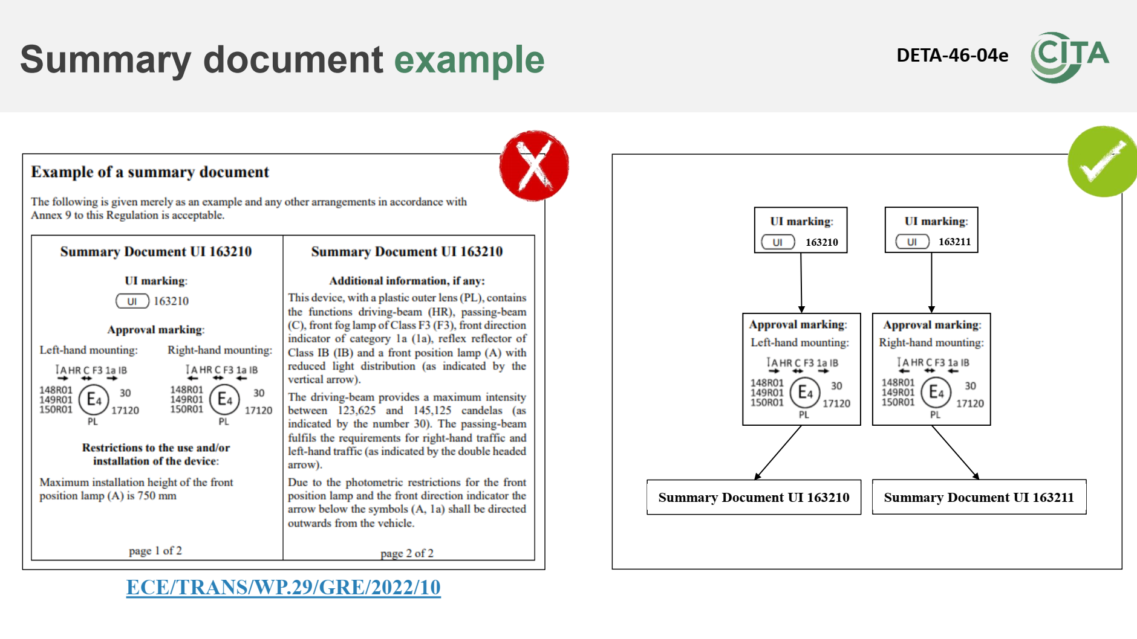
DETA and the UI
“Summary document” for supporting the Unique Identifier (UI)
ECE/TRANS/WP.29/GRE/2022/10 → Suppl. to UN Regulation No. 148.01
ECE/TRANS/WP.29/GRE/2022/11 → Suppl. to UN Regulation No. 149.01
ECE/TRANS/WP.29/GRE/2022/12 → Suppl. to UN Regulation No. 150.01
Outcome of SLR-61:
Instead of issuing two UIs for left and right units, a possible alternative could be to use only one UI and to add the arrow indicating right or left.

Slide 8
DETA and the UI
DETA-45-07/Rev.1
“to provide clarity on UI to support a uniform implementation across the UN Regulations and the CPs”
The GRs are invited to review the list of regulations under their purview (listed in WP.29/343/Rev.31). This list, once finalize and approved, could provide an overview to the stakeholders, when UI can be used.
Use GRE reference once available

Slide 9

Input from CPs and NGOs is always welcome
Please feel free to join!

