Slide 1

37th Session
Status Review and Session Orientation
Document FRAV-37-03
Web Conference
20-21 February 2023

Slide 2
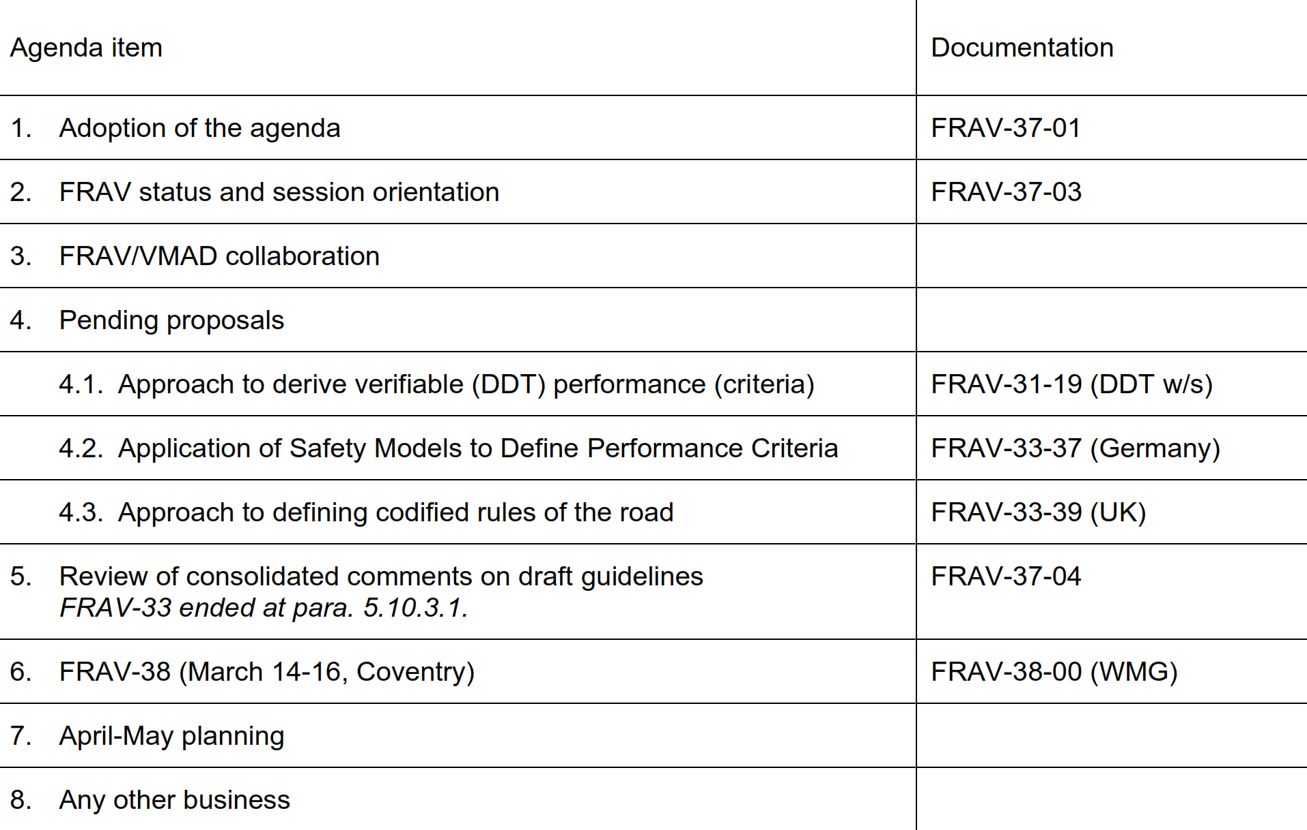
Agenda item 1
Adoption of the agenda

Slide 3
FRAV status
Review of consolidated table of proposals → GRVA May submission
  Skipped over 1.5.6.-1.8.5.
  Session 36 review ended at para. 5.10.3.1.
  Aim to complete review by end of March session (FRAV-38), including proposals to resolve open issues.
Need decisions on handling of components for establishing verifiable criteria for DDT assessments
  Scenario generation and coverage
  Establishment of valid behavioural competencies
  Processes for traffic-rule analysis (application to scenarios and competencies)
  Establishment of safety models and use in assessments
FRAV/VMAD collaboration on joint guidelines

Slide 4
FRAV/VMAD collaboration

Slide 5
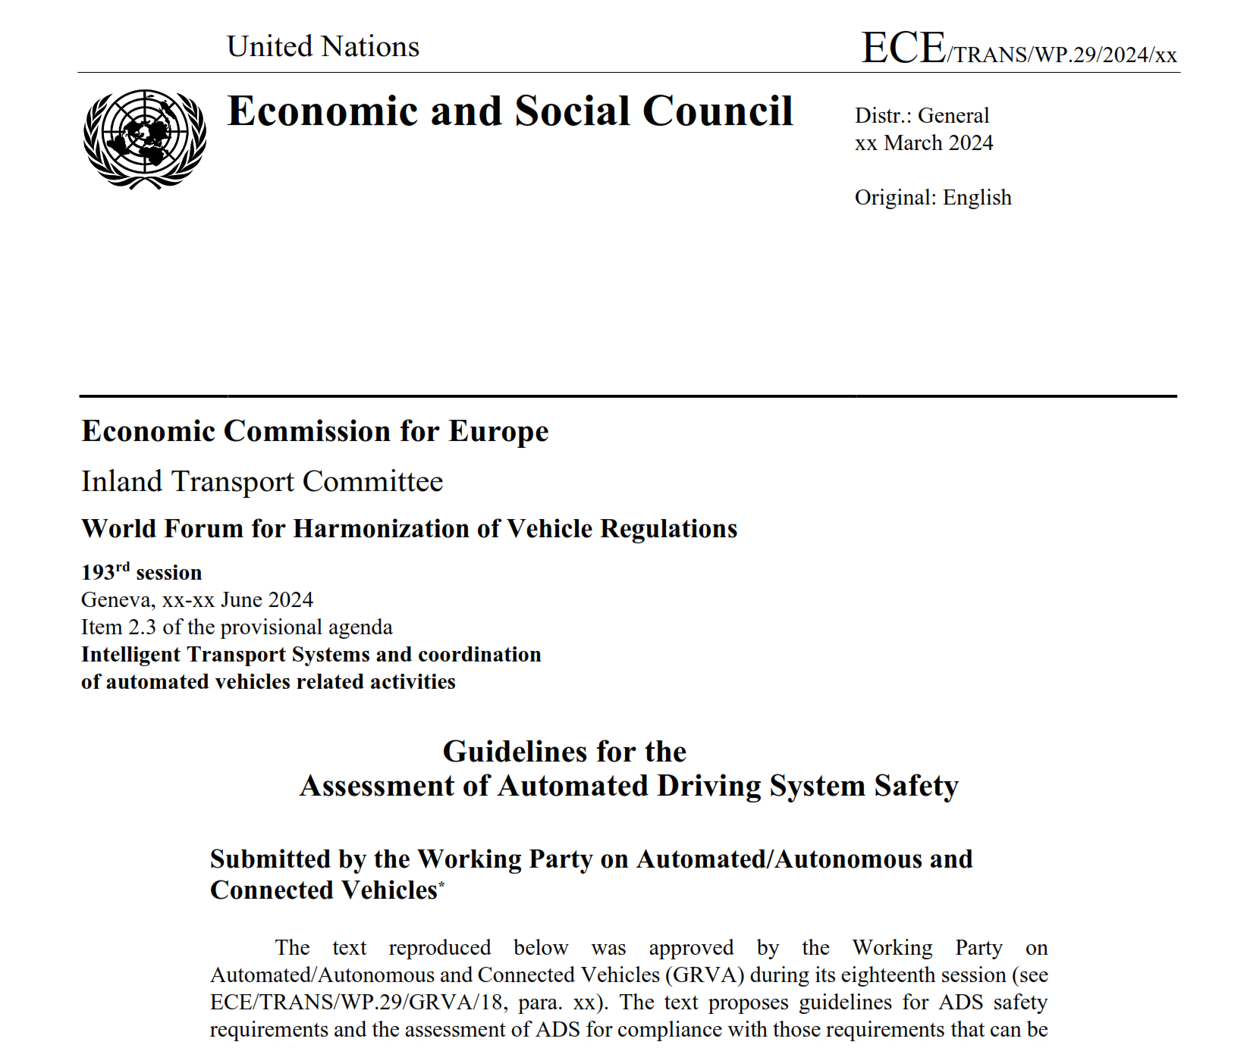
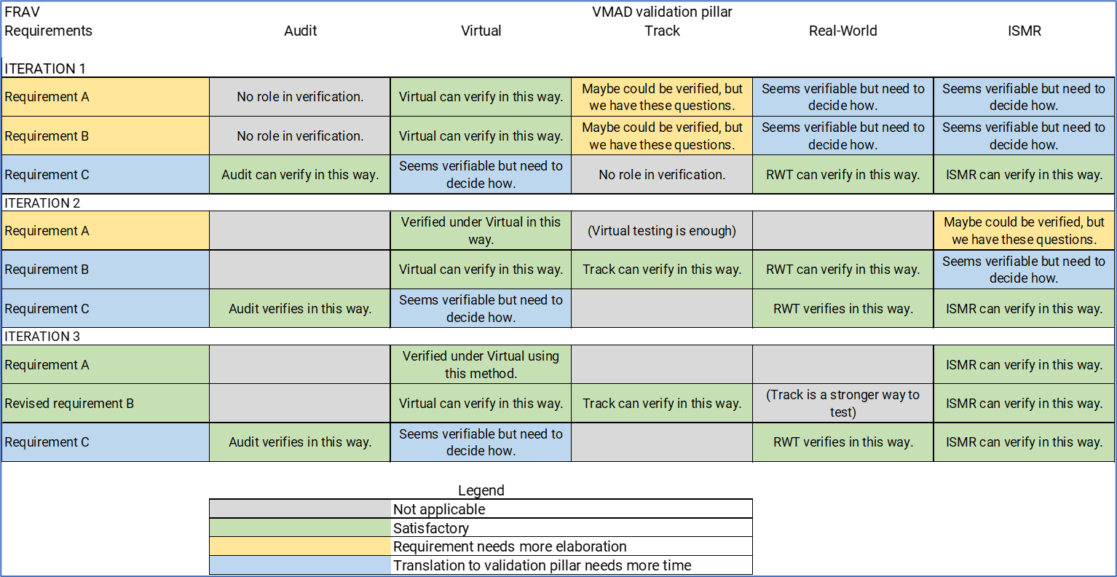
FRAV/VMAD joint guidelines

Slide 6
First step: Small working group
Which requirements are, at this stage, sufficiently described to be used for each of the validation pillars
Which requirements need more elaboration for using one or more of the validation pillars
Which validation pillars need further development for validating the related requirement
Which validation pillars are sufficiently described to apply for the related requirement
As far as possible/needed, the boundaries for the requirements and validation methods for this first iteration
Discussion items for FRAV, VMAD or GRVA to be resolved in order to allow further execution of the first iteration

Slide 7
Delivery calendar
June 2024: Formal WP.29 consideration of ADS guidelines
March 2024: Deadline for formal submissions to June WP.29 session
January 2024: GRVA consideration and approval of guidelines
November 2023: FRAV/VMAD submission of guidelines to GRVA January session

Slide 8
FRAV/VMAD: Big picture
February 2023
FRAV/VMAD Joint Submission to GRVA: November 2023
FRAV
VMAD
Coordination Group

Slide 9
Pending proposals
FRAV has received:
  Draft text explaining the approach to defining verifiable criteria for assessing ADS performance of the DDT (FRAV-31-19)
  A proposal to include explanation for developing safety models (FRAV-33-37)
  Draft text explaining an approach to analysing and codifying traffic rules (FRAV-33-39)
The draft submission refers to these elements, but the text does not provide further explanation.
  Proposal: The submission should include sufficient information to enable understanding of how to derive verifiable criteria from the high-level requirements.

Slide 10
Interim submission review
Introductory paragraphs remain to be reviewed and agreed.
FRAV has covered definitions, nominal DDT, critical DDT, and portions of failure DDT.
  Open issues remain to be resolved in each section.
Remaining failure DDT, User interactions, and lifetime safety to be reviewed.
  Key goal to identify obstacles in path to final text so FRAV can consider proposals to remove them during the March session.
Left off at para. 5.10.3.1.

Slide 11

Next session
14-16 March in Coventry (UK)
Logistical information posted on the FRAV-38 wiki page.
  Hotel and transportation info
Need to confirm in-person participation.
Expect to start at 10h00 GMT
  15th: 9h30-17h00 GMT
  16th: 9h30-13h00 GMT
Further details to be provided

Slide 12
Agenda item 9
Outlook for next steps
FRAV Calendar
WP.29: March 6-9
Session 38: 14-16 March UK
Session 39: April
Session 40: May
GRVA: May 22-26
Session 41: June
WP.29: June 19-22
Next sessions
Consider April-May needs to finalise GRVA submission.
After June, focus must shift to drafting the joint FRAV/VMAD submission.

