Slide 1
For your
VMAD/FRAV meeting@ITU
2023.4.24 – 2023.4.28

Slide 2
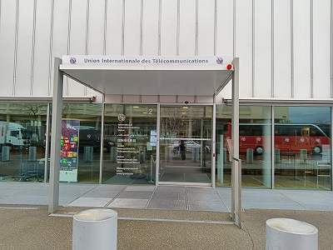
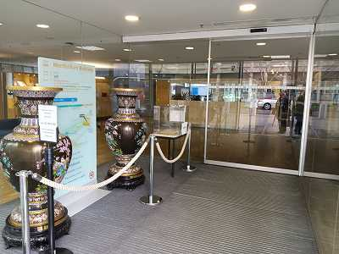
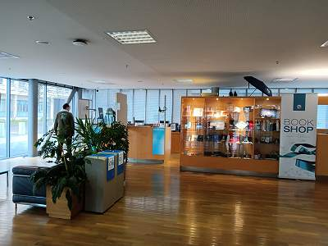
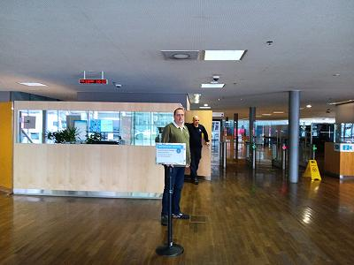
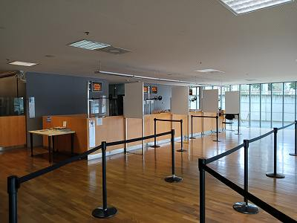
① Enter 1st door
② Enter 2nd door
③ Go to Right for Registration to make the ITU Badge
Registration Area
Book Shop
Entrance
Left
Center
Right

Slide 3
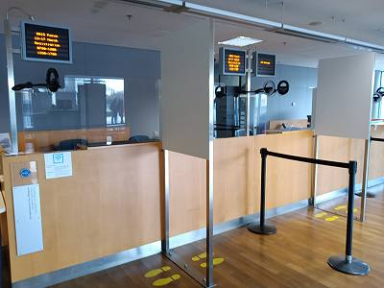
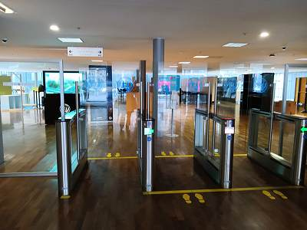
Registration Booth
④ At Registration booth, please present your
+ Passport
+ ITU registration confirmation (if you have w you)
Note: Staff will take your photo, Please give your big smile
Note: It will take around 5 min
Note: Registration is open from 8:30-.
Entrance
⑤ Enter using your ITU badge. You need your ITU badge to exit as well.

Slide 4
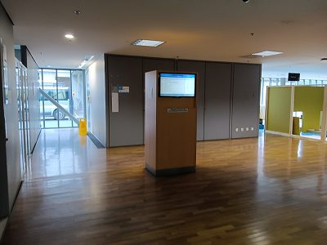
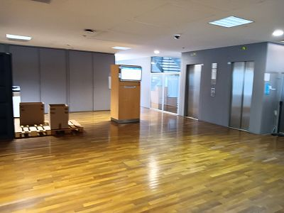
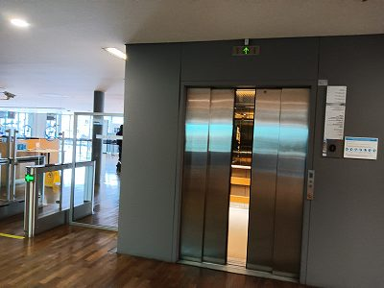
⑥ Check your meeting room on the screen.
The screens are located right side and left side once you enter ITU Monbrillant building.
Note: Meeting room might change without any notice before and during your meeting.
Screen
⑦ Take elevator to 1st floor
Elevator
Screen
Elevator
Entrance

Slide 5
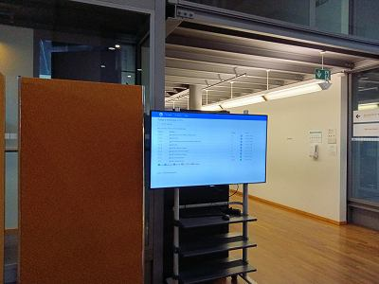
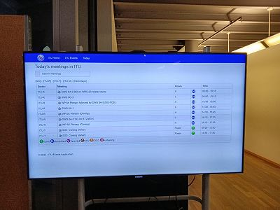
⑧ Check your meeting room on the Screen.
If you forget to check your meeting room at ground floor, you can still find another screen at 1st floor once you get our from elevator.
Screen
Building | Meeting rooms
Montbrillant | H1, H2, K1, K2, L1, L2, M1, M2
Varembé | A, E, G1, G2, G3
Tower | Popov, C, D, T101, T103
Screen

Slide 6
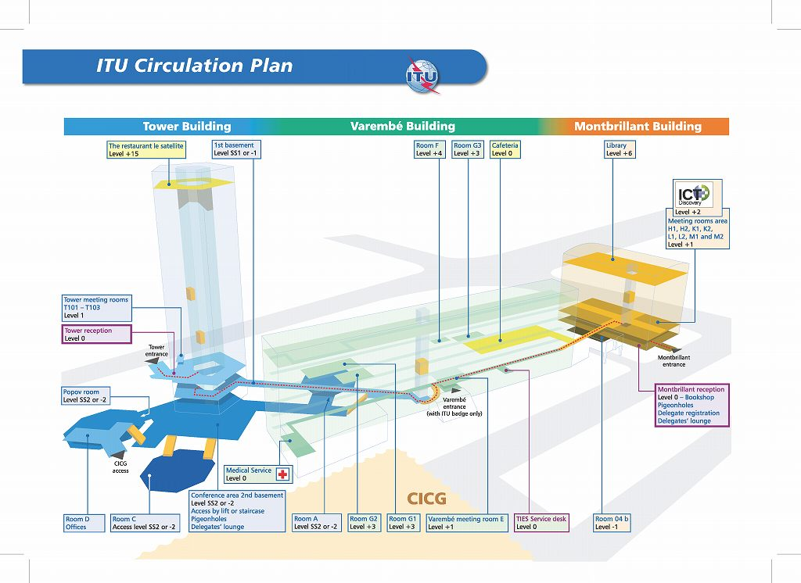
⑨ Use ITU Circulation Plan to find your meeting room and building. You can find this on the wall in the ITU buildings with your current location.

Slide 7
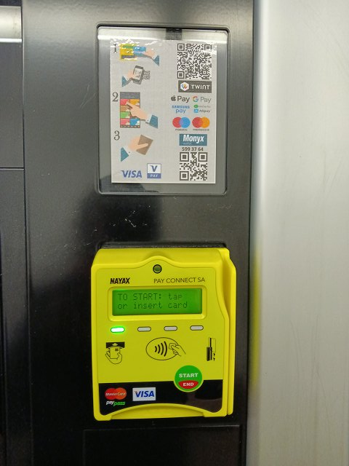
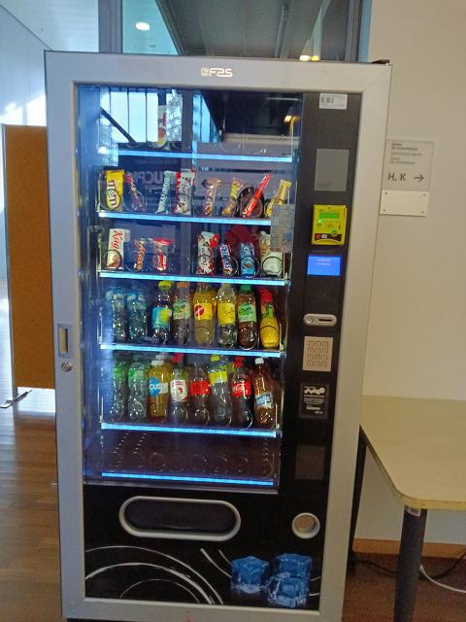
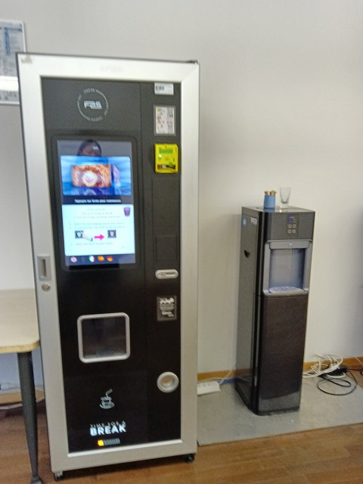
Meeting room K2 is located at 1st floor of Monbrillant building.
You can use
+ Apple pay
+ Google pay
+ Credit card
- VISA
- Master
Water
Server
Drink/Snack
Coffee
Vending machines are available outside of Meeting room K/H

Slide 8
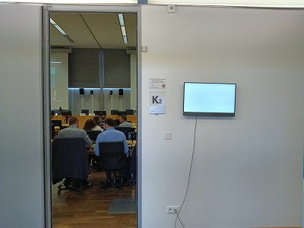
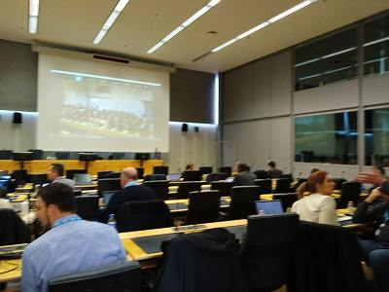
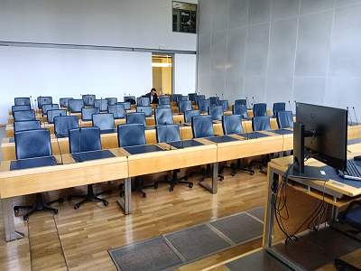
Meeting Room K2
Stage: 6 seats
Audience: 10 seats x 5 rows = 50 seats
Hours: 8:30 – 17:30
WiFi: Username and Password are written on your ITU badge.
K2
K2

Slide 9
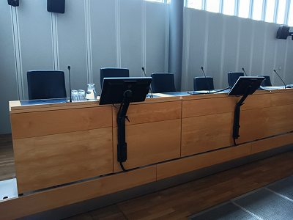
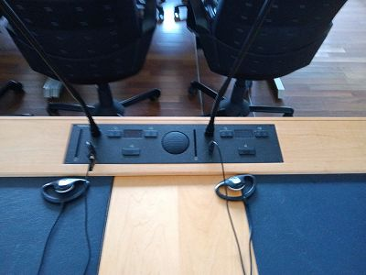
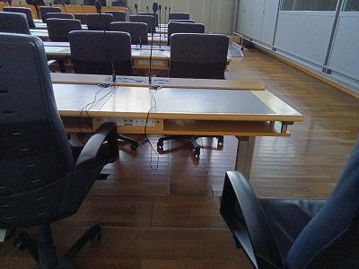
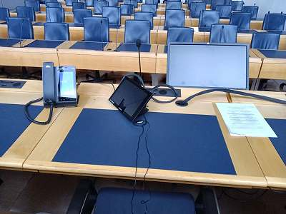
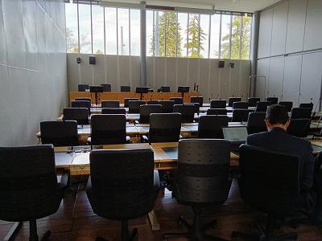
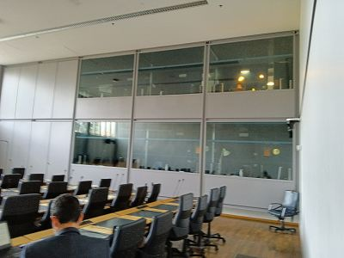
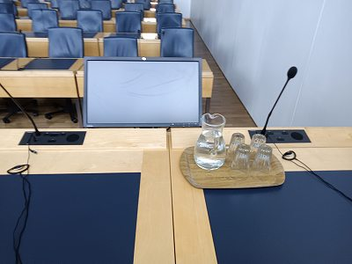
Meeting Room K2
Stage: 6 seats
Microphone/Headsets
Power plug
Stage
Stage

Slide 10
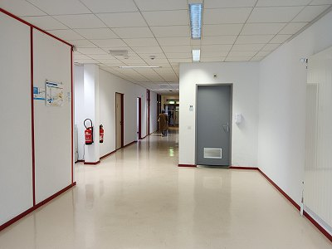
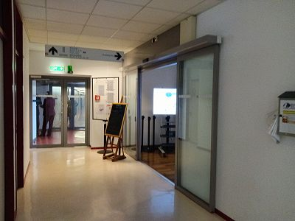
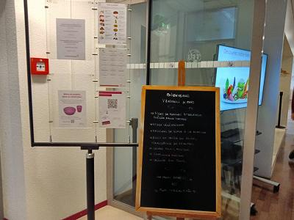
Cafeteria is located in Varembe building (Level0) connected to Monbrillant Building (1F).
Hours: 8:30 – 16:00
Lunch: 12:00-13:45

Slide 11
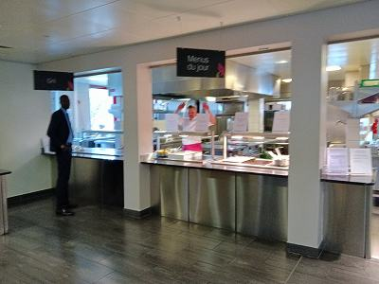
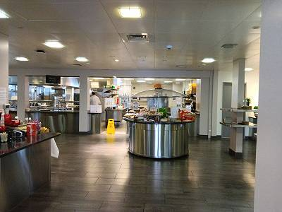
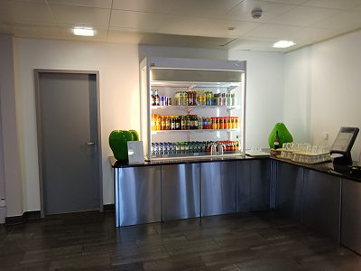
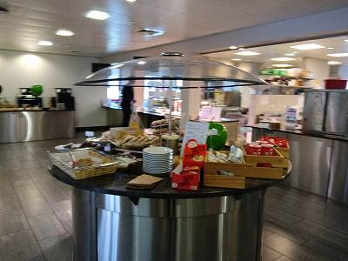
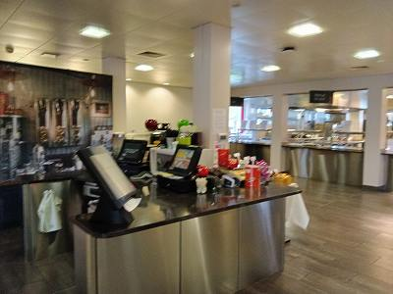
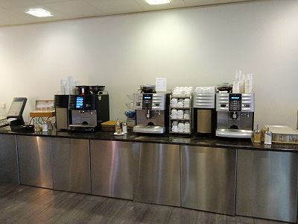
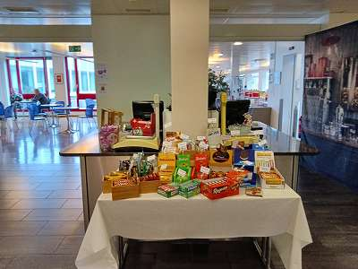
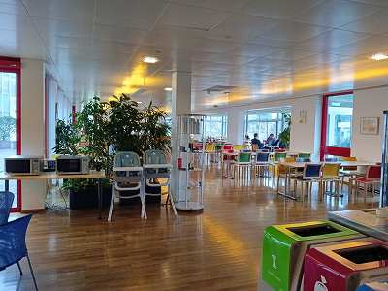
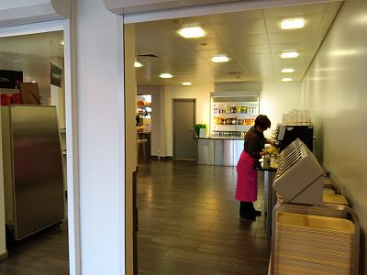
Grill
Today’s Lunch
Cafeteria
Drink
Glass
Hot Foods
Bread/Snacks/Fruits
Tea/Coffee (Self)
Casher1
Casher2
Casher1
Seating Area
Pick Tray
Snacks
Available
Coffee/tea/Snacks : 8:30 – 16:00
Lunch time: 12:00-13:45

Slide 12
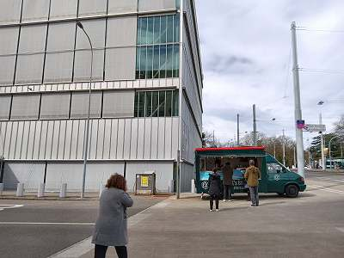
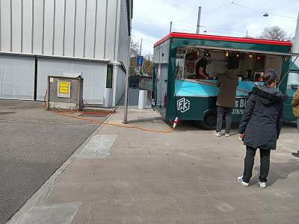
Food Truck (Debi’s Street Food) is available outside of Monbrillant Building from 11:30 – 13:30.
You can check menu @ http://debiskitchen.ch/

Slide 13
For people who will join physically in ITU
1. Delegate register online at: https://www.itu.int/net/CRM/js/sr/C-00012381
2. Delegate receive an email from the system which the delegate needs to validate
3. Delegate receive the confirmation of registration via email
For delegate who will join remotely:
Please use this link
https://itu.zoom.us/j/94194493491?pwd=dzdsTklVd3Y5L1pjK3JIZEMxeHFaZz09

Slide 14
Questions:
Q1) What time does Cafeteria open for coffee/tea/snacks (morning/break)?
A) The cafeteria opens form 8h30 to 16h00
Q2) What time does Cafeteria open for lunch?
A) 12h00 to 13h45
Q3) How to connect WiFi?
A) The wi-fi Username and Password are written on the registration badges and it’s different for each participants, one more reason to collect the badges for the meeting once in ITU.
Q4) What time does registration(ITU reception) open in the morning?
A) 8h30
Q5) How long can we use meeting room each day? By 17:00? 18:00? 19:00? Any limitation?
A) 17h30 Official ITU time (if more time is required this should be coordinated beforehand with Zanou, Marc Antoine MarcAntoine.Zanou@itu.int)

