Slide 1

ACPE-01-03
ACPE on HCVs
Industry input
ACPE IWG kick-off meeting
(March 24 and 27, 2023)

Slide 2



HCVs - Regulatory Status and initiatives
(Use case: Low speed Collision avoidance)
Speed
GRSG
MOIS: Moving Off Information System
Warn at standstill & up to 10km/h
Status: UN R159 in force
Max speed
GRSG
EMIS: Emergency Motion Inhibit System
Inhibit acceleration at standstill
Annex to direct vision?
Status: replacing UEBS; discussions at GRSG / VRU Proxi;
60 km/h
AEBS
Warn and brake
GRVA
ACPE: Accelerator Control Pedal Error
Prevent acceleration at standstill
New regulation?
Status: GRVA-15 decision to consider HCVs in the scope of the ACPE IWG.
GRVA
20 km/h
UEBS: Urban Emergency Braking system
Warn and brake
New regulation? Alternative to direct vision
Status: replaced by EMIS; on agenda of GRVA-16
Too many initiatives around same or similar use cases
Risk to get incompatible / overlapping requirements, spread in different regulations.
Overlap between GRVA and GRSG
10 km/h
0 km/h

Slide 3
HCVs - Regulatory Status and initiatives
(Use case: Low speed Collision avoidance)
UN R131
AEBS
Warning + brake, down to 10km/h*
([5]km/h with a design margin)
MOIS
Warning
UEBS → EMIS
Warning
+ inhibit acceleration
ACPE
Warning
+ inhibit acceleration
+ brake ?
When
stopped
When
Moving (<10kmh)
?
?
3,7m
0,8m
0,5m
0,5m
UN R159
Annex to UN R167 (Direct vision)
New regulation
Risk to get incompatible / overlapping requirements, spread in different regulations.

Slide 4
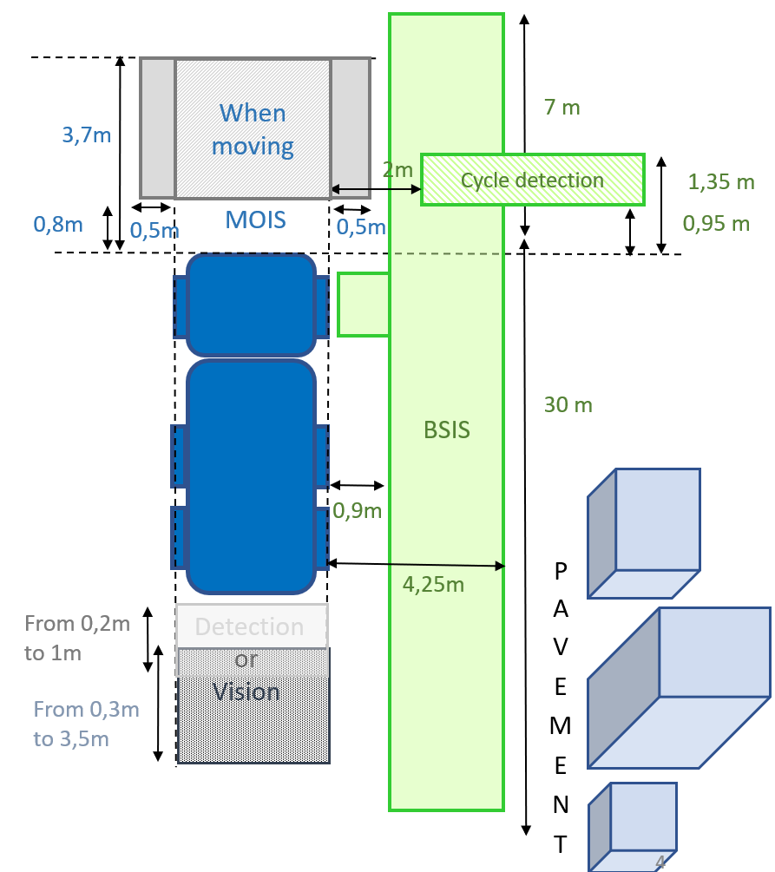
HCV Status – Focus on VRUs
(Use case: Low speed Collision avoidance)
Protection of VRUs at low speed is already broadly addressed:
5 new regulations (all with mandatory installation in EU):
  R151 BSIS 2024
  R158 Reversing safety 2024
  R159 MOIS 2024
  R131-02 AEBS 2028
  R167 Direct vision 2029
  ~10 years between start of developments and implementation of the last measure
Heavy technical impacts
Implementation issues (e.g. overlapping technical measures in different regulations)
Is it relevant to start developments on a new system
addressing the same use case,
before the « pedal error » HCVs accidents statistics have been analyzed, and the effect of already decided measures assessed ?

Slide 5
Effect of HCVs specific parameters (vs M1N1)
Specificities of HCVs vs M1N1
UN R158 MOIS warning
+
Lower vehicle dynamics
(i.e. more time for driver to react to an error)
+
Professional drivers
(and no elderly professionals)
+
More space in cab between pedals
+
Different usages (highway, construction area vs cities, city buses seldom driving backward during normal use…)
Minimized risk of “pedal error” accident on a HCV

Slide 6
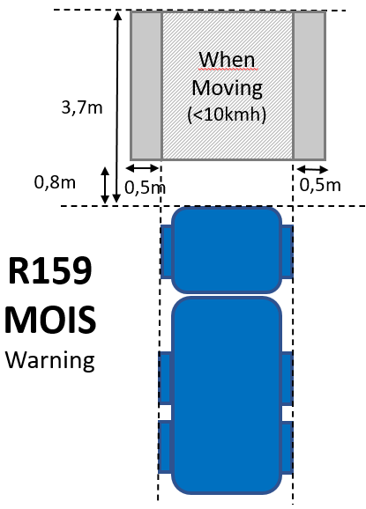
Effect of HCVs decided measures
HCV “pedal error”
Accidents data 2023
HCV “pedal error”
Accidents data 2025-2030 ??
MOIS draws driver attention in presence of a VRU in front
+
UN R167
Direct Vision
The « pedal error » HCVs accidents statistics should be analyzed, and the effect of already decided measures assessed

Slide 7
Summary
Too many regulatory initiatives on very similar use cases (MOIS, UEBS/EMIS, ACPE, AEBS), creating risks to get incompatible / overlapping requirements, generate driver confusion / rejection… during a period with very heavy work program.
Protection of VRUs at low speed is already broadly addressed at UNECE, with 5 (five) UN regulations.
Lack of accidents data to assess the magnitude of the potential issue.
No measurement of the effect of decided measures on those accidents.
No assessment of the effect of specific HCV parameters (vs M1N1)
Unclear use case (conditions for pedal error)
Unclear intention:
  Mandatory installation ?
  Mandatory application for all ACPE-equipped vehicles?
  Optional “technical standard”, available for use by CPs for specific vehicles (e.g. city buses) ?

Slide 8
Proposal
Focus the work on regulating what exists on the market (M1N1)
Recognize HCV industry is focusing on other technical measures than ACPE to address
VRU low speed protection
Temporarily exclude HCVs from scope and
    Collect and analyze accidents due to pedal error on HCVs
    Measure the effect of already decided measures on HCV pedal error accidents
    Assess the effect of specific parameters to HCVs vs M1N1
  to make an informed decision on ACPE for HCVs, once the effect
  of the decided measures on VRUs is known

