Slide 1

Industry experience with Pedal Misapplication / ACPE
ACPE-01-07
March 23rd, 2023

Slide 2

State of the art passenger cars in Japan
ACPE is a system operating at standstill which is detecting conditions when a pedal error can be assumed and suppressing such unintended acceleration (typically a very strong acceleration or kick-down).
The conditions to detect “pedal error” are not necessarily based on obstacle detection. Different types of system indeed exist:
  Some systems detect obstacles and inhibit/limit the acceleration to avoid/mitigate potential collisions.
  Some systems do not detect obstacles, but conditions when a pedal error can be assumed (e.g. the driver suddenly slams on the accelerator pedal at standstill), to inhibit/limit the acceleration.
ACPE is operating at standstill
Some systems are also operating at low speed, in similar use cases as those addressed by low-speed collision avoidance system (AEBS)

Slide 3
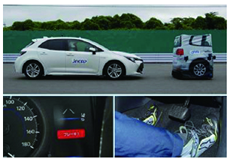
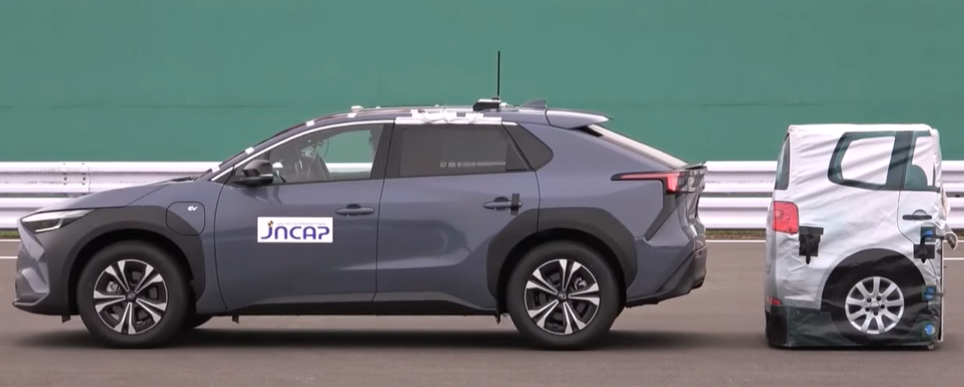
JNCAP Pedal Misapplication Overview
Scope:
  limited to ACPE systems able to detect obstacles
  the feature is expected to suppress unintended acceleration to avoid resulting collision, in case of pedal misapplication at standstill
JNCAP had introduced this feature in 2018.
  Current JNCAP Protocol has two scenarios for avoiding / mitigating collision with Vehicle from [0,8/0,9/1,0]m (manufacturer’s choice) from stand still.
    Forward Scenario
    Reverse Scenario
  In addition, base-tests without target are performed (measuring collision speed without a function)
  Awards – full points for avoidance, partial points for mitigation
From 2023 JNCAP intends to introduce additional Car-to-”Stationary adult pedestrian” scenarios (tbc – no protocol is published yet / no industry experience yet)
Picture source JNCAP

Slide 4
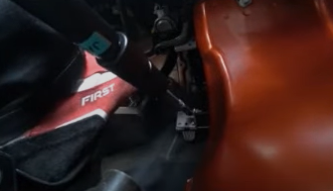
JNCAP Pedal Misapplication
Typical USE CASES / test scenario
 | Forward Scenario | Reverse Scenario
Initial position | Vehicle in stand-still, Steering wheel in neutral position
Transmission | Automatic or robotized gearbox * lowest forward gear or D | Automatic or robotized gearbox * Reverse gear or R
Test | Test driver quickly steps from brake pedal to the accelerator and holds it all the way down until car stops or exceed the potential collision location
For testability reason the kick-down on acceleration is realized by the robot, while test driver releases brake pedal
Acceleration robot
* manual gearbox out of scope; i.e. double pedal error not considered (accelerate and release clutch pedal
See example : https://youtu.be/KC9vqif0hrw?t=74
Functionality
  Pedal application logic is analyzed and/or Sensor detecting obstacles
  In case of potential pedal error detection inhibition of vehicle movement
Relevant Links
  JNCAP - General Description of Pedal Misapplication - Pedal misapplication prevention / National agency for Automotive Safety & Victims' Aid (nasva.go.jp)
  Methods for Checking Equipment Designed to Curb Acceleration In The Event of Peddle Misapplication.pdf (JNCAP protocol in English – Version from June 2019
  Version of JNCAP protocol from March 2022 ( in Japanese)
Picture source JNCAP

Slide 5
JNCAP Pedal Misapplication
Results 2019-2022
General
  Only car-to-car standstill scenarios tested so far
  Widely implemented feature on vehicles in Japan
Sensors
  For reverse detection mostly ultrasonic sensors are used
  For forward detection: ultrasonic, radar, vision sensors or sensor fusion is used
Data source JNCAP

Slide 6
Back-up AEBS vs ACPE

Slide 7
Pedal Misapplication
How to Distinguish ACPE vs AEB
Highlighted red text: potential ACPE / AEBS overlaps
 | AEB | ACPE
Subject of control | “AEB” is required to controls the brake system to stop the vehicle. AEB also controls the power train system to suppress acceleration force | “ACPE” controls the power train system to suppress acceleration force.
Driver’s behavior | AEB intervenes when driver fails to take measures to avoid a potential collision | Driver by mistake apply acceleration instead of a brake. ACPE ignores / override driver’s input
Operational speeds | Works while driving (at least down to 10km/h for C2C and 20km/h for C2P/C2B) | Standstill and low speed
Overridability | “…at any time through a conscious action, e.g., by a steering action or an accelerator kick-down, …” | Inhibits kick-down
Picture source ITARDA

