Slide 1
ETRTO comments and questions on document WT-51-2 (JASIC)
IWG WGWT 52nd session: 27 March 2023

Slide 2
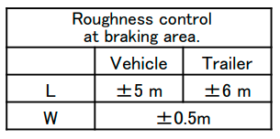
ETRTO comments
ETRTO welcomed the document WT-51-2 from JASIC concerning the test plan proposal for the standardization of water depth measurement.
When reviewing the document, ETRTO detected the following points for endorsement and clarification:
Slide 2: Levelling between external watering and self watering: ETRTO can support the JASIC proposal, but ETRTO would like to have more details on the JASIC workplan (eg: test sequence, how many runs/repeats, which conditions (Temp ranges, MTD, water depth, …)
Slide 3:
ETRTO need to understand from where the ±5m and ±6 m are coming from.

Slide 3
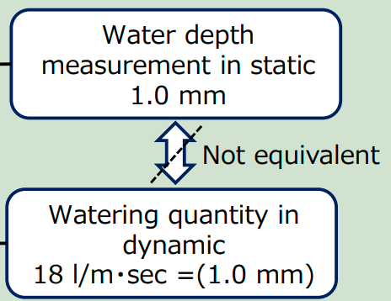
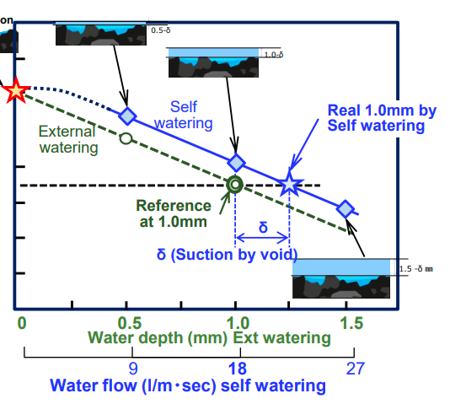
ETRTO comments
Slide 4: What is the meaning of ‘not equivalent?
Is it a conclusion or to be assessed during the test
campaign?
Slide 5: Test plan is not 100% clear: µpeak for self-watering > µpeak for external watering. Is this a conclusion or expected as outcome of the study?
ETRTO thank JASIC in advance for their clarifications

Slide 4
Thank you

