Slide 1
Simulation Credibility Framework for ADS Virtual Testing
Outcome from JRC – RDW – Siemens
Riccardo Donà,
Biagio Ciuffo, Espedito Rusciano
24/04/2023
Notes:
Good morning everyone and thank for staying till the very end. My presentation for today will cover the so-called simulation credibility framework for ADS virtual testing. Essentially, the message I will try to convey is how to make sure the results you have from a simulation analysis are sufficiently credible that you can accept those as a substitution for a physical test for certification purposes

Slide 2
Introduction
A collaboration was established among EC/JRC – RDW – Siemens
Purpose: to verify the feasibility of the “Simulation Credibility” framework
“Simulation Credibility” is main outcome of SG2 activities + Annex III Part IV of EU 2022/1426 (EU ADS Act)
AVP use-case has been selected has a reference case

Slide 3
Meetings
In total, 4 meetings were held:
  Presentation of the Credibility framework (JRC/RDW)
  Presentation of Siemens latest simulation toolchain (Siemens)
  Q/A on credibility framework (blind review by Siemens)
  Credibility handbook draft template (RDW/JRC/Siemens)
Discussion took place mainly at a technical level

Slide 4
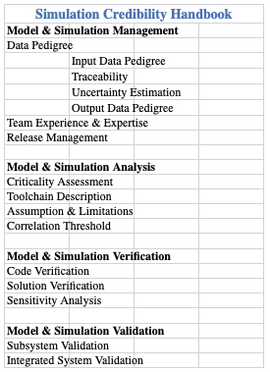
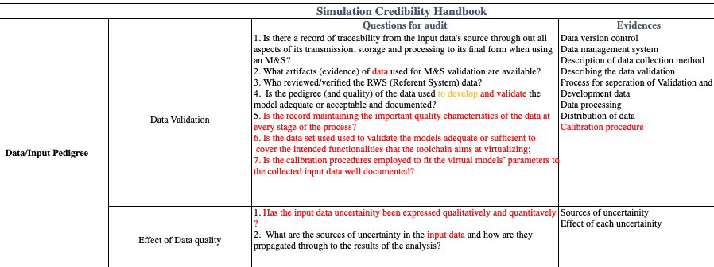
Credibility checklist
“Checklist” compiled:
Map credibility entries into “Questions” and “Evidences”

Slide 5
Conclusion
No major flaws/shortcomings were identified by Siemens
Siemens employees who reviewed the document returned a positive feedback on the need for a credibility assessment
Siemens is confident that the requirements listed are achievable albeit some work will be needed by the OEM/SW provider to be compliant
Further interaction might be necessary to finalize handbook

Slide 6

Thank you
Riccardo.DONA@ec.europa.eu
© European Union 2023
Unless otherwise noted the reuse of this presentation is authorised under the CC BY 4.0 license. For any use or reproduction of elements that are not owned by the EU, permission may need to be sought directly from the respective right holders.

