Slide 1
ACPE-02-09r1 Summarized positions
Submitted by Chair and Secretary
Items | Stakeholder position
Definition | (CP1:J) Acceleration control (JNCAP: Acceleration control, JASO: Acceleration control) Industry: ACPE = system able to inhibit acceleration when a potential pedal error is detected (CP2: DE revised position) System that is able to prevent unintended acceleration, in case a pedal misapplication has been detected. The ACPE shall ensure that AEBS is not overridden in such a case. (CP3:F) FR would support industry definition as this definition is larger than Germany proposal (it may appear that a mistake acceleration may cause emergency situation even without a collision, as crossing lane marking, leaving road) (ACPE-01) Definition of ACPE: “ACPE is a system to control an unintended acceleration”

Slide 2
Items | Stakeholder position
Vehicle categories | (CP1:J) M1 and N1. After initial discussion M1/N1, we can discuss application and modification to other vehicle categories. (JNCAP: Pass car≦9P, Track≦2.8t, JASO: M1 and N1) (CP2: DE revised position) GIDAS data shows only M1 vehicles (CP3:F) FR supports limitation of the work to M1/N1 vehicles in the ToR and in the coming UN reg, as we don’t see proof of evidence that this system would be necessary for heavy duty vehicles. HDV don’t react in the same acceleration as light vehicles. Moreover, heavy duty vehicles are driven by trained professional drivers. Industry revised position: M1 [N1] (ACPE-01-03) Focus the work on regulating what exists on the market (M1 [and N1]) N1 Further analysis of N1 accidents should be done to confirm N1 inclusion in scope Issue of body installation on N1s, making the installation of sensors difficult (out of the manufacturers control), especially on the rear HCVs French LAB study shows a substantial number of N2+ vehicles. Accident rate is very low, and much lower that the of passenger cars (0.02% vs 0.06%) The cause is only “slipping foot between brake and accelerator pedal” (i.e. the driver is not mixing up brake and accelerator, unlike what M1 analysis shows) Low severity of accidents : no fatalities nor severe injuries Recognize HCV industry is focusing on other technical measures than ACPE to address VRU low speed protection Conclusion: Exclude HCVs from scope / make an informed decision on ACPE for HCVs, once the effect of the decided measures on VRUs is known (ACPE-01) CP (D, J, UK, etc.) and industry will provide the accident data in the next meeting (ACPE-02).

Slide 3
Items | Stakeholder position
Collision obstacle (Working direction) | (CP1:J)Wall, vehicle and pedestrian, but no obstacles operation※ can be accepted as alternative (JNCAP: Vehicle(2018~), Pedestrian for front and rear(2023~), JASO: vehicles or walls for front and rear) (CP2:DE revised position): Wall, vehicle and VRU. Unintended acceleration shall be inhibited. Technology neutrality: if detection using actuation speed fulfils the requirements, this should be allowed. (CP3:F) FR would support (as said in definition) that no obstacle operation shall be accepted (only reaction to actuation speed of the accelerator pedal ) Industry revised position: Regulate what exist on the market with sufficient feedback / experience (e.g. JNCAP scenario) Limit ACPE operation to standstill vehicle-to-vehicle use case: Lack of experience / clarity, with regard to overlapping requirements with AEBS (e.g. accelerator kick down is an ACPE trigger, while also an AEBS overriding means) Keep current systems on the market possible, e.g. Systems without obstacle detection capability, based on actuation speed of the accelerator pedal Systems with obstacle detection capability, to trigger ACPE acceleration inhibition (ACPE-01) Japan provide the investigation result for the wall, and Germany clarify the detail of VRU in the next meeting (ACPE-02).

Slide 4
Items | Stakeholder position
Requirements (Including the collision prevention?) | (CP1:J): Ratio of speed change shall be more than 0.3 or vehicle speed at collision shall be [5] km/h or less. (CP2:DE): System can prevent unintended acceleration when a pedal error is detected. (CP3:F) FR : if the system works and prevent acceleration, then collision will be avoided. Defining requirements based of specific obstacles (as walls, VRU), would not prevent situation where acceleration mistakes may cause critical situation as crossing lane marking or road departures (fall into a canal for example) Industry: Inhibit acceleration when pedal error is detected Don’t prohibit the use of brakes Collision mitigation should be accepted
Distance from obstacle | (CP1:J): From front edge of ego-vehicle to object; 1.0m Industry: 1m (M1)

Slide 5
Items | Stakeholder position
AEBS Interaction | (CP2:DE): AEBS shall not be overruled when pedal error is detected. (CP3:F) FR : if the system works and prevent acceleration, then collision will be avoided. Defining requirements based of specific obstacles (as walls, VRU), would not prevent situation where acceleration mistakes may cause critical situation as crossing lane marking or road departures (fall into a canal for example) Industry: Hard to detect for the AEBS that kick-down is pedal error

Slide 6
Items | Stakeholder position
Velocity (e.g. below 10km/h) | (CP1:J): 0 km/h to obstacle (change from brake pedal to acceleration pedal as soon as possible) (CP2:DE): Prevent unintended acceleration by pedal misapplication up to [30] km/h (CP3:F) FR suggests to have an application up to 30 km/h (urban low speed limit) Industry: The recommendation is to limit ACPE to standstill operation. Justification: Overlapping of requirements must me avoided (There must be a gap between ACPE and AEBS requirements). Standstill operation is the only feature considered today in J-NCAP, where industry have sufficient experience.

Slide 7
Items | Stakeholder position
Control strategies (e.g. activation, deactivation) | (CP1:J): Pause switch can be accepted, but paused function shall be automatically restarted. In this case, function other than regulated, such as acceleration control in lower pedal speed, may continue to be paused. If driver continues to operate acceleration pedal even after [ ] second starting acceleration control, vehicle shall be accelerated gradually. (CP4:Finland): It could be possible to deactivate ACPE easily and preferably with the same means the vehicles other parking aids are deactivated. (Eg. same button for parking sensors and for ACPE) ACPE should always be reactivated when the vehicle is restarted. Reason for this is that if the vehicle gets stuck, in usually winter conditions, the driver might need to use the throttle in an unusual way and the ACPE-related sensors might be obstructed by snow. ACPE-function might then hinder attempts to ease the car out of the situation. Usually regular parking sensors are also deactivated by the driver in a situation like this, so it would be best to deactivate both functions at the same time. Industry: Easy override is needed (e.g. to escape from critical situations like railway crossing) ACPE must not interfere with emergency braking systems (e.g. AEBS), e.g. to prevent unpredictable behavior for the driver and contradictions between different regulations on the same use case

Slide 8
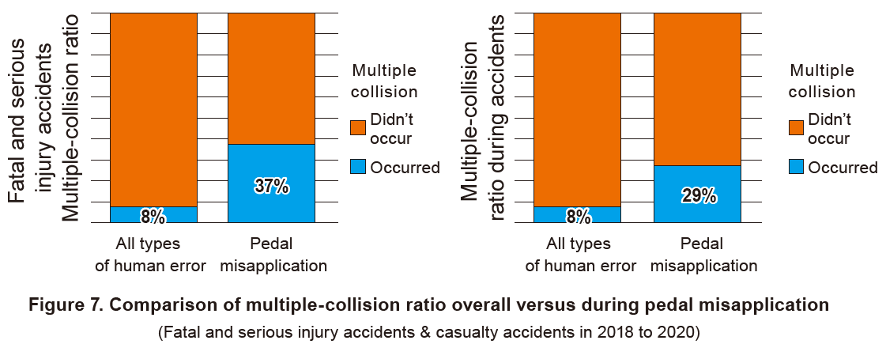
Items | Stakeholder position
Trigger (e.g. after collision, after Risk Mitigation Function) | (CP1:J): After collision and during RMF operation, strong acceleration should be avoided. Range of collision to be detected should be decided considering EDR deceleration and airbag operation(more than ●m/s2). Parameters for collision detection and trigger can be discussed within IWG. Industry: ACPE regulation should only address standstill (i.e. where industry has sufficient experience) If ACPE is not damaged by a collision, it will still operate (thus no need to regulate what happens after a collision…?) Considering secondary collisions is not a mature topic within industry, and is out of scope of ACPE All collisions cannot be detected / detecting collisions involves other technologies (more related to automated driving)

Slide 9
Items | Stakeholder position
Confirmation of consistency with Vienna convention and Geneva convention | (CP1:J): IWG can check this matter after making draft of UNR. Industry Consistency would be ensured if the possibility of an override / deactivation is provided

