Slide 1
Japan Proposal for Thermal Propagation
EVS-GTR IWG#27
June 27, 2023

Slide 2
Agenga
Alternative method (ex. Nail penetration)
  Vehicle level test
Component level test
  Severity comparison
  Validation for occupant safety
  Merit
Regulatory draft revised proposal

Slide 3
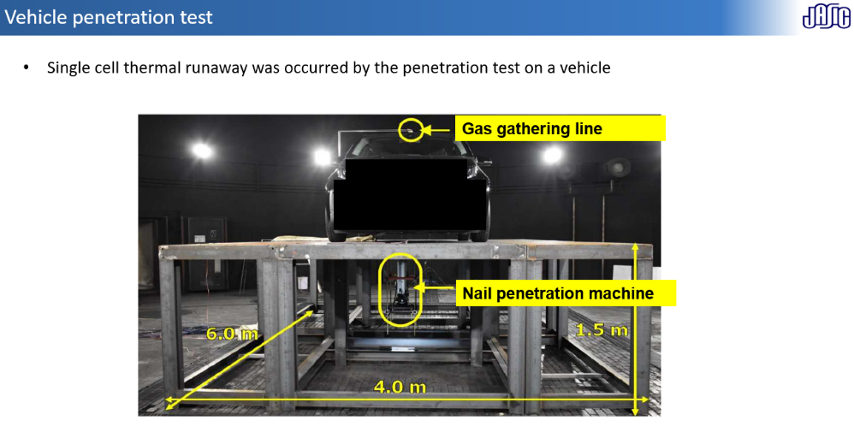
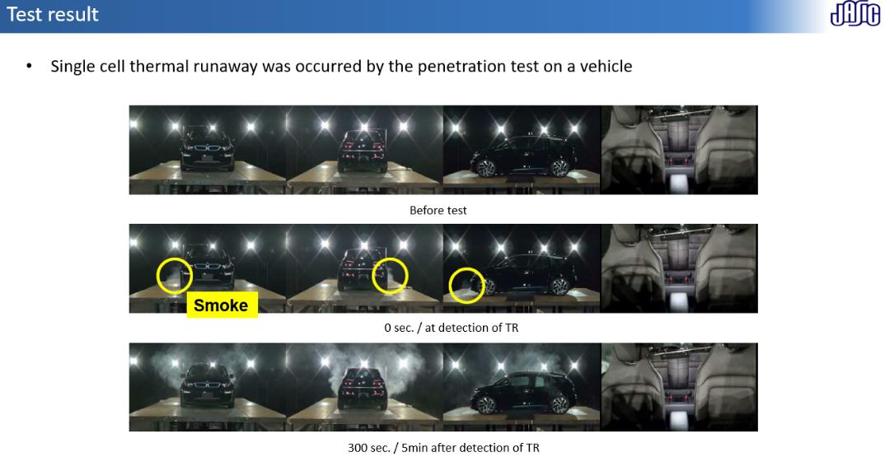
Nail penetration on the vehicle level test
Remind reported in TP-TF #4
Vehicle penetration test are feasible as JPN reported in TP-TF #4 in Feb.2023

Slide 4
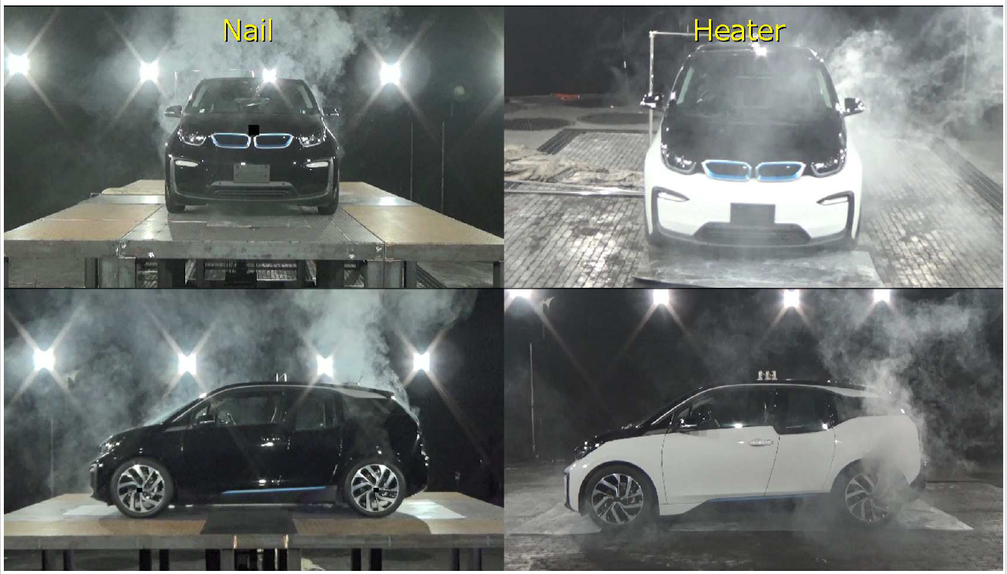
[Video] Nail penetration on the vehicle level test

Slide 5
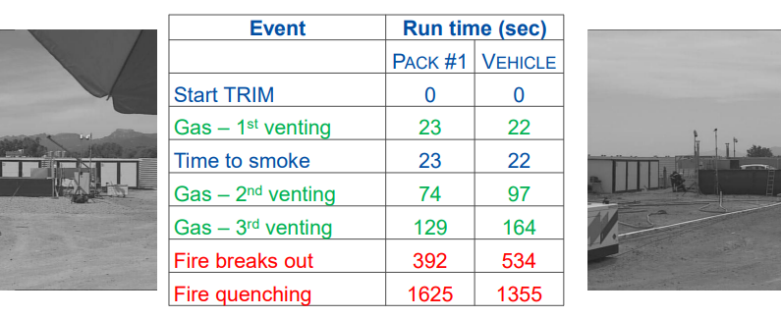
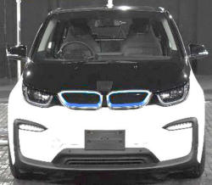
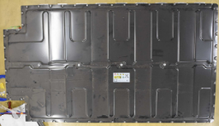
Component level test
Remind reported in TP-TF #5
Difference of severity between vehicle level test and pack level test is not observed.
JRC’s test data
EVS26-E2TG-0300 [EC]Gas emissions in thermal runaway
Japan’s test data
 | Run time (sec)
 | Heater |  | Nail
 | Pack | Vehicle | Pack | Vehicle
Gas-1st venting | 0 | 0 | 0 | 0
Gas-2nd venting | 48 | 75 | 34 | 50
Gas-3rd venting | 123 | 183 | 151 | 151
Gas-4th venting | 257 | 257 | 290 | 278
Gas-5th venting |  | 265 |  | 283
Gas-6th venting |  |  |  | 290
No-identifiability

Slide 6
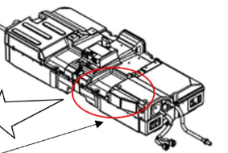
Validation for occupant safety
Clearer to explain of occupant safety by the component level test in case of no propagation batteries
Example 1
Example 2
Component level TP test + visual inspection
Component level TP test + Cell gas analysis
No Fire and explosion
During Pack TP test
No Fire and explosion
During Pack TP test
Gas emitting to out of occupant compartment
Cell level
Gas analysis
During Cell TR test
Cell
(Documentation : structure explanation might be needed)
Gas amount < Hazardous content inside the cabin

Slide 7


Component level test
Remind reported in TP-TF #5
Component level tests can cover the various future battery business scheme
1) Heavy usage vehicles are sometimes needed battery replacement
2) The customer want to install the new batteries if updated batteries are launched,
3) Battery exchange system would be expanding due to reducing charging time
Battery replacement
2
1
1
1
1
1
Battery upgrade
3
Battery exchange system
Updated battery
launch
Exchange station
Life
Life
24
hours

Slide 8
Draft structure comparison
EC draft
Start
TP test with Vehicle/Heater is feasible ？
5.4.12. Thermal propagation.
By default, a test shall be conducted in accordance with paragraph 6.3. If a testing authority deems the test not to be feasible for technical reasons, the vehicle manufacturer shall demonstrate compliance in accordance with paragraph 5.4.12.1.a.
No
Ｙｅｓ
Documentation approach
(Required material are not clear.)
TP test with Vehicle/ Heater is performed.
Target cell is heated with specified conditions.
Criteria for documentation are satisfied?
No
Target cell satisfies TR criteria?
A TP test in 6.3 is required if it can be performed.
No
Ｙｅｓ
If TP test in 6.3 is not feasible, documentation approach is applied.
To be discussed
Ｙｅｓ
Providing warning or No hazards
No
Main method (Vehicle/Heater) is an only option for TP test. Alternative methods are not accepted.
Fail
Pass
End

Slide 9
Draft structure comparison
Japan draft
5.4.12.1.
The vehicle manufacturers shall provide evidence and/or documentation to the testing authority as applicable on how the vehicle occupants remain safe after a single cell thermal runaway caused by an internal short circuit and the requirements of paragraphs 5.4.12.2. and 5.4.12.3. are met.
If the evidence and/or documentation provided is not satisfactory, the testing authority shall require the manufacturer to perform a test based on the specifications as those described in paragraph 6.3. and prove the requirements in 5.4.12.2. are met.
Start
Documentation submission
5.4.12.2 _Providing warning or No risk
5.4.12.3_Protection function
Criteria for documentation are satisfied?
Ｙｅｓ
No
6.3 TP test with main method or other methods is performed.
TP test with main method is performed.
No
In the first place, the vehicle manufacturers shall provide documentation to the testing authority.
Target cell satisfies TR criteria?
Main method?
No
Ｙｅｓ
If the documentation provided is not satisfactory, the testing authority shall require the manufacturer to perform a TP test in 6.3.
Ｙｅｓ
Providing warning or No hazards
To be discussed
No
TP tests with not only the main method (Vehicle/Heater) but also other methods in 6.3 are accepted.
Ｙｅｓ
Pass
Fail
End

Slide 10
Thank you for your attention!

