Slide 1
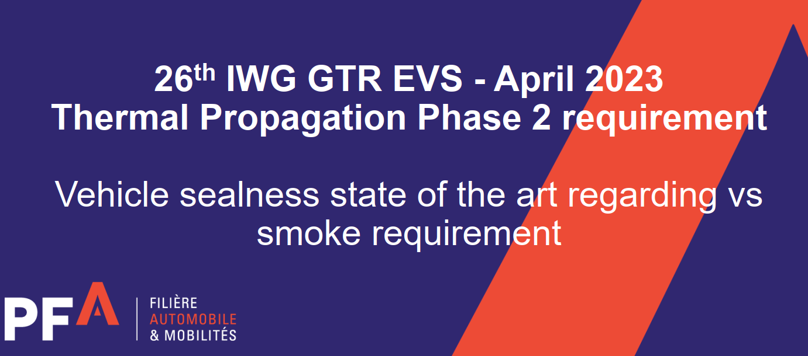
CA questions/comments

Slide 2
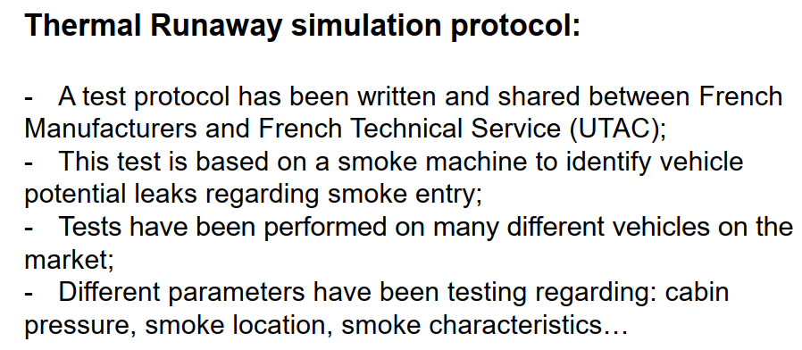
CA comments – Can you share/define this test protocol? You have indicated tests have been conducted on many different vehicles, Can you asses how smoke ingress into the cabin of a vehicle can be evaluated from a component level test.

Slide 3
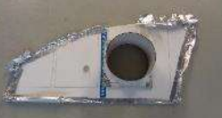
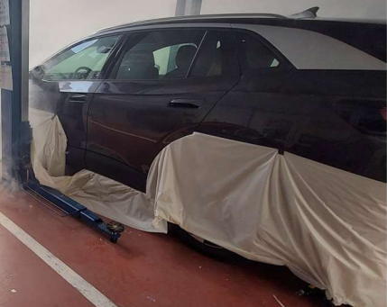
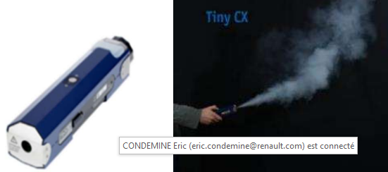
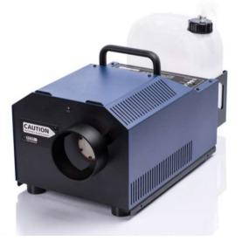
Test environment:
Closed local
Vehicle prepared following different configuration:
  With bottom skirt or not
  With or without adapted window for 2mbar depressure in the passenger compartment
Smoking machine:
COBRA 3.1 LOOK
LOOK TINY CX (Portable)
Non toxic smoke
Smoke test:
Smoke produced around the vehicle
Smoke directly under the vehicle close to the battery events

Slide 4
Testing:
Reminder: the smoke machine tests are complely representative to a TP test but give us information on sealness weakness of the vehicle before performing a real TP test
Test duration: around 10 min
Fixed camera inside the vehicle and somebody inside with a portable camera
Tests with body vehicle filling to identify the area where the smoke could come from
Test without body vehicle filling to see precisely the entrance of the smoke
Measure of the time to apparent smoke inside
Obviously, this test could not be performed at component level

Slide 5
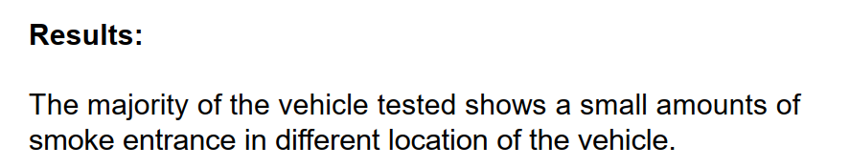
CA comments – Can you propose what an acceptable amount of smoke ingress is permissible.

Slide 6
Criteria to be assessed with a smoke machine test:
Reminder: usual definition of smoke during fire:
« In a fire, the smokes represent a major hazard because of their opacity, their heat, their toxicity, their risk of explosion and their mobility (no risk of explosion regarding the regulation because it’s a failed criterion)
Opacity:
- Risk assessment: visual judgement after 5 min from camera on driver headrest
- Criteria: based on the driver capacity to see clearly the outside environment in front of him
Heat: not representative in this test
Gas mobility: (trends because of the difference gas composition between smoke machine gas and TP gas)
- Assessment: visual gas height from camera overview of the whole passenger compartment
- Criteria: smoke below the rear or front seats height during the 5 min test
Toxicity : not representative in this test

