Slide 1
SG-EDR-36 Meeting
June 6 2023
Proposal for HVEDR trigger-last stop
Guangxiu Zhang, Yanning Chang, Yu Liu, Xi Hu, Hanzhengnan Yu
CATARC

Slide 2
Statistics for vehicle idle conditions in China
Established a fleet composed of 76 heavy-duty vehicles, covering typical vehicle types, vocations and cities all over China.
Collected 1Hz real-time data including vehicle speed, engine speed and other parameters by free driving operation.
Collected about 1.5 million kilometer’s real-road data by 3-6 months of stable driving
 | Bus | Coach | Dumper | Truck (GVW≤5500kg) | Truck (GVW>5500kg) | Tractor
Fleet Size | 13 | 12 | 10 | 12 | 15 | 14
Distance(10000 km） | 43.74 | 28.14 | 13.46 | 13.23 | 23.22 | 29.63
Vocation | Intercity Long Haul 、Local Delivery、City Construction、Passenger Transportation…
According to China Automotive Test Cycle(CATC,HD vehicles)

Slide 3
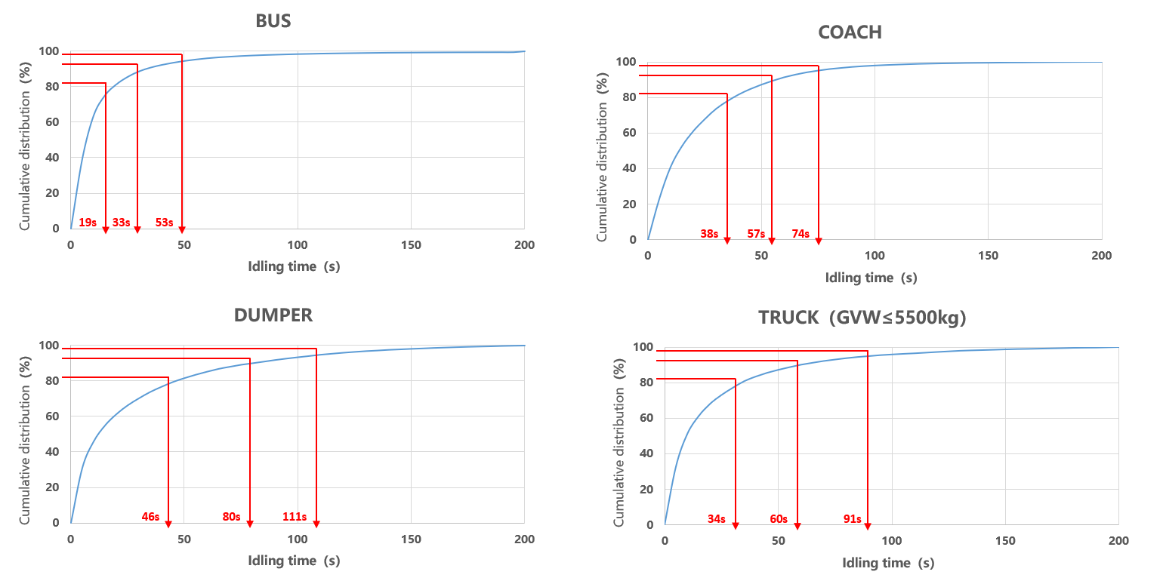
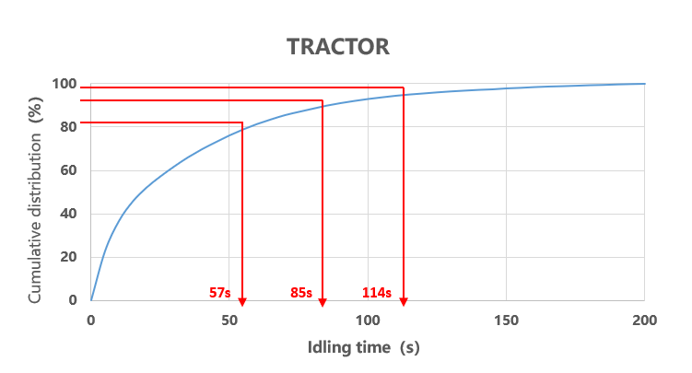
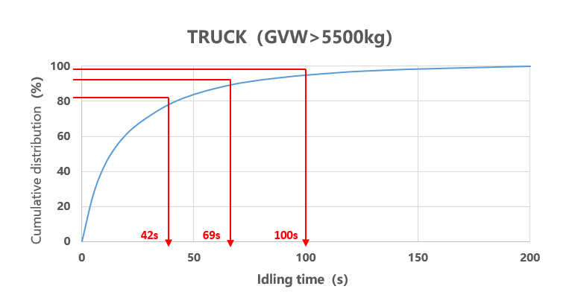
Statistics for vehicle idle conditions in China
According to China Automotive Test Cycle(CATC,HD vehicles)

Slide 4
Statistics for vehicle idle conditions in China
Quantile | Bus | Coach | Dumper | Truck (GVW≤5500kg) | Truck (GVW>5500kg) | Tractor | Average
80% | 18.92 | 37.74 | 46.21 | 33.89 | 41.91 | 57.06 | 39.29
90% | 33.14 | 56.55 | 79.84 | 59.67 | 68.84 | 85.41 | 63.91
95% | 52.69 | 74.49 | 111.46 | 90.60 | 100.48 | 114.48 | 90.70
Learning from statistics, we suggest that the interval when the vehicle speed is reported as 0 shall be longer than 15s.

Slide 5
Thanks for your attention!

