Slide 1
SG1 Status report
VMAD-31-03
VMAD 31
Pete Edwards
29/06/23

Slide 2
Contents
  1. DDT Annex
  2. VMAD Scenario Catalogue
  3. Request for template proposals
  4. Open items
  5. Future meetings

Slide 3
DDT workstream Scenario generation annex

Slide 4
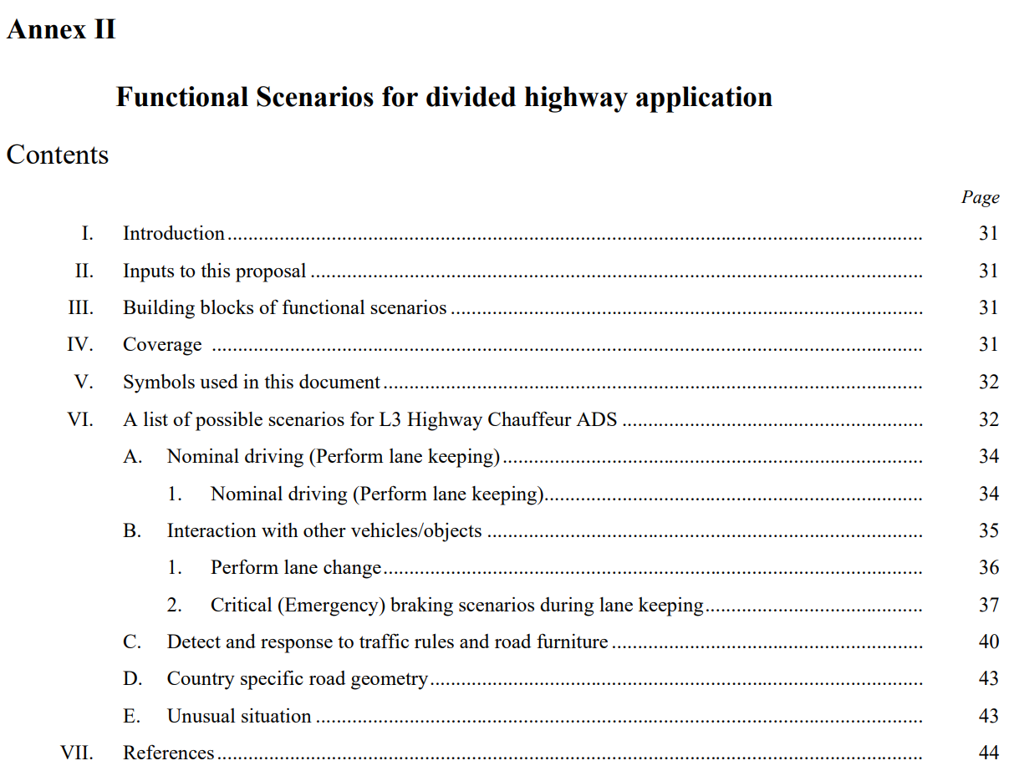
2. VMAD scenario catalogue
Focused specifically on the highway use-case
Functional level
Under 50 scenarios in total
Scenarios sourced from pre-existing scenario databases

Slide 5
2. VMAD scenario catalogue
Considerations
  Use of the catalogue – What do contracting parties require from the VMAD scenario catalogue? How would they use it?
  Number of scenarios – What is practical to include within the VMAD document?
  Timescales – What is practical to complete by the end of the year?
  ODD – Scenarios need to be representative of the ODD of the system being approved. Systems will have diverse ODDs.
Suggestions
  A comprehensive list of functional scenarios that are needed for testing (very many scenarios).
  A small list of nominal “must have” scenarios
  Scenarios that specifically address behavioural competencies
  Scenarios that specifically address dangerous/critical situations
  Example scenarios showing progression from functional -> concrete and demonstrating the template
  No catalogue at all (authorities use manufacture data, pre-existing databases and the FRAV DDT Annex to pick relevant scenarios for testing) – This may involve SG1 developing specifications for scenarios / scenario databases, rather than a specific catalogue

Slide 6
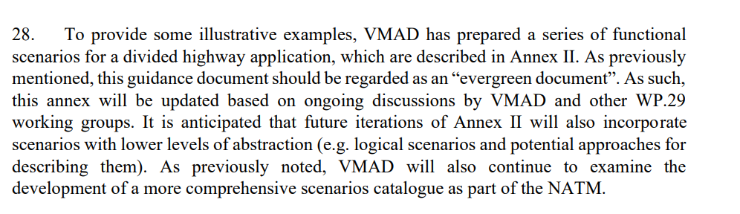
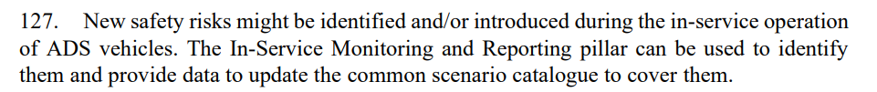
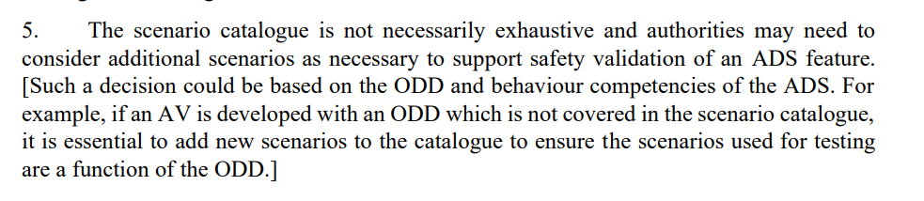
Scenario catalogue in the NATM text

Slide 7
3. Request for template proposals
  Most of the proposals for the scenario catalogue will require a scenario template (or language) to ensure information to be included in the scenario is consistent and minimizes the possibility of confusion in its interpretation.
  This may include ODD and behaviour tags
  Requesting attendees submit (or resubmit) proposals for templates for the group to consider over the summer and discuss in September

Slide 8
4. Open Items
  Update of the Scenario Catalogue
  Maintenance of the Scenario Catalogue
  Scenarios not covered by the Scenario Catalogue
  Scenario template

Slide 9
5. Future Meetings
Planned meetings
26th SG1 Meeting
  July 6th
  Purpose of the scenario catalogue
27th SG1 Meeting
  September TBD
  Scenario Template

