Slide 1
Status on C-ITS work within ETSI
Working paper VCTF-01-07
1st Task Force on Vehicular Communication, 11 May 2023
Provisional agenda item 4
Niels Peter Skov Andersen
Chair ETSI TC ITS
UNECE- Task Force on Vehiclular Communication
11.05.2023

Slide 2
Agenda
  Background
  Status
  Key features for Release 2
  Ongoing work
  Questions

Slide 3
Background

Slide 4
Background – ETSI TC ITS
Responsibilty
  Development and maintenance of Standards, Specifications and other deliverables to support the development and implementation of ITS Service provision across the network, for transport networks, vehicles and transport users, including interface aspects and multiple modes of transport and interoperability between systems, but not including ITS application standards, radio matters, and EMC
  Scope includes communication media, and associated physical layer, transport layer, network layer, security, lawful intercept and the provision of generic web services

Slide 5
Background – ETSI TC ITS
Main areas of work
  Cooperative Intelligent Transport Systems this includes
    Maintenance of existing standards
    Further elaboration of standards
    Test specifications for the developed standards
    Test specification from European Fee Collection
  MirrorLink in collaboration with Connected Car Consortium

Slide 6
Cooperative ITS – Wide Area Communication
Generic Broadcast
  TMC as part of the RDS channel of FM Broadcast
  Information shared over DAB+
Target Broadcast
  Use of cellular systems such as (e)MBMS/ cell broadcast to share information, allowing distribution on a cellular cell network level.
Dedicated Connections
  Based using Cellular Connectivity and knowledge of location – relevant information in provided – Scope of content of information is dependent on end to end latency of end to end delay of enacting entities

Slide 7
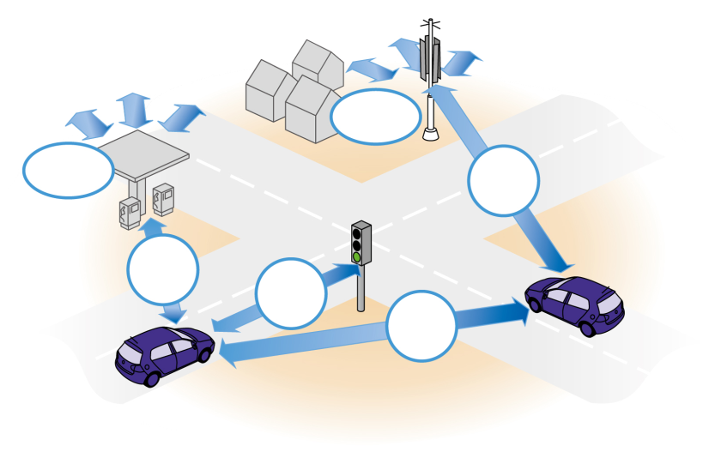
Key characteristics of C-ITS short range communication
  Dedicated Short-Range Communication for exchanging messages between vehicles, and between vehicles and road-side units
  Short range: specifically tailored for cooperative safety -Only local communication – range 300-400 m
  Communication latency < 5 ms
  Connection less many to many
  communication
  Information dissemination rates
  up to 10 times-per-second (10 Hz), but prepared
  for rates of >50Hz, e.g. for platooning
  Ad-hoc Sensor network
WLAN
Internet
Direct
Direct
Direct
Direct

Slide 8
The Security Challenge
  No main secondary relation !
  It is an ad-hoc network everyone broadcast their information to everyone that might be around and shall work without infrastructure
  Sender do not know the receiver – Receiver is just those in geographical scope
  Connection less service and a need to be able to decode first received messages within milliseconds
  No time to establish connection through other means to a backend
  Encryption will be a false security as everyone needs to know the keys to be able to decrypt – only a question of time before keys are leaked

Slide 9
Security
  The Security is based on authenticating the sender, ie. establishing trust.
  Traditional trust model based on signing the messages – Authorizations Tickets (AT) is used – Also often called pseudonyms
  PKI infrastructure provides a limited number of ATs with a limited validity time based on the C-ITS stations Long Term certificate
  Number of simultaneous valid ATs for one C-ITS station should be kept low to minimize risk of Sybil Attacks
  Revocation of ATs is in first release based on expiry, ie. revocation of trust will be based on stopping issuing ATs

Slide 10
Status of standards
  TR 101 607 ver 1.2.1 provides and overview of relevant ETSI standards
  The specifications separate access layer dependent parts and access layer agnostic parts
  Specifications available for support of ITS G5 and LTE-V2X PC5 as access layer for short range communication

Slide 11
Spectrum related work
  Standard for Mitigation to protect tolling is available (for ITS-G5 - work ongoing to cover other access layer technologies)
  Work ongoing on co-existence of Urban Rail and C-ITS
  Work on co-existence of ITS-G5 and LTE-V2X PC5 did not lead to a solution
    Study of co-channel co-existence between ITS-G5 and LTE V2X PC5
    Study of Feasibility and performance of solutions for shared use of 5.9 GHz spectrum by ITS-G5 and LTE-V2X PC5
  Harmonised standard for 5.9 GHz
  Harmonised standard for ITS in 60 GHz band
  Harmonised standards for road tolling (OBU, RSU)

Slide 12
Status

Slide 13
Status of the work on C-ITS
  Release 1 is completed and entering maintenance mode
  Release 1 of Standard has be reworked to allow for supporting multiple access layer technologies
    ETSI ITS-G5 (IEEE 802.11p based)
    LTE-V2X (3GPP Based)
  Release 1 is aligned with European Security and Certificate policies
  TR 101 607 v 1.2.1 has been updated to reflect current set of Release 1 specifications. The TR will be updated periodically to reflect updates of the Release 1
  Open area on ETSI server to show critical corrections https://docbox.etsi.org/ITS/Open

Slide 14
Status of the work on C-ITS
  Work on a backwards compatible Release 2 is ongoing
    Will add additional features and functions, while maintaining interoperability and functionality implemented based on Release 1
    Work typically based on a pre-standardisation study leading to the standardisation
  Release 2 will be a superset of the new release to functionality and Release 1 functionality. In parallel maintenance of Release 1 specifications will be continued, but only ‘essential’ error correction

Slide 15
ASN.1 publishing
ETSI TC ITS have found the approach of copying ASN.1 code into the specifications in the WORD/PDF files is not optimal neither for the standardization process nor for the implementations of the standard.
Further ETSI TC ITS had been made aware that some groups of implementers planned to publish/Share common ASN.1 based on conversion from PDF back to compliable ASN.1 – To avoid the risk that this could create multiple potential ‘reference’ ASN.1 implementations, ETSI have made all ASN.1 code for the ITS deliverables available at ETSI Forge
The publishing repository is publicly available.
The technical specification can reference the specific revision of the code within the repository instead of including the software code in the text of the document. It has been decided for future deliverables to only include the ASN.1 by reference to the ETSI Forge

Slide 16
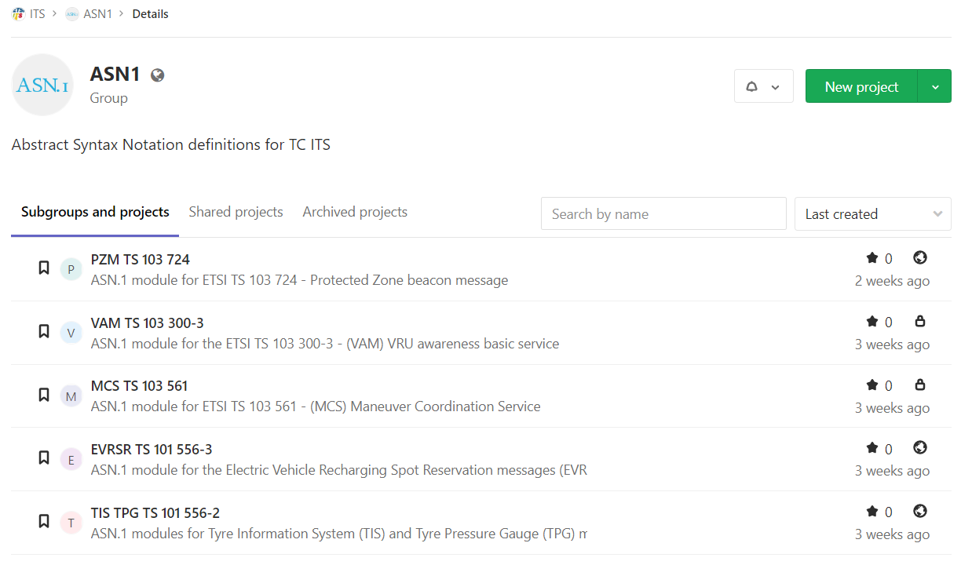
The ETSI ITS ASN.1 publishing repositories
https://forge.etsi.org/rep/ITS/asn1

Slide 17
The ASN.1 publishing repository content
The repository contains:
  ASN.1 module(s)
  The brief README file
  Module dependencies
The repository contains tags for published versions of the specification:
  v1.2.1
  v1.3.1
The HEAD of each release branch contains the currently actual version
of modules. This version can be different with the published one if some corrections were proposed, approved by the TC ITS and included in the ERRATA.
The repository can contain branches for different releases (if any):
  release 1
  release 2

Slide 18
Key features for Release 2

Slide 19
Key features for Release 2
  Collective Perception Service
  Sharing of observations – this is both a vehicle and infrastructure feature
  ETSI will standardise the protocol
  Looking into objects not sharing raw data !!!!!
  Work progressing from study to standardization

Slide 20
Key features for Release 2
  Misbehavior Detection
  Architecture for Misbehavior Detection and Reporting are discussed
  Sharing of observations – this is both a vehicle and infrastructure feature – potential benefit from the Collective Perception to verify CAM
  Challenge to separate operational errors (lack of precision due to bad conditions) from permanent issues that should be reported
  Plausibility checks is an important component that goes beyond security expertise

Slide 21
Key features for Release 2
  Multi Channel Operation (MCO)
  Already today infrastructure installations have capability to support multiple channels
  Service Announcement Messages supports distribution of traffic over multiple channels
  The objective of this work is to provide a sustainable concept for MCO

Slide 22
Key features for Release 2 - Objective MCO
  The objective of this action is to extend the ETSI ITS Release-1 set of C-ITS specifications with a consistent set of interoperable Multi-Channel Operation (MCO) specifications, forming the bases of a Release-2 set of norms and standards to facilitate the growing amount of C-ITS and Automation requirements and increase of information exchange between C-ITS stations as required for handling the Day-2 and beyond road traffic services.

Slide 23
Ongoing work

Slide 24
Ongoing work items 1/4
On-Board Weighing (OBW) equipment; protocol and data elements specification; Release 2
On-Board Weighing (OBW) equipment; pre-standardisation study; Release 2
Cooperative ITS (C-ITS); Release 2
Collective Perception Service
Platooning; Pre-standardization study
Vehicular communication; Basic Set of Applications; Release 2
Vehicular Communications; Basic Set of Applications;Maneuver Coordination Service
Vehicular Communications; Informative report for the Maneuver Coordination Service
Parking Availability Service Specification; Release 2
Functional Safety; Pre-Standardization study; Release 2
Vehicular Communications; Basic Set of Applications; Diagnosis, Logging and Status Service
Vehicular Communications; Basic Set of Applications; Study on ITS Support for Pre-Crash based Applications; Release 2
Vehicular Communications; Basic Set of Applications; Decentralized Environmental Notification Service; Release 2
Vulnerable Road Users (VRU) awareness; Interoperability tests specification
Cooperative Perception Services; Interoperability tests specification
Vehicular Communications; Basic Set of Applications; Cooperative Awareness Service; Release 2
Automated Valet Parking Service; Release 2
Users and applications requirements; Part 2: Applications and facilities layer common data dictionary; Release 2
Vulnerable Road Users (VRU) awareness; Part 3: Specification of VRU awareness basic service; Release 2

Slide 25
Ongoing work items 2/4
Pre-standardization study on ITS architecture; Part 1: Architecture for communications among ITS stations with multiple access layer technologies;
Framework for Public Mobile Networks in Cooperative ITS (C-ITS)
Vehicular Communications; GeoNetworking; Part 1: Requirements; Release 2
Vehicular Communications; GeoNetworking; Part 2: Scenarios; Release 2
Vehicular Communications; GeoNetworking; Part 3: Network Architecture; Release 2
Vehicular Communications; GeoNetworking; Part 4: Geographical addressing and forwarding for point-to-point and point-to-multipoint communications; Sub-part 1: Media independent functionalitites; Release 2
Vehicular Communications; GeoNetworking; Part 4: Geographical addressing and forwarding for point-to-point and point-to-multipoint communications; Sub-part 2: Media-dependent functionalities for ITS-G5; Release 2
Vehicular Communications; GeoNetworking; Part 4: Geographical addressing and forwarding for point-to-point and point-to-multipoint communications; Sub-part 4: Media-dependent functionalities for NR-V2X PC5; Release 2

Slide 26
Ongoing work items 3/4
Testing; Coexistence of Cooperative ITS G5 with TTT DSRC; Part 1: Protocol Implementation Conformance Statement (PICS)
Testing; Coexistence of Cooperative ITS G5 with TTT DSRC; Part 2: Test Suite Structure and Test Purposes (TSS & TP)
Testing; Coexistence of Cooperative ITS G5 with TTT DSRC; Part 3: Abstract Test Suite (ATS) and partial Protocol Implementation eXtra Information for Testing (PIXIT)
ITS-G5 Access layer specification for Intelligent Transport Systems operating in the 5 GHz frequency band; Release 2
LTE-V2X and NR-V2X Access layer specification for Intelligent Transport Systems operating in the 5 GHz frequency band; Release 2
Mitigation techniques to avoid interference between European CEN Dedicated Short Range Communication (CEN DSRC) equipment and Intelligent Transport Systems (ITS) operating in the 5 GHz frequency range
Radiocommunications equipment operating in the 5 855 MHz to 5 925 MHz frequency band; Harmonised Standard for access to radio spectrum
Radiocommunications equipment operating in the 63,72 GHz to 65,88 GHz frequency band

Slide 27
Ongoing work items 4/4
Security; TVRA
Conformance test specifications for ITS Misbehaviour Reporting; Part 1: Protocol Implementation Conformance Statement (PICS)
Conformance test specifications for ITS Misbehaviour Reporting; Part 2: Test Suite Structure and Test Purposes (TSS & TP)
Conformance test specifications for ITS Misbehaviour Reporting; Part 3: Abstract Test Suite (ATS) and Protocol Implementation eXtra
Conformance test specifications for ITS PKI management;Part 1: Protocol Implementation Conformance Statement (PICS);
Conformance test specifications for ITS PKI management; Part 2: Test Suite Structure and Test Purposes (TSS & TP);
Conformance test specifications for ITS PKI management; Part 3: Abstract Test Suite (ATS) and Protocol Implementation eXtra Information for Testing (PIXIT)
Misbehaviour Reporting service; Release 2
Test mode (TM) for operational devices in the field; Release 2
On-Board Weighing (OBW) equipment; Threat, Vulnerability and Risk Assessment (TVRA); Release 2
On-Board Weighing (OBW) equipment; Security and Privacy; Release 2
On-Board Weighing (OBW) equipment; Security and Privacy study ; Release 2
ITS migration to QSC report

Slide 28
Questions ?

