Slide 1
OICA Proposal for Revision of Modulations in UN ECE R10 Rev.7
IWG-EMC-36-04
May 2023

Slide 2
1. Proposal
IWG-EMC-36-04

Slide 3
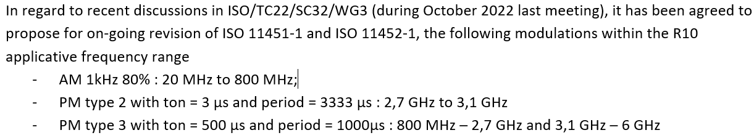
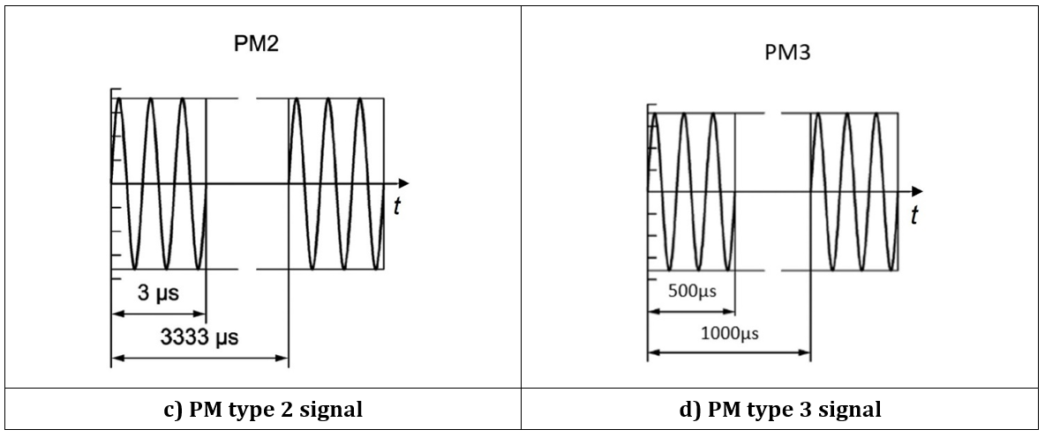
Proposal for Revision of Modulations and their Frequency Allocation
IWG-EMC-36-04
Reference document: IWG-EMC-33-05

Slide 4
2. Technical Rationale and References
IWG-EMC-36-04

Slide 5
From Technical rationale to WG3 decision
IWG-EMC-36-04
The technical rational presented in the following slides show that:
  For 2G : PM type 1 (217Hz = 4.16 ms, 577 µs) is suitable to emulate 2G.
  For 3G : PM type 3 (1kHz, 50% Duty Cycle) is suitable to emulate 3G
  For 4G : PM type 3 (1kHz, 50% Duty Cycle) is suitable to emulate 4G
  For 5G : PM type 3 (1kHz, 50% Duty Cycle) is suitable to emulate 5G
  For WLAN/WIFI : WLAN/WIFI uses digital modulation schemes that are difficult to emulate with “simple” pulse modulations. Thus, the harmonizing proposal is to use PM type 3 (1000 Hz, 50 % duty cycle) that is similar to 3G/4G/5G or a 20/40/80 MHz AWGN signal, the latter taking into account that the maximum bandwidth of an AWGN signal currently cannot exceed 100 MHz (technically not possible
During the WG3 October 2022 meeting this was discussed, and it was finally agreed to use harmonized PM type 3 for
  3G, 4G and 5G.
  WLAN/WIFI
  And also, for 2G for the following reasons :
    Limit the number of different modulations
    PM type 3 could be considered more stringent in terms of power density than PM type 1
    2G systems trend to disappear progressively

Slide 6
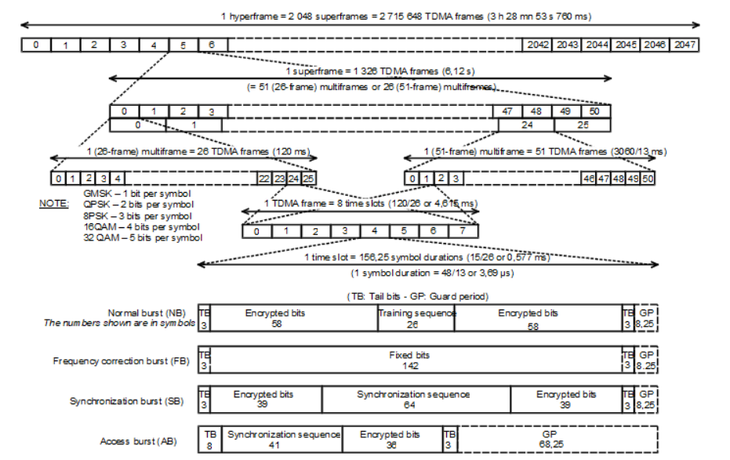
2G
IWG-EMC-36-04
Channel bandwidth: 200kHz
Frame length: 4.16ms = 217Hz
Slot length: 577µs
Derivation:
The ratio of slot length (577 µs) to frame length (4.16 ms) corresponds to PM (577µs, 4.16ms).
Conclusion:
PM (217Hz = 4.16 ms, 577 µs) is suitable to emulate 2G.
Source: GSM TDMA Frame Parameterization for Waveform Generation - MATLAB & Simulink (mathworks.com)

Slide 7
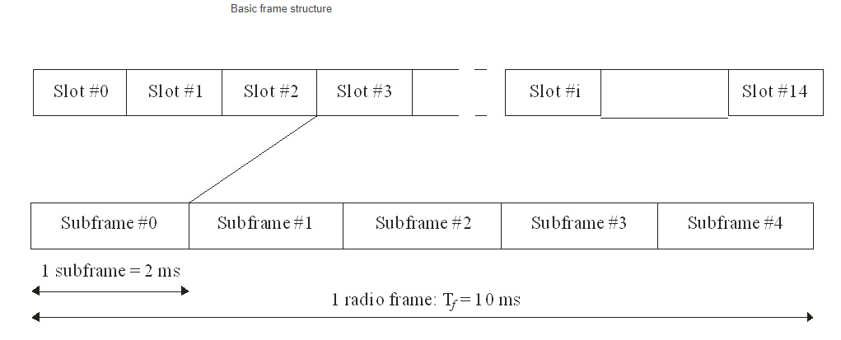
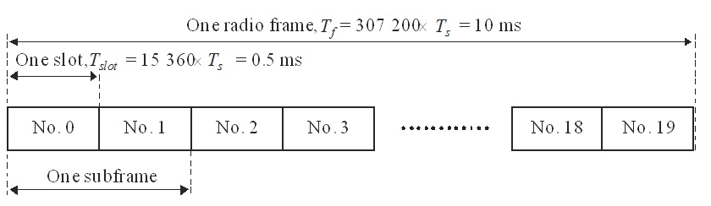
3G
IWG-EMC-36-04
Channel bandwidth: 5 MHz
Basic frame structure
Frame structure type 1 for FDD
15 slots per subframe with a length of 2 ms → slot length: 133 µs
1 subframe consists of 2 slots with a length of 0.5 ms each → subframe length = 1ms
Frame length: 10 ms, subframe lengths 2 ms, slot length: 133 µs
Frame length: 10 ms, subframe length: 1ms, slot length: 500µs
Derivation:
The ratio of subframe (2 ms) to frame (10 ms) results in a duty cycle of 20 %. Taking the subframe length (2 ms) as a reference, this results in PM (500 Hz, 20 % duty cycle).
Derivation:
The ration of subframe (1 ms) to frame (10 ms) results in a duty cycle of 10 %. Taking the subframe length (1 ms) as a reference, this results in PM (1 kHz, 10 % duty cycle).
Conclusion and Harmonizing Proposal: In order to account for a superposition of signals (→ energy density) and existing standards (e.g. MIL-STD 461G), PM (1kHz, 50% Duty Cycle) is suitable to emulate 3G.
Alternatively, a 5 MHz AWGN signal would also be suitable, taking the channel bandwidth into consideration.
Source: UMTS detailed description (3gpp.org), 3G UMTS Frequency Bands: UARFCN » Electronics Notes (electronics-notes.com)

Slide 8
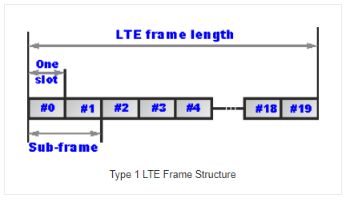
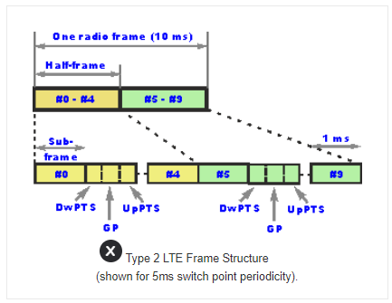
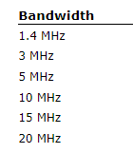
4G - LTE
IWG-EMC-36-04
LTE Frame Structure Type 1 (FDD)
LTE Frame Structure Type 2 (TDD)
max. bandwidth
Frame length: 10 ms
(20 slots per frame with duration of 500µs each)
Sub-frame length: 1 ms
(2 slots per subframe with duration of 500µs each)
Slot length: 500 µs
Frame length: 10ms
(consisting of 10 sub-frames)
Sub-frame length: 1 ms
Derivation:
The ration of subframe (1 ms) to frame (10 ms) results in a duty cycle of 10%. Taking the subframe length (1 ms) as a reference, this results in PM (1 kHz, 10 % duty cycle).
Conclusion and Harmonizing Proposal: In order to account for a superposition of signals (→ energy density) and existing standards (e.g. MIL-STD 461G), PM (1kHz, 50% Duty Cycle) is suitable to emulate 4G (LTE).
Alternatively, a 20 MHz AWGN signal would also be suitable, taking the channel bandwidth into consideration.
Sources: LTE Frame Structure: Type 1 Type 2 » Electronics Notes (electronics-notes.com), LTE Physical Layer Overview (keysight.com)

Slide 9
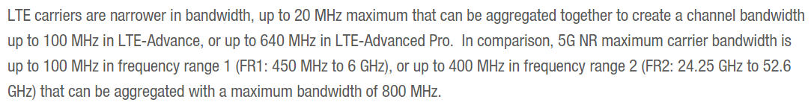
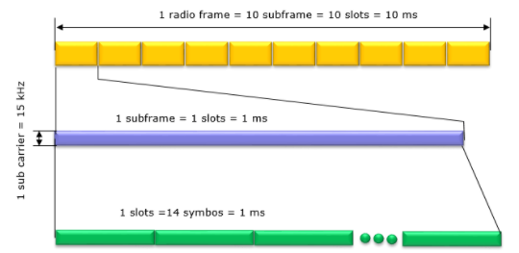
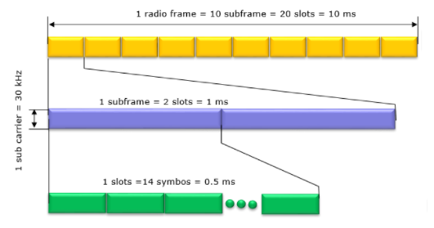
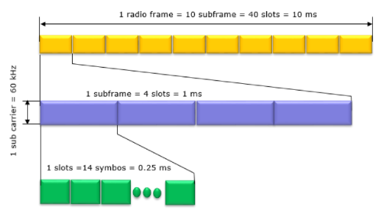
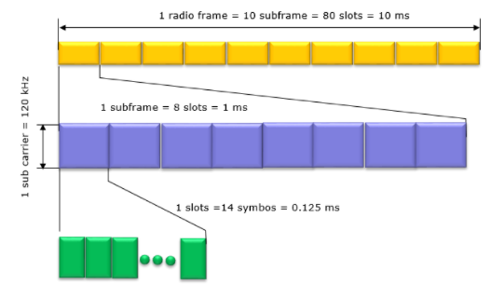
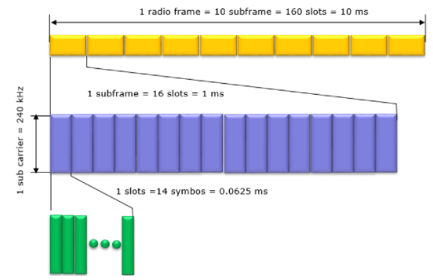
5G
IWG-EMC-36-04
Note: As UN ECE R10 Rev.7 only intends to cover radiated immunity up to 6 GHz, a 400 MHz AWGN is not (yet) relevant for 24.25 - 52.6 GHz.
Derivation:
The ration of subframe (1 ms) to frame (10 ms) results in a duty cycle of 10%. Taking the subframe length (1 ms) as a reference, this results in PM (1 kHz, 10 % duty cycle).
Conclusion and Harmonizing Proposal: In order to account for a superposition of signals (→ energy density) and existing standards (e.g. MIL-STD 461G), PM (1kHz, 50% Duty Cycle) is suitable to emulate 5G.
Alternatively, a 100 MHz AWGN signal would also be suitable, taking the channel bandwidth into consideration.
Frame length: 10ms, sub-frame length: 1ms,
slot length: depends on subcarrier spacing (1ms to 62.5µs)
Source: 5G NR Frame Structure - 5G Networks (5g-networks.net), Understanding 5G New Radio Bandwidth Parts | Keysight Blogs

Slide 10
WLAN/WIFI
IWG-EMC-36-04
 | IEEE 802.11 (obsolete and deprecated) | IEEE 802.11 b | IEEE 802.11 a/h/j | IEEE 802.11 g | IEEE 802.11 n | IEEE 802.11 ac | IEEE 802.11 ax
 | Wi-Fi™ 1 | Wi-Fi™ 2 |  | Wi-Fi™ 3 | Wi-Fi™ 4 | Wi-Fi™ 5 | Wi-Fi™ 6
Release date | 1997 | 1999 | 1999 | 2003 | 2009 | 2013 | 2019
Frequency bands | 2.4 GHz | 2.4 GHz | 5 GHz | 2.4 GHz | 2.4 GHz, 5 GHz | 2.4 GHz, 5 GHz | 2.4 GHz, 5 GHz
Frequency range | 2.400 GHz - 2.4835 GHz | 2.400 GHz - 2.4835 GHz | 5.150 GHz - 5.350 GHz 5.725 GHz - 5.850 GHz | 2.400 GHz - 2.4835 GHz 5.150 GHz - 5.350 GHz 5.725 GHz - 5.850 GHz | 2.400 GHz - 2.4835 GHz 5.150 GHz - 5.350 GHz 5.725 GHz - 5.850 GHz | 2.400 GHz - 2.4835 GHz 5.150 GHz - 5.350 GHz 5.725 GHz - 5.850 GHz | 2.400 GHz - 2.4835 GHz 5.150 GHz - 5.350 GHz 5.725 GHz - 5.850 GHz
Channel bandwidth | 22 MHz | 22 MHz | 20 MHz | 20 MHz | 20 MHz / 40 MHz | 20 MHz / 40 MHz / 80 MHz / 160 MHz | 20 MHz / 40 MHz / 80 MHz / 160 MHz
Maximum throughput | 2 Mbps | 4 Mbps | 54 Mbps | 54 Mbps | 600 Mbps | 6.8 Gbps | 100 Gbps
Modulation | Frequency Hopping Spread Spectrum (FHSS), Direct Sequencing Spread Spectrum (DSSS) | Direct Sequencing Spread Spectrum (DSSS) | Orthogonal Frequency Division Multiplexing (OFDM) | Orthogonal Frequency Division Multiplexing (OFDM) | Orthogonal Frequency Division Multiplexing (OFDM) | Orthogonal Frequency Division Multiplexing (OFDM) | Orthogonal Frequency Division Multiplexing (OFDM)
 |  |  | Subcarrier modulations: Binary Phase Shift Keying (BPSK), Quaternary Phase Shift Keying (QPSK), Quadrature Amplitude Modulation (16 QAM, 64 QAM) | Subcarrier modulations: Binary Phase Shift Keying (BPSK), Quaternary Phase Shift Keying (QPSK), Quadrature Amplitude Modulation (16 QAM, 64 QAM) | Subcarrier modulations: Binary Phase Shift Keying (BPSK), Quaternary Phase Shift Keying (QPSK), Quadrature Amplitude Modulation (16 QAM, 64 QAM) | Subcarrier modulations: Binary Phase Shift Keying (BPSK), Quaternary Phase Shift Keying (QPSK), Quadrature Amplitude Modulation (16 QAM, 64 QAM, 256 QAM) | Subcarrier modulations: Binary Phase Shift Keying (BPSK), Quaternary Phase Shift Keying (QPSK), Quadrature Amplitude Modulation (16 QAM, 64 QAM, 256 QAM, 1024 QAM)
Conclusion and Harmonizing Proposal:
Modern WLAN/WIFI uses digital modulation schemes that are difficult to emulate with “simple” pulse modulations.
Thus, the harmonizing proposal is to use PM (1000 Hz, 50 % duty cycle) that is similar to 3G/4G/5G or a 20/40/80 MHz AWGN signal, the latter taking into account that the maximum bandwidth of an AWGN signal currently cannot exceed 100 MHz (technically not possible).
Source: Jaidev Sharma, The Wi-Fi Evolution, White Paper, 2020.03
* bold print indicates the highest modulation

