Slide 1
30th Unece VRU proxi group:
A- pillar distance measurement and reduction in volume by A-pillar distance
Dr Steve Summerskill
VRU-Proxi-30-05

Slide 2
Content
Reminder of discussion in last VRU proxi Meeting
Task force meeting requirements
Options for measuring A-pillar distance
Results from testing volume required for reduced inter A-pillar distance.

Slide 3
Reminder of discussion in last VRU proxi Meeting
In the last meeting it was agreed that we would explore how the volume requirements to the front of Level 1, 2 and 3 vehicles can be reduced with reduced A-pillar distance
In future there may be vehicles which by design employ a smaller distance between the A-pillars than the cabs that were used to derive the standard then the volume
In this situation the proposal is that these vehicles should be required to achieve a frontal volume that reduces proportionally with A-pillar distance

Slide 4
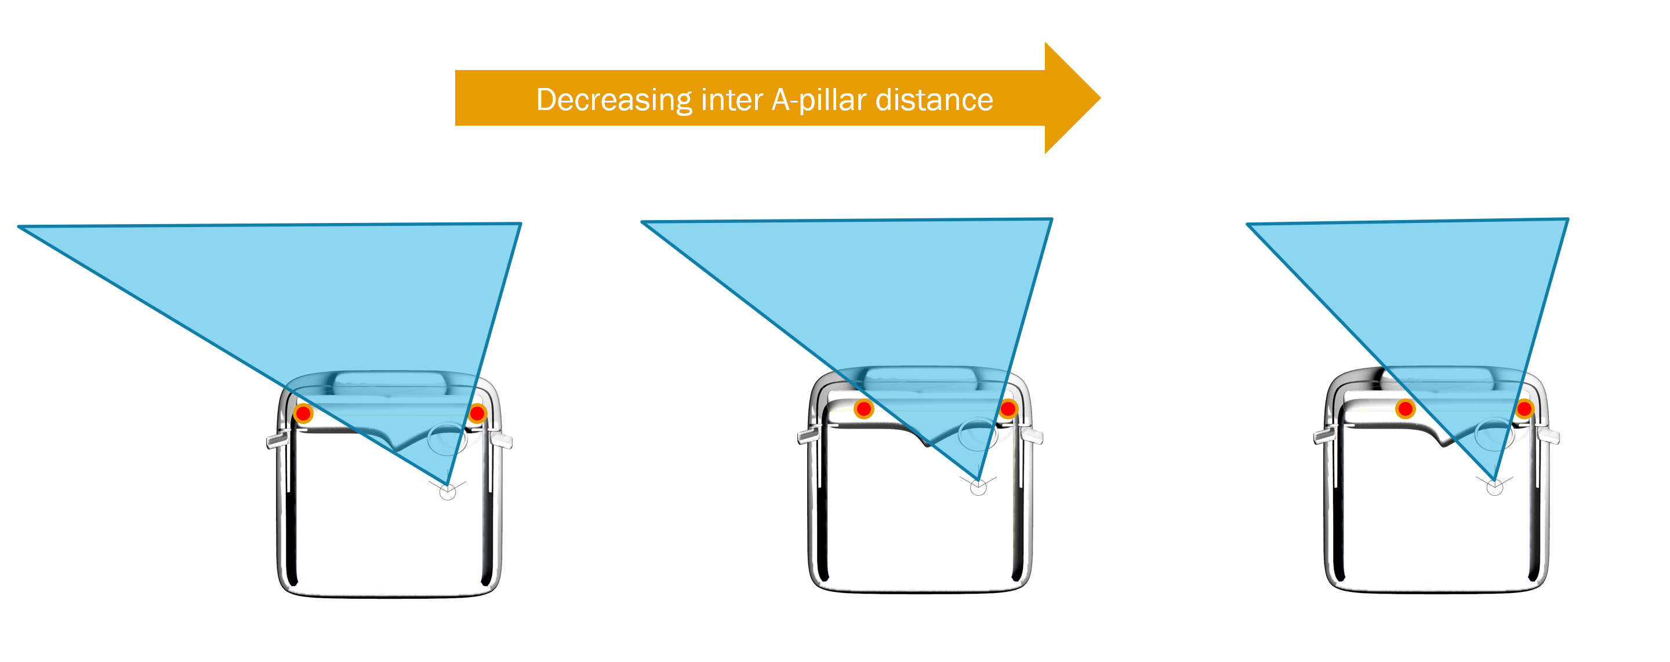
Requirements defined by a subsequent Task force meeting
A task force meeting was held to discuss the issues
It was decided that we (LDS) would utilise the sample of data that have to explore the following issues
  Which of two possible methods for measuring inter A-pillar distance is best?
  The options for producing requirements for the volume that must be seen at different inter A-pillar distances

Slide 5
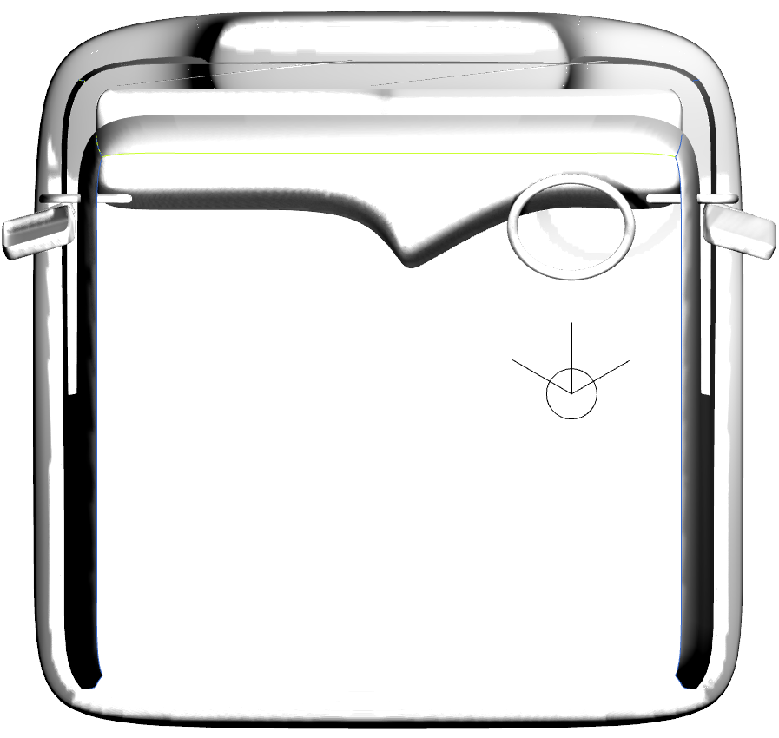
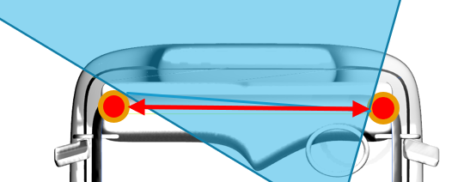
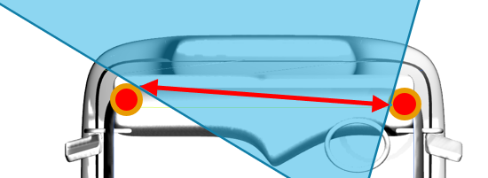
two possible methods for measuring inter A-pillar distance
Method 1 = shortest distance between A-pillars in the Y-Axis at the DVS eye point height
Method 2 = distance between A – pillars as seen from the driver’s eye point
Y-Axis
Distance as seen from eye point

Slide 6
two possible methods for measuring inter A-pillar distance
Results for two possible methods for measuring inter A-pillar distance

Slide 7
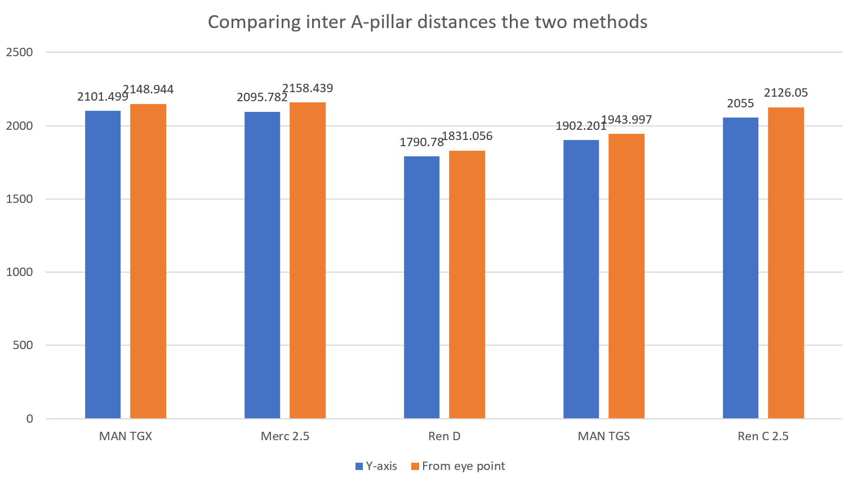
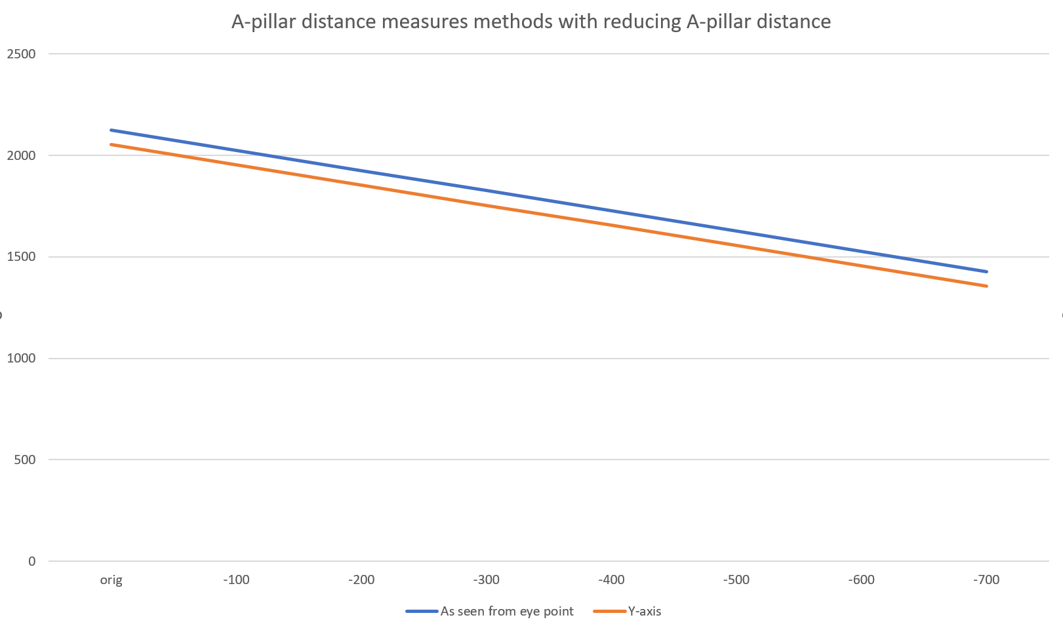
two possible methods for measuring inter A-pillar distance
The two methods produce similar results with the inter a-pillar distance for the vehicles tested
The bottom graph shows an example for one vehicle where the two methods produce linear results
Hence, the A-pillar profile didn’t vary the “as seen from eye point view” as much as anticipated.
This is good. The simpler method is preferred.

Slide 8
Testing volume required for reduced inter A-pillar distance.
Testing volume required for reduced inter A-pillar distance.

Slide 9
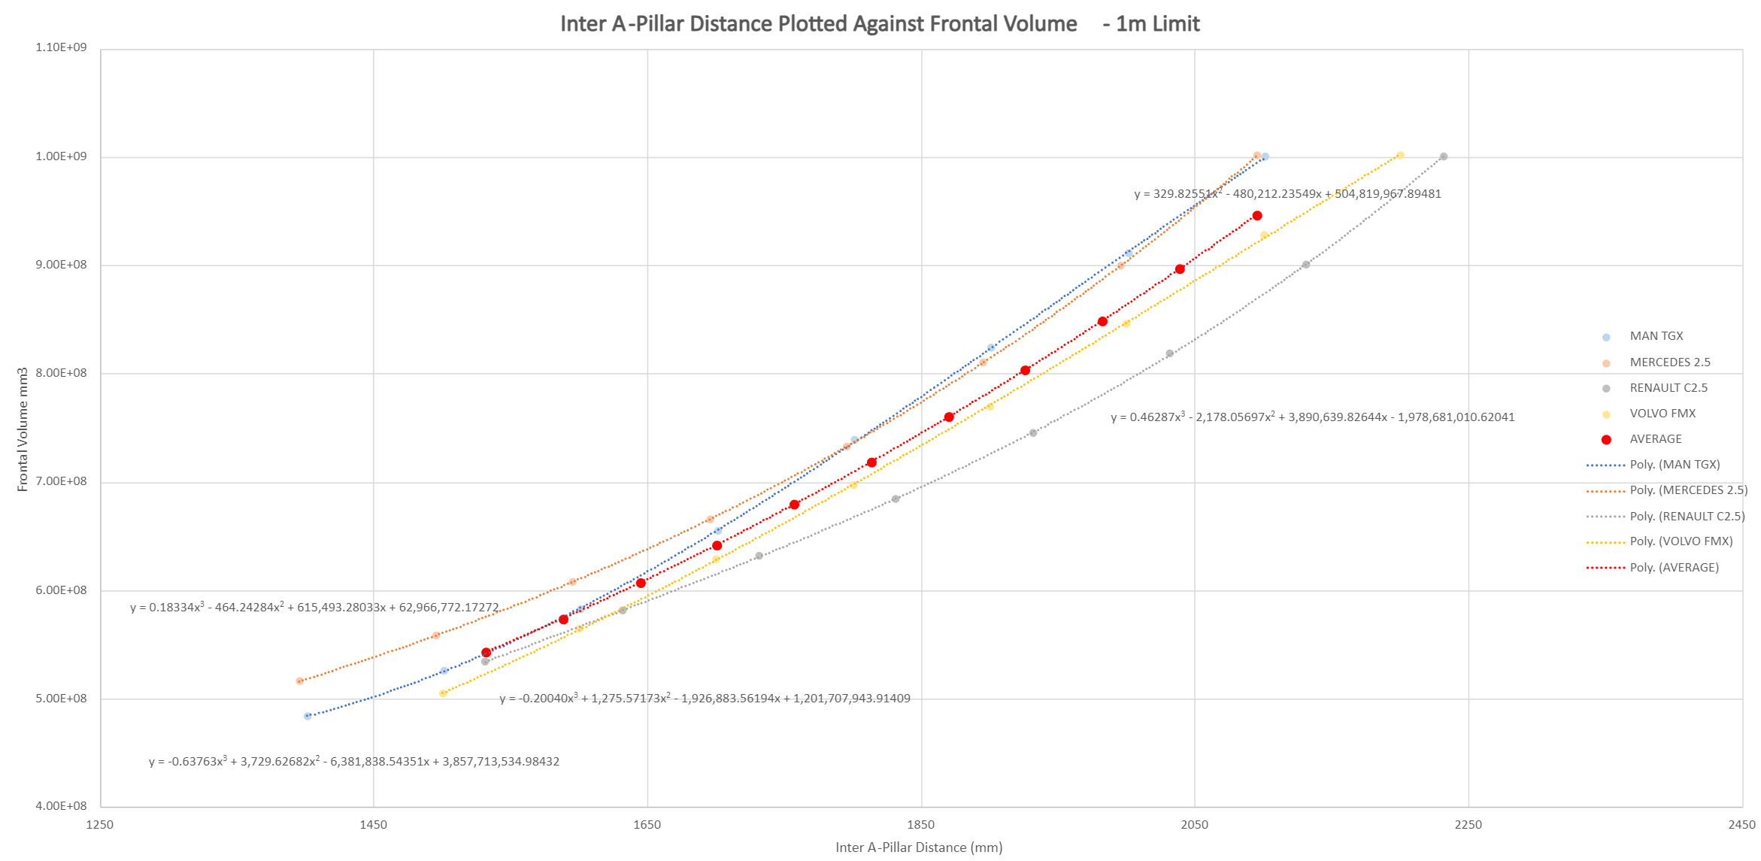
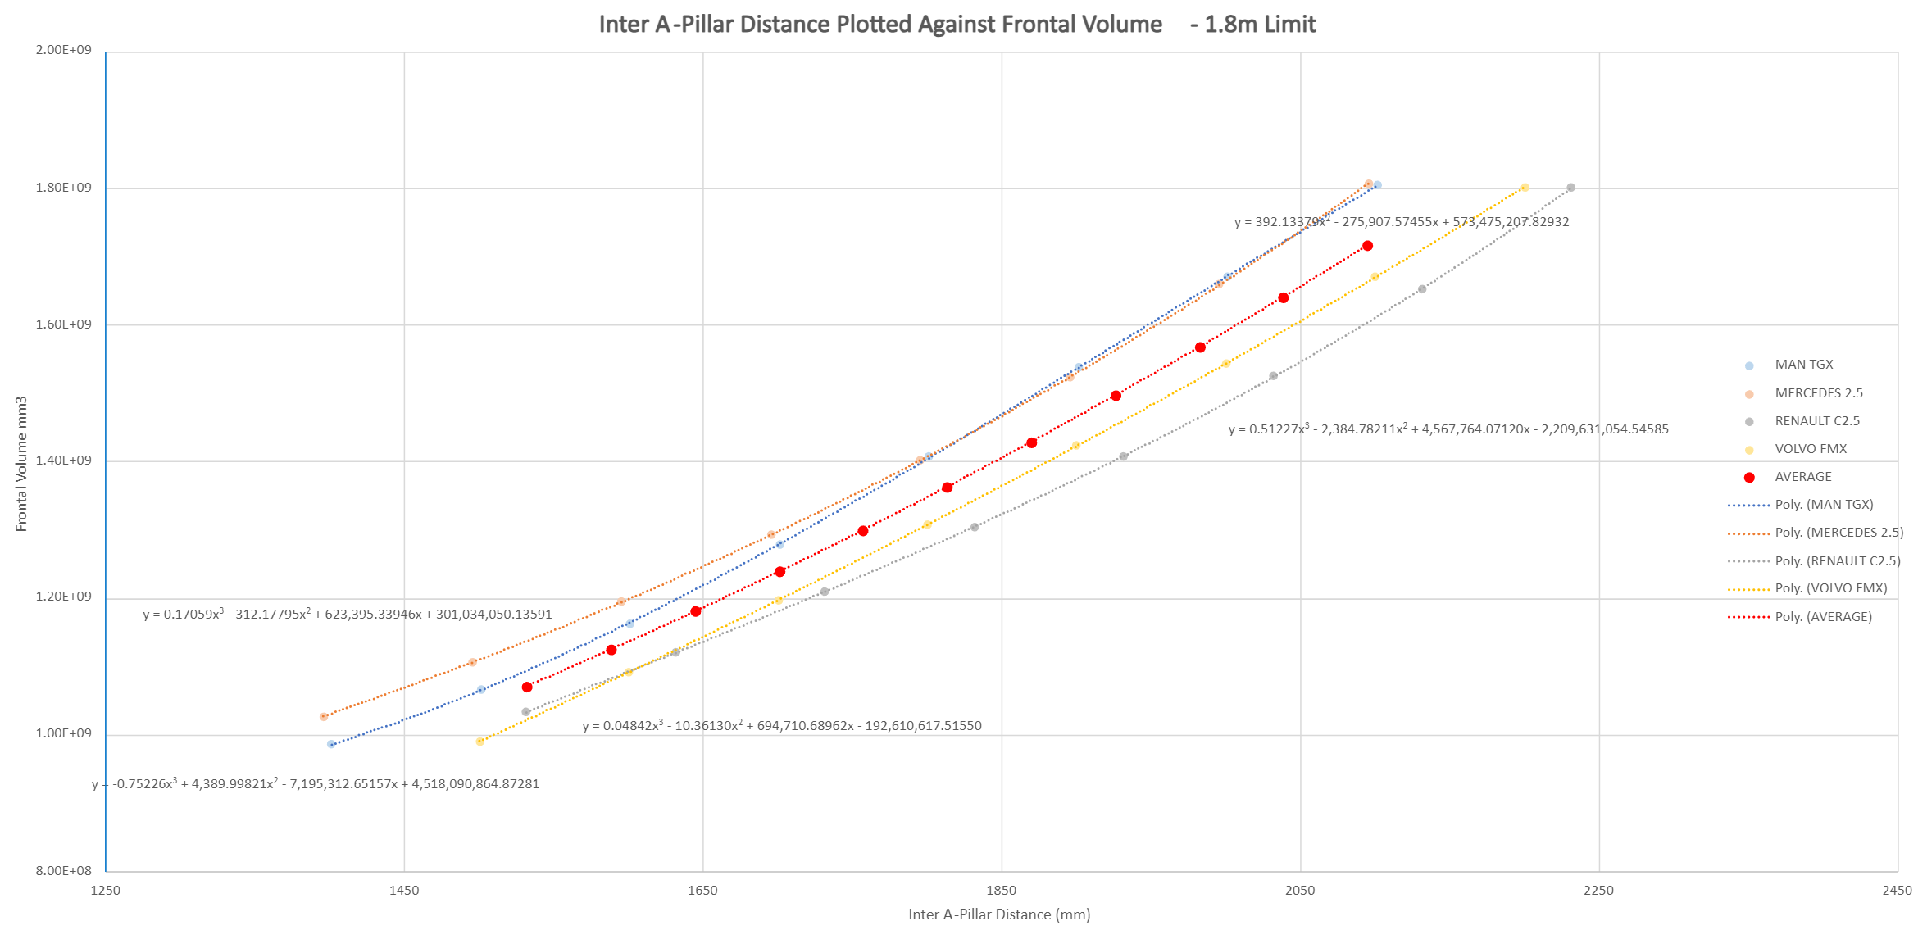
Testing volume required for reduced inter A-pillar distance.
In the last task force meeting we agreed to perform an analysis with the data that we have
We have performed the following steps
Selected a sample of vehicles that have differing dash board designs
  MAN TGX, Daimler 2.5m cab, Volvo FMX, Renault C 2.5
Found the height of the cabs where they meet the 1.8m³ volume requirement for Level 1 vehicles and the same for 1m³ Level 2/3 vehicles.
Reduced the inter A-pillar distance in seven 100mm increments for all vehicles
Plotted these data to generate the graph on the right

Slide 10
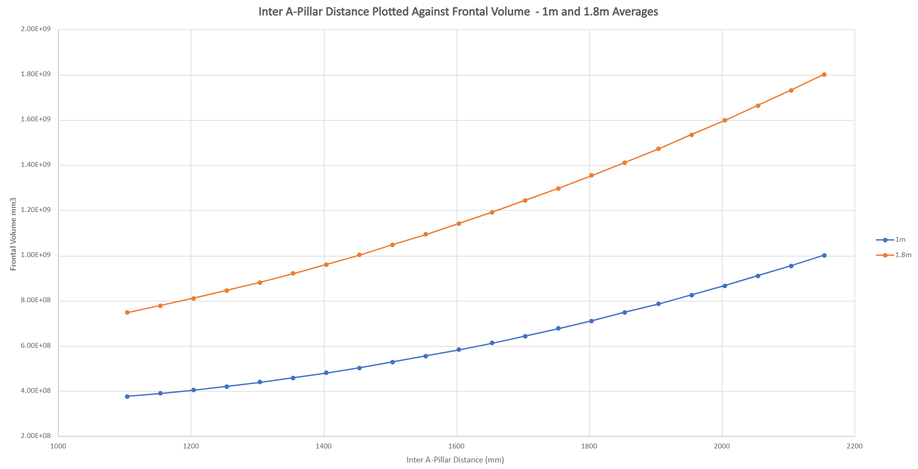
Testing volume required for reduced inter A-pillar distance.
It was proposed at the last meeting that we could average the values for all vehicles at certain A-pillar distances
To enable this we have captured the equations of the curves so that we can use these to find equivalent values at certain inter- A-pillar distance
These data are then used to produce the Average curves shown in the graph where orange is for Level 1 Vehicles and Blue is for level 2 and 3 vehicles
The equation of the red line for 1m³ and 1.8m³ could be used in the standard to derive volume requirements values for any inter A-pillar distance
We then used the new equation of line to extrapolate the curves to cover a wide range of values as the graph on the right
1.8m³ Y=392.13379x2 - 275,907.57455x + 573,475,207.82932
1.0m³ Y=329.82551x2 - 480,212.23549x + 504,819,967.89481

Slide 11
SUmmary
We are happy with the simpler method of measuring inter A-pillar distance
The process followed for the definition of the volume required for reducing inter A-pillar width has gone well and with issues
This led to the proposal that the following equations can be included in the standard to allow a manufacturer to find the exact volume requirement for the exact inter A-pillar distance
This process did highlight a further issue as defined in the following presentation
1.8m³ Y=392.13379x2 - 275,907.57455x + 573,475,207.82932
1.0m³ Y=329.82551x2 - 480,212.23549x + 504,819,967.89481

Slide 12
30th Unece VRU proxi group:
Potential amendment to ensure frontal direct vision requirements
Dr Steve Summerskill

Slide 13
Contents
A new issue which has been identified by the new work recently performed
Reminder of the premise that established the method used for UNECE regulation 167
Highlighting a concern that has arisen which means that designs can be produced which do not meet the ‘spirit’ of the regulation
Ways forward

Slide 14
Proportional front volume by A-pillar width
The content above explores the issue of new designs where A-pillar distance is reduced when compared to vehicle sample that was used to defined DVS system
Decreasing inter A-pillar distance

Slide 15
Addressing the concerns
However, if manufacturers choose to move the A-pillars rearwards towards the driver compared to the original sample they will able to gain volume without improving the view of the area of greatest risk
Area of greatest risk directly in front of the vehicle
Original vehicle design
Redesign moves A-pillars rearwards
Red areas show volume gained outside of area of greatest risk for frontal collisions, potentially allowing a vehicle to pass the minimum requirements without improving direct vision directly in front of the vehicle.

Slide 16
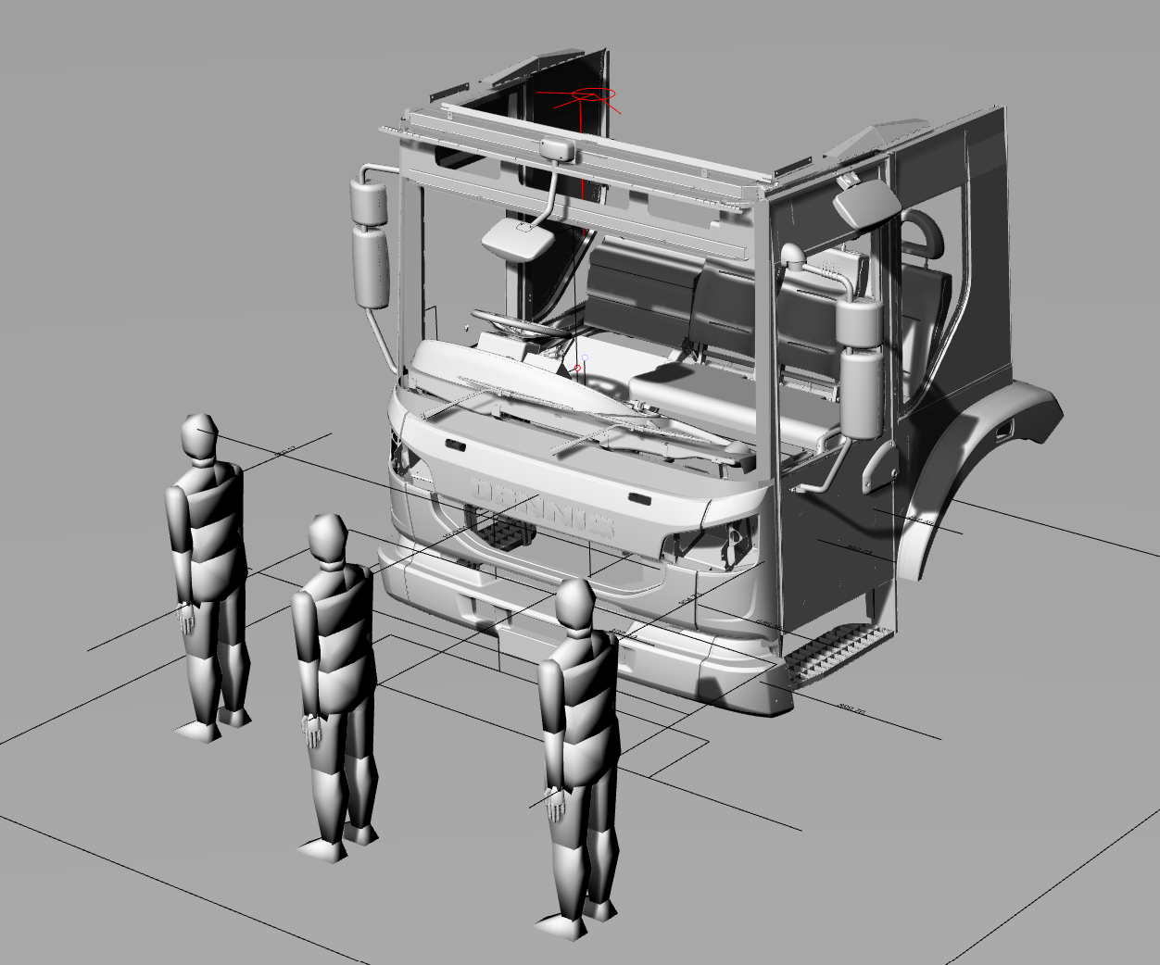
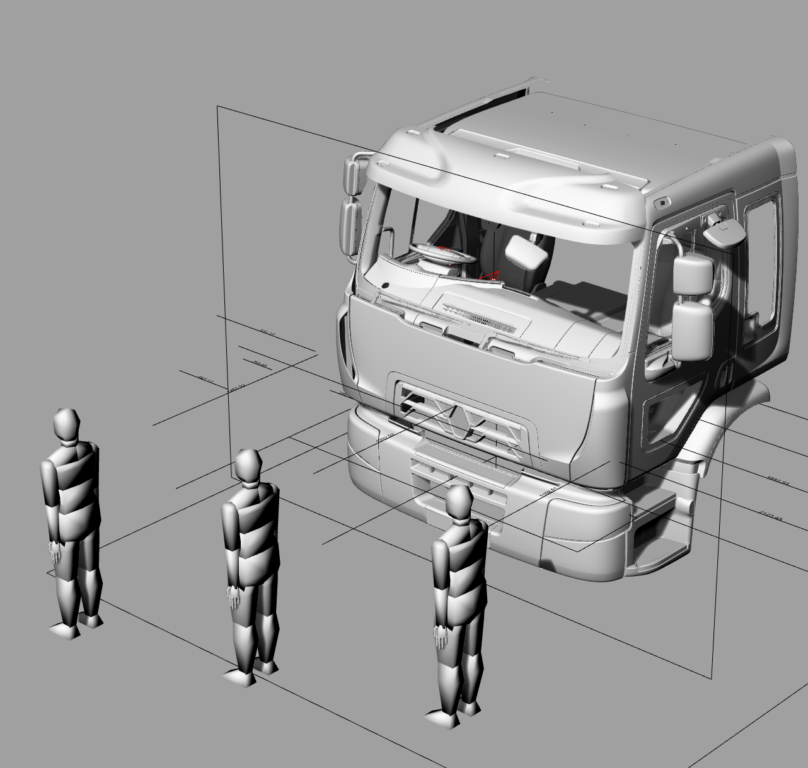
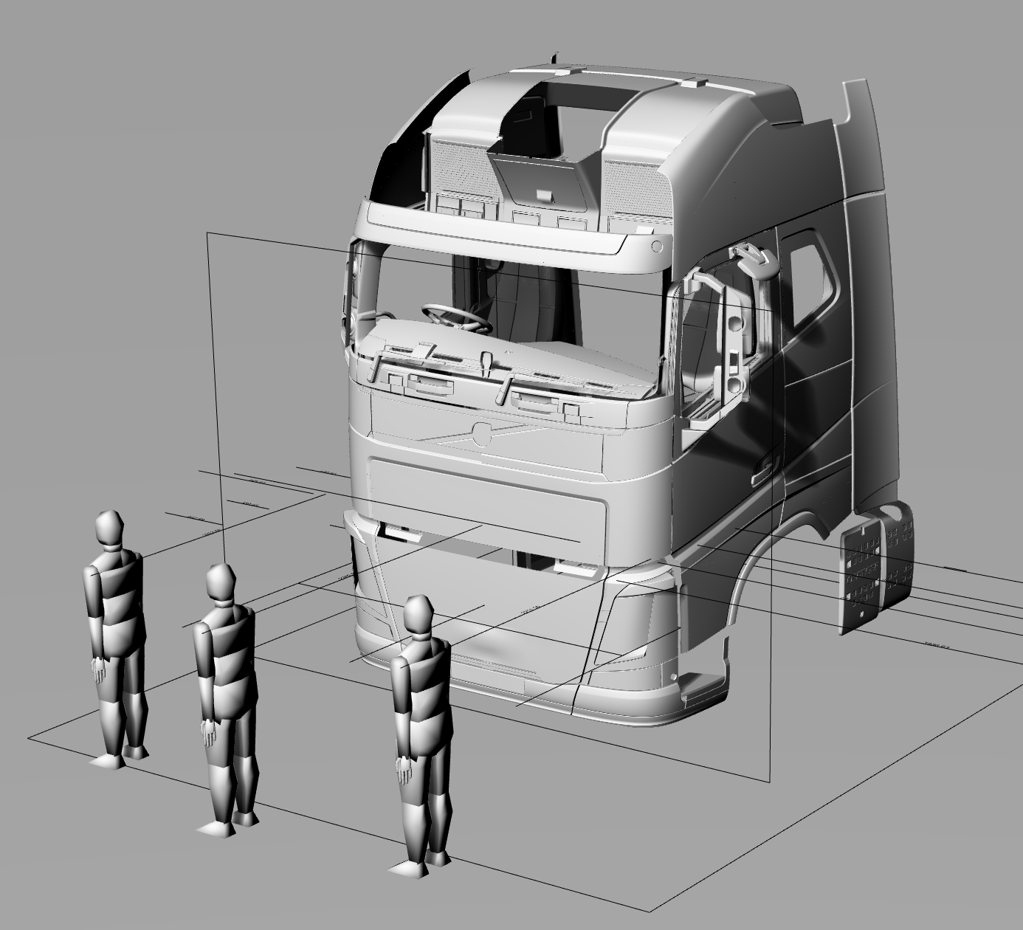
the premise that established the method used for UNECE regulation 167
Excellent
Good
As discussed in numerous VRU Proxi Group meetings, the basic premise of Regulation 167 is that the volumetric approach is given real world context using VRU simulations and the distance from the side and front of the vehicle at which the head of the VRUs can be seen.
For the front of the vehicle this involves the use of the three VRUs that placed directly in front of the vehicle to highlight the area of greatest risk established in the accident data analysis which supported the DVS design.
  The driver should be able to see the VRU approaching the vehicle, and allow the VRU to be seen they are walking directly in front of the cab where possible.
  The Series 00 method defined average frontal VRU distances of 1653mm for Level 1 and 1958mm for levels 2 and 3
Pass

Slide 17
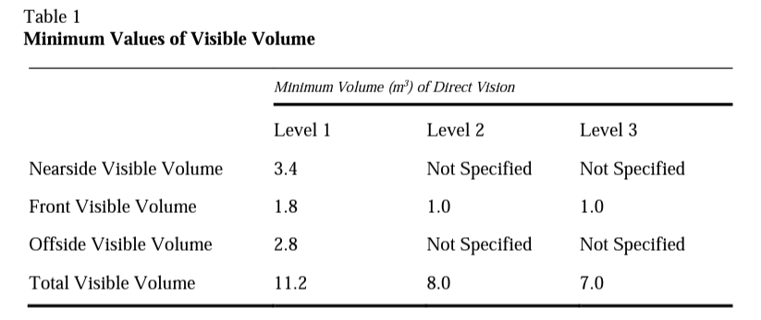
the premise that established the method used for UNECE regulation 167
Defining the separated approach
The LDS spent much time in the VRU Proxi meetings exploring how manufacturers could make design changes to meet the DVS minimum requirements
It was established that manufacturers could meet the minimum requirements by improving older designs to the sides only, resulting in no improvement of direct vision to the front (32% of accidents occur to the front, mostly involving VRUs over the age of 65).
The separated approach was defined to avoid this situation by requiring a volume in front of the vehicle.

Slide 18
the premise that established the method used for UNECE regulation 167
Tech Neutrality
It was noted by manufacturers that the DVS method was not tech neutral in that it is tied to A-pillar position
The LDS team designed a new version of the standard with ACEA which used a subdivided assessment volume to define the requirements, but also repeatedly stated that new method should be equivalent to the Series 00 method shown in Regulation 167
The LDS team highlighted again that the new method (known as option 3) could allow lateral improvements to once again replace the need to see the volume as per the description on the following slide

Slide 19
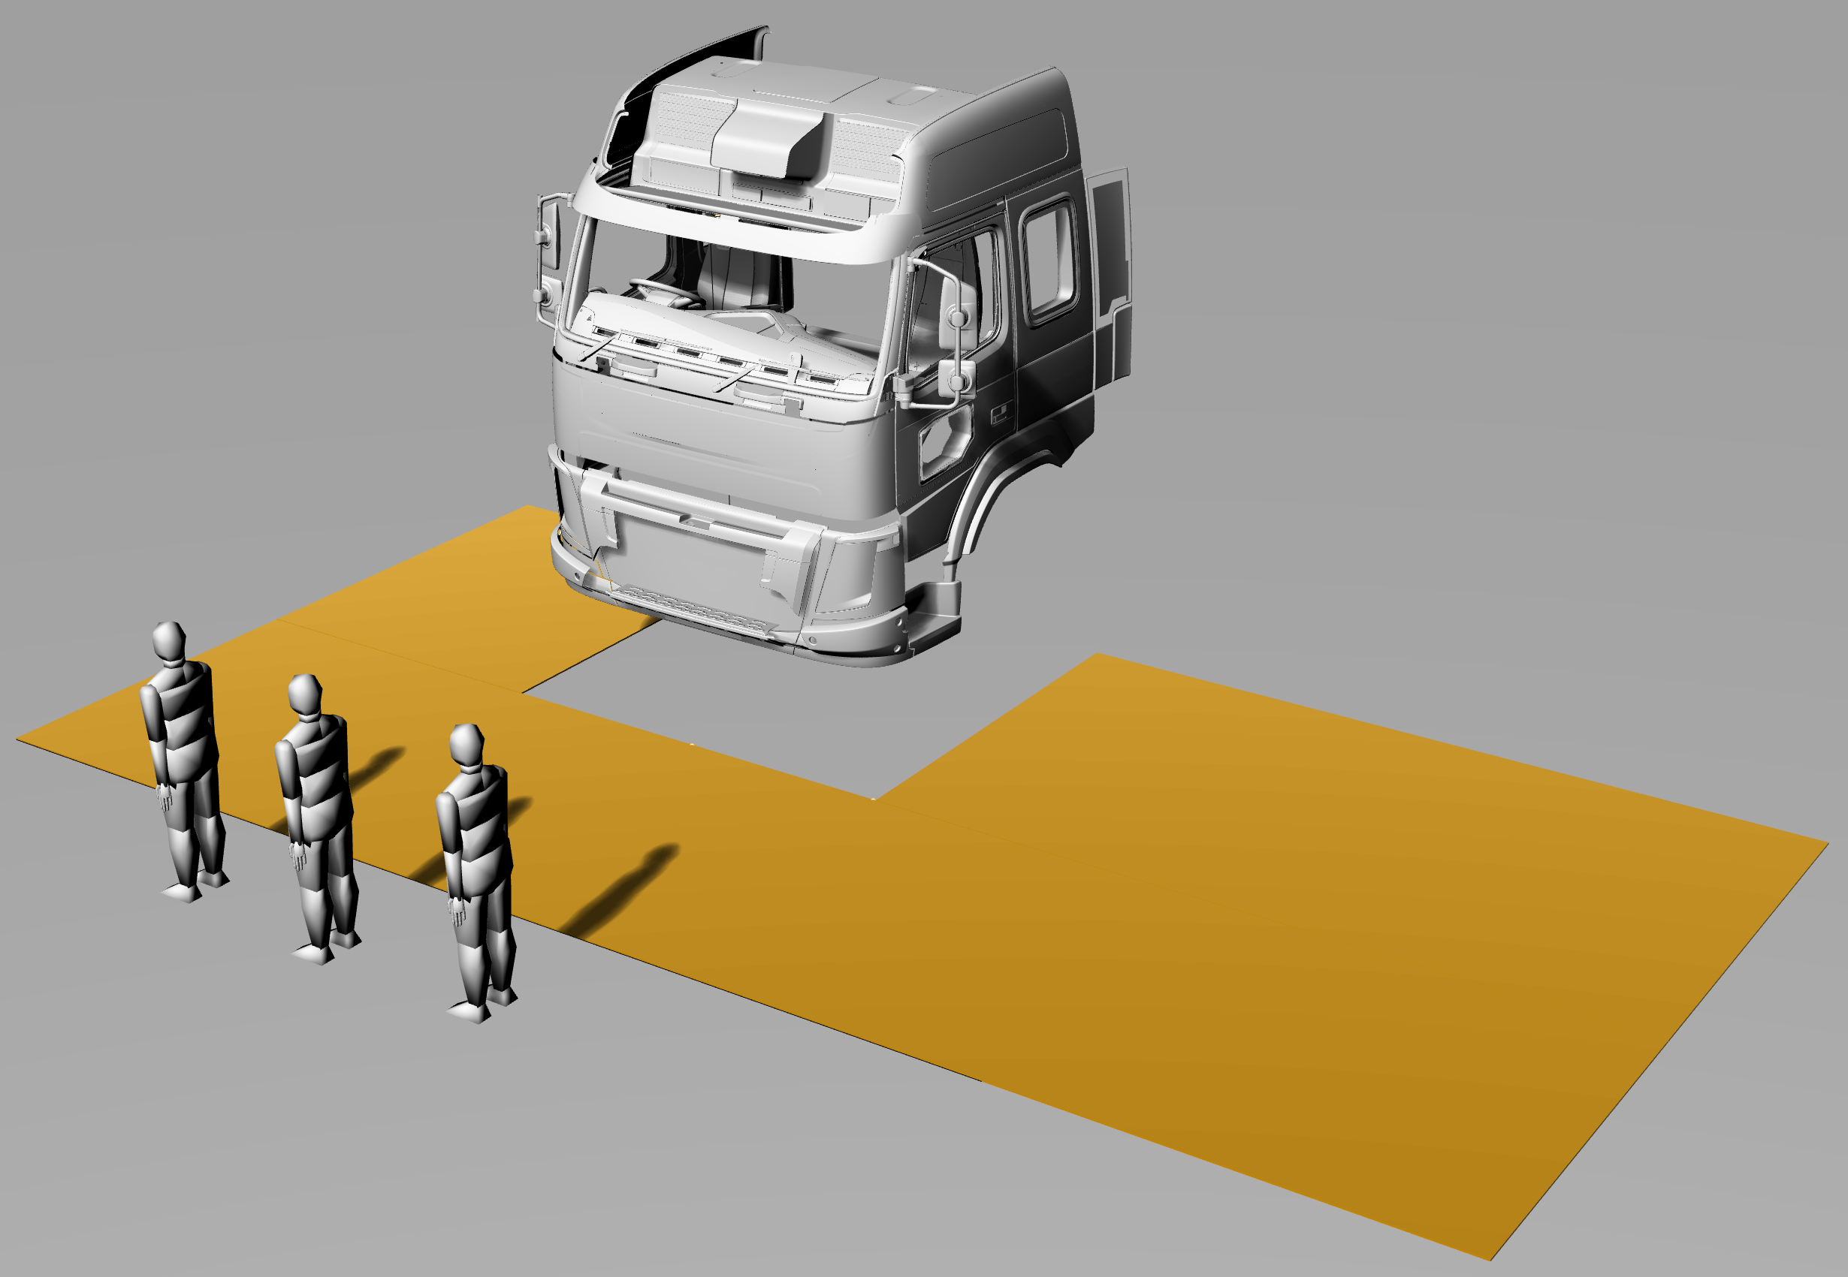
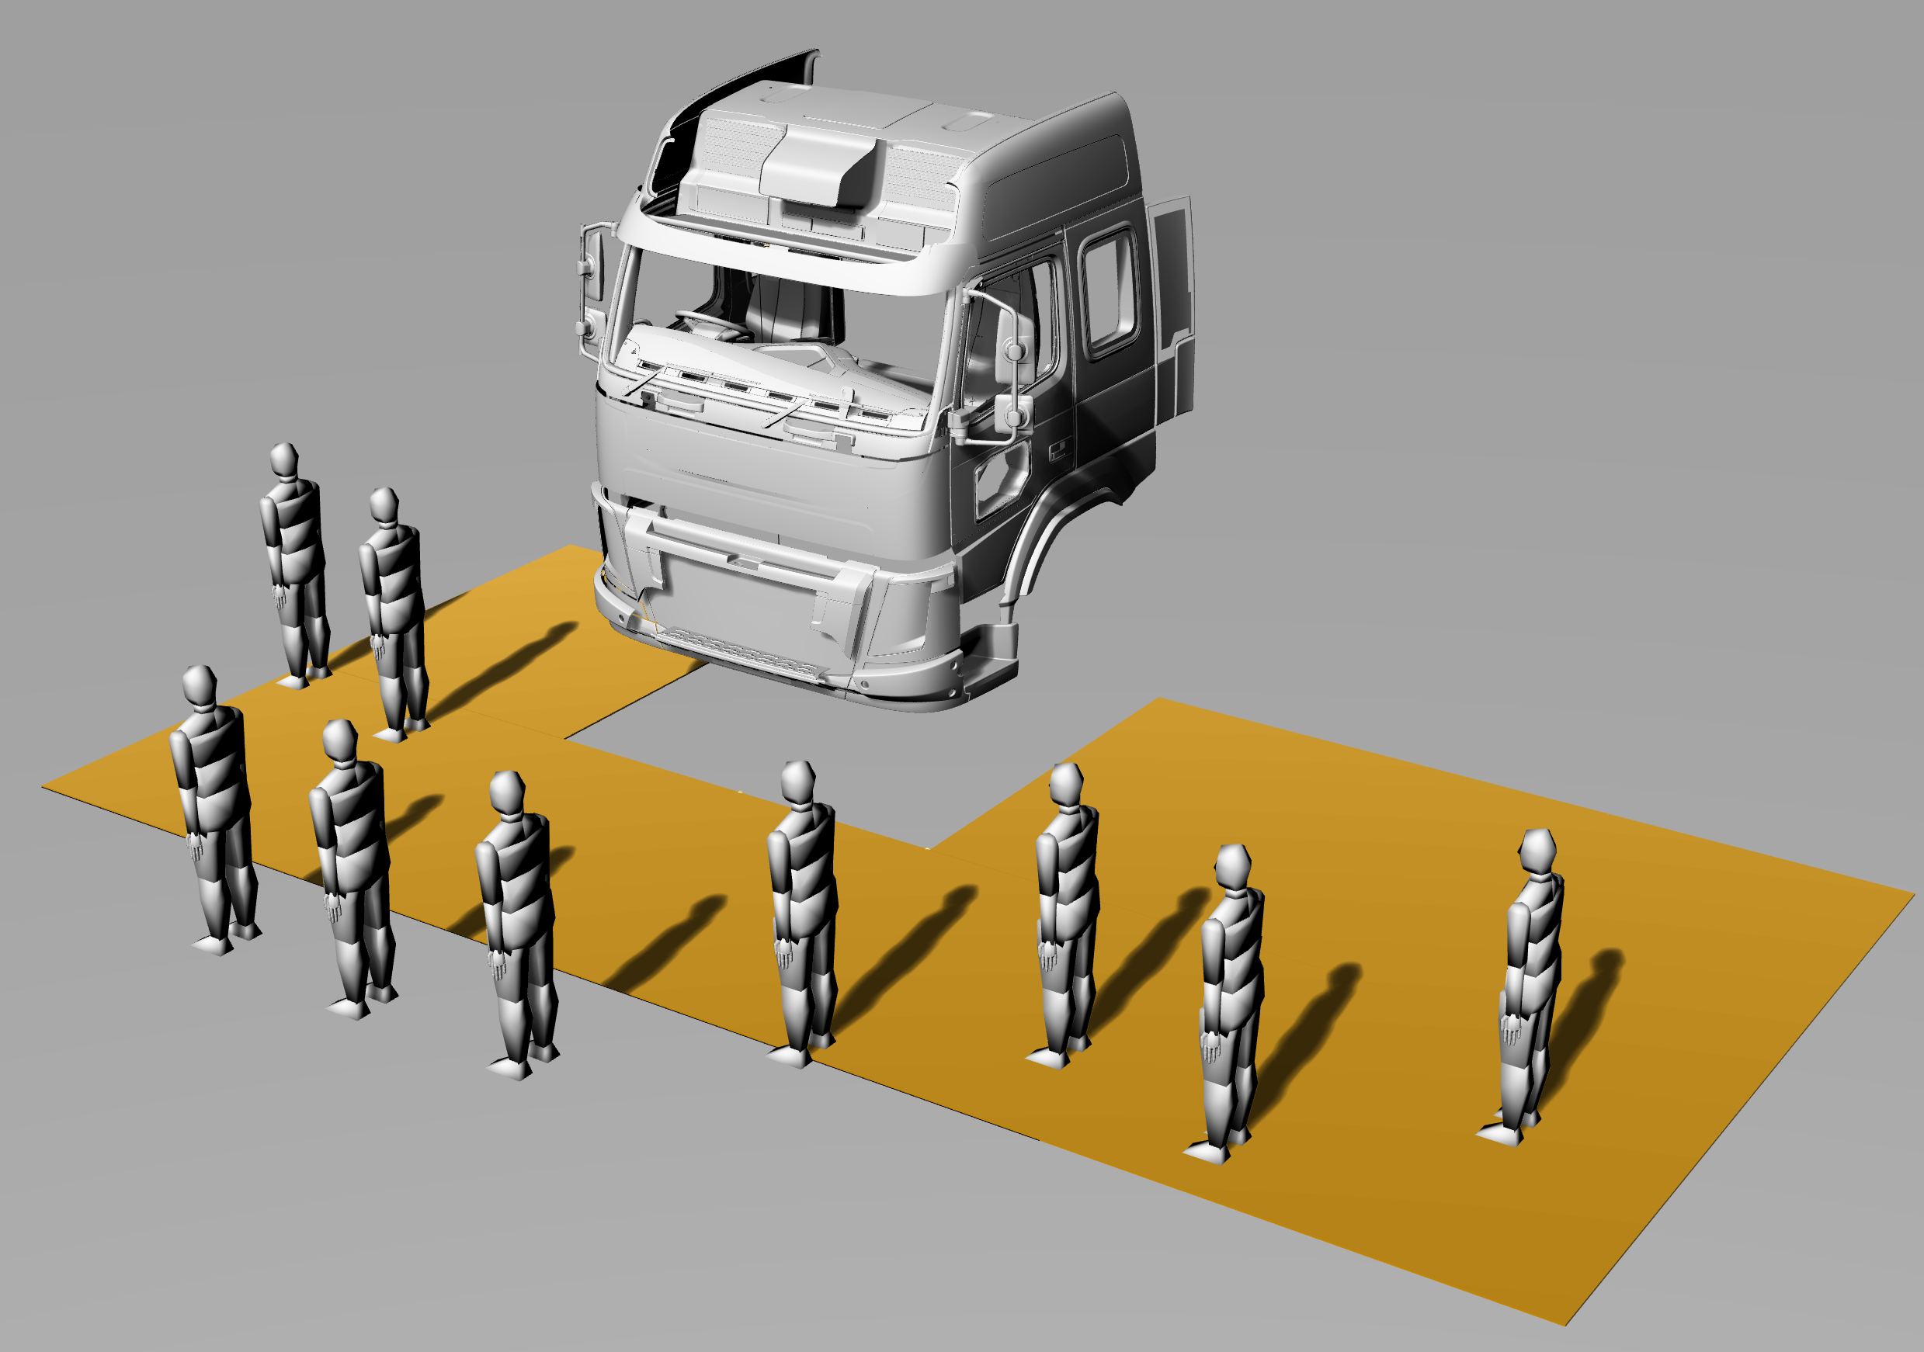
Problems with the new version to address tech neutrality
The new version (option 3 or option 4) once again allowed manufacturers to gain volume by making changes to the side of the vehicle and this means that the original method in the current standard and the amendment version are not equivalent
This can be demonstrated in the example below, in both cases the 3 VRUs directly in front of the cab are in a blind spot between direct vision and indirect vision
167 series 00 - Front
Amendment version - Option 3 method - Front
Outside of the mirror coverage zone
Outside of the mirror coverage zone
The vehicle fails the minimum requirement to the front and must be improved – e.g. lowered overall – lower windscreen and dashboard
This vehicle fails the minimum requirement to the front and must be improved – manufacturers can gain volume by removing mirrors, lowering window edges and can then pass
NO improvement to frontal direct vision blind spots

Slide 20
the premise that established the method used for UNECE regulation 167
Tech Neutrality
We therefore designed a new method to ensure that the intent of the standard (to allow the VRUs in front of the vehicle to be seen) as per the content in the next three sides.

Slide 21
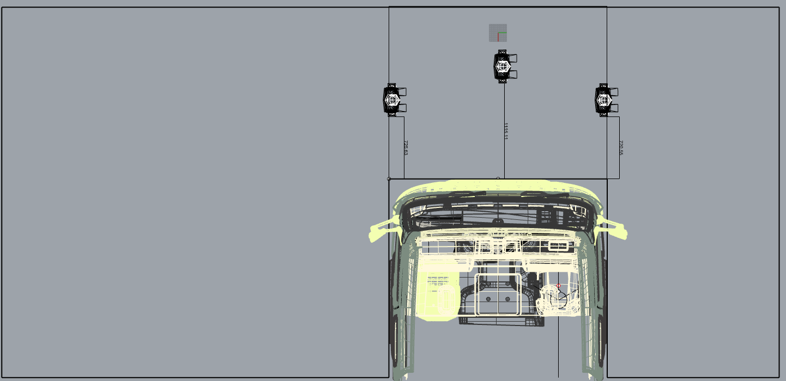
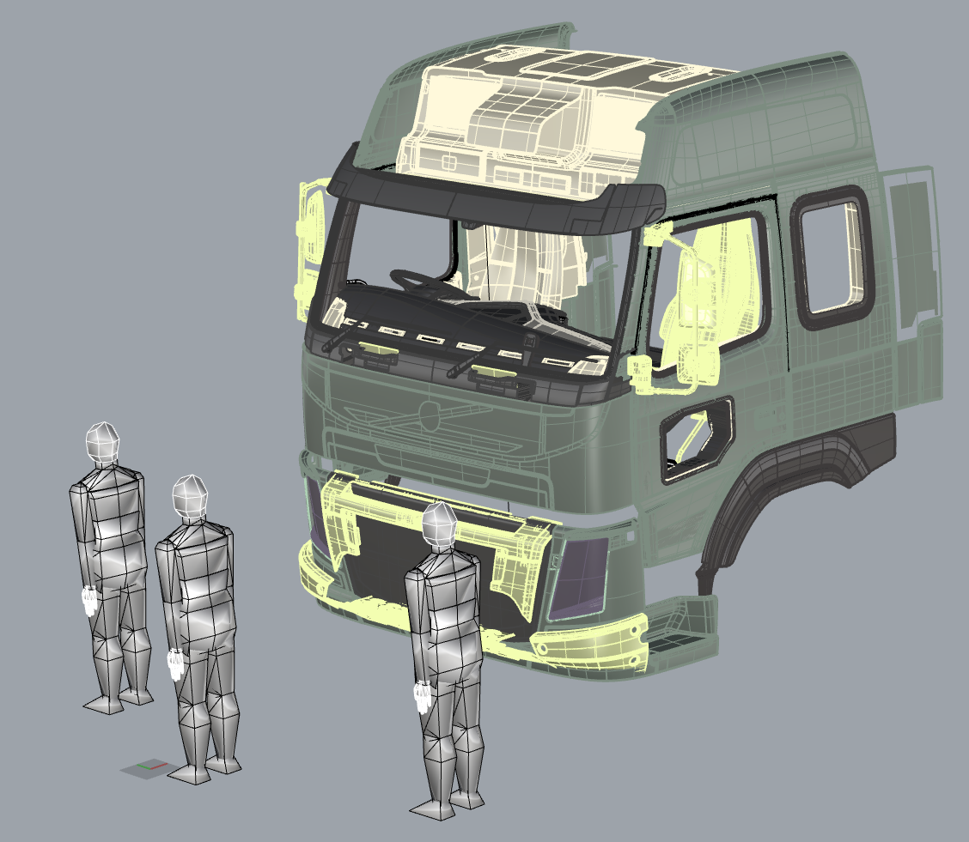
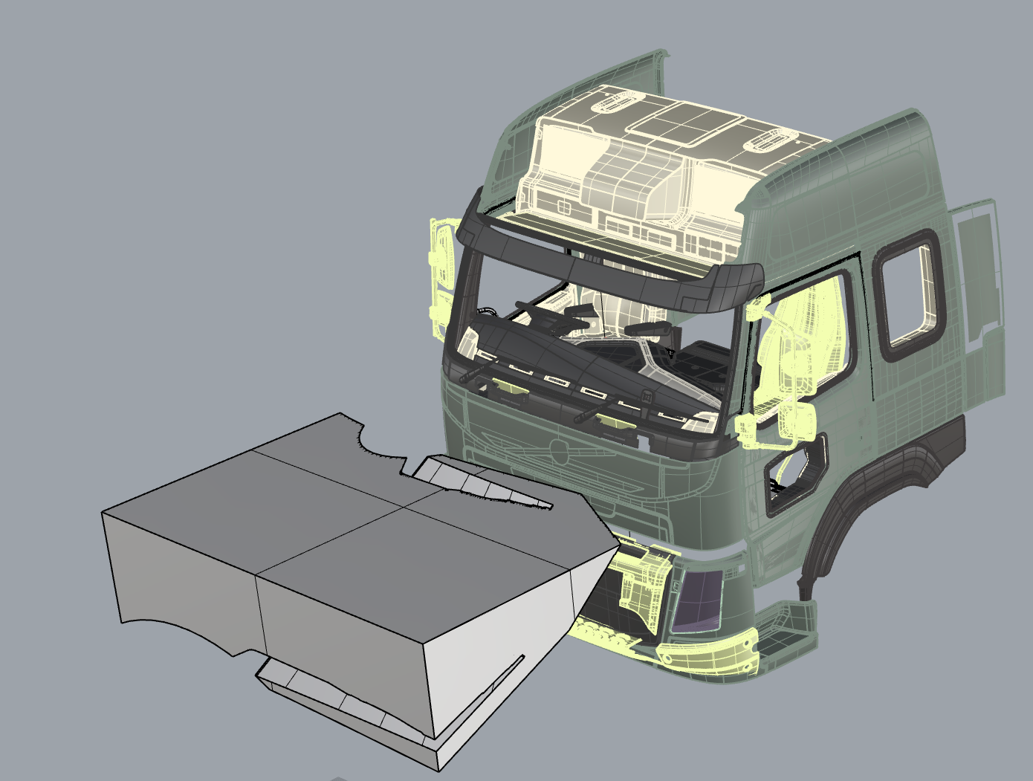
How can we ensure equivalence between the two methods?
The premise is as follows;
  What volume is equivalent to the need to see three VRUs directly in front of the vehicle?
  We needed a way to define a frontal volume
  We have taken the lateral extents of the vehicle to define the volume directly in front of the vehicle as this is the area that contains the three VRUs for the Series 00 method. Frontal Extents Volume (FEV).
  Therefore plotting the VRU distance against the Volume gives a trend line that can be used to calculate the volume that should be seen at a certain VRU distance in the same way as the method used to define the volume requirement for the series 00 version
Three VRUs in front of the cab as defined in Series 00
Plan view of the area within which the VRUs are contained, therefore VRU distance should corelate well with volume as per the previous uses of this method
Volume that is visible between the lateral extents of the vehicle

Slide 22
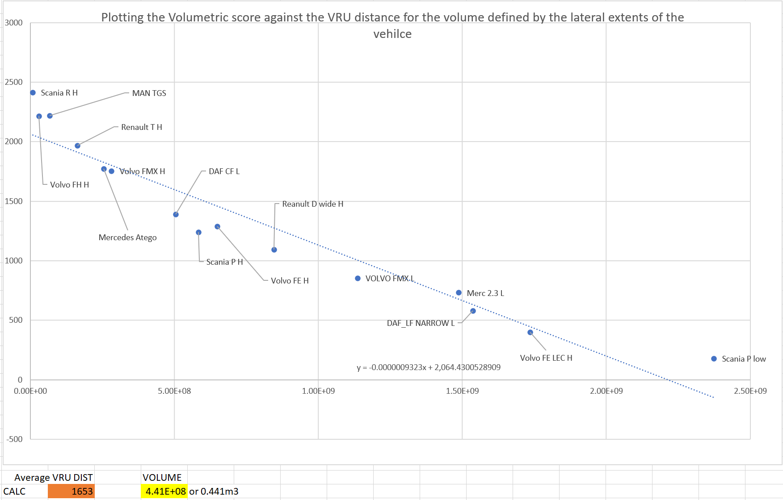
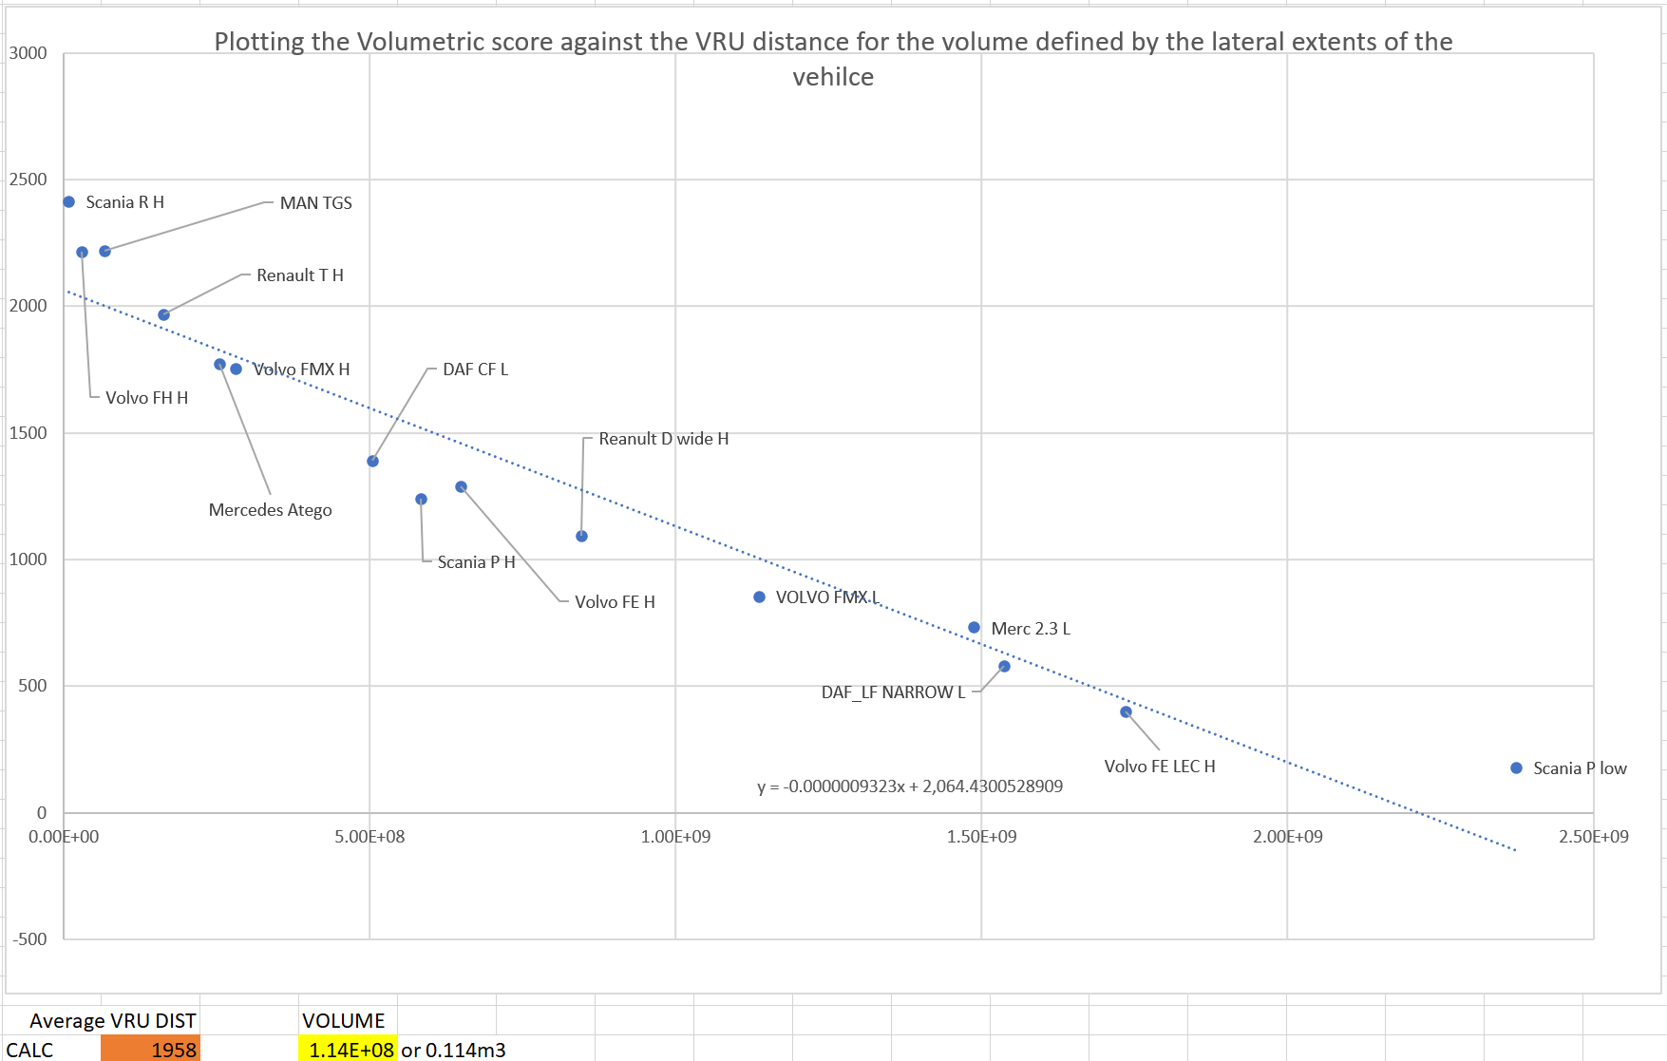
How can we ensure equivalence between the two methods?
So far we have performed this process for 15 vehicles across the sample of 50+
  Therefore the suggested figures for the volume requirement are PROVISIONAL
  As an indicative value for review by manufactures based upon the VRU distances agreed in the Series 00 version table
    Level 1 vehicles (urban) would need to be able to see 0.441m³ in the FEV area (average VRU distance 1653mm)
    Level 2 (construction) and 3 (long haul) vehicles would need to be able to see 0.114m³ in the FEV area (average VRU distance 1958mm)

Slide 23
Addressing the concerns
By requiring a design to allow visibility of the FEV area we can avoid the issue shown below.
Area of greatest risk directly in front of the vehicle
Original vehicle design
Redesign moves A-pillars rearwards
Red areas show volume gained outside of area of greatest risk for frontal collisions, potentially allowing a vehicle to pass the minimum requirements without improving direct vision directly in front of the vehicle.

Slide 24
SUmmary
We have been told in the Task Force that this issue is beyond the current Terms of Reference and so we are presenting this issue to you to get feedback on whether this is worth pursuing
We think that we need a solution to this issue and it would be possible with the content presented today to get an amendment into the standard quickly.
To be clear we propose that the existing frontal requirements be augmented with the requirement for a level 1 vehicle to see 0.441m³ of the FEV area
Level 2 vehicles should be able to see 0.114m³ of the FEV area
We are not making the requirement any more onerous, we are simply ensuring that the design intent of the standard is met
We are happy to discuss

Slide 25
Project information
Thank you for your attention, are there any questions?
Dr Steve Summerskill (s.j.summerskill2@lboro.ac.uk)
Dr Russell Marshall
Dr Abby Paterson
Anthony Eland
Design Ergonomics Group
Loughborough Design School
Loughborough University
United Kingdom

