Slide 1
Documentation: VRU-Proxi-30-02 (OICA) R158_OICA Proposal.
・Paragraph 16.1.1.3., amend to read:
・Paragraph 16.1.1.4., amend to read: as a content check and revision proposal
VRU-Proxi-30-06
【JAMA HD committee of OICA MEMBER /19th.JUNE.2023】

Slide 2
Proposal content:
VRU-Proxi-30-02 (OICA) R158_OICA Proposal
Paragraph 16.1.1.3., amend to read:
"16.1.1.3. Deactivation
The rear-view image shall remain visible during the backing event until either, the driver modifies the view, or the vehicle direction selector is no longer in the reverse position, or the backing event is finished.
Modifying the view means to switch to any other camera views.
The view can may be manually switched off when the vehicle is not moving rearward.
The system may be switched off when the vehicle detects a coupling by means of a coupling device. In that case the monitor may be used to display other views (e.g. view of a rear-mounted camera on a trailer).”
Paragraph 16.1.1.4., amend to read:
“16.1.1.4. Temporarily modified Automatic change of view
When there is a risk of collision, the field of view may change and focus on the collision area.
It shall be demonstrated to the Technical Service that this change of view increases the safety.
When the vehicle is not driving straight, the field of view may change following the vehicle trajectory.
To enable an improved view while manoeuvring (e.g. when there is a risk of collision, or when
the vehicle is not reversing straight), it shall be permitted to temporarily change the view, in such
a way that the requirements laid down in paragraphs 16.1. (default view) and 16.1.1. (object size)
are not fulfilled during this temporarily modified view.
It shall be demonstrated to the Technical Service that this change of view increases the safety.
【JAMA HD committee of OICA MEMBER /19th.JUNE.2023】

Slide 3
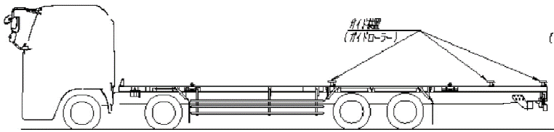
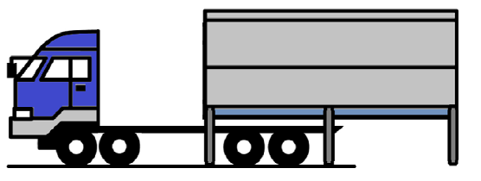
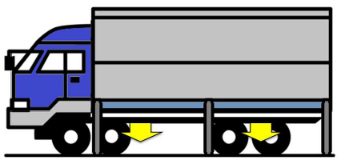
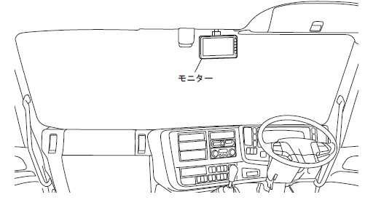
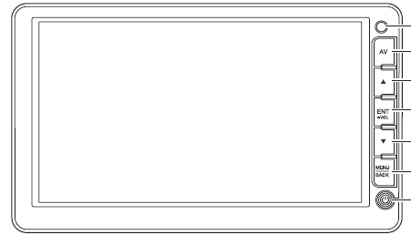
As confirmations and additional proposed revisions
< Confirmation of functions related to detachable body cars >
1- When retreating without a loading platform, A:Camera and A:Monitor provide rear view information to the driver
2- Equipped with a detachable loading platform and when retreating, B:Camera and B:Monitor provide
additional rearward visibility information to the driver
【Points to check】:
Q1: Is the automatic switching between “A:Camera&A:Monitor information” and “B:Camera&B:Monitor
information" compatible?
Q2: With "A:Monitor" and "B:Monitor" as one unit, is the switching display of "A:Monitor Information"
and "B:Monitor Information" compatible?
Ｂ:Camera
Ｂ:Camera
A:Camera
A:Camera
A:Camera
【Proposal points】:
1, When the rear view information
by B:Camera satisfies the specified
performance of UN-R158,
"It complies with this regulation
with a detachable loading platform."
A: The video on the monitor is
A: Camera information
(Visibility performance meets UN-R 158)
A:monitor
B: The monitor's image is
B: Camera information
(Visibility performance meets UN-R 158)
B:monitor
<Driver's cabin>
【JAMA HD committee of OICA MEMBER /19th.JUNE.2023】

Slide 4
Proposal
Add the deficit section to the proposed revision of paragraph 16.1.1.3.
"16.1.1.3. Deactivation
The rear-view image shall remain visible during the backing event until either, the driver modifies the view, or the vehicle direction selector is no longer in the reverse position, or the backing event is finished.
Modifying the view means to switch to any other camera views.
The view can may be manually switched off when the vehicle is not moving rearward.
The system may be switched off when the vehicle detects a coupling by means of a coupling device. In that case the monitor may be used to display other views (e.g. view of a rear-mounted camera on a trailer or the rear of a detachable container bed).”
Add the deficit section to the proposed amendment to Section 16.1.1.4.
“16.1.1.4. Temporarily modified Automatic change of view
When there is a risk of collision, the field of view may change and focus on the collision area.
It shall be demonstrated to the Technical Service that this change of view increases the safety.
When the vehicle is not driving straight, the field of view may change following the vehicle trajectory.
To enable an improved view while manoeuvring (e.g. when there is a risk of collision, or when
the vehicle is not reversing straight), it shall be permitted to temporarily change the view, in such
a way that the requirements laid down in paragraphs 16.1. (default view) and 16.1.1. (object size)
are not fulfilled during this temporarily modified view.
In addition, it shall comply with this Regulation if the view switched in paragraph 16.1.1.3. meets the visibility performance specified in paragraph 15.2
It shall be demonstrated to the Technical Service that this change of view increases the safety.
【JAMA HD committee of OICA MEMBER /19th.JUNE.2023】

Slide 5
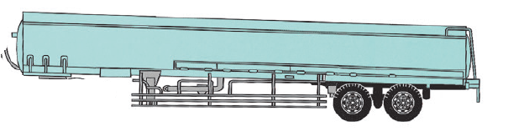
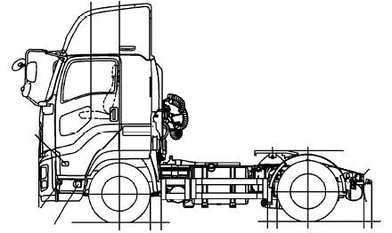
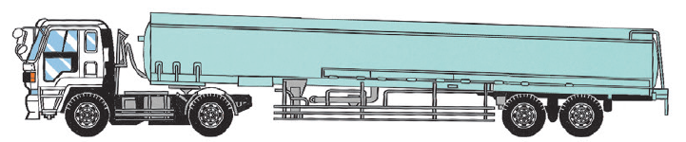
As confirmations and additional proposed revisions
< Confirmation of functions related to detachable body cars >
1- When retreating without a loading platform, A:Camera and A:Monitor provide rear view information to the driver
2- Equipped with a detachable loading platform and when retreating, B:Camera and B:Monitor provide
additional rearward visibility information to the driver
【Points to check】:
Q1: Is the automatic switching between “A:Camera&A:Monitor information” and “B:Camera&B:Monitor
information" compatible?
Q2: With "A:Monitor" and "B:Monitor" as one unit, is the switching display of "A:Monitor Information"
and "B:Monitor Information" compatible?
A:Camera
Ｂ:Camera
Ｂ:Camera
A:Camera
A:Camera
【Proposal points】:
1, When the rear view information
by B:Camera satisfies the specified
performance of UN-R158,
"It complies with this regulation
with a detachable loading platform."
A: The video on the monitor is
A: Camera information
(Visibility performance meets UN-R 158)
A:monitor
B: The monitor's image is
B: Camera information
(Visibility performance meets UN-R 158)
B:monitor
<Driver's cabin>
【JAMA HD committee of OICA MEMBER /19th.JUNE.2023】

Slide 6
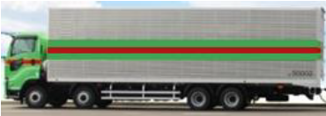
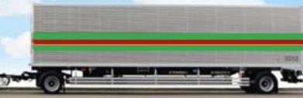
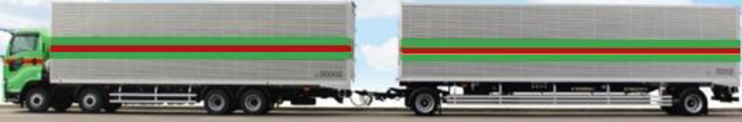
As confirmations and additional proposed revisions
< Confirmation of functions related to detachable body cars >
1- When retreating without a loading platform, A:Camera and A:Monitor provide rear view information to the driver
2- Equipped with a detachable loading platform and when retreating, B:Camera and B:Monitor provide
additional rearward visibility information to the driver
【Points to check】:
Q1: Is the automatic switching between “A:Camera&A:Monitor information” and “B:Camera&B:Monitor
information" compatible?
Q2: With "A:Monitor" and "B:Monitor" as one unit, is the switching display of "A:Monitor Information"
and "B:Monitor Information" compatible?
A:Camera
Ｂ:Camera
A:Camera
Ｂ:Camera
【Proposal points】:
1, When the rear view information
by B:Camera satisfies the specified
performance of UN-R158,
"It complies with this regulation
with a detachable loading platform."
A: The video on the monitor is
A: Camera information
(Visibility performance meets UN-R 158)
A:monitor
B: The monitor's image is
B: Camera information
(Visibility performance meets UN-R 158)
B:monitor
<Driver's cabin>
【JAMA HD committee of OICA MEMBER /19th.JUNE.2023】

