Slide 1
Task Force Direct Vision: Progress & Status
Iain Knight & Johannes Peter Bauer on behalf of the Task force
VRU-Proxi-30-07

Slide 2
Objectives
From Terms of Reference
  Amending the alternative testing method for innovative vehicle designs (e.g. aerodynamic narrow A-pillar designs) by replacing paragraph 5.3. (April 2023 or earlier if possible)
  For vehicles with competing objectives (e.g. improved direct vision versus high capacity transport, high efficiency, new powertrain technology, impact on freight industry) with direct vision challenges an alternative approach could be considered. It shall be limited to Level 3 for N3 category of vehicles and shall be based on quantified data. (October 2023 or earlier if possible)

Slide 3
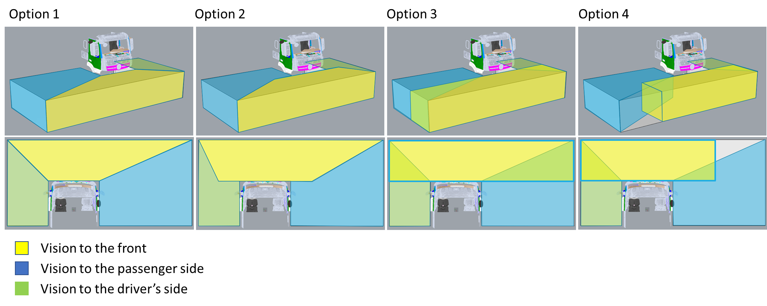
Design Neutrality – Solutions involving different assessment volumes
No Agreement could be reached on this approach. No method was perfect, all had advantages and disadvantages

Slide 4
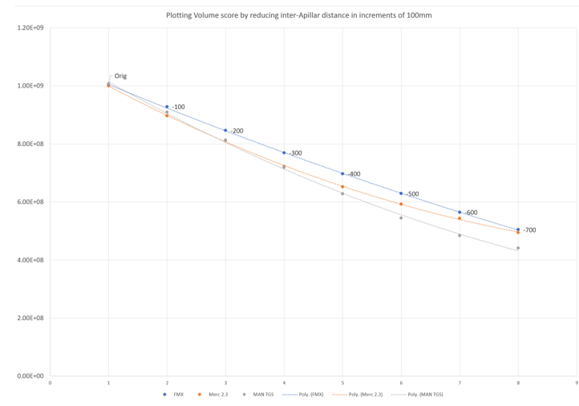
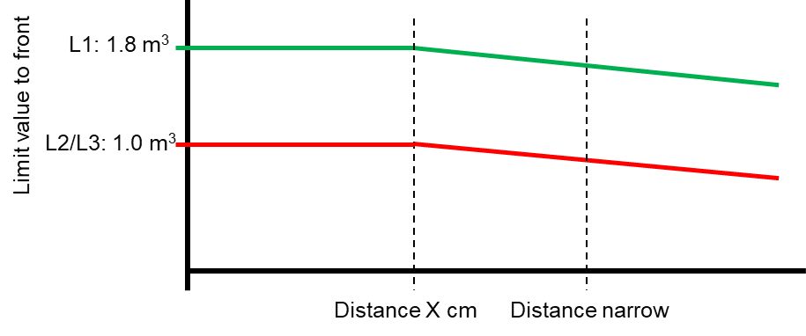

Alternative: Design Dependent approach (DDA)
Simpler Approach based on scaling the frontal limit value based on the distance between A-pillars
Working on key definitions now
  How to fairly measure inter A-pillar distance without unintended consequences
  By what formula/factor should the volumetric limit value change, bearing in mind variable dashboard shapes etc that may make it non-linear

Slide 5
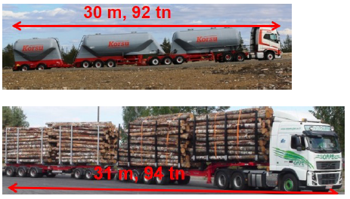
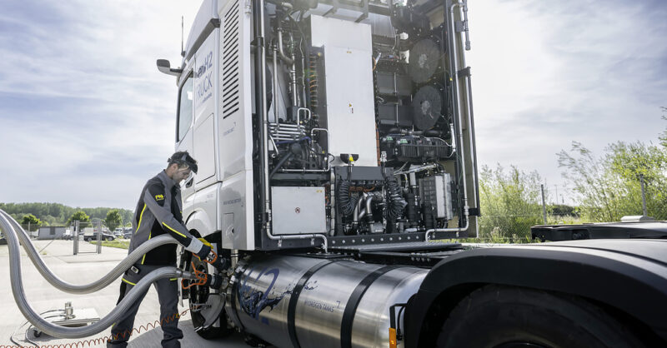
Alternative Approach for Competing Objectives
High Capacity Transport (HCT) Concept
  Sweden has proposed general text to deal with this issue
  ACEA has proposed identifying features as follows:
    3 or more axles
    Minimum 320 kW power (independent of power train type)
    Maximum permitted combination mass in country of sale more than 50 tonnes

Slide 6
Outstanding issues
Further evidence to be presented on key principles for DDA – decisions required
Draft Text required for the DDA
Revised limit value required for the ‘competing objectives’ proposal

