Slide 1
Brief summary of DCAS
TF ADAS 26/06/2023

Slide 2
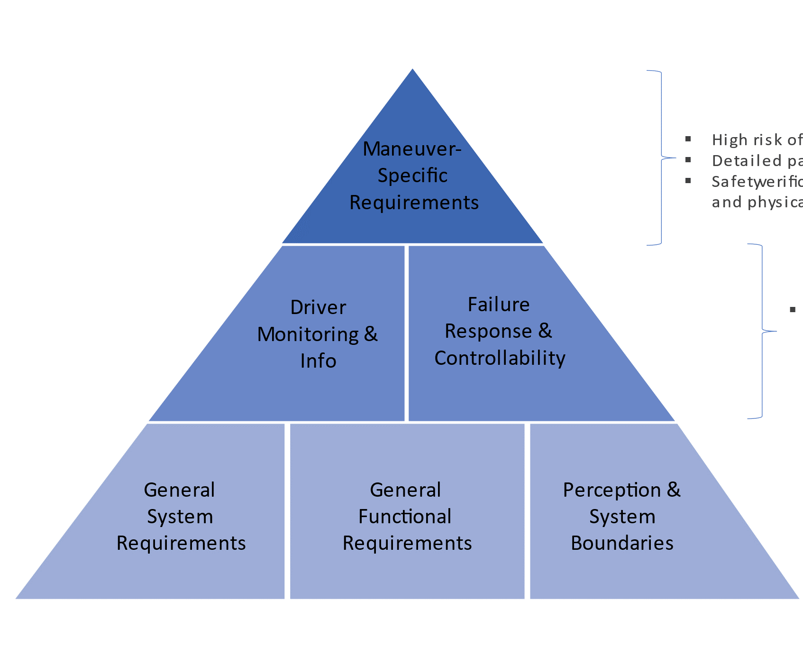
DCAS system in general
Definition
means hardware and software collectively capable of assisting a driver in controlling the longitudinal and lateral motion of the vehicle on a sustained basis containing at least one feature, which is specified under section 6 in this Regulation and which requires the driver to be engaged and to monitor the environment, and vehicle/system performance, permanently.
Phase 1: Implement the main concept with agreed features
Phase 2: Implement further more complex features

Slide 3
New Assessment Method (ADS)
Traditional type approval
Design requirements
Strict testing conditions
?
Pass fail criteria
Pass
Fail
Notes:
The EC adopted an innovative approach to define safety requirements into the EU ADS Regulation, blending different criteria for the definition of the acceptable level of safety:
- Safety as a measurement, defining expected driving behaviours correlated to safety outcomes;
- Safety as a process, relating to the pervasiveness of attention to safety across a developer and its activities and personnel (i.e. corporate safety culture);
- Safety as a threshold, by meeting a goal based on human-driving performance and technology potential.
An innovative approach was also adopted for the safety assessment, according to the principle of the multipillar approach developed at UNECE level (described in VMAD NATM Document and Guidelines):
AUDIT & ASSESSMENT
PHYSICAL TESTING
IN-SERVICE REPORTING after market introduction and throughout the ADS lifetime
SCENARIOS CATALOGUE as common framework between authorities and manufacturers

Slide 4

Safety Assessment (ANNEX 3)
The safety concept complies with the legislative requirements
It has been correctly implemented into the design
Safety Concept matches the ODD
Is correctly documented
Assessment report by Authority
Information Document
Formal documentation package
Confidential material
Notes:
ASSESSMENT:
The safety concept complies with the legislative requirements
It has been correctly implemented into the design
It has been validated (through virtual, track and real world testing)
Is correctly documented
Assessment report by Authority
The documentation package to be submitted is composed by three parts:
The Information Document, as described in Annex I
The formal Documentation package, that will contain detailed information about all the points above (safety concept, design, validation…)
All confidential material that will be made available for inspection at the manufacturer premises (eg results of the safety analysis)

Slide 5
Audit – ANNEX 3
Audit
Description of DCAS
functions and control strategies
DCAS
layout and schematics
Safety Concept
Manufacturer’s
Safety Management System
Results of physical tests
performed by the manufacturer
Compliance with specific provisions
of DCAS UN Regulation
Assurance of DCAS controllability
Functional safety
& Risk Assessment
SOTIF
Virtual testing (voluntary)
Declared safety performance of the system (Appendix 4)
Validation by testing – Pass/Fail criteria

Slide 6

Physical testing
TRACK TESTING
Basic capabilities
Critical/emergency situations
Repeatability
PUBLIC ROAD TESTING
Final verification
Normal operation in real world
Representativeness

Slide 7
Declaration and validation of system capabilities
Aimed to outline system/feature performance to support testing
Operating Ranges of each feature
Operating Domain of each feature
System capability to respond to other road users
System capability to follow the course of the lane
System’s ability to ensure safe operation when assisting lane changes
System’s ability to operate in accordance to traffic rules for a certain maneuver

Slide 8


In-Service Monitoring and Reporting (ISMR)
Learning from in-service data is a central component to the safety potential of DCAS
Guiding principle that safety is of global concern and its improvement should not be limited by geographical or organizational borders (ECCAIRS)
Objectives: Safety confirmation, scenarios generation, safety recommendations
EDR
EDR
DSSAD
Reduced information requirements in Phase 1

Slide 9
DCAS Multi-Pillar Assessment – In-Service
Monitoring
Periodic Reporting to the Approval Authority
Manufacturer must maintain processes to monitor safety-critical occurrences resulting from DCAS operation
Manufacturer must notify Authority without undue delay of any severe accidents where DCAS was active, or active [x] seconds before accident, resulting in:
  Deployment of airbags and/or restraints
  Activation of emergency systems
Any safety-critical occurence within system boundaries which may impact the broader safe use of DCAS, must be investigated and notified to the Authority (incl. applicable remediations)
Approval Authority shall have authority to request investigation results from the manufacturer [within 6 months of the occurence or accident] subject to national rules
Example List of ccurrences, list to be agreed with authority
Occurrence | Periodic Reporting [1 Year]
1.a. Safety-critical occurrences known to the DCAS manufacturer | X
1.b. Aggregated distance driven with Paragraph 6 features switched on or active | X
2.a. Detection of prolonged driver disengagement, resulting in a warning cascade | X
2.b. Activation of an emergency system, such as a Risk Mitigation Function, due to the continuous driver disengagement | X
3.a Detected system-level failures resulting in the unavailability of DCAS | X
3.b Detected DCAS-deactivations without prior warning to the driver | X
3.c Detected driver response to system deactivation | X

Slide 10

Thank you!
© European Union 2023
Unless otherwise noted the reuse of this presentation is authorised under the CC BY 4.0 license. For any use or reproduction of elements that are not owned by the EU, permission may need to be sought directly from the respective right holders.
Slide 14: image left-hand side, source: heiko119; Slide 14: image right-hand side, source: ERA; Slide 15: image, source: garagestock
Notes:
Update/add/delete parts of the copy right notice where appropriate.
More information: https://myintracomm.ec.europa.eu/corp/intellectual-property/Documents/2019_Reuse-guidelines%28CC-BY%29.pdf

