Slide 1
Implementation of RXSWIN in UN Regulations
Context
In the next years, more and more vehicles will get UN R156 type approval (software update and software updates management system) as it will become mandatory in EU and Japan.
It is hence important for all stakeholders to clarify how the RXSWIN can be declared in the different system type approvals if the vehicle manufacturer implements an RXSWIN.
The Consolidated Resolution on the Construction of Vehicles (R.E.3), Annex 7, defines provisions on Software Identification Numbers (integration of RXSWIN in system type approvals) http://www.unece.org/fileadmin/DAM/trans/doc/2020/wp29/ECE-TRANS-WP29-2020-082e.pdf:
…
3.1. For the purpose of ensuring the software of the System can be identified, an RXSWIN may be implemented by the vehicle manufacturer.
3.2. If the manufacturer implements an RXSWIN, the following shall apply:
…
Intensive discussions within industry and with stakeholders from authorities.
Definition in R156 (software update): "Rx Software Identification Number (RXSWIN)" means a dedicated identifier, defined by the vehicle manufacturer, representing information about the type approval relevant software of the Electronic Control System contributing to the UN Regulation No. X type approval relevant characteristics of the vehicle.

Slide 2
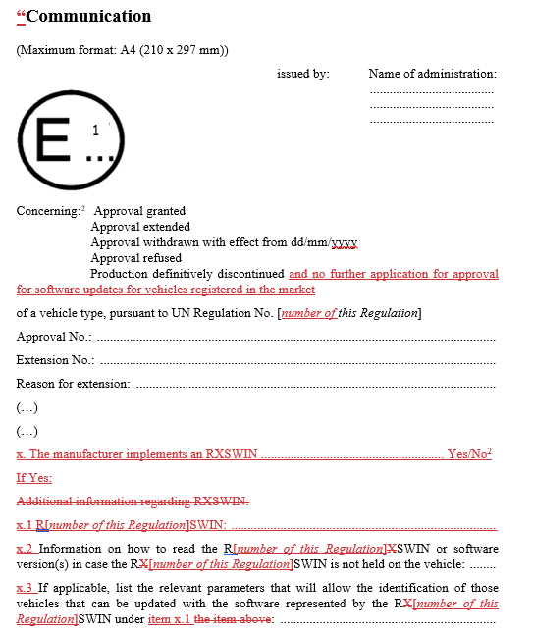
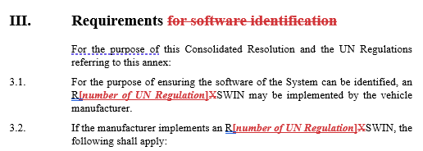
Implementation of RXSWIN in UN Regulations
Proposal to amend RE3 Annex 7
The proposal is to use the Consolidated Resolution on the Construction of Vehicles (R.E.3), Annex 7, “If the manufacturer implements an RXSWIN, the following shall apply…”, and suggest some necessary amendments:
Leave detailed definitions and requirements for software identification in RE3 Annex 7 as one central document.
In all relevant UN Regulations, add additional paragraphs referring to RE3 Annex 7 and amend the Annex “Communication”.

Slide 3
Implementation of RXSWIN in UN Regulations
Which UN Regulations to amend?
Industry tried to identify those UN Regulations where software updates may have an impact on the type approved characteristics.
However, this depends primarily on the individual vehicle design (electrical/electronic architecture).
For this reason, an individual discussion for all 165 UN Regulations seems not efficient.
As the RE3 does not mandate the use of RXSWIN:
  … an RXSWIN may be implemented by the vehicle manufacturer.
  If the manufacturer implements an RXSWIN, the following shall apply: …
an efficient solution could be to amend all relevant UN Regulations with the text of RE3 Annex 7.
This flexible solution would open the way for new technologies and would reduce long discussions (e.g., software may even change the type approved characteristics of head restraints R17/R25 and of external projections R26).

