Slide 1
Calibration procedure to reduce track-to-track variability, using the SRTT tyre
IWGMU-26-03
Brussels, Nov.9, 2023
Results from the ELANORE project.
Truls Berge, SINTEF

Slide 2
The ELANORE project
The "EU tyre LAbelling system for NOise and rolling REsistance" is a joint international project between Gdansk University of Technology (GUT, PL), SINTEF (N) and EKKOM (PL).
Project period: 2020-2024. Budget: Approx. 1.2 mill EURO.
It is funded within a joint agreement between Norway Grants and the National Centre for Research and Development (NCBiR) in Poland (POLNOR 2019 Call – Energy, transport and climate)
Main objectives: To improve the efficiency of the EU tyre label both concerning rolling resistance and noise.

Slide 3
ELANORE:
The main work consists of:
Studying the representativity of the test methods for rolling resistance, as specified in Reg.117, compared to measurements on real, conventional roads. Furthermore, to propose a practical method on rolling resistance that correlates better with measurements on real roads.
Studying the representativity of the rolling sound measurements in Reg.117, by comparison of measurements conducted on selected ISO tracks and on conventional roads. Both using the CPX method and controlled pass-by method (CPB) as defined in Reg.117. Furthermore, to propose an improved method for measuring tyre/road noise for labelling purposes.
Estimation of the impact on the environment of the proposed improved EU Tyre labelling procedures for rolling resistance and noise.
Both rolling resistance and rolling sound measurements include the use of the drum facilities of GUT for comparison purposes.

Slide 4
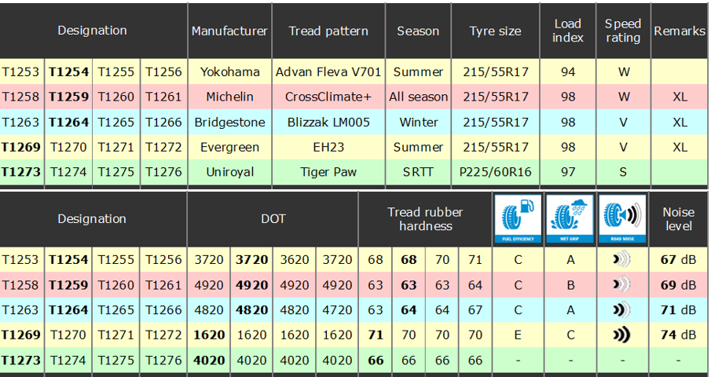
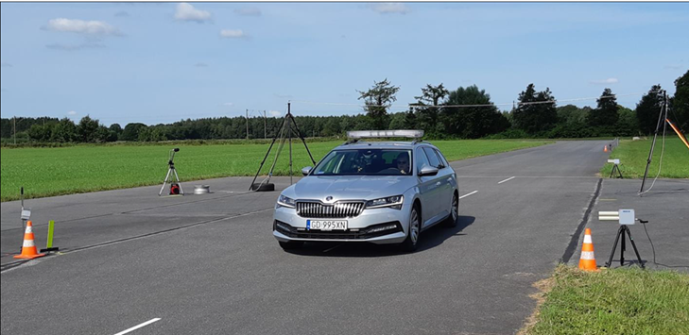
Test tyres and test vehicle:
Test vehicle: Skoda Superb Combi, 2.0 TSI

Slide 5
Round Robin Test on
ISO test tracks and on roads:
Two tests were performed:
UN ECE Reg.117 with speeds from 40 to 90 km/h. Tyre load = 530 kg and tyre inflation pressure = 200 kPa
A Light Test (LT) with same speed range as for Reg.117. Tyre load = 460 kg and tyre inflation pressure = 230 kPa
The LT: a reduction of the load with approx. 13 % and increase of the tyre inflation pressure with 15 %
The LT conditions were chosen to be more representative of normal use of the vehicle

Slide 6
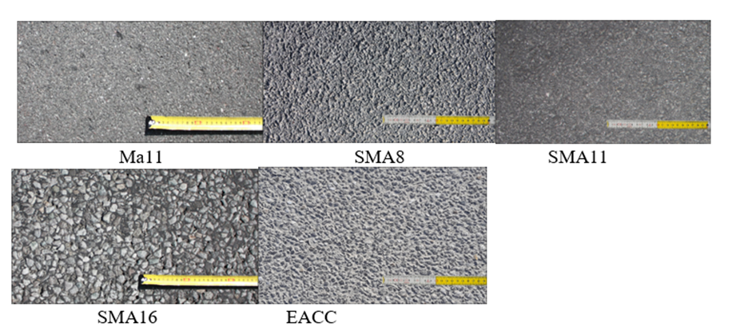
Test tracks and roads:
4 ISO test tracks (ISO1-ISO3 measured in 2021 and ISO4 measured in 2022).
5 trafficked pavements, measured in 2022:
Ma11 ("soft" asphalt), used in Norway on low trafficked roads, SMA8 (Poland), SMA11 (Poland), SMA16 (Norway), EACC (Poland)

Slide 7
ISO Test track information:

Slide 8
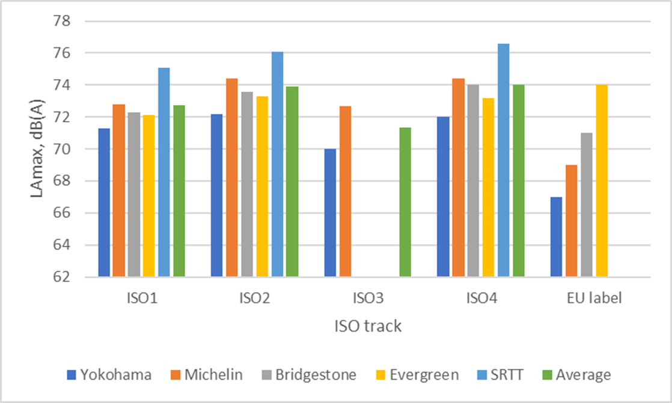
Results on ISO test tracks:
Note1: ISO4 had an MPD = 0.95, above the upper limit of 0.70 and
was repaved sometime after these measurements were performed
Note 2: Due to adverse weather conditions on ISO3, only 2 tyres were measured here

Slide 9
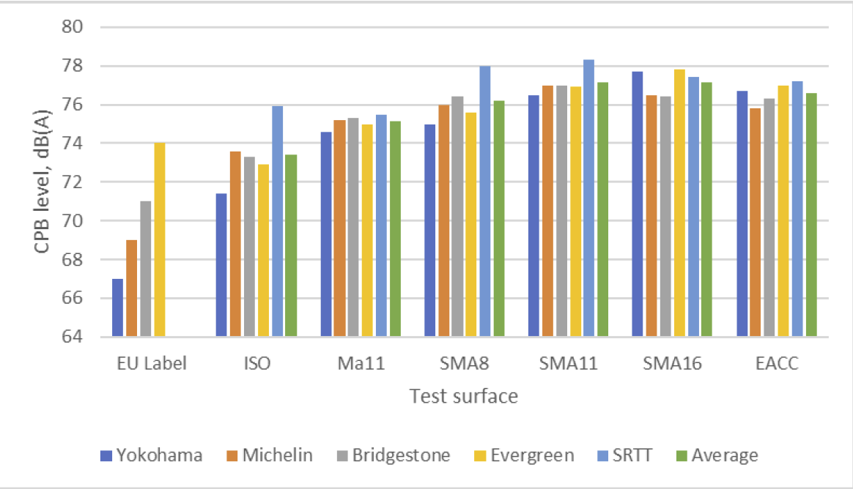
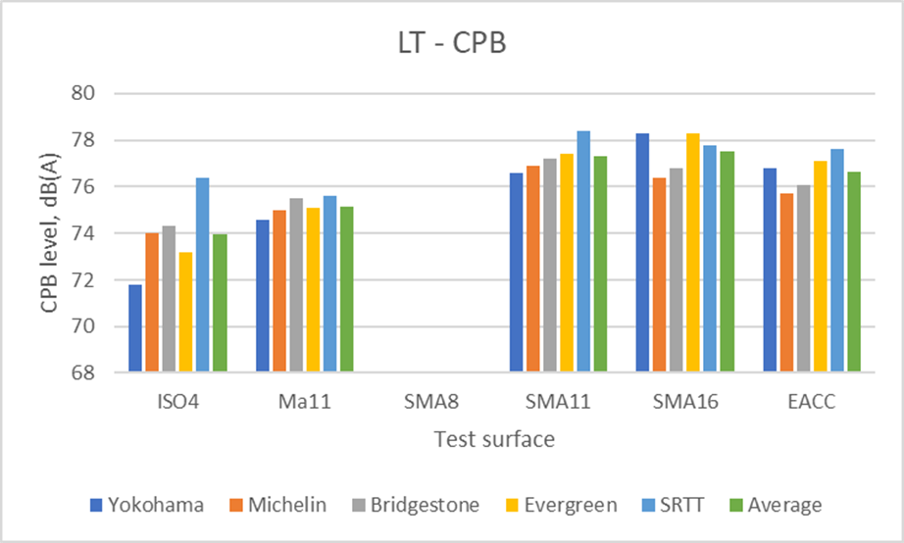
Measurement results on trafficked pavements, compared to ISO4:
Reg.117: Light Test:

Slide 10
ISO Test track – Measured temperatures

Slide 11
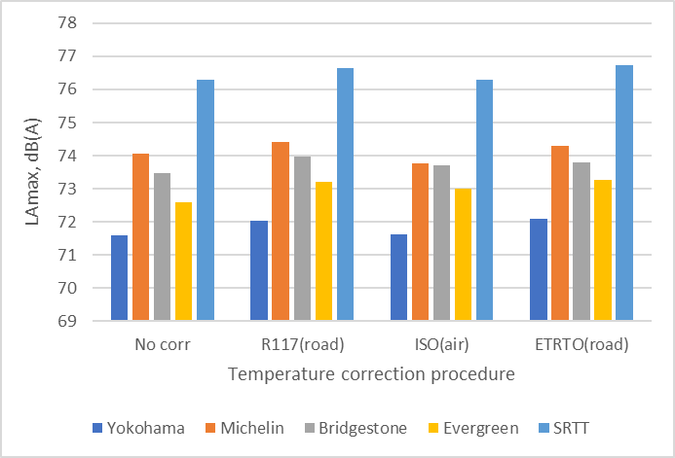
Temperature compensation procedures applied on ISO4 test track results:

Slide 12
Test track calibration – to reduce test track variations - options:
Calibration using reference tyre/"average" tyre: CPB or CPX measurements
Modelling of test track properties: Texture properties (VDA equation)
Round Robin Tests: To perform RRT at regular time intervals to determine how the track properties differ between each other and establish a "reference" level (costly and may not be practical)
3D printed reference surface: May be challenging to be laid on real test track, and may be more suitable for drum measurements

Slide 13
ELANORE and VDA RRT as basis for test track calibration procedure, based on SRTT16. Important: On all test tracks, a number of measurements on a set of normal tyres must be available from RRT.
List all measured levels on each test track of the SRTT tyre and calculate the average level of this tyre from all tracks
Calculate the average sound level from the set of normal tyres on each test track
For each of the test track, subtract the average calculated SRTT level from the average sound level. This will be the "correction factor" for the specific test track
Subtract this "correction factor" from the calculated average level (from a set of normal tyres) and the result will be the "calibrated" test track value

Slide 14
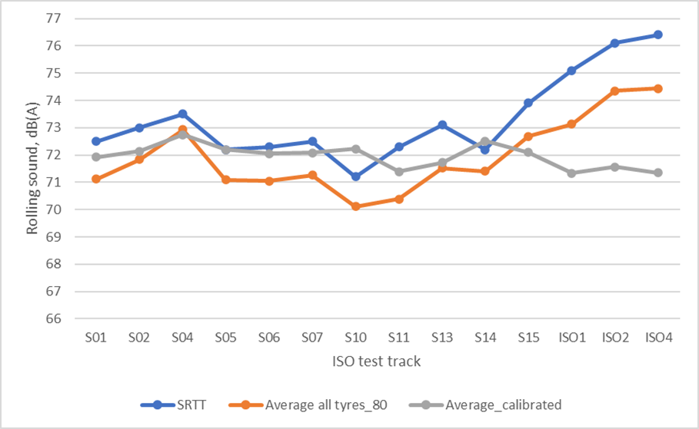
Result of calibration procedure - SRTT16:
Track-to-track variability was reduced
from 4.3 down to 1.3 dB
NOTE: Tyres measured on VDA ISO tracks (S01-S15) were pass-by measurements NOT according to Reg.117,
Just controlled pass-by with presumable less load and higher tyre inflation pressure, set of tyres, compared to ELANORE
(ISO1-ISO4). Also, different test vehicles (VDA: VW e-Golf, ELANORE: Skoda Superb).

Slide 15
Correction factors for VDA and ELANORE RRT ISO test tracks, based on SRTT16:

Slide 16
Thank you!

