Slide 1
GRPE A-LCA IWG
1st SG5(EoL) Meeting
26th June 2023
GRPE A-LCA IWG SG5
Leader ; Shoji Aoki (JASIC/JAMA)
Co leader; Zhang Tongzhu (CATARC)

Slide 2
Agenda
KY
1. SG5 organization introduction
2. Meeting management & communication
3. Overall & 3 months schedule
4. EoL LCA discussion
1) EoL level concept
2) “CONTROVERSAL” TOPICS
5. Next action

Slide 3
1. Organization
-Organization Chart-
SA
A-LCA IWG
Leading team
Sub group5
LEADER(2)
Leader
Shoji Aoki (JASIC/JAMA)
Co-Leader
Zhang Tongzhu (CATARC)
MAIN
PARTICIPANTS
(9)
SG5 Leading team;
Leaders + Core member*
Secretary; Tetsuya SUZUKI
Japan
･Katsuya YAMAMOTO (JASIC/JAMA)*
・Tetsuya SUZUKI (JASIC/JARI)*
China
・Tianning ZHAO (CATARC)*
・Mingnan ZHAO (CATARC)*
France
・Elodie COLLOT
OICA
・Matthieu GOY
・Juliette QUARTARARO
CLEPA
・Dominique MARTINEAU
European Aluminium
・Benedetta NUCCI
OBSERVERS(32)
UN
・1 member
China
・2 members
EU
・2 members
Korea
・4 members
AVERE
・1 members
OICA
・2 member
CLEPA
・16 members
EGEA
・4 members

Slide 4
SA
2. Meeting management
& Communication -Meeting structure-
 | Chair | Participant | Secretariat | Frequency | Meeting timing
GRPE A-LCA IWG | IWG Leader/ Co leader | All IWG CPO/NGO’s | IWG Leading team | - | -
SG5 Leading Team Meeting | SG Leader/ Co leader | SG Core member | SG Secretariat | Bi weekly | 1^{st ;} 8th June 2nd ;21st June
SG5 Meeting | SG Leader/ Co leader | MAIN PARTICIPANTS/ OBSERVERS | SG Secretariat | Monthly | Kick off & 1st meeting; 26th June

Slide 5
SA
2. Meeting management
& Communication -Communication-
- Discuss and decide SG5 meeting agenda in SG5 leading team meeting
- Arrange SG5 meeting with the meeting agenda through e-mail by SG5 Secretariat
- How to meet; On line (Teams) basis, F2F/hybrid case by case
- Make SG5 meeting minutes by SG5 Secretariat
- Approve the minutes by SG5 leaders and Issue
minutes by SG5 Secretariat
- Arrange an interpreter for the communication, e.g. Meeting, Materials, Minutes, by each party if needed because the official communication language is English

Slide 6
3. Overall & 3 months Schedule
SA
 | 2023 |  |  |  |  |  |  |  | 2024 |  |  |  |  |  |  |  |  |  |  |  | 2025
 | 5 | 6 | 7 | 8 | 9 | 10 | 11 | 12 | 1 | 2 | 3 | 4 | 5 | 6 | 7 | 8 | 9 | 10 | 11 | 12 | 1 | 2 | 3 | 4～
Main activities |  |  | Develop Methodologies |  |  |  |  |  |  |  |  |  |  |  | Finalize Methodologies |  |  |  |  |  |  |  |  | ☆Jun. GRPE ☆ Nov. WP.29
 |  |  |  |  |  |  |  |  |  |  |  |  |  |  | Drafting
GRPE A-LCA IWG | ☆23 ☆30 |  | ☆10 |  | ☆ 7 | ☆ 17 - 18 |  |  | ☆ |  |  |  |  | ☆ |  |  |  |  |  |  | ☆
SG5 leading team Meeting | ☆10 ☆26 | ☆6 ☆21 | ☆3- ☆18- | ☆ ☆ | ☆ ☆ | ☆ ☆ | ☆ ☆ | ☆ ☆ | ☆ ☆ | ☆ ☆ | ☆ ☆ | ☆ ☆ | ☆ ☆ | ☆ ☆ | ☆ ☆ | ☆ ☆ | ☆ ☆ | ☆ ☆ | ☆ ☆ | ☆ ☆ | ☆ ☆
SG5 Meeting |  | Kick off & 1st meeting ☆ 26 | (☆) |  | ☆ | ☆ | ☆ | (☆) | ☆ | ☆ | ☆ | ☆ | ☆ | ☆ | ☆ |  | ☆ | ☆ | ☆ | (☆) | ☆
Level concept
Definition & Initial target

Slide 7
KY
Agenda
1. SG5 organization introduction
2. Meeting management & communication
3. Overall & 3 months schedule
4. EoL LCA discussion
1) EoL level concept
2) “CONTROVERSAL” TOPICS
5. Next action

Slide 8
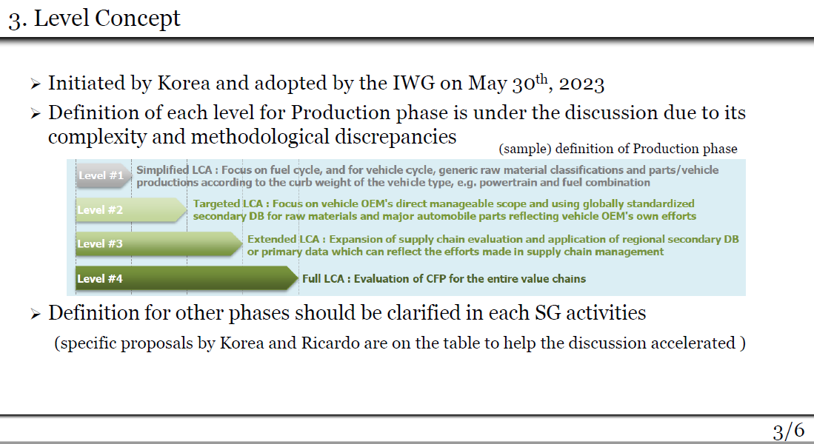
Level Concept
SA
“Definition of levels & Initial target level” to be reported in 17-18th Oct. GRPE IWG @ Brussel
Schedule
 | June | July | August | Sept. | Oct.
GRPE A-LCA IWG |  | ☆10 |  | ☆7 | ☆17-18
SG5 Meeting | 1st meeting ☆26 | (☆) |  | (☆) | ☆
#1 Study by each party
#2 Study
Leading Team Proposal
Discussion
Discussion
Final discussion

Slide 9
EoL level concept proposal
Achievement target
KY
SG/Level |  | Lv.1 Simplified/Generic LCA | Lv.2 Targeted LCA | Lv.3 Extended LCA | Lv.4 Full LCA
(Example) Level concept |  | Focus on fuel cycle, and for vehicle cycle, generic raw material classifications and parts/vehicle productions according to the curb weight of the vehicle type, e.g. powertrain and fuel combination | Focus on vehicle OEM's direct manageable scope and using globally standardized secondary DB for raw materials and major automobile parts reflecting vehicle OEM's own efforts | Expansion of supply chain evaluation and application of regional secondary DB or primary data which can reflect the efforts made in supply chain management | Evaluation of CFP for the entire value chains
Level concept of vehicle cycle in detail |  | F focusing on evaluating GHG emissions from a fuel cycle and a generic model vehicle | Focusing on precise evaluation of GHG emissions within vehicle OEM’s manageable scope to incorporate the OEM's own efforts to reduce carbon emissions on a specific vehicle | By extending the assessment of GHG emissions to supply chains, vehicle OEM's initiatives to reduce GHG emissions beyond its management scope could be demonstrated | Assessment of GHG emissions for the entire value chains
SG5 | End of life | No EoL evaluation | Global/Generic secondary data | Regional secondary data /partial primary data | Primary data
 |  |  | Covering 50% of total process | Covering 80% of total process | Covering 100% of total process
 |  |  | Cut off | CFF application for important materials/Parts | CFF application for all materials, parts and process scrap
 |  |  | Current basis | Current basis | Future basis
Data grade
System
Boundary
Recycle modeling
Recycle technology scenario

Slide 10
EoL System boundary
- JAMA boundary base-
Dismantled
ELV
transport
Metal recycle
Dismantled
ELV
Metal Scrap
(Fe, Al, Cu)
Metal recycle
Dismantled
ELV
transport
Shredding
ASR
ASR
transport
ASR
recycle
Residue
Residue
transport
Landfill
ELV
ELV
transport
Dismantling
1. Tire
Transport
Disposal/Recycle
2 Lead BAT
Transport
Disposal
Recovered
parts
3. Air Bag
Transport
Disposal
4. Lubricant
Transport
Disposal
5. AC refrigerant
Transport
Disposal
“System boundary ” related in level concept
6. LiB BAT
Transport
Repurpose/Recycle/Disposal
7. Other Parts
Transport
Disposal/Recycle
Process
to be calculated
Process
Not calculated
Inputs, outputs,
etc.
“Data grade” related in level concept
Process
to be calculated
Vehicle EoL CFP = Σ( CFP)
Process
to be calculated
CFP=Activity data ×
Functional unit data

Slide 11
EoL level concept image
- JAMA boundary base-

Slide 12
KY
Agenda
1. SG5 organization introduction
2. Meeting management & communication
3. Overall & 3 months schedule
4. EoL LCA discussion
1) EoL level concept
2) “CONTROVERSAL” TOPICS
5. Next action

Slide 13
LCA-012-05 Cluster5
4-2) “CONTROVERSAL” TOPICS
MG
LCA-007-03
OICA TF LCA 012
12/06/2023

Slide 14
Break-out session to identify
RANGE OF OPTIONS FOR IDENTIFIED “CONTROVERSAL” TOPICS
MG
Round | Overarching aspects | Supply Chain & Production | Use Phase | End-of-Life
#1 | Goal / aim of the study (which questions shall be answered by the vehicle LCAs), functional unit | Possible alignment with regulatory requirements and existing standards | Energy consumption (real life or type approval), service life (… k km) | EoL scenario: current/future technology, global/regional, re-use incl./excl., …
#2 | Use of primary data, detail of vehicle model | Raw material & part production, logistics | Electricity conversion, GHG definition | EoL allocation
#3 | Dynamic modelling of energy carriers, system expansion | Databases (Software) & Secondary databasis | Maintenance | Simplicity or Accuracy for parameters of ELV treatment

Slide 15
4 - End-of-Life
MG
Top 5 controversial topics:
EoL scenario e.g. logistic, recycling, definition of primary or secondary data, current or future recycling process, ELV recycle process to be decided region by region, reuse treatment considering parts second life …
Cut off or allocation of burden and credit for recycling e.g. CFF
Simplicity or Accuracy for parameters of ELV treatment?
Relevant for “overarching topics”:
1) Cut off or allocation of burden and credit for recycling for process scrap
LCA-007-03

Slide 16
Controversial topics with options
MG
Topic | Option 1 | Option 2 | Option 3
EoL 2nd data | Global harmonised | Region by region | Country by Country
Logistics | Include | Exclude | -
Recycle process | Current process | Future process | -
2nd life parts | Include | Exclude | -
ELV management out of sale region | Take into account process of country of sale | Take into account global average | Take into account process of country of EoL
Material/Parts recycling modeling | Recycled content method (Cutoff) | Closed Loop Approximation Method (CLAM) | Circular Footprint Formula (CFF)
Boundary conditions | SG 5 | SG 2
More important controversial topics

Slide 17
MG
LCA modeling Benchmarking on A-Material recycling
 | Attributional LCA | Consequential LCA
 | Recycled content method (Cut off) | Closed loop approximation method（CLAM） | Circular Footprint Formula (CFF)
Carbon Neutral promotion | ++ ・By low CO2, e.g. recycled material, selection(+) ・No evaluation on recycling at EoL(ｰ) | ++ ・By good recycling material at EoL selection (+) ・No evaluation on recycled material use (-) | +++ ・By both low CO2 material and good recycling material at EoL selection (+)
Circular Economy promotion | + ・By recycled material use (+) ・No evaluation on material/Parts recycling at EoL (-) | + ・By evaluation on material recycling at EoL (+) ・Not evaluate Parts recycling (-) | +++ ・By balanced evaluation on recycled material use and material/Parts Recycling at EoL (+)
LCA Operation | +++ ・Data base exist (+) ・Familiar with many industries (+) | + ・Not good data base (-) ・Not included in Corp. LCA (-) | + ・No date base (-) ・Not included into Corp.LCA (-)

Slide 18
CFF study & discussion process proposal
KY
- There are “Many Argument” about CFF...
- If CFF is the best methodology to promote CN and CE,
why not challenge ?
- Propose following actions considering our resource
and timing
Establish SG5 common Pros/Cons for LCA modeling on Material/Parts recycling
(2) Study CFF application benefit/feasibility on
each material/Parts recycling based on common
Pros/Cons
e.g. LiB Re-Purpose, LiB material, Body Metal,
Process scrap, PGM...
(3) Establish Roadmap for CFF application

Slide 19
KY
5. Next action
- Study following subject until next SG5 meeting
EoL Level concept considering EoL system boundary and EoL process data availability in your region
(Level definition & Initial target level)
2) Additional “CONTROVERSAL” TOPICS
- Next meeting
Option 1 ; Middle July after 10th IWG,
On line
Option 2-1 ; September, Hybrid in Japan
Option 2-2 ; Early September, On line

Slide 20
KY
Next meeting Option 2 detail
<Option 2-1 >
1. Date ; 2 days, 13th-14th or 20th-21st or 27th-28th in Sept.
2. Venue; JAMA Tokyo, Hybrid + ELV Recycler closed to Tokyo
3. Attendee; all SG5 member
4. Agenda
<1st day>
EoL LCA topics intensive discussion
- EoL level concept including achievement target level
- EoL topics discussion based on “CONTROVERSAL” TOPICS list
e.g. System boundary, Material/Parts recycling modeling with
SG2?
<2nd day>
ELV Recycler visit closed to Tokyo, Wrap up.
<Option 2-2>
1. Date ; 2-3 hour, early Sept.
2. Venue; On line 3. Attendee; all SG5 member
4. Agenda; EoL LCA topics intensive discussion
Remarks;
・F2F with hybrid meeting will be held in Nov. @Tokyo

