Slide 1
GRPE A-LCA IWG
SG5(EoL) Meeting 002
12th July 2023
GRPE A-LCA IWG SG5
Leader ; Shoji Aoki (JASIC/JAMA),
Co leader; Zhang Tongzhu (CATARC)

Slide 2
Agenda
1. CFF introduction by JRC
2. 10th July GRPE A-LCA IWG cascade
3. EoL LCA discussion
1) EoL “CONTROVERSIAL” TOPICS list #2
2) EoL level concept #2
4. Next action

Slide 3
Agenda
1. CFF introduction by JRC
2. 10th July GRPE A-LCA IWG cascade
3. EoL LCA discussion
1) EoL “CONTROVERSIAL” TOPICS list #2
2) EoL level concept #2
4. Next action

Slide 4
Agenda
1. CFF introduction by JRC
2. 10th July GRPE A-LCA IWG cascade
3. EoL LCA discussion
1) EoL “CONTROVERSIAL” TOPICS list #2
2) EoL level concept #2
4. Next action

Slide 5
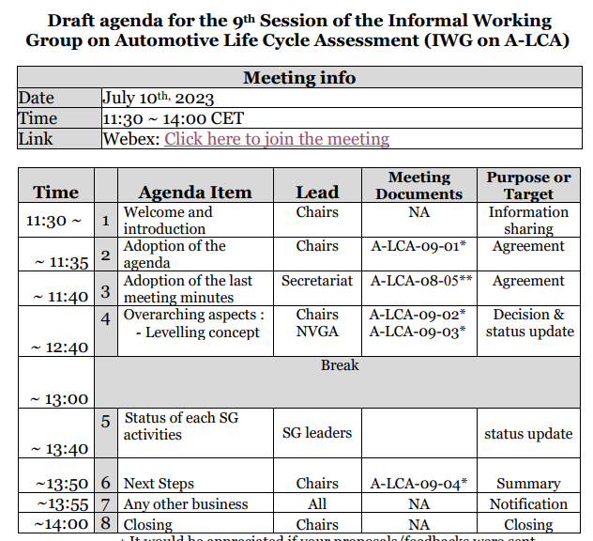

Slide 6
SG5 direction
Leading team is under discussion whether to prioritize some vehicle category type
But SG5 will open our eyes to all category at the early stage of EoL LCA study.

Slide 7
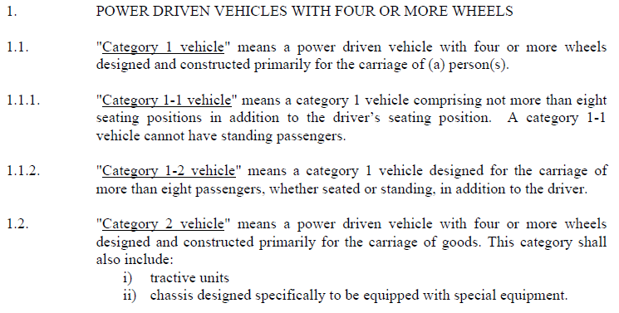
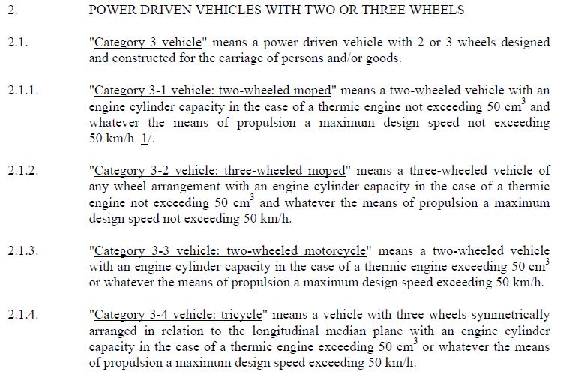

Slide 8




Slide 9
Agenda
1. CFF introduction by JRC
2. 10th July GRPE A-LCA IWG cascade
3. EoL LCA discussion
1) EoL “CONTROVERSIAL” TOPICS list #2
2) EoL level concept #2
4. Next action

Slide 10
SG5 Controversial topics list
・No additional topics FB
⇒Take OICA list to SG5 one
Topic | Option 1 | Option 2 | Option 3
Secondary data | Global harmonised | Region by region | Country by Country
Logistics | Include | Exclude | -
Recycle process | Current process | Future process | -
Second life parts | Include | Exclude | -
ELV management out of sale region | Take into account process of country of sale | Take into account global average | Take into account process of country of EoL
Material/Parts recycling modeling | Recycled content method (Cutoff) | Closed Loop Approximation Method (CLAM) | Circular Footprint Formula (CFF)
Boundary conditions | SG 5 | SG 2
More important controversial topics

Slide 11
Agenda
1. CFF introduction by JRC
2. 10th July GRPE A-LCA IWG cascade
3. EoL LCA discussion
1) EoL “CONTROVERSIAL” TOPICS list #2
2) EoL level concept #2
4. Next action

Slide 12
Achievement target
Original
EoL level concept
SG/Level |  | Lv.1 Simplified/Generic LCA | Lv.2 Targeted LCA | Lv.3 Extended LCA | Lv.4 Full LCA
(Example) Level concept |  | Focus on fuel cycle, and for vehicle cycle, generic raw material classifications and parts/vehicle productions according to the curb weight of the vehicle type, e.g. powertrain and fuel combination | Focus on vehicle OEM's direct manageable scope and using globally standardized secondary DB for raw materials and major automobile parts reflecting vehicle OEM's own efforts | Expansion of supply chain evaluation and application of regional secondary DB or primary data which can reflect the efforts made in supply chain management | Evaluation of CFP for the entire value chains
Level concept of vehicle cycle in detail |  | F ocusing on evaluating GHG emissions from a fuel cycle and a generic model vehicle | Focusing on precise evaluation of GHG emissions within vehicle OEM’s manageable scope to incorporate the OEM's own efforts to reduce carbon emissions on a specific vehicle | By extending the assessment of GHG emissions to supply chains, vehicle OEM's initiatives to reduce GHG emissions beyond its management scope could be demonstrated | Assessment of GHG emissions for the entire value chains
SG5 | End of life | No EoL evaluation | Global/Generic secondary data | Regional secondary data /partial primary data | Primary data
 |  |  | Covering 50% of total process | Covering 80% of total process | Covering 100% of total process
 |  |  | Cut off | CFF application for important materials/Parts | CFF application for all materials, parts and process scrap
 |  |  | Current basis | Current basis | Future basis
Data grade
System
Boundary
Recycle modeling
Recycle technology scenario

Slide 13
Achievement
target
- Still having some secondary data in level four
- “Primary data basis+Secondary data in DB (country or company level)
⇒Take these FB with small modification
・No FB
⇒Keep original
FB summary
SG/Level |  | Lv.1 Simplified/Generic LCA | Lv.2 Targeted LCA | Lv.3 Extended LCA | Lv.4 Full LCA
SG5 | End of life | No EoL evaluation | Global/Generic secondary data | Regional secondary data /partial primary data | Primary data
 |  |  | Covering 50% of total process | Covering 80% of total process | Covering 100% of total process
 |  |  | Cut off | CFF application for important materials/Parts | CFF application for all materials, parts and process scrap
 |  |  | Current basis | Current basis | Future basis
- Default recycling process should be defined at regional level.
⇒Add Default recycling process category
Lv2; Global/Generic
Lv3; Regional
Lv4; country or company
1. Data grade
2. System Boundary
3. Recycle modeling
- Possibility for remanufacturing and repair before recycling.
⇒To be managed in Controversial topics, not to be included in level concept.
- Always refer to current basis for the modelling of EOL
- How do we validate non-existent future data
⇒Change Lv4 definition from Future basis to Current basis and delete 4. Recycle technology scenario from level concept
4. Recycle technology scenario

Slide 14
Red letter; Revised point from Original
EoL level concept ver.1
Achievement target
SG/Level |  | Lv.1 Simplified/Generic LCA | Lv.2 Targeted LCA | Lv.3 Extended LCA | Lv.4 Full LCA
(Example) Level concept |  | Focus on fuel cycle, and for vehicle cycle, generic raw material classifications and parts/vehicle productions according to the curb weight of the vehicle type, e.g. powertrain and fuel combination | Focus on vehicle OEM's direct manageable scope and using globally standardized secondary DB for raw materials and major automobile parts reflecting vehicle OEM's own efforts | Expansion of supply chain evaluation and application of regional secondary DB or primary data which can reflect the efforts made in supply chain management | Evaluation of CFP for the entire value chains
SG5 | End of life | No EoL evaluation | Global/Generic secondary data | Partial primary data with regional secondary data | Primary data basis with country or company level secondary data
 |  |  | Covering 50%(t.b.d.) of global/generic EoL process | Covering 80%(t.b.d.) of total regional EoL process | Covering 100% of total country or company level EoL process
 |  |  | Cut off | CFF application for important materials/Parts | CFF application for all materials, parts and process scrap
Data grade
EoL process coverage
Recycle modeling

Slide 15
Agenda
1. CFF introduction by JRC
2. 10th July GRPE A-LCA IWG cascade
3. EoL LCA discussion
1) EoL “CONTROVERSIAL” TOPICS list #2
2) EoL level concept #2
4. Next action

Slide 16
Overall & 3 months Schedule
 | 2023 |  |  |  |  |  | 2024 |  |  |  |  |  |  |  |  |  |  |  | 2025
 | 7 | 8 | 9 | 10 | 11 | 12 | 1 | 2 | 3 | 4 | 5 | 6 | 7 | 8 | 9 | 10 | 11 | 12 | 1 | 2 | 3 | 4～
Main activities | Develop Methodologies |  |  |  |  |  |  |  |  |  |  |  | Finalise Methodologies |  |  |  |  |  |  |  |  | ☆Jun. GRPE ☆ Nov. WP.29
 |  |  |  |  |  |  |  |  |  |  |  |  | Drafting
GRPE A-LCA IWG | ☆10 |  | ☆7 | ☆ 17-18 |  |  | ☆ |  |  |  |  | ☆ |  |  |  |  |  |  | ☆
SG5 leading team Meeting | ☆11 ☆26 | ☆ | ☆ ☆ | ☆ ☆ | ☆ ☆ | ☆ ☆ | ☆ ☆ | ☆ ☆ | ☆ ☆ | ☆ ☆ | ☆ ☆ | ☆ ☆ | ☆ ☆ | ☆ ☆ | ☆ ☆ | ☆ ☆ | ☆ ☆ | ☆ ☆ | ☆ ☆
SG5 Meeting | ☆12 |  | ☆ | ☆ | ☆ | (☆) | ☆ | ☆ | ☆ | ☆ | ☆ | ☆ | ☆ | (☆) | ☆ | ☆ | ☆ | (☆) | ☆
Level concept
Definition & Initial target

Slide 17
12 months Schedule
 |  |  | 2023 |  |  |  |  |  | 2024
 |  |  | 7 | 8 | 9 | 10 | 11 | 12 | 1 | 2 | 3 | 4 | 5 | 6
Main activities |  | Main activities | Develop Methodologies
GRPE A-LCA IWG |  | GRPE A-LCA IWG | ☆10 |  | ☆7 | ☆ 17-18 |  |  | ☆ |  |  |  |  | ☆
SG5 leading team Meeting (LTM) |  |  | ☆11 ☆26 | ☆ | ☆ ☆ | ☆ ☆ | ☆ ☆ | ☆ ☆ | ☆ ☆ | ☆ ☆ | ☆ ☆ | ☆ ☆ | ☆ ☆ | ☆ ☆
SG5 Meeting |  |  | ☆12 |  | ☆ | ☆ | ☆ | (☆) | ☆ | ☆ | ☆ | ☆ | ☆ | ☆
Objectives | 1. Level concept Definition & Initial target | 1) Level concept Definition & Initial target | ☆12 |  | (☆) | (☆)
 | 2. System boundary with activity data & functional unit data based on each regional EoL process | 2) System boundary with EoL process functional unit |  |  | ☆ JPN, CHI | ☆ EU | ☆ US | ☆ IND | ☆ #1 |  |  |  | ☆ #2 | ☆ Final
 | 3. Contro versial topics | 1) Material/Parts recycling modeling | ☆JRC intro. |  | ☆ JAMA intro. | ☆ #1 | ☆ #2 | ☆ #1 | ☆ #2 | ☆ #1 | ☆ #2 | ☆ Final
 |  | 2) Other |  |  | ☆ |  |  |  |  | ☆ | ☆ | ☆
 | 4. Summary for drafting |  |  |  |  |  |  |  |  |  |  |  |  | ☆
Reginal info. sharing
Harmonization
(Regional Study)
Common Pros/Cons
Discussion
CFF
Application
Study
CFF
Road
Map
Boundary
Conditions
Rec.
Process
2nd life Parts
Logistics

Slide 18
5. Next action
- Next SG5 meeting
<Option 1 >
1. Date ; 2 days, 13th-14th, 20th-21st, 27th-28th in Sept.
2. Venue; JAMA Tokyo, Hybrid + ELV Recycler closed to Tokyo
3. Attendee; all SG5 member
4. Agenda
<1st day>
EoL LCA topics intensive discussion
- EoL level concept including achievement target level
- EoL topics discussion based on “CONTROVERSAL” TOPICS list
e.g. System boundary, Material/Parts recycling modeling with
SG2?
<2nd day>
ELV Recycler visit closed to Tokyo
<Option 2>
1. Date ; 2-3 hour, early Sept.
2. Venue; On line 3. Attendee; all SG5 member
4. Agenda; EoL LCA topics intensive discussion
Remarks;
・F2F with hybrid meeting will be held in Oct.@Brussel or Nov. @Tokyo

Slide 19
Appendix

