Slide 1

Pedal Application Error on London Buses
Finn Coyle, Head of Bus Engineering
Kerri Cheek, Senior Bus Safety Development Manager
Transport for London
19 September 2023

Slide 2
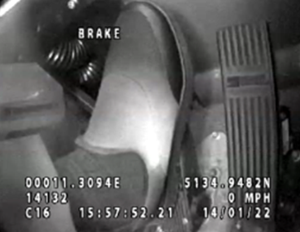
Pedal Application Error (PAE)
Sources of information
- Pedal cameras introduced on new buses in 2019 as part of Bus Safety Standard
- Some operators have also retrofitted cameras
- 25% of TfL bus fleet fitted (c.2200 buses)
Incident data
  IRIS: 145 cases, 6 years, c.50/billion bus km
  CCTV: 11 cases, 7 with pedal cameras
  Additional CCTV collection ongoing
Review of technologies
  Literature review
  Consultation with manufacturers/tier 1s
In service fleet data (Continuous 33 Hz data, 440,000 km travelled)
  Location, acceleration, speed
  Throttle pedal position, brake pedal on/off
  CCTV clips to identify context of events
Physical measurements of buses
  Pedal layouts
  Pedal forces/displacements
  Braking and acceleration tests
Published literature
  ISO standard
  Previous studies
Projects
Review of Incidents
Potential of Technology
Criteria for Throttle Suppression
Role of Regenerative Braking
Potential for Pedal Standardisation

Slide 3
Pedal Application Error (PAE)
Assessed a range of theories
Cause of PAE
  Head and body movement of the driver
  Variation in pedal layout
  Effect of regenerative braking
Recovery from PAE
  Acceleration potential of EVs
Mitigating the consequences of PAE
  Acceleration suppression
Today we focus on evidence around activation criteria (force or speed)

Slide 4
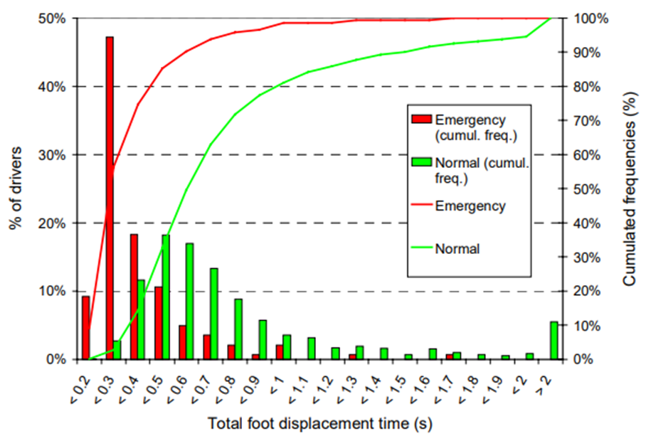
Pedal Application Error (PAE)
Identifying a pedal error incident
Aim
Similar to Brake Assist Systems – find one or more criteria that happens rarely in normal driving and frequently happens in the incident
  For example, Perron et al 2001 found normal drivers typically pressed the brake much faster in emergency situations than in normal driving
Notes:
Peaks occurring at different points show difference between normal and emergency situations

Slide 5
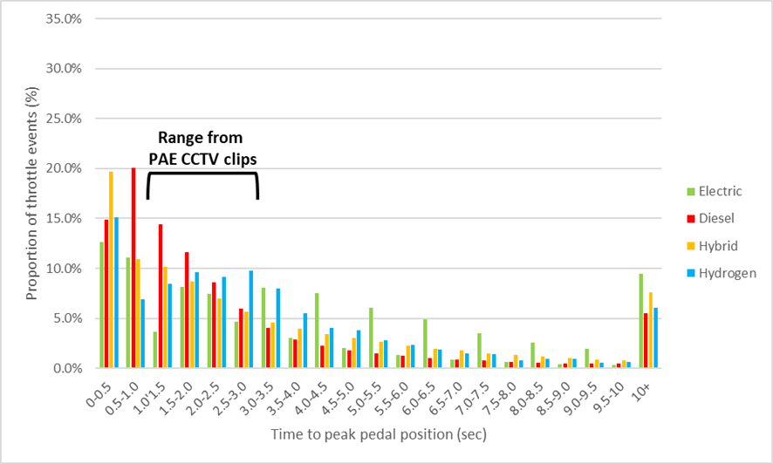
Pedal Application Error (PAE)
Throttle behaviour
- Vehicle speed
- Duration of throttle application
- Pedal speed
Evidence
PAE occur across wide range of driving scenarios
Considerable overlap with normal driving characteristics including pedal speed
400%/s sustained across full application = time to peak of 0.25s
Incidents on buses have a slower pedal speed and would be completely missed by a fast pedal speed criteria
Notes:
Other driving characteristics considered were vehicle speed, and throttle duration

Slide 6
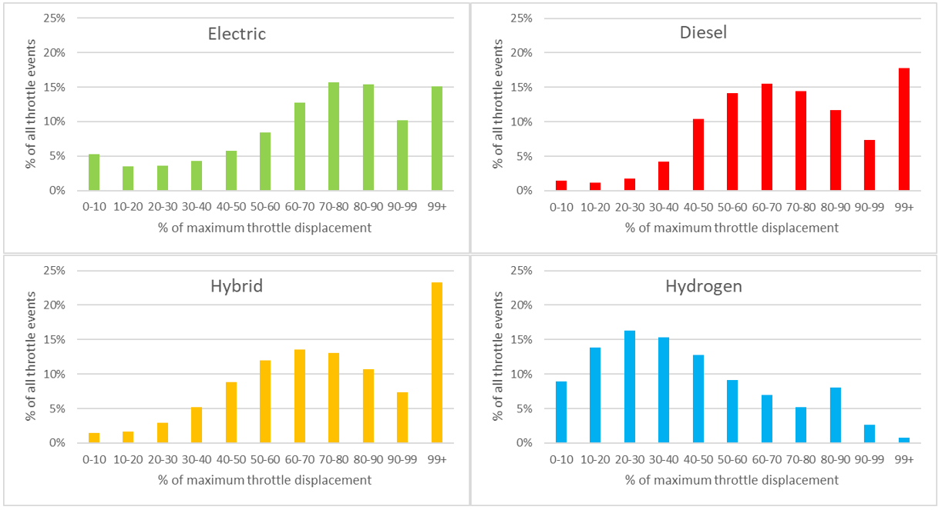
Pedal Application Error (PAE)
Throttle behaviour
All PAE incidents involve full throttle.
How common is full throttle application in normal driving?
Evidence
Using full throttle as an indicator of pedal error would result in system activation in a very large number of ‘normal driving’ events
  Drivers use full throttle 15-23% of times they press the throttle
  Except for Hydrogen buses (<1%)...Why?
Notes:
All throttle applications categorised by the maximum pedal displacement (0-100%). Graphs show the proportion of throttle applications within each displacement group.
For Electric, Diesel and Hybrid buses, drivers used full throttle 15-22% of the time they press the accelerator.
For Hydrogen buses this is < 1% of times. Why?

Slide 7
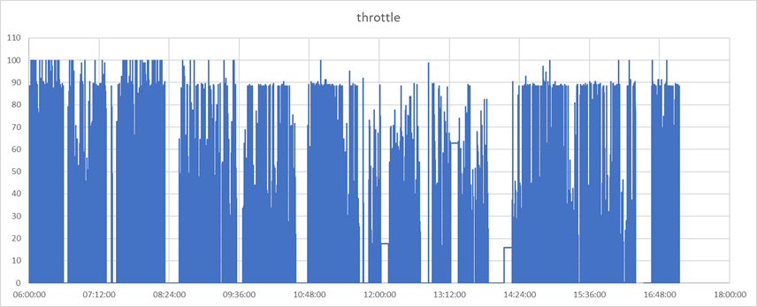
Pedal Application Error (PAE)
Why did Hydrogen buses have much lower levels of full throttle?
Evidence
In-service data showed drivers regularly stopped ~90% of max pedal displacement
  Vehicle measurements confirmed this was because of a two-stage accelerator pedal, requiring additional force > 90%
Throttle pedal displacement (%)
Time of day

Slide 8
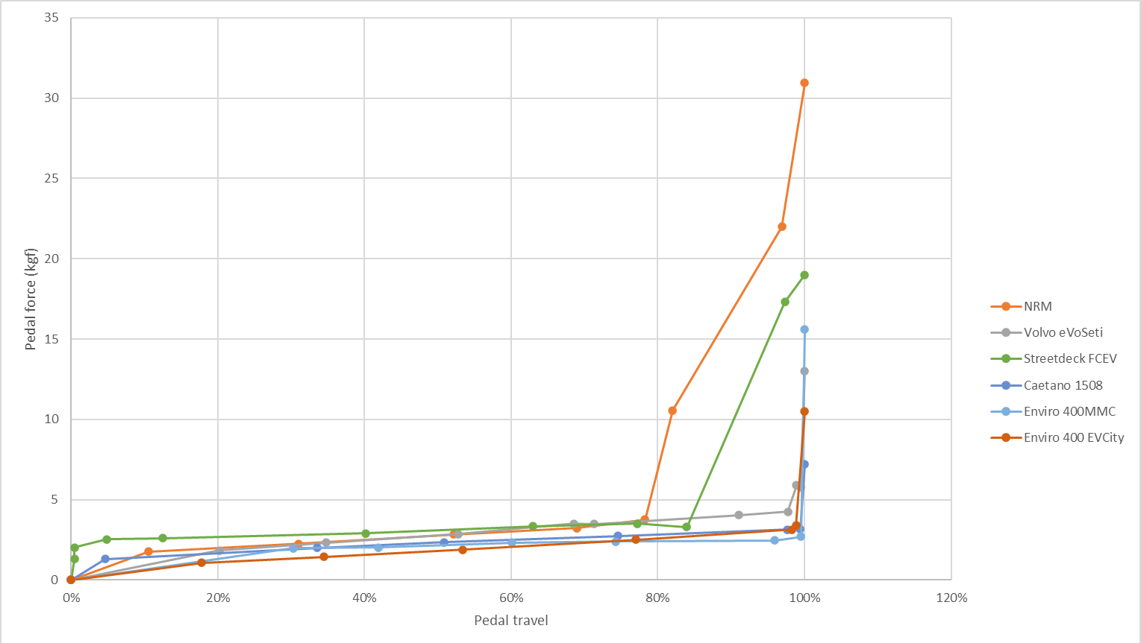
Pedal Application Error (PAE)
On-board measurement of pedal characteristics
Evidence
  Suggests much reduced chance of ‘false positive’
  Expectation: drivers press very hard during pedal error, they think it’s the brake
  Requires validation and identification of best force threshold
Force for max throttle Kickdown pedal ~20-30 kgf
Force for max throttle normal pedal <5kgf
Notes:
Hydrogen bus characteristics shown by Green line. NRM buses (orange line) also have a similar characteristic....telematics data not recorded for these buses in current trial.

Slide 9
Pedal Application Error (PAE)
Conclusions and next steps
Identifying incidents
  Pedal force has much better potential to discriminate between normal driving and incidents – much fewer false positives
  Can be implemented very simply through a two-stage (kickdown) pedal and existing ECU architecture (all diesel buses with autoboxes used to need this, standard componentry available, redundant in EVs)
  Potential to co-exist with AEB false positive suppression on low force throttle
  Aim: Vehicle trial to investigate further and define appropriate force threshold
    Small number of buses equipped with two-stage pedal (different spring stiffness)
    Parallel simulator / track trials to simulate pedal error emergency
      How hard/fast do subjects press pedal
    Road trial progressing from open loop (shadow mode) to fully active

Slide 10
Pedal Application Error (PAE)
Conclusions and next steps
Relationship to regulation
  Evidence may be relevant to cars too – CCTV data a unique resource
  A regulation based on pedal force with buses in scope could help encourage manufacturers to develop the proposed solution
  A regulation based on pedal speed, excluding force-based activation, with buses in scope would have opposite effect
  Please don’t let regulation get in the way of what we think is the best solution

Slide 11
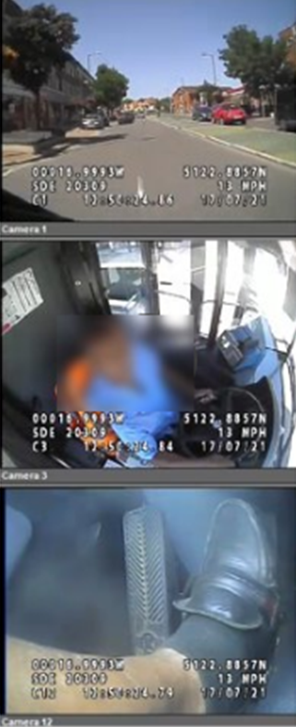
CCTV Case (1 of 8)
Speed at moment of pedal error | 10 mph
Time from throttle application to max | 1.5s
Time from 1st throttle movement to impact | 3.5s
Peak accel after pedal error | 1.4
Low Speed accel suppression (Impact) | No effect: Initial speed too high
Low Speed accel suppression (Not Impact dependent) | No effect: Initial speed too high
Accel suppression (Not impact dependent) | Likely: subject to pedal speed detection
Accel suppression (pedal force based) | V. Likely: improved chance of error detection
AEB (Typical) | Possible: Depending on override strategy
AEB (Modified throttle speed) | Likely: subject to pedal speed detection
AEB (pedal force based) | Probable avoidance: Improved chance of detection plus auto braking

