Slide 1
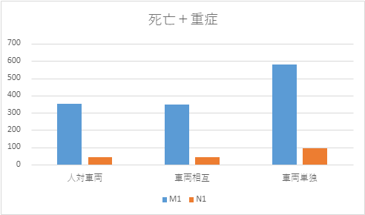
Pedal error accident in vehicle category M1&N1 (JAPAN)
confidential
Number of accidents (Using ITARDA data )
 | Number of fatal+ severe injury
 |  | Person to vehicle | Vehicle to vehicle | Single vehicle
 | M1 | 352 | 350 | 579
 | N1 | 44 | 42 | 93
 | N2 and above | 2 | 5 | 2
Fatal + severe injury number
M1
M1
M1
*Accidents for the 5-year period 2018-2022
N1
N1
N1
Calculate as below
M1 ＝Regular passenger vehicles + Light passenger vehicles(K-car)
N1 ＝Regurar cargo vehicles ＋ Light cargo vehicles (K-car)
N2 and above ＝ Large and medium-sized freight vehicles
+ semi-medium-sized freight vehicles
（* Excludes buses, microbuses）
Person to vehicle
Vehicle to vehicle
Single vehicle
N1 has fewer accidents than M1
→ N1 should be out of scope.

