Slide 1

ACPE-04
ACPE-04-XX
ACPE operation towards pedestrians
Detection difficulty (ACPE #3 IWG follow up)
Traffic accidents analysis & Test dummy selection
Application plan proposal

Slide 2
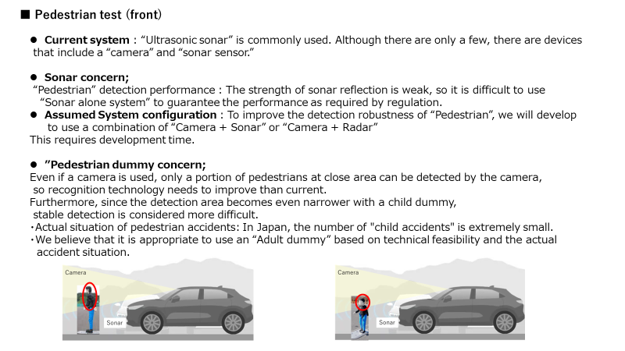
ACPE IWG #3 explained (previous document)

Slide 3
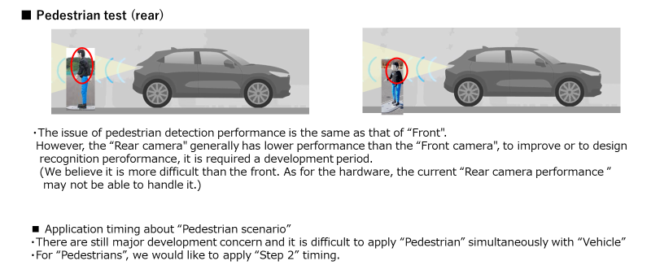
ACPE IWG #3 explained (previous document)
Summary;
To ensure detection robustness, it is difficult to stable detection by sonar sensor only.
Need to “development lead time” for new system (e.g; Sonar+Camera, Sonar+Radar, …etc)
=> Apply timing “Step 2”

Slide 4
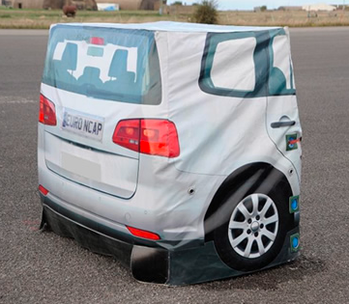
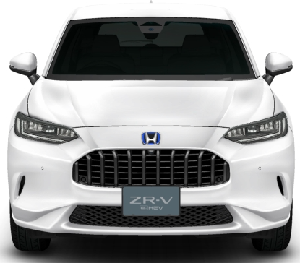
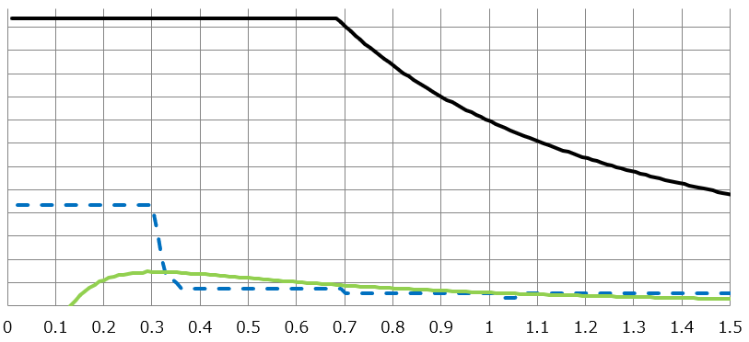

Sonar sensor detection performance for pedestrian
Object detection characteristics
(sensor Height = 60cm)
Reflection intensity
ADAC dummy
Road surface Noise
Due to the characteristics of
ultrasonic waves, sonar sensors
directivity cannot be narrowed.
Easy to pick up noise from
the road surface.
H = approx. 60cm
Distance from the object [m]
Even at a 1.0m point, the reflection intensity from the pedestrian dummy is
at the same level as road surface noise.
4a adult
dummy
Due to technical difficulty, we need Development lead time.
(application plan proposal is later)

Slide 5
Traffic Accidents Result
ACPE “Pedestrian Accidents (Fatal & Severe injured person) ” ; Age classification
Fatal
Severe injury
Fatal
Severe injury
Fatal & Severe injured person
0~6
Years old
7~12
Years old
13~64
Years old
Over 65
Years old
0~6
Years old
7~12
Years old
13~64
Years old
Over 65
Years old
Ref ; JARI Research Journal 20220601
PDF用自動車研究テンプレート (jari.or.jp)
In the majority of pedestrian accidents, adults are the casualties.
Proposal ; Using “Adult dummies” is appropriate as it reflects the majority of accidents.

Slide 6
Test dummy selection & Installation direction
Proposal
Pedestrian dummy ; Adult dummy
Installation direction ; Turn dummy’s back to the vehicle
Forward test
Adult dummy setting ;
the dummy should be used in its resting position with the articulation being switched off (i.e. not the static dummy posture as defined in ISO 19206-2
ref : Euro NCAP AEB LSS VRU Test Protocol - v4.4
Backward test
Justification
Adult dummy select
Based on “Traffic accidents result” => Many accidents occurred “Adult”
Installation Direction
  Clear results not shown “Accident analysis”
  Since pedestrians have their backs to the vehicle, it is thought that it is difficult for them to notice the vehicle.
Current JNCAP
自動車安全性能2023試験映像：トヨタ クラウン クロスオーバー - YouTube

Slide 7
Application proposal
Current draft
Step | Object | Speed
Step1 | Wall, Vehicle, Pedestrian | From standstill or very low speed
Step2 | Same above | Speed up 0 ~ [30]km/h
Application plan Proposal
 | Scenario |  | Speed | Application approach
 | Object | Pedestrian application | Speed
Step1 | Wall, & Vehicle, Pedestrian | ー | From standstill or very low speed | Step1 00 Series
 | Same above Wall, Vehicle, Pedestrian | Pedestrian/ Front | From standstill or very low speed | Step1 01 Series
 |  | +Pedestrian/ Rear |  | Step1 02 Series
Step X (Long term) (Step 2) | Wall, Vehicle, Pedestrian | Pedestrian both side (Front and Rear) | Speed up 0 ~ [30]km/h | Step X

