Slide 1

ACPE-04
ACPE-04-XX
Performance requirement proposal
November 21st 2023

Slide 2
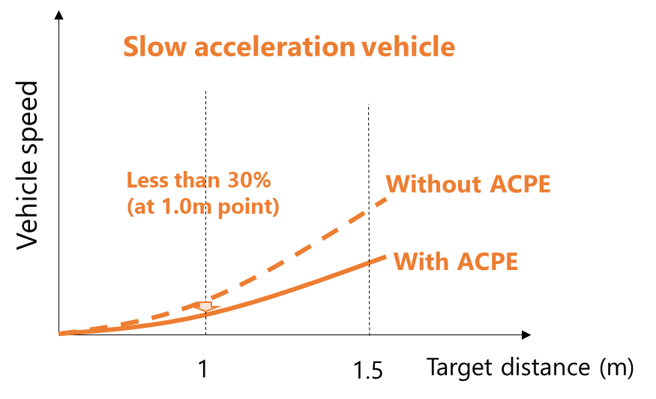
Background
Current discussion; There are 2 kinds of index.
Performance requirement ;
Collision speed at 1.0m ; [5], [10] km/h or lower
Speed reduction rate ; 30% or more (speed measuring point 1.0m)
; Based on JNCAP
(control image)
Concern
There is some concern to using these kinds of 2 index.
 | Requirement index (draft) | Requirement (draft) | Concern | Performance evaluation perspective
１ | Collision speed | Lower than [5], [10] km/h At 1.0m distance | In the case of “slow acceleration vehicle”, it is possible to achieve this value without control. | The appropriateness of the operation functionality cannot be evaluated.
２ | Speed reduction rate (%) | Speed reduction rate more than 30% At 1.0m distance | In the case of “slow acceleration vehicle”, it is not possible to achieve this value with control. | Achieves speed reduction effect at a point far away (May lead to underestimation of functionality)
Appropriate evaluation of the system cannot be determined using a single evaluation index.

Slide 3
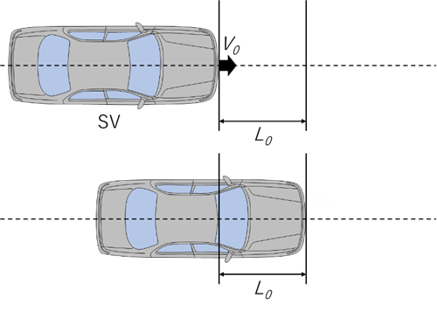
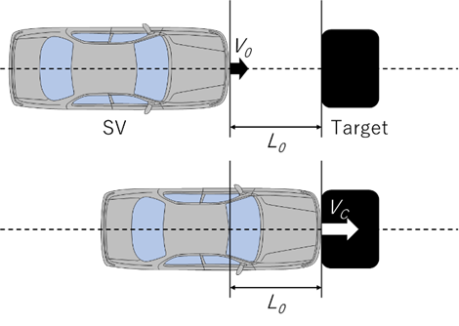
Proposal
Set the following two types as performance evaluation index
Performance evaluation test ; Collision impact evaluation
Criteria : Collision Speed “ 8 km/h or less ” at obstacle position 1.0m
(The reason 8km/h will be shown later)
2. Functional performance evaluation test ; Evaluation of acceleration suppression function
Criteria : Speed reduction rate “30% or more” at obstacle position depend on OEM declare
(Select distance; from 1.0 to [1.5] m)
Requirement; to meet “1. Collision speed” and “2. Speed reduction rate” both criteria
Without system (No target)
With system (Target install)
Initial
Initial
Accelerate
Accelerate
NO1: L0=1.0m NO2 : L₀ is selectable; 1.0m~[1.5] m

Slide 4
Impact speed ; investigation from JAPAN OEM M1 vehicle
Collision Speed
Collision Speed
Vehicle Number (n=13)
Vehicle Number (n=6)
ACPE test results
Target Vehicle (dummy) set position ; 1.0 m
Collision speed distribution for each vehicle when ACPE is activated
Varies depending on vehicle
Proposal
As a common requirement for Front/Rear, and considering past test vehicle results.
8km/h or less is proposed (measurement distance: 1.0m)

