Slide 1
EBSIG I Specialist sub-group to address the energy question
Meeting # 3 I 8th of August 2023
Summary and Conclusions

Slide 2
EBSIG I Specialist sub-group to address the energy question
Summary
By energy in scope of the work of this group the reserve of energy is understood, which is dedicated to the braking system.
Pneumatic Braking Systems
  the reserve of energy can be measured and monitored at any time directly (by direct means at the moment of TA and PTI )
  the reserve of energy is direct proportional to the forcing clamp of the actuators.
  the clamping force depends directly on the number of full stroke applications.
EMB
  the reserve of energy cannot be measured and monitored at any time directly.
  The clamping force depends directly on the output power [KW] of the reserve of energy , but not on the content of the reserve of energy [kWh] itself.
  multiple signals ( voltage, current, temperature) are necessary to be observed to measure and monitor the output power of the reserve of energy.
  The clamping force does not depend directly on the number of full stroke applications but will be almost constant until as certain discharge level of the reserve of energy is reached.

Slide 3

EBSIG I Specialist sub-group to address the energy question
Justification statement (3)
Measurement Reserve of Energy ( pneumatic EBS vs. EMB )
NEW
Pneumatic EBS
EMB
E_{res_p}
_{U [V]}
_{? U1 ?}
_{? U2 ?}
_{? U3 ?}
_{E1}
t
t
_{t1}
_{t1}
_{t2}
_{t3}
Secondary Braking Performance
Secondary Braking Performance
t
t
8 full stroke braking applications → E_{res_p}
8 full stroke braking applications → E_{res_e}

Slide 4
EBSIG I Specialist sub-group to address the energy question
Conclusions (1)
A Rechargeable Electrical Energy Storage System (REESS) is needed to store, measure and monitor the reserve of energy dedicated to the braking system.
The REESS will use multiple signals ( voltage, current, temperature) and models (or observers) ensuring that , in real time, EMB “knows” which reserve of energy and output power is available and whether that is enough to guarantee a specific braking performance
The manufacturer shall demonstrate that REESS is robust under all reasonably foreseeable operating conditions to the satisfaction of the Approval Authority or the Technical Service acting on its behalf (hereafter referred to as Type Approval Authority)

Slide 5
EBSIG I Specialist sub-group to address the energy question
Conclusions (2)
NEW
REESS State Parameter are depending on Technology of Storage Device.
REESS is providing the State of Function to the Braking System
State of Function explains, if reserve of energy and output power is available to guarantee a specific braking performance
State of Function is containing a prediction on
  State of Health ( Aging )
  State of Charge
  Inner Resistance
  Providing warnings

Slide 6
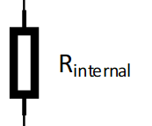
Rechargeable Electrical Energy Storage System(REESS)
( Energy Storage Device with a Reserve of Energy dedicated to the Braking System)
under discussion
Load profiles
e.g. 8+1 brake applications
State of charge is proportional to the amount of stored Energy E_{res_e}
ESD
(Energy
Storage
Device)
U
I
T
Predictors
Reserve of Energy dedicated to the Braking System
Estimator of states & parameters
State of Charge (SoC) [kWh]
SOC
Unit of feedback
+
-
^
U
Inner Resistance
Model of the ESD
state variables
State of Health (SoH)
Adaption of parameters
model
parameters
State of Function (SoF) [kW]
→ Prediction number of brakings
REESS State Parameter
[ depending on Technology of Storage Device under Type Approval ]
e.g., Discharge Capacity Algorithm, Aging Sub-Algorithms, Capacitance
Algorithm, Quiescent Voltage Measurement, Device Off Detection, Internal Resistance Determination, Device Temperature Model, …
6

Slide 7


Rechargeable Electrical Energy Storage System(REESS)
(Example: Lead acid battery state detection)
State of charge is proportional to the amount of stored Energy E_{res_e}
Load profiles
e.g. 8+1 brake applications
I
U
T
Examples of Predictors
SOC
State of Charge (SoC) Q
Estimator of battery states & parameters
Charge-Acceptance
∆SOC
Unit of feedback
+
-
^
Ageing State of Health (SoH)
U
Model of the battery
state variables
Internal Resistance (R_{i})
Adaption of parameters
model
parameters
Voltage after safe stop
(state of function (SoF) -> U_{pred})
Discharge Capacity
Algorithm
Ageing Sub-
Algorithms
Quiescent Voltage
Measurement
Internal Resistance
Determination
Voltage after Safe Stop calculates the minimum Voltage for a defined (worst case) load profile. It takes into account the power output capability (R_{i} , P_{res_e}) and the stored Energy (E_{res_e}) of the reserve.
Voltage after Safe Stop indicates that the energy and power supply for the 8+1 brake applications is ensured.
Examples for
Sub-Algorithms
Capacitance
Algorithm
Battery Off
Detection
Battery Temperature
Model

Slide 8
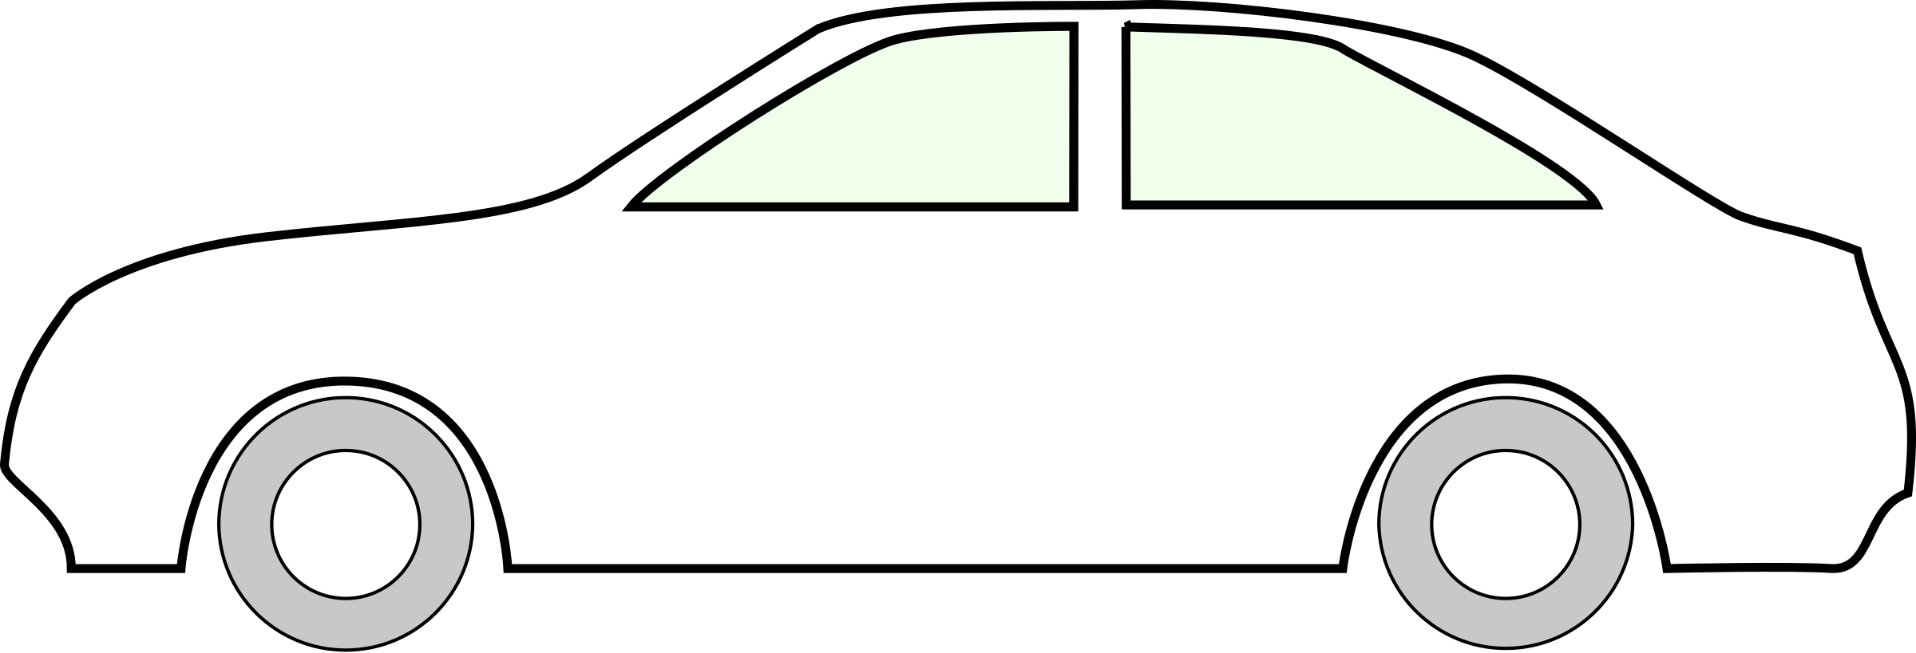
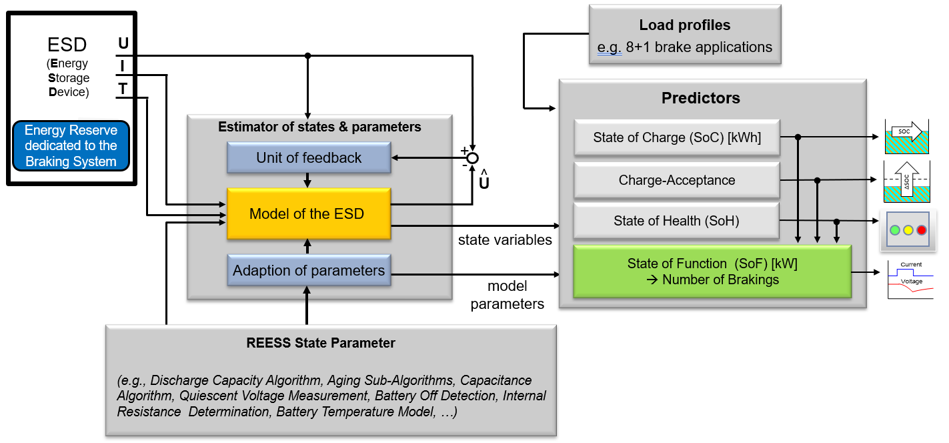
EBSIG I Specialist sub-group to address the energy question
Interaction REESS to Braking System
NEW
ESD
REESS
(related to the reserve of energy dedicated to the braking system system)
Braking System
I, U, T
Request Status SOF
SOF
The setting of trigger conditions to issue the warning signal is done else ware ( e.g., REESS, EMB)

Slide 9
EBSIG I Specialist sub-group to address the energy question
Scenarios to proof the concept of REESS
Low temperature ☑
High temperature ☑
Exchange of a battery ☑
Aging ☑
Type Approval Test
Long Time Parking ☑

Slide 10
EBSIG I Specialist sub-group to address the energy question
Scenarios to proof the concept of REESS based on a lead-acid battery
Scenario | Physical effect on battery | REESS-Control Action | Warning
Low temperature e.g., the vehicle is parked outside during a cold night | Increased internal resistance (Ri) In combination with internal resistance increase due to battery aging, low temperature is problematic for battery’s power delivery capability | REESS-Control continuously measures voltage (U), current (I) and temperature (T). Because of low temperature the “predictor of Ri” will exceed the threshold. REESS-Control reports “State of function critical, due to insufficient Power Delivery Capability”. SOF Warning issued during vehicle startup Previous warnings to the driver due to battery aging are technically possible and recommended | Red The power supply for the 8+1 brake applications cannot be is ensured.

Slide 11
EBSIG I Specialist sub-group to address the energy question
Scenarios to proof the concept of REESS based on a lead-acid battery
NEW
Scenario | Physical effect on battery | REESS-Control Action | Warning
Long time parking | Battery charge low​ due to vehicle’s quiescent current draw | REESS-Control continuously measures voltage (U), current (I) and temperature (T) even during parking phase. Due to current flowing out of the Battery, and decreasing voltage, it recognized when charge drops below warning threshold.​ REESS-Control reports “too low state of charge”. SOF Warning issued immediately during vehicle startup As soon as the battery and is charged sufficiently, the REESS-Control reports “state of charge ok”. | Red The power supply for the 8+1 brake applications cannot be ensured.

Slide 12
EBSIG I Specialist sub-group to address the energy question
Scenarios to proof the concept of REESS based on a lead-acid battery
NEW
Scenario | Physical effect on battery | REESS-Control Action | Warning
High temperature e.g., Kuwait Taxi | Increased internal resistance (Ri) - due to calendric aging or - due to accelerated aging during high temperature exposure (high temperature has no negative effect on lead acid batteries apart from aging.) | REESS-Control continuously measures voltage (U), current (I) and temperature (T). Because of the increase of Ri, the Ri predictor will exceed the threshold. REESS-Control reports “State of function critical, due to insufficient Power Delivery Capability”. SOF Warning issued during vehicle startup Previous warnings to the driver due to battery aging are technically possible and recommended | Red The power supply for the 8+1 brake applications cannot be ensured.
Aging

Slide 13
EBSIG I Specialist sub-group to address the energy question
Scenarios to proof the concept of REESS based on a lead-acid battery
NEW
Scenario | Physical effect on battery | REESS-Control Action | Warning
Battery change | Battery is replaced. | REESS-Control has constantly measured U, I and T. REES detects the assembly of a new battery *. REESS-Control resets its battery model to new battery SOF warning issued Warning is removed as soon as battery model calibration is successful and battery state of function is ensured | Red The power supply for the 8+1 brake applications cannot be ensured. Warning is removed as soon as battery model calibration is successful and battery state of function is ensured
* New Battery recognized due to service technician’s electronic tooling service request and/or supply interruption and/or abrupt changes of battery parameters.
Hint: The process of changing battery of an EMB system could be compared to changing a tire on vehicles equipped with active Tire Pressure Monitoring System (TPMS) according ECE R64 – New tires can only be installed by a service technician using special equipment, because the TPMS controller in the vehicle needs to learn each Tire ID.

Slide 14
EBSIG I Specialist sub-group to address the energy question
Attachments

Slide 15
EBSIG I Specialist sub-group to address the energy question
Tasks given by GRVA SIG on Electromechanical Braking
Provide confidence that technology is able to do the following:
Measure and/or monitor in real time the energy available in the reserve in all operating conditions and over the lifetime (high temperatures, ageing, …).
Compare that measured value with the known threshold value required to meet the specific performances required by the regulations. Note: The known value means the value identified by the manufacturer to fulfil the specific requirements of the regulation.
To be able to generate the warning to the driver in real time in accordance with the known threshold value

Slide 16
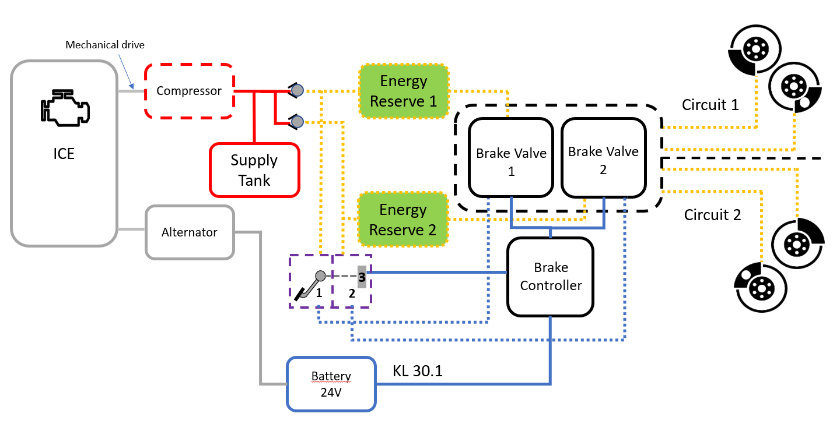
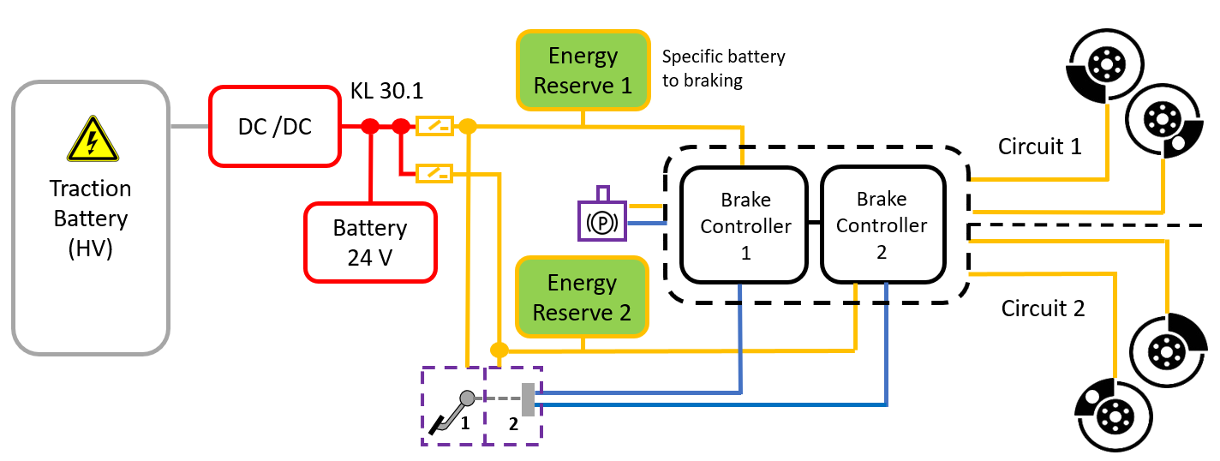
Energy level and clamping force analogies and differences in EBS vs. EMB
F_{clamp_p} ~ p_{chamb} x const_{brake}
E_{res_p} ~ p_{res} x const_{res}
In pneumatic brake systems the E_{res_p} ~ p_{res} and the F_{clamp_p} ~ p_{chamb}. Since p_{chamb} directly depens on p_{res} in full stroke actions → change of F_{clamp_p} follows the reduction of E_{res_p.}
Both major quantities (E_{res,} F_{clamp}) can be easily measured with an external manometer by the technical service or PTI.
EBS
In EMBs the E_{res_e} cannot be measured by a single proportional quantity, but from multiple signals and models (observer), similarly F_{clamp_e} is either measured internally by the EMB system or also estimated from other signals and caliper models (observer), therefore technical service/PTI shall rely on internal signals of the EMB system (e.g. SOC).
In an EMB system the F_{clamp_e} primarily depends on the power output capability of the reserve P_{res_e} and only indirectly on E_{res_e} !
E_{res_e} [kWh]
P_{res_e} [kW]
F_{clamp_e} [kN]
EMB
Quantities to be monitored

Slide 17
Clamping force and energy level degradations of the reserve in a capacity test of EBS vs. EMB
F_{clamp_p}
Pneumatic EBS
E_{res_p}
F_{clamp_e}
EMB
E_{res_e}
Widely constant then progressive clamping force tendency
Degressive clamping force tendency
Secondary brake force limit
t
t
8 full stroke braking applications → E_{res_p}
8 full stroke braking applications → E_{res_e}
The clamping force of pneumatic brakes gradually degrades with each application, since the clamping force is directly proportional to the reserve’s pressure level, i.e., with the energy level of the reserve. → Pressure level of the reserve well represents the energy state of the brake system.
The clamping force of EMBs is approximately constant till a critical discharge level, where the rated power output of the energy reserve cannot be anymore provided. After this a reduction of brake performance occurs, since the power output capability of the reserve depends also on its energy level. → Both the energy level and power output capability shall be monitored (e.g. by a BMS).

Slide 18
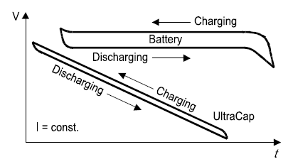
Impact of the energy reserve characteristics to the EMB performance
U_{Reserve}
U_{Reserve}
F_{clamp_e} ~ P_{mot_e}
U_{OCV}
The (secondary) clamping brake force of EMB is directly depending on the power output available to the EMB actuator (effect of harness and connectors, etc. also to be considered → board network design)
The available power output of the reserve depends primarily on its internal resistance
The ratio of internal resistance to the capacity of a reserve is technology dependent
The internal resistance and the capacity fade with different rates during the lifetime, which also depends on technology, i.e. both the energy amount as well as the power output requires monitoring

Slide 19
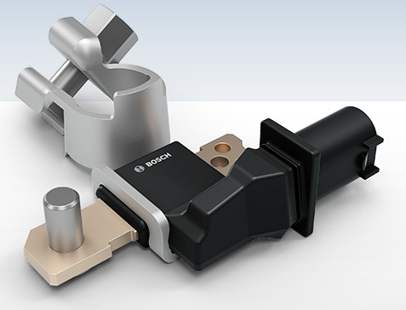
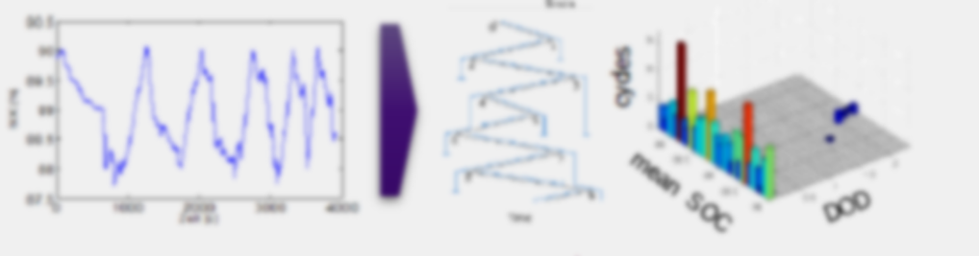
Technology insight : Battery Sensor (EBS)
Example for a Technical Solution
EBS working principle:
Lead-acid technology has a long history of use. It’s ageing process and its failure modes are known and well-understood.
Reliable models exist for all relevant battery parameters. The EBS constantly measures voltage, current and temperature. Those values are fed into a battery model for continuous battery state estimation:
safety-state of function (SOF):
estimates max. transient voltage drop, considering state of charge (SOC) and state of health (SOH)
Indicates battery availability in Safe Power Net:
“Battery has enough energy and power to support a Minimal Risk Maneuver (MRM)”
ASIL-B conformity | Bosch EBS Gen1 SOP: 2006
l
Technical realizations of battery sensors from a variety of suppliers exist
Source: https://www.bosch-mobility.com/en/solutions/sensors/electronic-battery-sensor/

Slide 20
Energy content comparison (e.g., M1 vehicle)
Nominal Content 60Ah Pb Battery: 720Wh / degraded battery: 10% of initial value.
MRM: 2 x double lane change + braking to standstill; Full-size SUV, hydraulic brakes.
9 full brake actuation: full actuation with 7s hold, M1 vehicle, hydraulic brake system, worst case estimation
base load Power Net: C-Segment BEV, drive cycle with minimal comfort loads, source vehicle measurements
base load Power Net max: luxury BEV, drive cycle with max comfort loads, source vehicle measurements

Slide 21
EBSIG I Specialist sub-group to address the energy question
Proposal Definition REESS
For later ;-)
Proposal for a definition on RESS
UN R100, para. 2.37
"Rechargeable Electrical Energy Storage System (REESS)" means the rechargeable energy storage system that provides electric energy for electrical propulsion.
A battery whose primary use is to supply power for starting the engine and/or lighting and/or other vehicle auxiliaries’ systems is not considered as a REESS.
The REESS may include the necessary systems for physical support, thermal management, electronic controls and casing.
Proposal UN R13, UN R13-H para. x.xy ( amended to read)
"Rechargeable Electrical Energy Storage System (REESS)" means the rechargeable energy storage system that provides electric energy for braking electrical propulsion.
The same REESS may supply power for starting the engine and/or steering and/or other vehicle auxiliaries’ systems
A battery whose primary use is to supply power for starting the engine and/or lighting and/or other vehicle auxiliaries’ systems is not considered as a REESS.
The REESS may shall include the necessary systems for physical support, thermal management, and electronic controls and casing.

