Slide 1
Report to ‘Joint session of the WP.29 expert groups on regulatory fitness for automated driving system’
Transmitted by the Netherlands
Informal Document FADS-J1-XX
16th – 17th of October, 2023,
agenda item 5
Task Force Automated Vehicles Regulation Screening
(TF-AVRS)

Slide 2


TF Automated Vehicles Regulation Screening
7
13
Number of Meetings
Participants
(Contracting Parties & NGOs)
Web-meetings
1st Kick-off meeting: 13th March 2023
2nd TF-AVRS: 4th April 2023
3rd TF-AVRS: 17th April 2023
4th TF-AVRS: 9th May 2023
5th TF-AVRS: 22nd May 2023
6th TF-AVRS: 11th September 2023
7th TF-AVRS: 10th October 2023
CPs:
Germany, France, United Kingdom, South Africa, Unites States, Netherlands
NGO‘s:
OICA
Report TF-AVRS – FADS Joint Session

Slide 3
TF Automated Vehicles Regulation Screening
Targets
WP29 requests a screening of regulation for application of Automated Vehicles.
GRVA proposed a template for the screening
TF-FADS (GRVA) provides further guidance
Roles
Chair: [Netherlands]
Secretariat: […]
TF-AVRS wikipage
https://wiki.unece.org/pages/viewpage.action?pageId=198672917&src=contextnavpagetreemode

Slide 4
Screening process: Considered items
1. Terminology
    Relevant terms based on GRVA guidance (accelerator, handle-bar type steering)
2. Use cases AVs
    Driverless AVs
      With passenger
      Without passengers (cargo)
    AVs with driver
    Bi-directional AV’s
3. Other considered items
    Telltales & warning signals
    Test modes

Slide 5
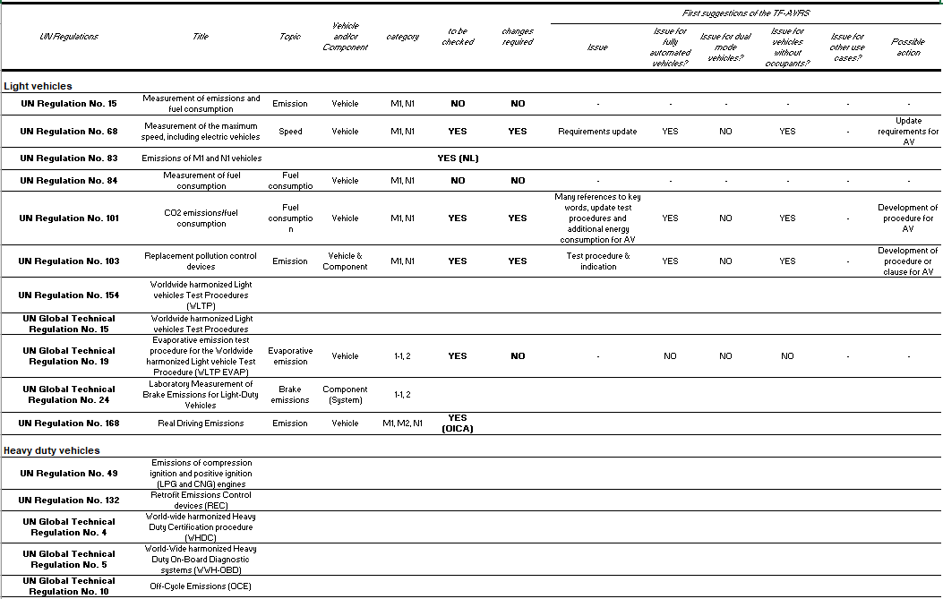

Slide 6
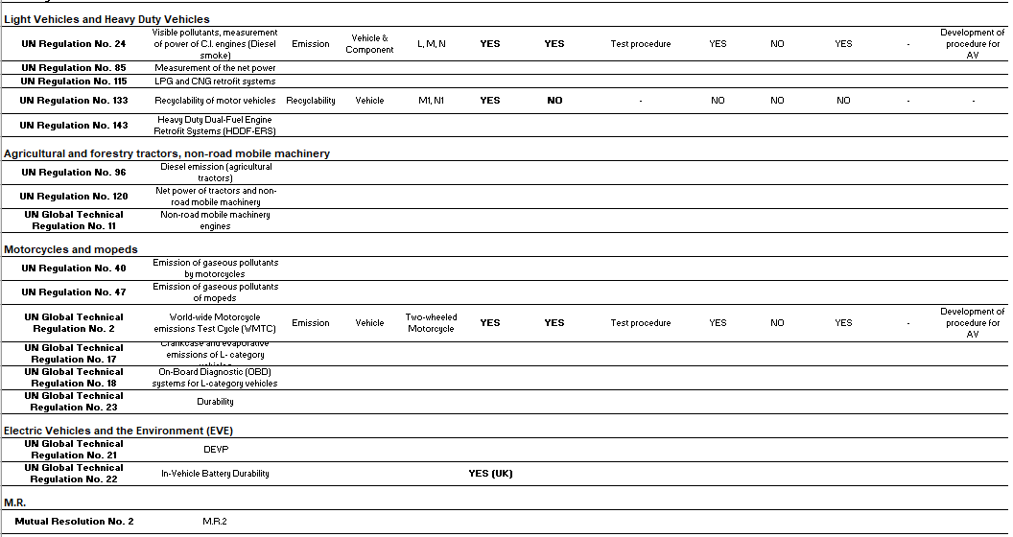

Slide 7
TF-AVRS Results
First focus on light vehicles
No vehicle categories will be excluded from screening
2 Regulations are excluded from screening (old)
7 regulations are screened
3 regulations are planned to be screened

Slide 8
Next steps
Continue with meetings once per month
Participants from CP’s and NGO’s are really needed to accelerate the screening and to continue the work after the screening.

Slide 9
Thank you for your attention

Slide 10
Back-up related to Test modes
Some emission Regulations make use of vehicle test modes.
UN R154 is an example where vehicle test modes are used.
The Regulation refers to “Vehicle coastdown mode” and “Vehicle’s dynamometer operation mode”.

Slide 11
Back-up related to Test modes
Vehicle coastdown mode;
3.2.21. "Vehicle coastdown mode" means a system of operation enabling an accurate and repeatable determination of road load and an accurate dynamometer setting.
4.2.1.8.5. Vehicle coastdown mode
If the determined dynamometer settings cannot meet the criteria described in paragraphs 8.1.3. or 8.2.3. of this annex due to non-reproducible forces, the vehicle shall be equipped with a vehicle coastdown mode. The vehicle coastdown mode shall be approved and its use shall be recorded by the responsible authority.
If a vehicle is equipped with a vehicle coastdown mode, it shall be engaged both during road load determination and on the chassis dynamometer.
7.3.2. If the determination of dynamometer settings cannot meet the criteria described in paragraph 8.1.3. of this annex due to non-reproducible forces, the vehicle shall be equipped with a vehicle coastdown mode. The coastdown mode shall be approved by the responsible authority and its use shall be included in all relevant test reports.
If a vehicle is equipped with a vehicle coastdown mode, it shall be engaged both during road load determination and on the chassis dynamometer.

Slide 12
Back-up related to Test modes
Vehicle’s dynamometer operation mode;
2.4.2.2. The vehicle’s dynamometer operation mode, if any, shall be activated by using the manufacturer's instruction (e.g. using vehicle steering wheel buttons in a special sequence, using the manufacturer’s workshop tester, removing a fuse).
The manufacturer shall provide the responsible authority a list of the deactivated devices and/or functionalities and justification for the deactivation. The dynamometer operation mode shall be approved by the responsible authority and the use of a dynamometer operation mode shall be recorded.
2.4.2.3. The vehicle’s dynamometer operation mode shall not activate, modulate, delay or deactivate the operation of any part (with the exclusion of the coasting functionality) that affects the emissions and fuel consumption under the test conditions. Any device that affects the operation on a chassis dynamometer shall be set to ensure a proper operation.
2.4.2.4.4. If the test vehicle is tested on a 4WD dynamometer in 2WD operation the wheels on the non-powered axle may rotate during the test, provided that the vehicle dynamometer operation mode and vehicle coastdown mode support this way of operation.

Slide 13
Back-up related to Testing robots
In relation to emission testing and GRPE it appears that work has been performed in relation to testing robots in the past.
Information is gathered and will be shared if available.

