Slide 1
ETRTO/ETRMA position on amendments to TFTA ToR and explaining TA-16-09
TA-16-08
TFTA meeting 11 October 2023

Slide 2
Agenda
1. C1 market assessment and timeline
2. C2 and C3 timelines and rationale
3. ETRTO comments on mileage

Slide 3
1. C1 market assessment and timeline
EU Tyre Industry supports the timeline for C1 tyres as proposed in TA-13-04, by providing technical, logistical and financial support.
This means that EU Tyre Industry is agreeing to perform the market assessment in 2024 (and multi-circuit begin 2025).
EU Tyre Industry is also looking for some partnership among TFTA by having TFTA members joining the test campaign.
EU Tyre Industry is also willing to provide a validity to the tests performed and request TFTA (Type Approval Authorities, JRC, …) to witness the tests to support this test campaign.

Slide 4
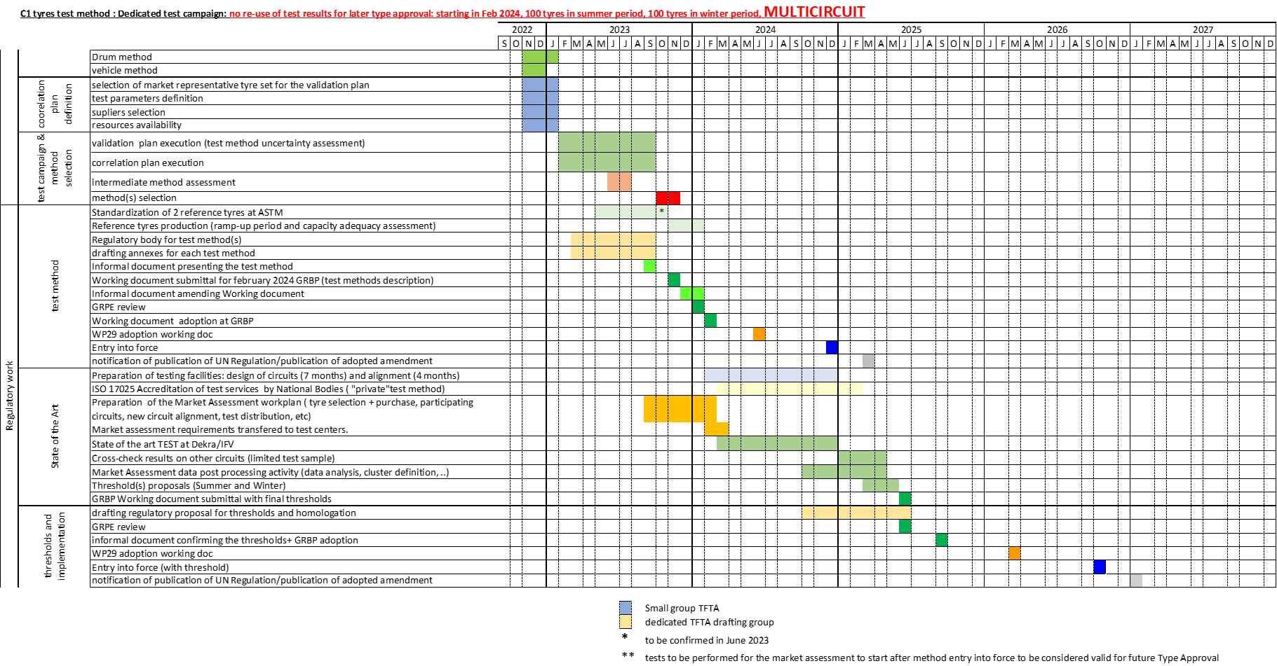
1. C1 market assessment and timeline
Source: TA-13-04
slide 14
In TFTA ToR:

Slide 5
2. C2 and C3 timelines:
ETRTO reviewed the proposal made by TFTA co-chairs for C2 and C3 timelines that can be visualised as following:
ETRTO propose to reconsider the proposed timelines for C2 and C3 tyres, by providing the detailed workprocess needed for this activity with the following Gantts:

Slide 6
C2 timeline:

Slide 7
C2 timeline: summary
an informal document to amend UNR 117 introducing C2 tyres test method(s) for consideration during 82nd GRBP in September 2025 (submitted for information to the 93rd GRPE in June 2025)
a working document to amend UNR 117 introducing C2 tyres test method(s) for adoption and consideration, within 83th GRBP in February 2026 (submitted for feedback and information, respectively, to 94th GRPE in within January 2026)
a working document to amend UNR 117 introducing C2 tyres abrasion limits and characterising tyres by the means of an index for both abrasion and mileage and an informal document to amend UNR 117 introducing C3 tyres test method for adoption and consideration, respectively, during 87th GRBP in February 2028 (submitted for feedback and information, respectively, to the 98th GRPE in January 2028)
In TFTA ToR:

Slide 8
C3 timeline:

Slide 9
C3 timeline: summary
an informal document to amend UNR 117 introducing C3 tyres test method(s) for consideration during 84th GRBP in September 2026 (submitted for information to the 95th GRPE in June 2026 )
a working document to amend UNR 117 introducing C3 tyres test method(s) for adoption and consideration, within 85th GRBP in February 2027 (submitted for feedback and information, respectively, to 96th GRPE in within January 2027)
a working document to amend UNR 117 introducing C3 tyres abrasion limits and characterising tyres by the means of an index for both abrasion and mileage for adoption during 89th GRBP in February 2029 (submitted for feedback to the 100th GRPE in January 2029)
In TFTA ToR:

Slide 10
Mileage: ETRTO comments and concerns
As already indicated in previous meetings, ETRTO is strongly concerned with the new ToR amendment proposal on mileage and request to keep the task addressed to TFTA on mileage as it was addressed in the initial TFTA Terms of Reference:
Assess potential correlation, if any, between abrasion performance and mileage of tyres.
Rationale:
• The amendment to the ToR is proposing to address an EC request for working on a mileage indicator for the EU tyre labelling regulation.
• The current ToR are already clear enough to assess a potential correlation between abrasion performance and mileage performance. The new co-chairs proposal for a revised ToR is mandating TFTA to propose a mileage test method in any case to respond to the new EC request. As of today, the assessment of a potential correlation between mileage and abrasion is considered in TFTA (see meeting minutes TA-07-13 (item 8), TA-15-15 (item 5) and presentation TA-07-05), and TFTA is working actively on the mileage versus abrasion assessment (item is on the agenda of each TFTA meeting).

Slide 11
Mileage: ETRTO comments and concerns
Rationale (continued):
• Scope of the 1958 agreement defines the conditions for granting type approval and reciprocal recognition, not the conditions for labeling and grading. Labeling or grading purpose is different than type approval and therefore it’s not in the scope of UN 1958 Agreement. In consequence, it is not allowed to mandate a UN WP29 TF preparing to develop a method for classifying tyres in terms of their mileage based on the abrasion rate and design characteristics. Even the request to develop a method for assessing tyre mileage based on a separate measurement to be performed during the same testing campaign need to be submitted at least to UN GRBP for assessment and approval.
• Therefore, also the request to a “Working document to amend UNR 117 introducing C1 tyres abrasion limits and for introducing labelling by the means of an index for both abrasion and mileage” cannot be retained as this is not part of the 1958 agreement scope.
Based on the above, regarding the request to work on the mileage for labeling purposes, ETRTO strongly recommends to keep the initial TFTA ToR for the correlation study between abrasion and mileage, by keeping the topic on the TFTA agenda, with the understanding of a timeline to deliver; anyhow this study will have to be performed after abrasion test validation.

Slide 12
Thank you

