Slide 1
31st Unece VRU proxi group:
Potential amendment to ensure frontal direct vision requirements
Dr Steve Summerskill
VRU-Proxi-31-03

Slide 2
Contents
A new issue which has been identified by the new work recently performed
Reminder of the premise that established the method used for UNECE regulation 167
Highlighting a concern that has arisen which means that designs can be produced which do not meet the ‘spirit’ of the regulation
Ways forward

Slide 3
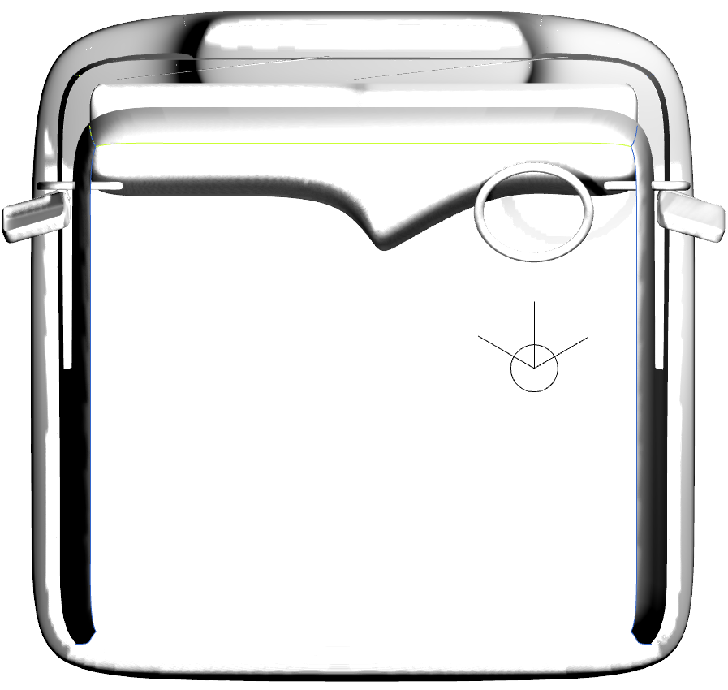
Proportional front volume by A-pillar width
The amendment is in place for consideration regarding to how to handle reduced inter A-pillar distance
Decreasing inter A-pillar distance

Slide 4
Addressing the concerns
However, if manufacturers choose to move the A-pillars rearwards towards the driver compared to the original sample they will able to gain volume without improving the view of the area of greatest risk
Area of greatest risk directly in front of the vehicle
Original vehicle design
Redesign moves A-pillars rearwards
Red areas show volume gained outside of area of greatest risk for frontal collisions, potentially allowing a vehicle to pass the minimum requirements without improving direct vision directly in front of the vehicle in the area of greatest risk.

Slide 5
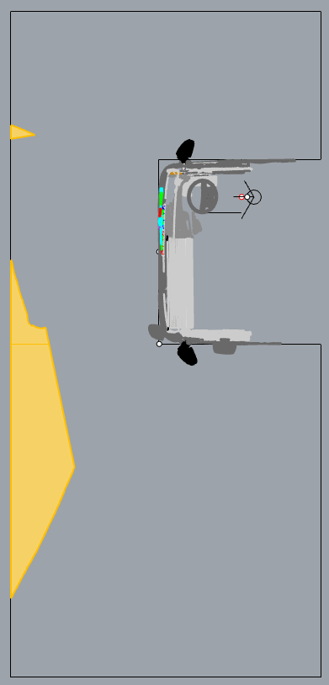
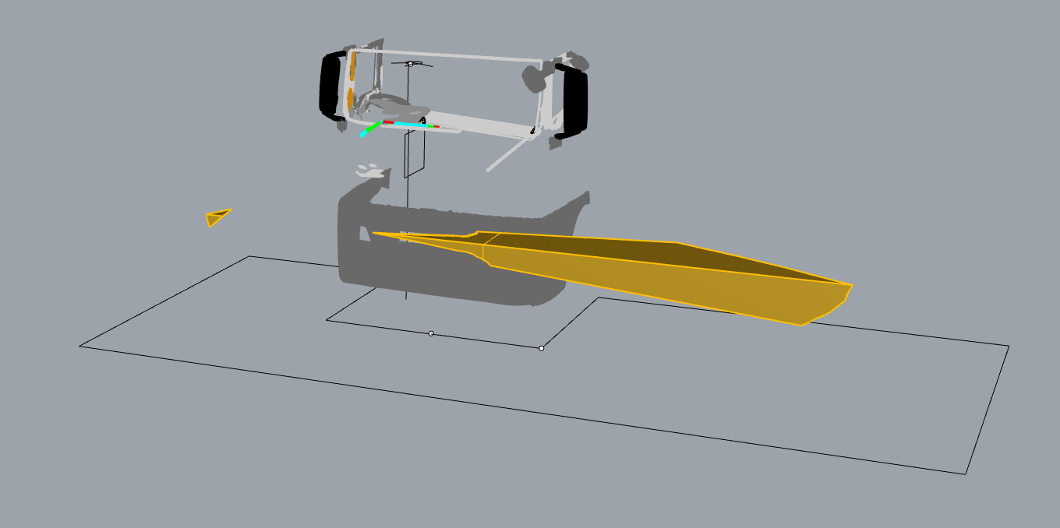
Addressing the concerns
In addition, further volume can be gained by lowering the passenger side dash board area, but this volume is also outside of the area of greatest risk. This approach has been suggested by ACEA
Area of greatest risk directly in front of the vehicle
Redesigned dashboard on the passenger side
Orange areas show volume gained outside of area of greatest risk for frontal collisions, potentially allowing a vehicle to pass the minimum requirements without improving direct vision directly in front of the vehicle in the area of greatest risk.

Slide 6
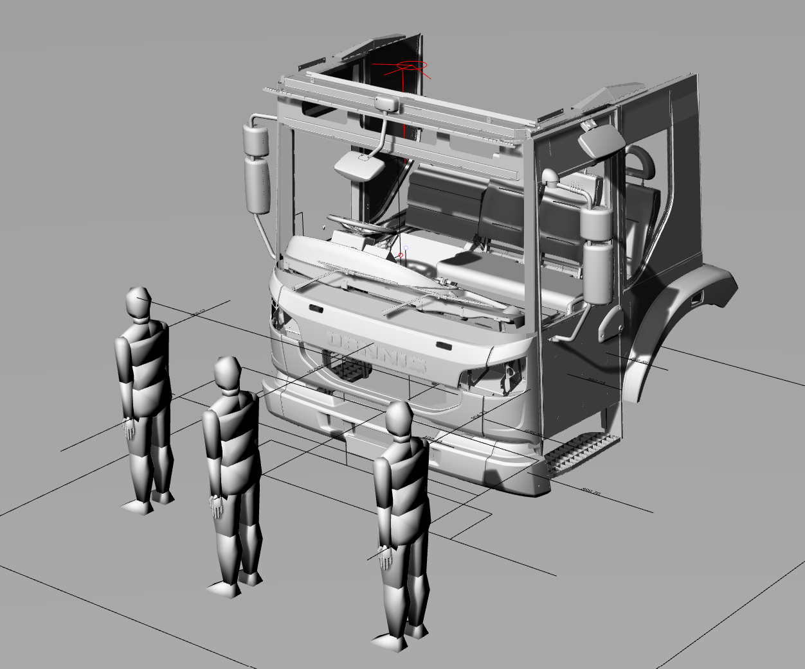
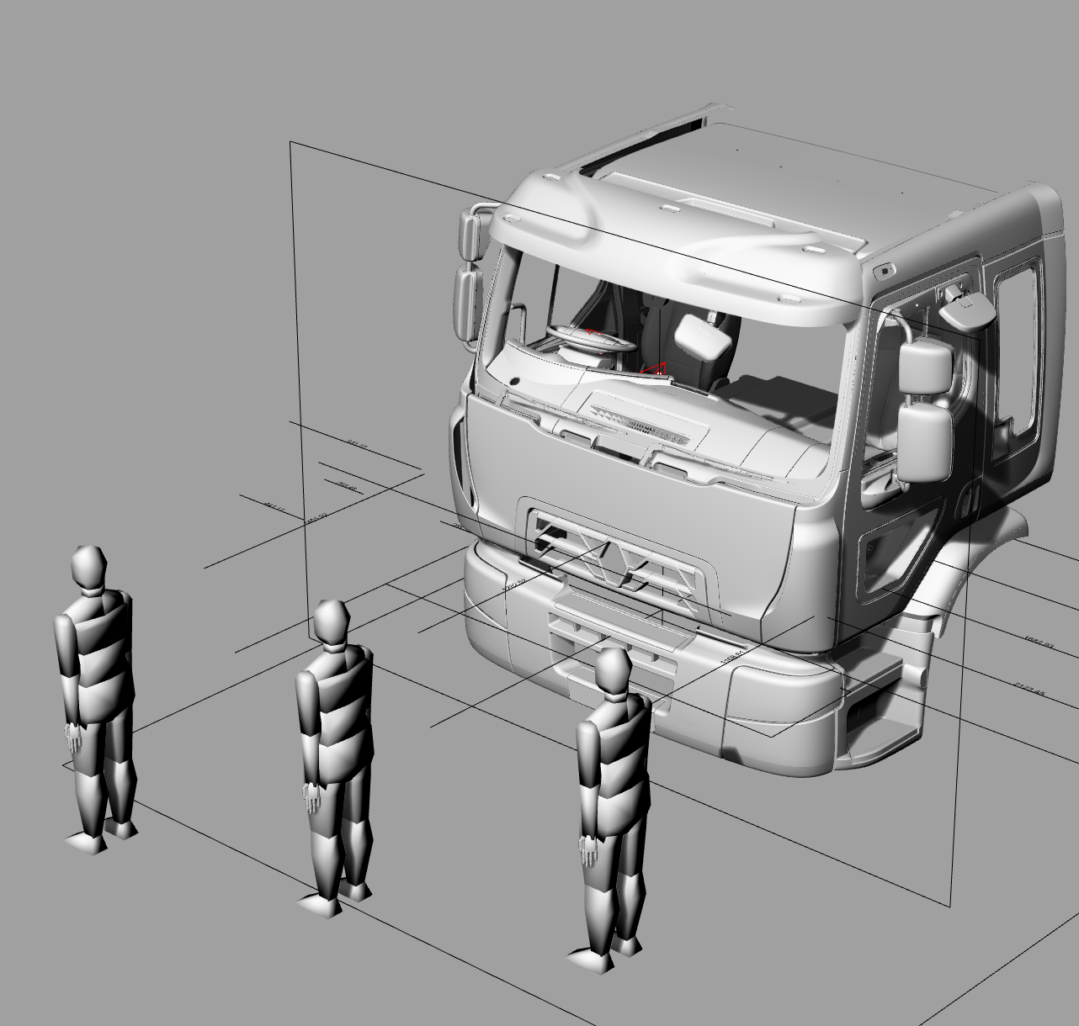
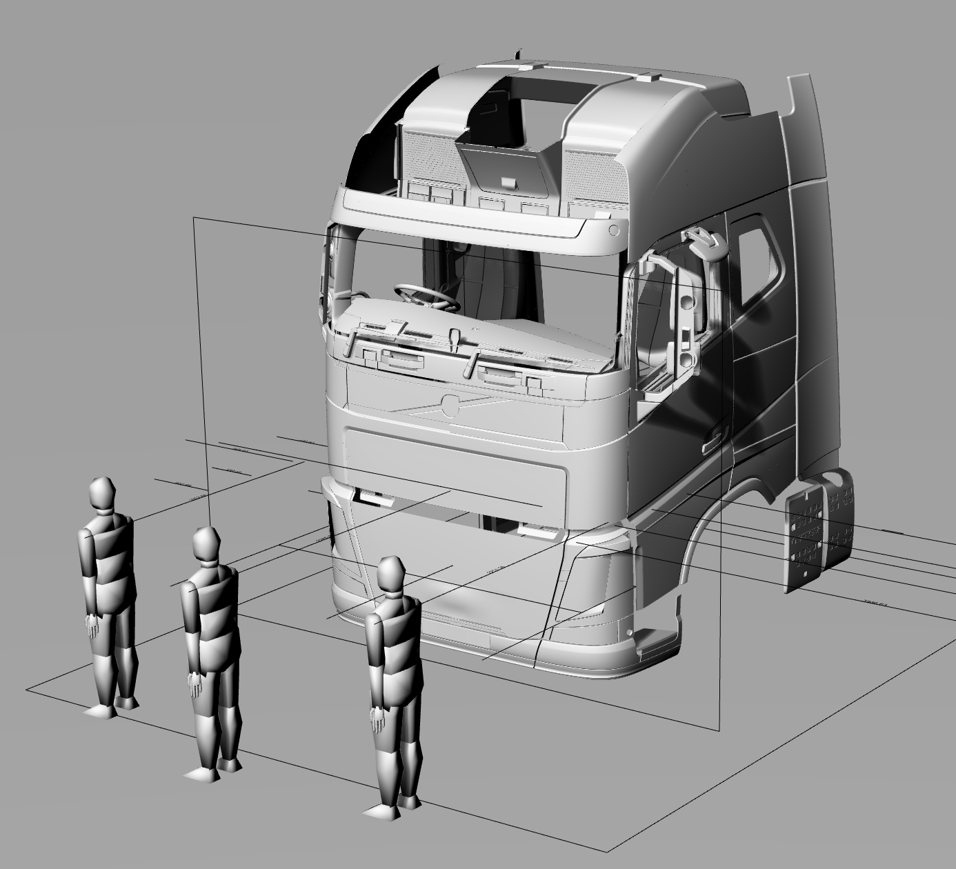
the premise that established the method used for UNECE regulation 167
Excellent
Good
As discussed in numerous VRU Proxi Group meetings, the basic premise of Regulation 167 is that the volumetric approach is given real world context using VRU simulations and the distance from the side and front of the vehicle at which the head of the VRUs can be seen.
For the front of the vehicle this involves the use of the three VRUs that placed directly in front of the vehicle to highlight the area of greatest risk established in the accident data analysis which supported the DVS design.
  The driver should be able to see the VRU approaching the vehicle, and allow the VRU to be seen when they are walking directly in front of the cab where possible.
  The Series 00 method defined average frontal average VRU distances of 1653mm for Level 1 and 1958mm for levels 2 and 3
The content above does highlight that the intent of the standard is potentially not being met in its current form
Pass

Slide 7
the premise that established the method used for UNECE regulation 167
Tech Neutrality
We therefore designed a new method to ensure that the intent of the standard (to allow the VRUs in front of the vehicle to be seen) as per the content in the next three sides.

Slide 8
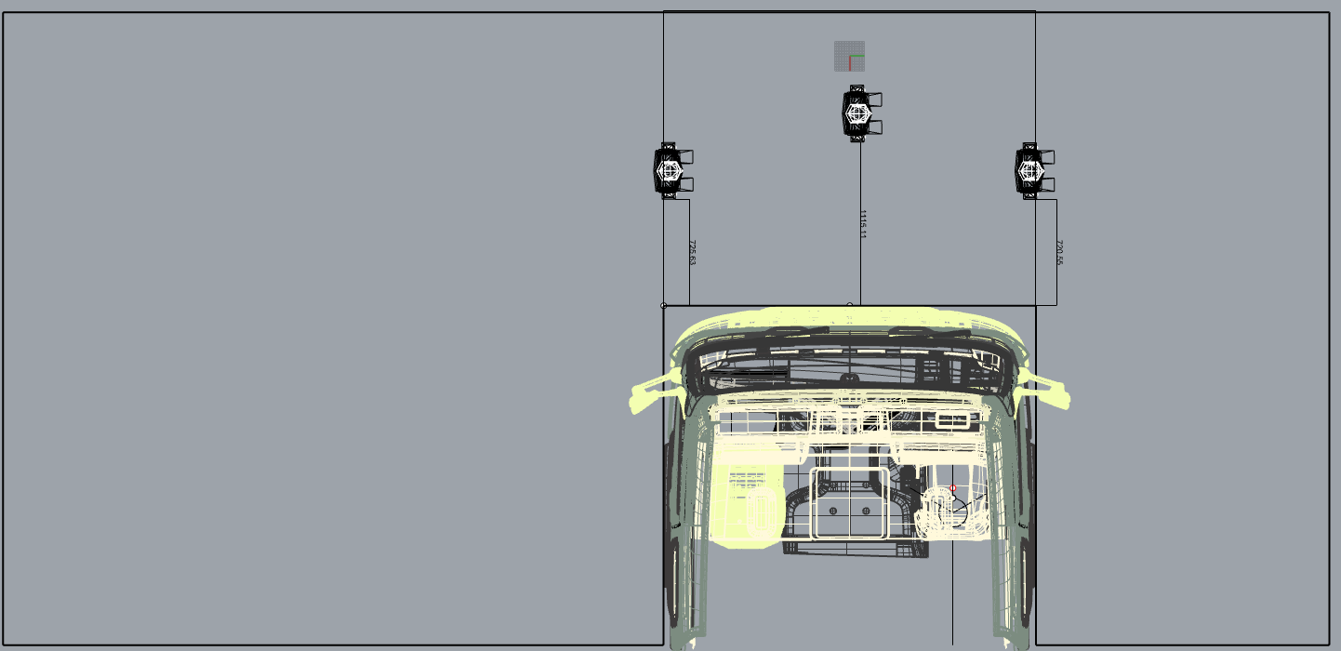
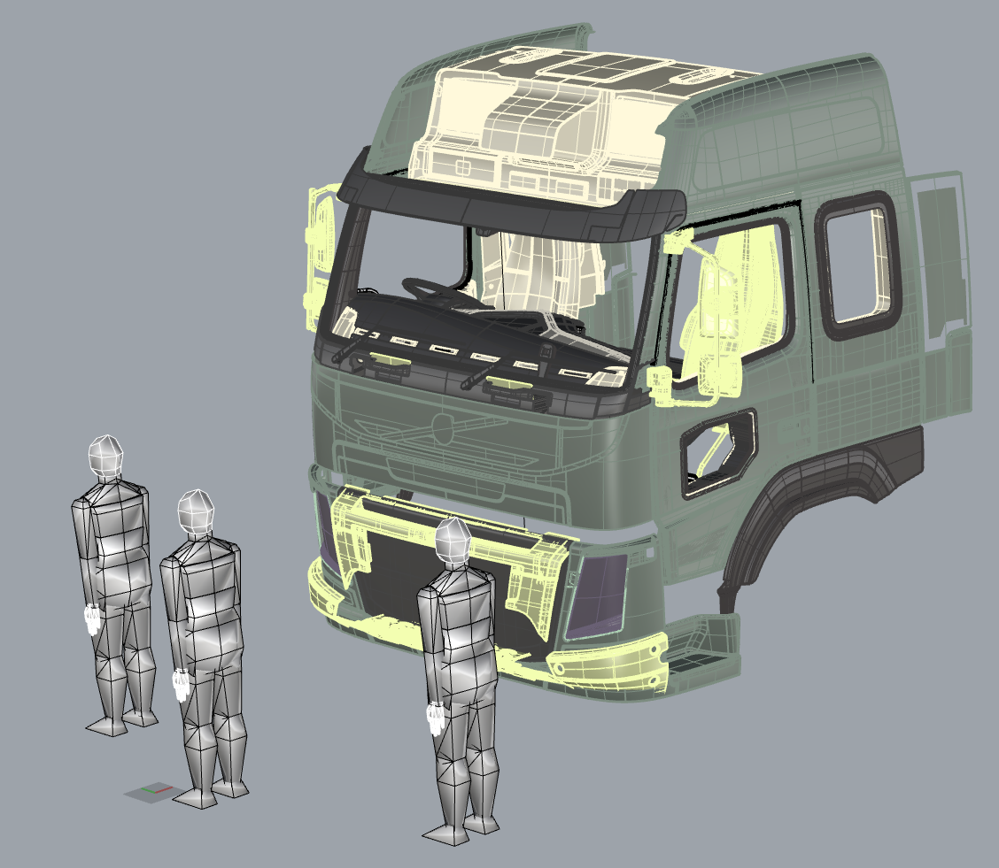
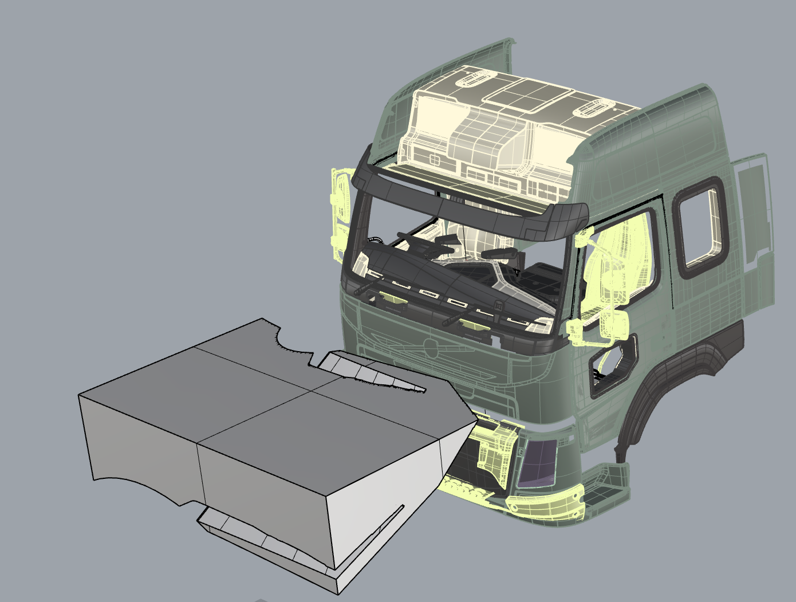
How can we ensure equivalence between the two methods?
The premise is as follows;
  What volume is equivalent to the need to see three VRUs directly in front of the vehicle?
  We needed a way to define a frontal volume
  We have taken the lateral extents of the vehicle to define the volume directly in front of the vehicle as this is the area that contains the three VRUs for the Series 00 method. Subsection Frontal Visible Volume (SFVV)
  Therefore plotting the VRU distance against the Volume gives a trend line that can be used to calculate the volume that should be seen at a certain VRU distance in the same way as the method used to define the volume requirement for the series 00 version
Three VRUs in front of the cab as defined in Series 00
Plan view of the area within which the VRUs are contained, therefore VRU distance should corelate well with volume as per the previous uses of this method
Volume that is visible between the lateral extents of the vehicle

Slide 9
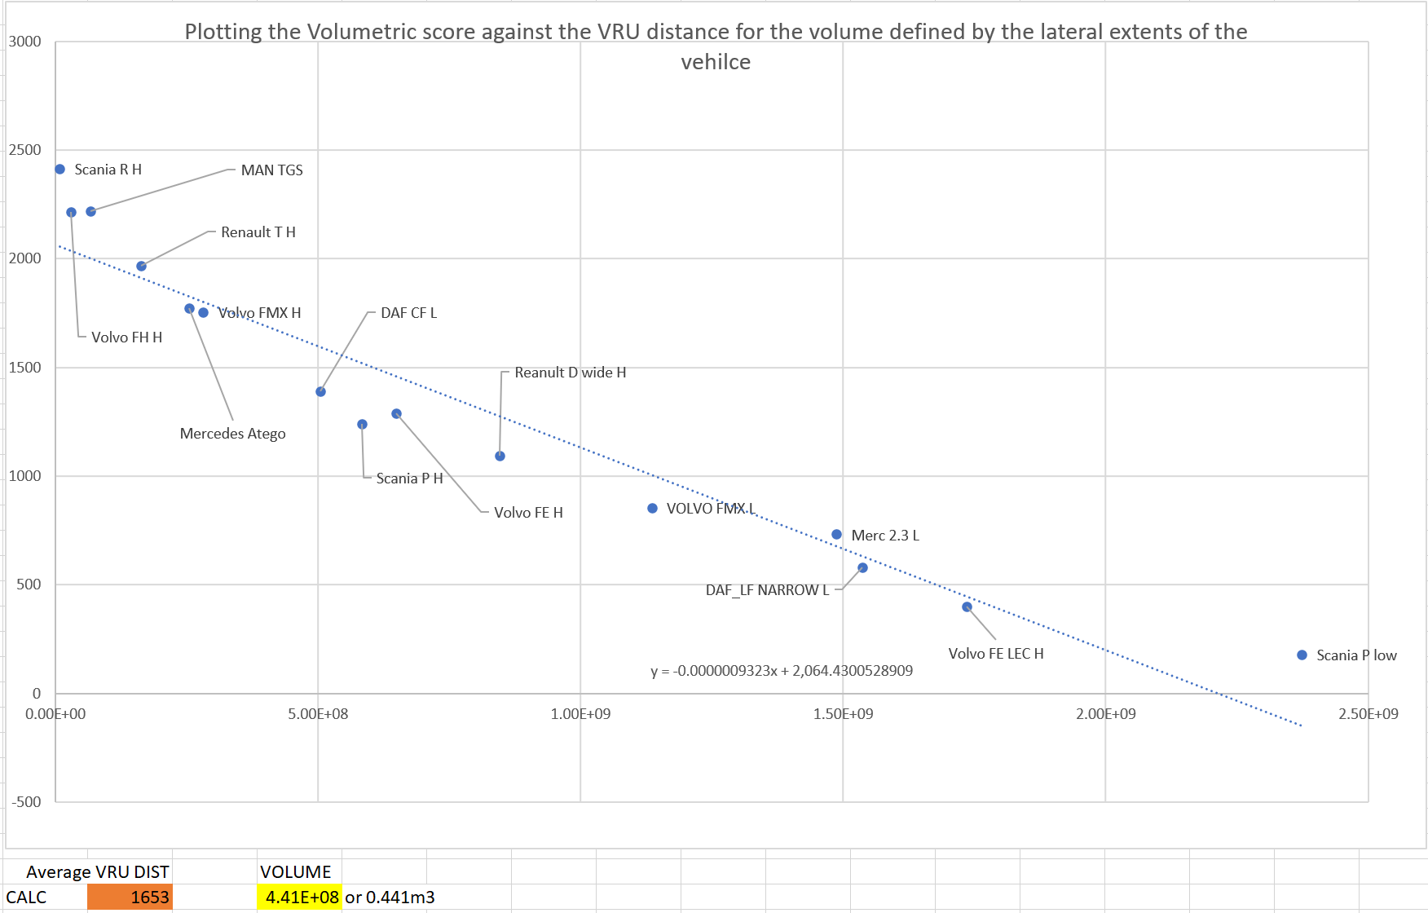
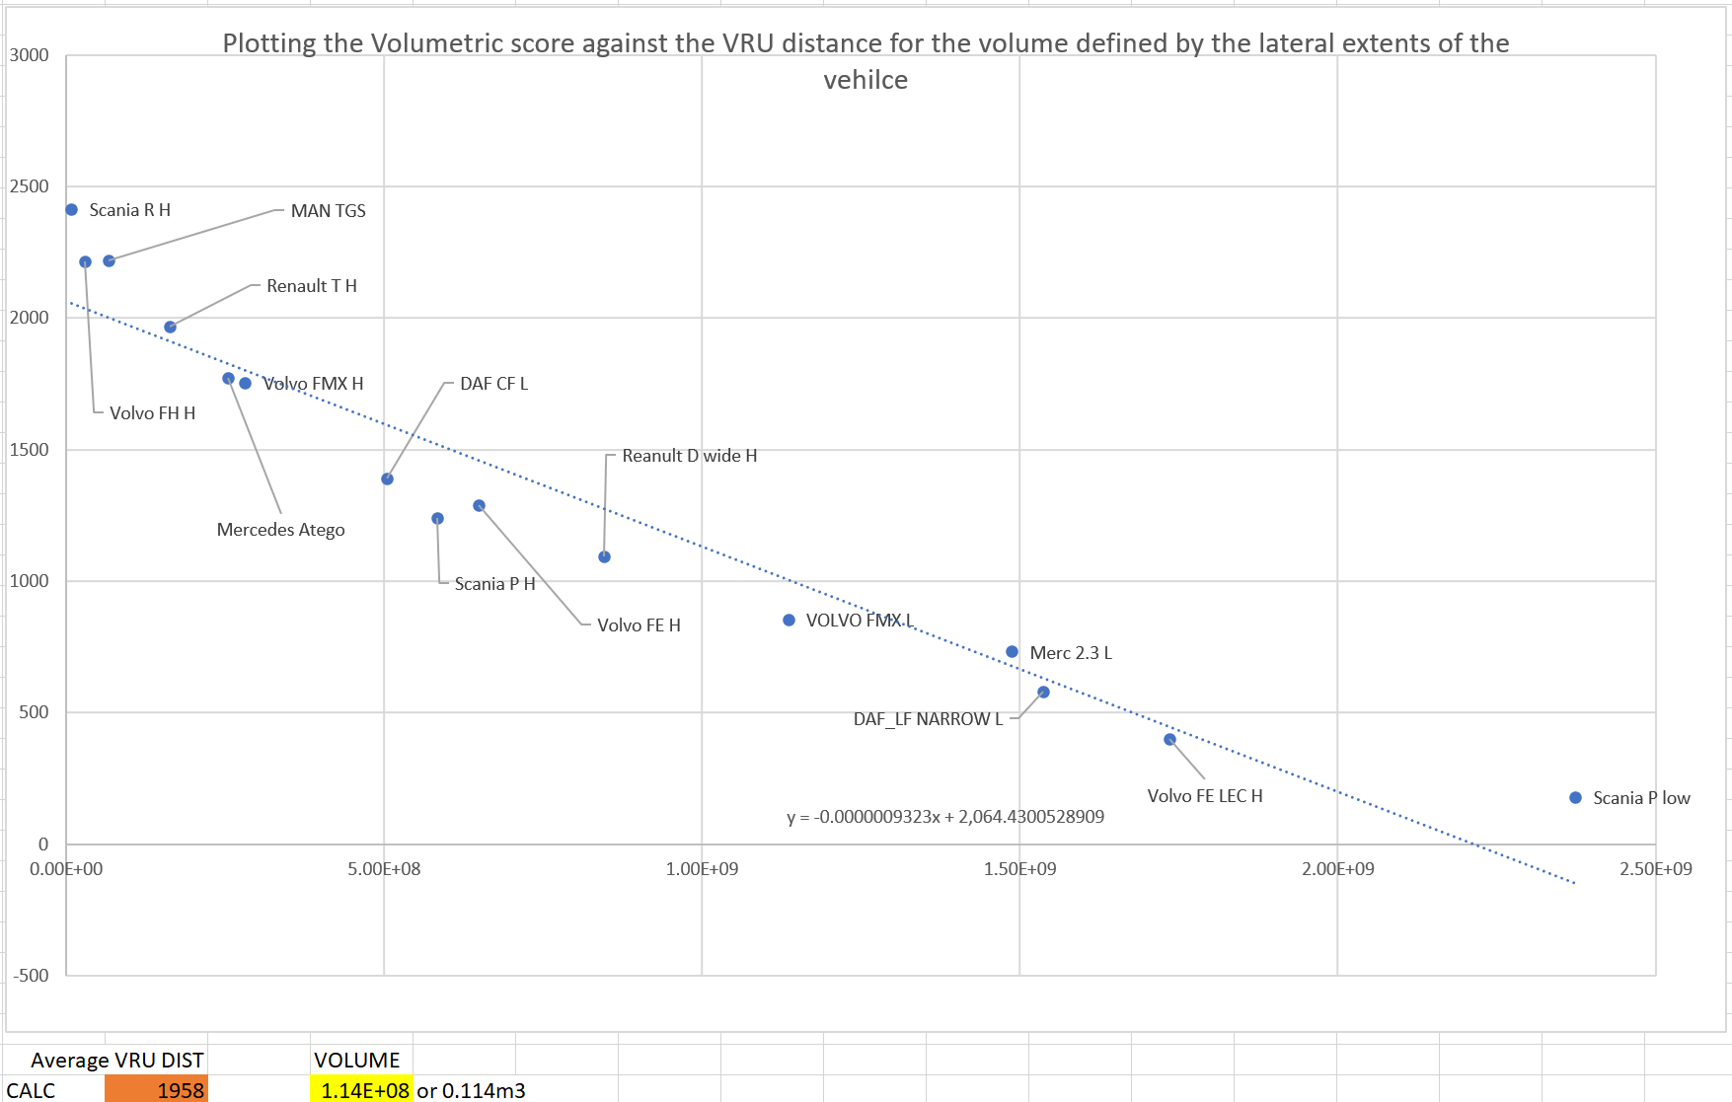
How can we ensure equivalence between the two methods?
So far we have performed this process for 15 vehicles across the sample of 50+
  Therefore the suggested figures for the volume requirement are PROVISIONAL
  As an indicative value for review by manufactures based upon the VRU distances agreed in the Series 00 version table
    Level 1 vehicles (urban) would need to be able to see 0.441m³ in the FEV area (average VRU distance 1653mm)
    Level 2 (construction) and 3 (long haul) vehicles would need to be able to see 0.114m³ in the FEV area (average VRU distance 1958mm)

Slide 10
Addressing the concerns
By requiring a design to allow visibility of the Subsection Frontal Visible Volume (SFVV) area we can avoid the issue shown below.
Area of greatest risk directly in front of the vehicle
Original vehicle design
Redesign moves A-pillars rearwards
Red areas show volume gained outside of area of greatest risk for frontal collisions, potentially allowing a vehicle to pass the minimum requirements without improving direct vision directly in front of the vehicle.

Slide 11
SUmmary
The volume required by the Series 00 version was defined by the use of VRUs directly in front of the vehicle.
It is clear that manufacturers are considering design interventions which will not allow the visibility of volume directly in front of the vehicle to be improved, e.g. ACEA have shown an option to lower the passenger side edge of the dashboard – which again improves direct vision outside of the area of greatest risk
We think that we need a solution to this issue and it would be possible with the content presented today to get an amendment into the standard quickly.
To be clear we propose that the existing frontal requirements be augmented with the requirement for a level 1 vehicle to see 0.441m³ of the FEV area
Level 2 vehicles should be able to see 0.114m³ of the FEV area
We are not making the requirement any more onerous, we are simply ensuring that the design intent of the standard is met
We are happy to discuss

Slide 12
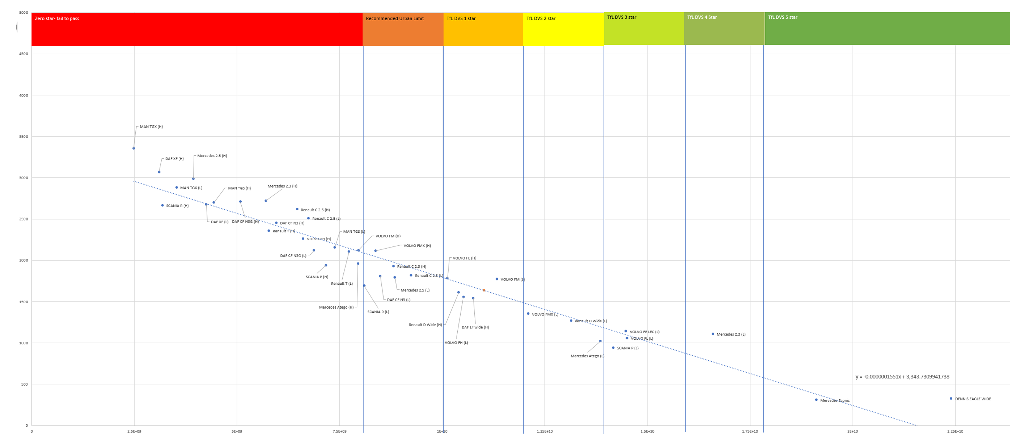
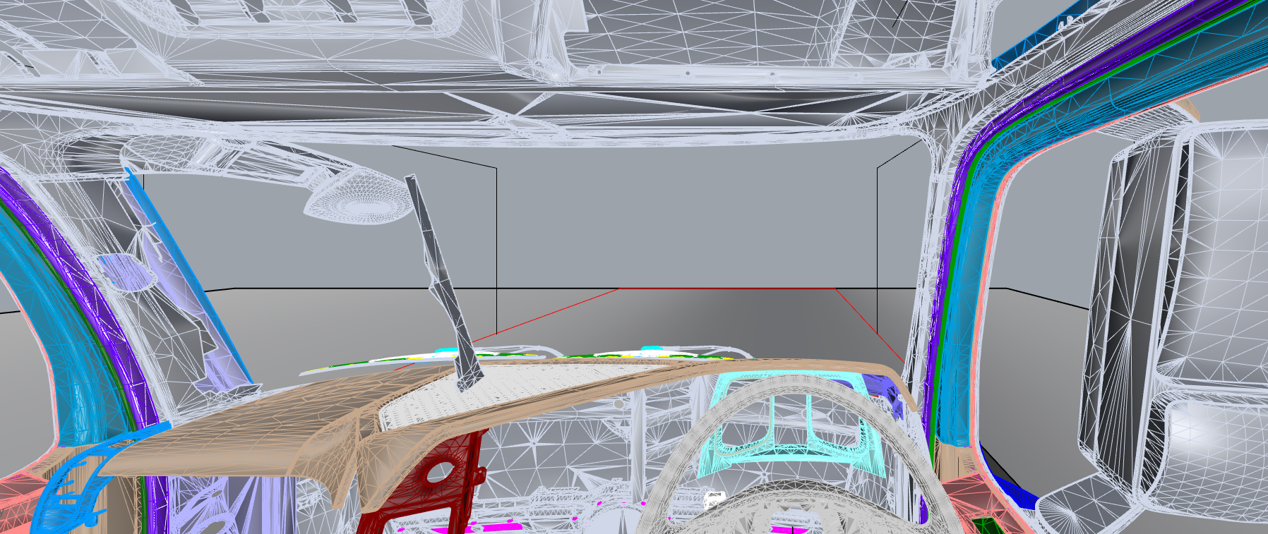
In session discussion – need to apply A-pillar width reduction to SFVV? Mercedes 2.3 low (best performing standard cad)
A-pillar moved 700mm laterally
Virtually no intersection with SFVV
Mercedes 2.3

Slide 13
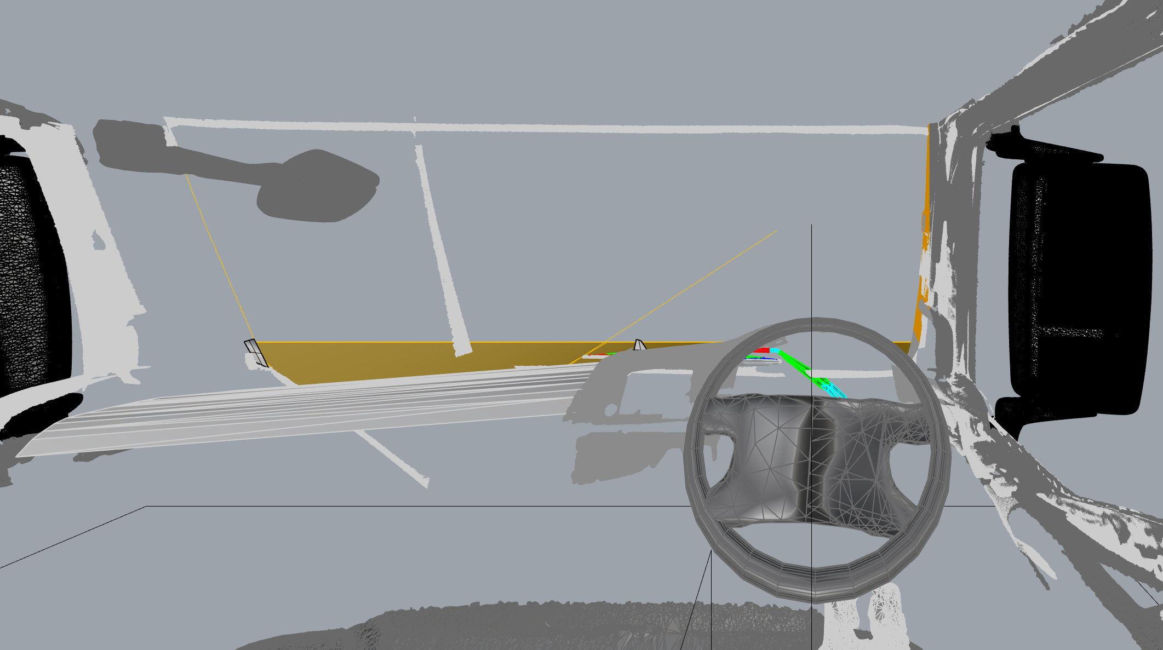
In session discussion – need to apply A-pillar width reduction to SFVV? MAN TGX Highest (worst performing 2018 standard cad)
A-pillar moved 700mm laterally
no intersection with SFVV
Man TGX Highest

Slide 14
In session discussion – need to apply A-pillar width reduction to SVVT? Mercedes 2.3 low (best performing standard cad)
Therefore it is highly unlikely that there will be a standard cab design that will require the SFVV to be reduced due to reducing inter A-pillar distance

Slide 15
Project information
Thank you for your attention, are there any questions?
Dr Steve Summerskill (s.j.summerskill2@lboro.ac.uk)
Dr Russell Marshall
Dr Abby Paterson
Anthony Eland
Design Ergonomics Group
Loughborough Design School
Loughborough University
United Kingdom

