Slide 1
FRAV/VMAD/IG Tokyo Meetings
Date: 11-15 of December 2023
Venue: AP ICHIGAYA
Monday 11 | 10:00~17:00 | Integration Group
Tuesday 12 | 10:00~17:00 | FRAV/VMAD joint session
Wednesday 13 | 9:30~17:00 | FRAV session
Thursday 14 | 9:30~17:00 18:00~20:00 | VMAD session Reception
Friday 15 | 9:30~12:30(*) | Integration Group(this session is open to all VMAD/FRAV that wish to attend)
(*The closing time for Friday can be decided on Tuesday 12 December.)

Slide 2
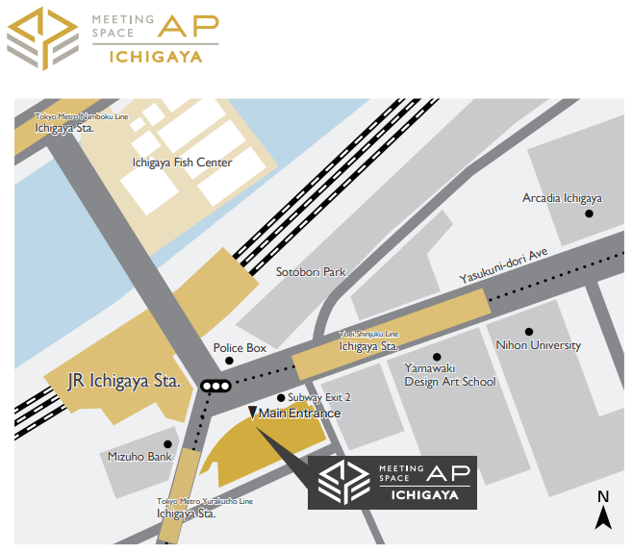
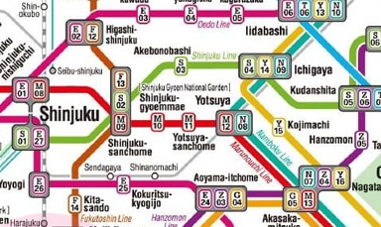

Access to the venue
Name of the venue:
AP ICHIGAYA
Address:
Ichigaya Osato Bldg. 5-8F
1-10, Gobancho, Chiyoda-ku, Tokyo 102-0076
(〒102-0076 東京都千代田区五番町1-10 市ヶ谷大郷ビル)
TEL: 03-3511-3109
AP ICHIGAYA is 1 minute walk from Ichigaya stations of JR and subway.
You can use JR, Toei Shinjuku, Tokyo Metro Nanboku, and Tokyo Metro Yurakucho lines to get to Ichigaya stations.
https://goo.gl/maps/kTPysAam5BBrS5c68

Slide 3
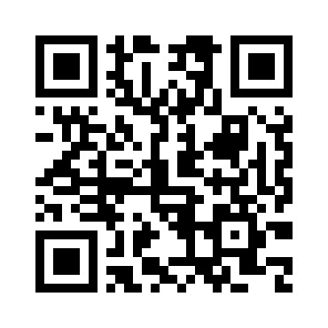
Access to the reception
Name of the reception venue:
Arcadia ICHIGAYA, 5th Floor
Room “Hodaka (East)”
Address:
4-2-25 Kudan-Kita,Chiyoda-ku,Tokyo 102-0073
(〒102-0073 東京都千代田区九段北４丁目２−２５)
TEL: 03-3261-9921
Arcadia ICHIGAYA is 1 minute walk from Ichigaya stations of JR and subway.
You can use JR, Toei Shinjuku, Tokyo Metro Nanboku, and Tokyo Metro Yurakucho lines to get to Ichigaya stations.
https://maps.app.goo.gl/nwBvpAREVwnQQ3qc7

Slide 4
Online meeting link
Monday 11 | 10:00~17:00 | -
Tuesday 12 | 10:00~17:00 | https://teams.microsoft.com/l/meetup-join/19%3ameeting_MGI0OWU4NmQtYzE2Zi00OGE4LWIyMTMtNTE3YjhiYzFiZTE0%40thread.v2/0?context=%7b%22Tid%22%3a%22530759f1-0bc8-4803-a1e7-f947e16dce91%22%2c%22Oid%22%3a%22c3572ec0-3b7a-4fb7-a4df-c707f9396d25%22%7d
Wednesday 13 | 9:30~17:00 | https://teams.microsoft.com/l/meetup-join/19%3ameeting_MDYyMTRiYmQtYmRlMi00NGZiLTliMjQtZDU2ZWRjNmJiNWVm%40thread.v2/0?context=%7b%22Tid%22%3a%22530759f1-0bc8-4803-a1e7-f947e16dce91%22%2c%22Oid%22%3a%22c3572ec0-3b7a-4fb7-a4df-c707f9396d25%22%7d
Thursday 14 | 9:30~17:00 | https://teams.microsoft.com/l/meetup-join/19%3ameeting_OWNmYjFlZWEtZjk4ZS00MmM3LThiYTItNjZmNzQ3YTEzMjhm%40thread.v2/0?context=%7b%22Tid%22%3a%22530759f1-0bc8-4803-a1e7-f947e16dce91%22%2c%22Oid%22%3a%22c3572ec0-3b7a-4fb7-a4df-c707f9396d25%22%7d
Friday 15 | 9:30~12:30(*) | https://teams.microsoft.com/l/meetup-join/19%3ameeting_NzNmMTU1ZDAtYTdhNy00OTA3LTlkMTAtZDJiYzdhNzRiMmNm%40thread.v2/0?context=%7b%22Tid%22%3a%22530759f1-0bc8-4803-a1e7-f947e16dce91%22%2c%22Oid%22%3a%22c3572ec0-3b7a-4fb7-a4df-c707f9396d25%22%7d
(*The closing time for Friday can be decided on Tuesday 12 December.)

