Slide 1
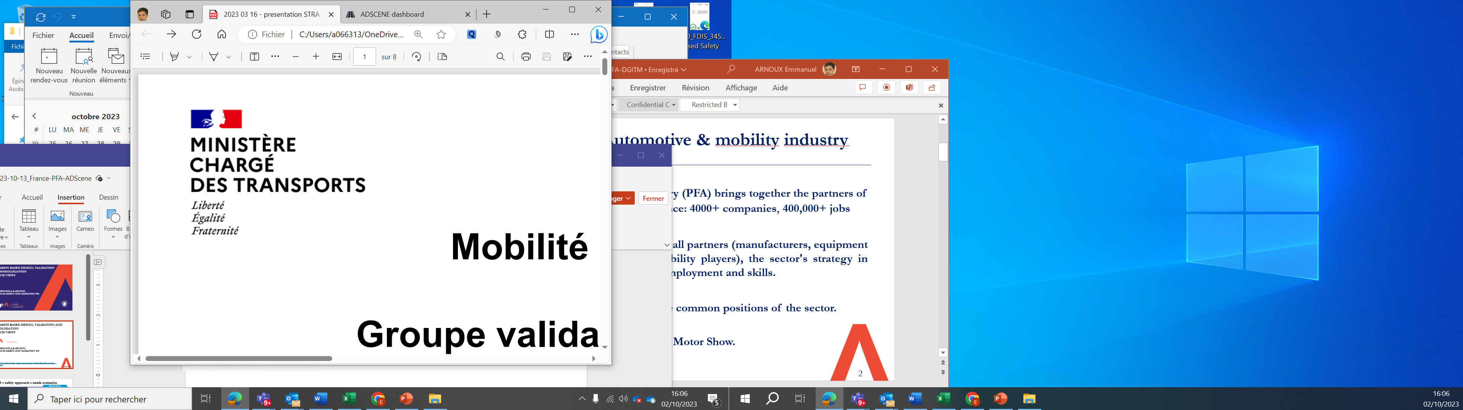


FRENCH WORKING group
SAFETY for AD
SCENARIOS BASED DESIGN,
VALIDATION AND HOMOLOGATION
French VIEWS
BY :
S.Geronimi & E.Arnoux, leaderS of Safety and Validation PFA WG
P.BAZZUCCHI, X.DELAcHE, E.LANAUD, France, Ministry of TRANSPORT
VMAD-34-09
1

Slide 2





Design, validation, homologation are using scenarios
    LEGACY
    Accumulating real world driving data then recorded data replay for design & validation of SOTIF
    SAFETY BY DESIGN
    Validation by scenarios representative from real world driving data, data from accidentology & risk analysis
Mileage ~ M or B km
Resimulation, but no or few Simulation
IMPROVED SAFETY using RETEX
Simulation & Scenarios as a Safety proof
    MULTI-PILLAR APPROACH
ADAS and AD L2, 3 & 4 validation / safety proof
through scenarios mandatory
In-use monitoring
Audit
Scenario library
In-use monitoring
Track testing
Virtual testing
Real world testing
21448
2020
Multipillar approach
2020
UN R 152
UN R157
NATM
ADS ACT
EU 2022/1426
FR law LOM 2019-2022
2

Slide 3
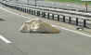
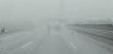

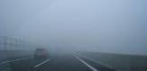



State of the art approach for design, validation (SOTIF but not only), & homologation
Real World Driving, Simulation and Scenarios capitalisation are necessary, to mitigate unintended behaviours
  Perception e.g. scenarii/objects driving to false Positive or False Negative events.
  Decision e.g. a wrong decision occurs during this scenario
  Cooperation with humans inside or outside the vehicle
Region dependency might deserve attention (traffic signs, road infrastructure)
Scenario library initiatives are already on-going … since 2019 PFA position is to promote scenarios libraries interoperability.
Notes:
Consensus 3 : bibliothèques en croissance car ODD réduit au début.

Slide 4
Why a common scenarios library in France ?
The worldwide ecosystem recognizes that the validation of automated driving & transport systems’ safety is based on scenarios:
  Usable by manufacturers during design and physical or virtual validation phases and for « safety » demonstration
  Generated by combinatory approach through scenarios parameter/descriptors
  Usable for the Product General Safety
To contribute to the definition of scenarios for the homologation
To define the state of the art for the industry and the authorities
To be used also in the French authorization of Automated Road Transport System owing to national framework (LOM law).
4

Slide 5





ADScene
An industrial scenarios library for ADAS & ADS design, validation and homologation
app.adscene.io
(Limited access)
Supported by

Slide 6
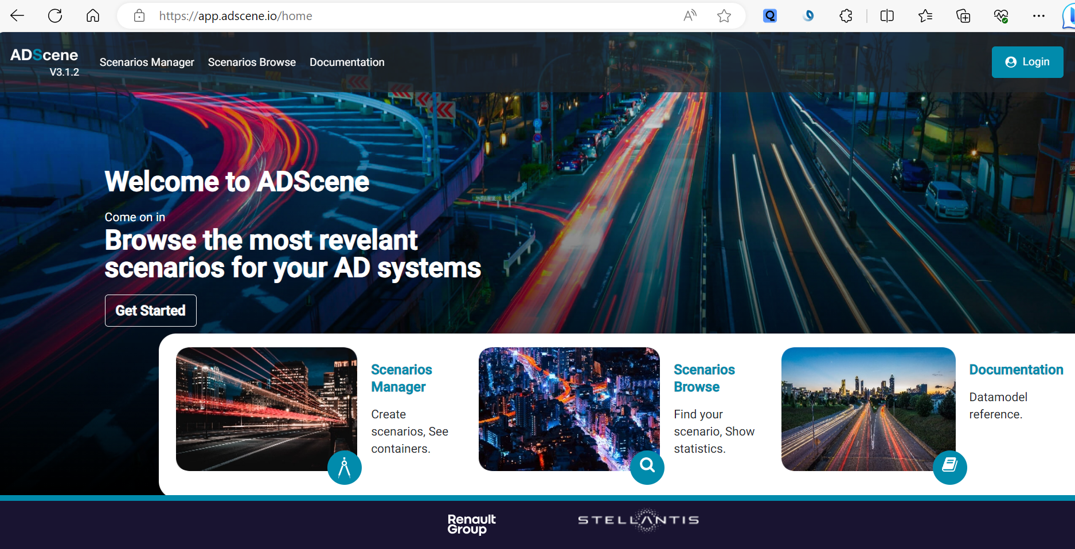

Slide 7
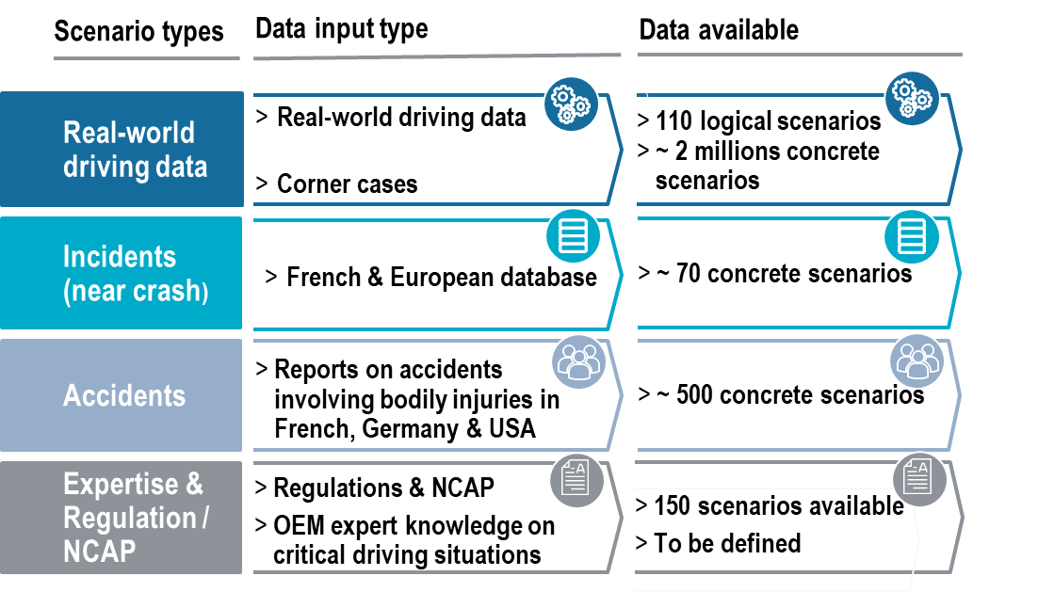
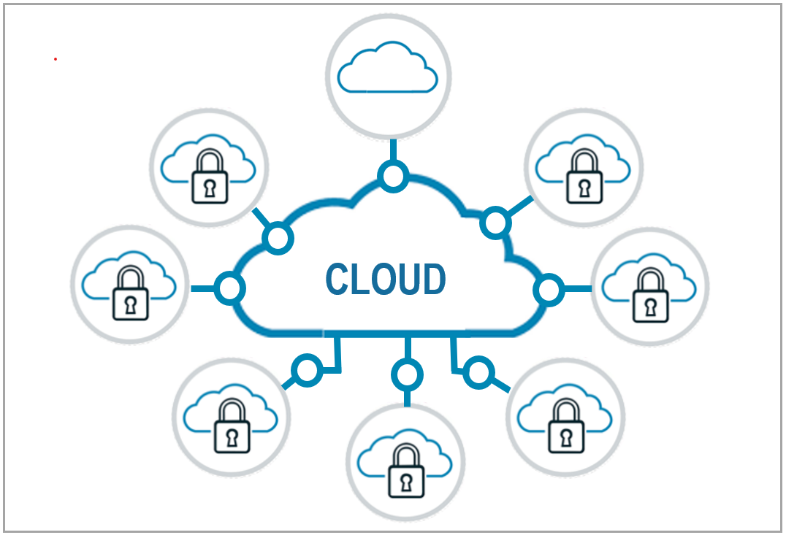
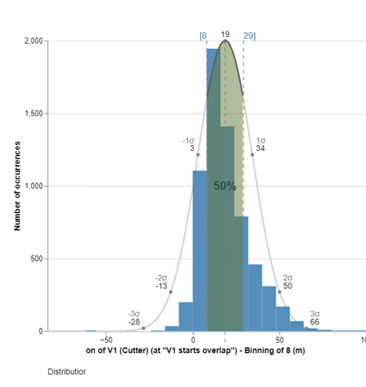
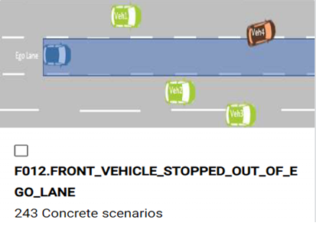
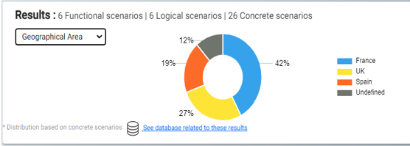
Data Content
ADSCENE: a solution to take up the challenge of scenario database
At state-of-the-art for designing, validating & homologating automated driving functions
A multi-partner scenario database
A secured, industrial Saas platform providing analysis & management tools
Data content
Features & tools
Secured environment
  Creation of scenarios
  Creation of usecases & test protocols
  Scenario browser & data visualisation
  Management of statistics from scenarios
  Link to simulation software
  Private environment for each OEM
  Shared environnement for collaborative activities
  Easy to interface
A multisource approach

Slide 8









1 plateform, 3 ambitions
ADSCENE
FOR INDUSTRY
Scenario library for Systems
design, validation & homologation
ADSCENE
FOR RESEARCH
ADSCENE
FOR REGULATION
Users : OEMs, tier 1, transport
operators, Shuttle manufacturers, …
Usage : design, validation,
Open framework to develop & integrate innovative features
Scenario Library for compliance to regulations and standard test scenarios
homologation
Research
centers
Supported by :
Users: Authorities, Technical Centers
Usage : Reference scenarios
Users: Academics, research
Usage : Innovation
to comply with regulation, Ncap, ISO, …

Slide 9
ADScene brings proposals to contribute to build state of the art for scenario-based safety & validation
>2025
Standardization
2024-25
Growth content & Business
+Site Analysis
+Coverage
2023
RUN & Quality recognition
+OEDR
+ODD
+Test Protocols
2022
Start of operations
+Use Cases
2021
Development
2020
Ignition
ADScene would like to work with VMAD on KPI to ensure compliance of scenario databases to regulations: e.g. data quality (validation by experts), shared data, published initiative, …
2017
Ideation @ PFA / SystemX, Vedecom
9

Slide 10
FRENCH WORKING group
SAFETY for AD
THANK YOU
MERCI
10

